Slide 1
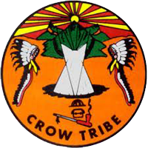

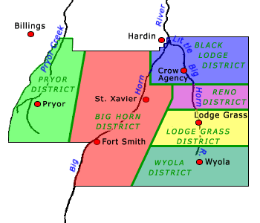
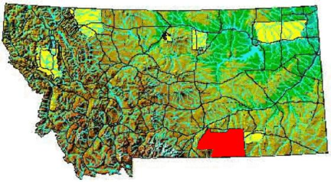
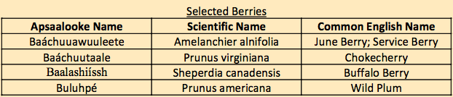
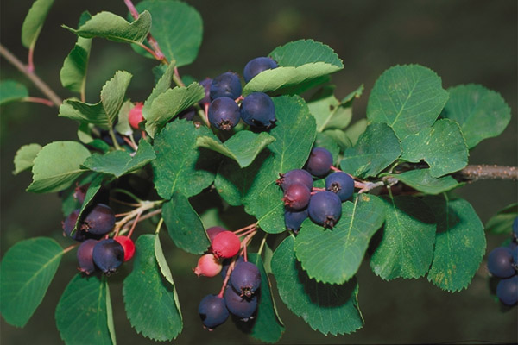
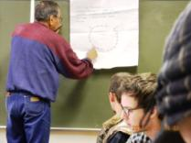
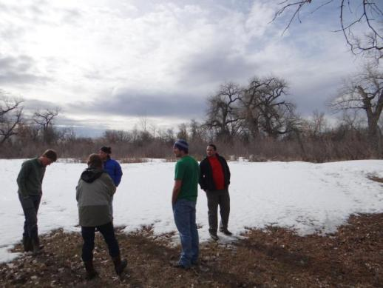
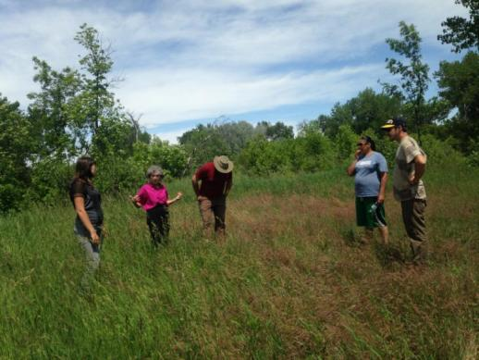
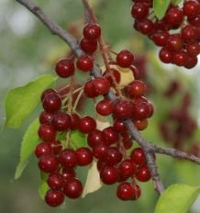

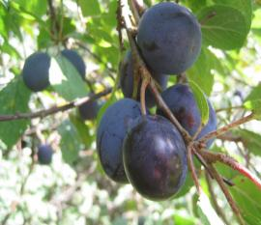
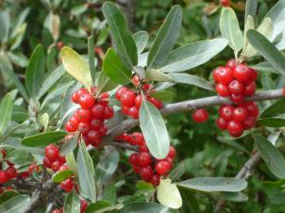
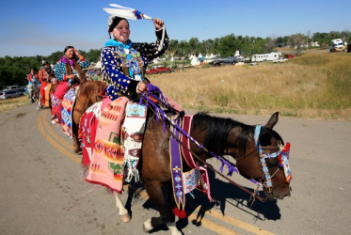
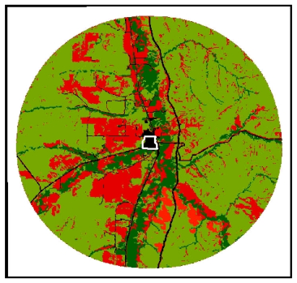
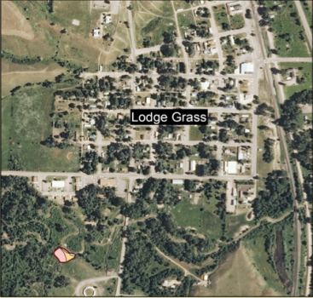
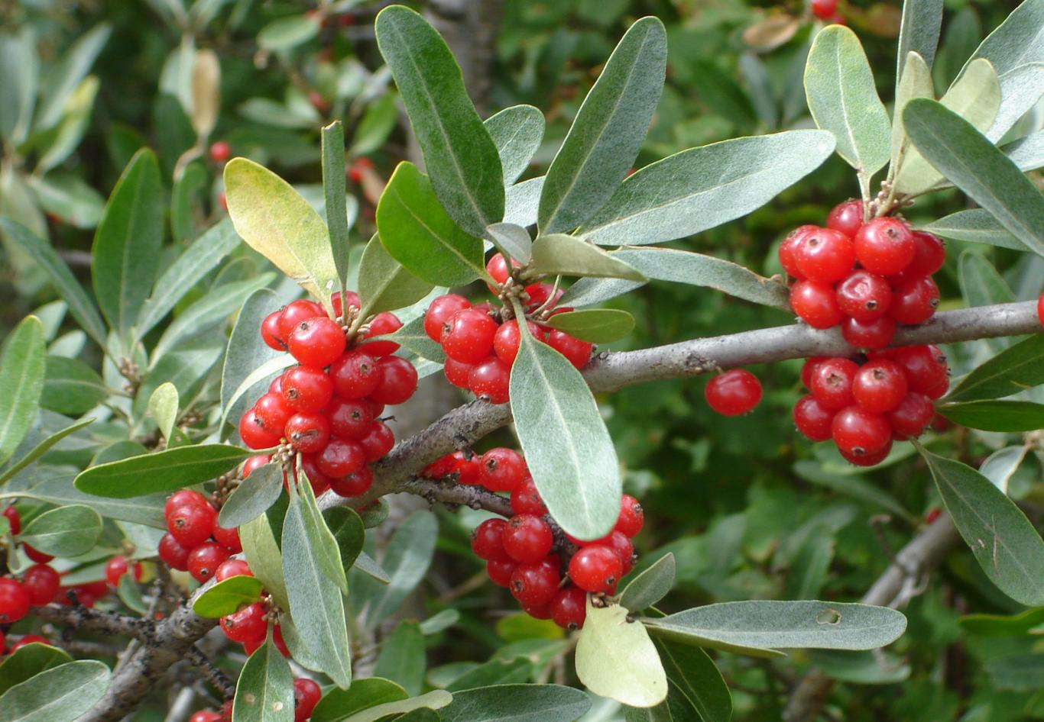


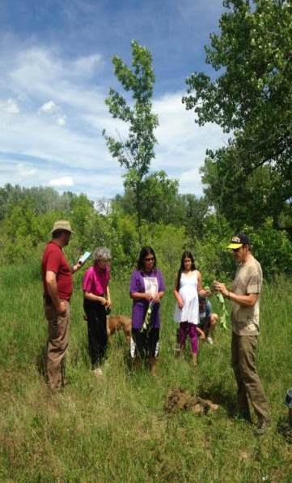
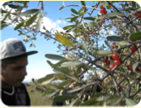
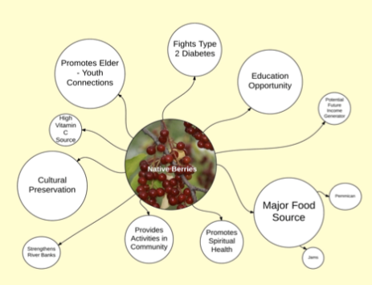
“Let’s Pick Berries”: Addressing Apsaalooke Needs for Nutrition, Plant Propagation, Community Engagement,
and Youth-Elder Connections through the Holistic Process
in a Community-Based, Service-Learning Course
Introduction
Authors: Tracie Small*¹, Florence Dunkel¹, Greta Robison^{2,3}, Tyler Nyman¹, Durc Setzer¹, Caleb Killian⁴, Zachary Ostrovsky³
Montana State University-Bozeman, ¹ Department of Plant Sciences/ Plant Pathology, ² Department of Earth Sciences, ³Department of Liberal Studies, ⁴ School of Architecture, * Lodge Grass, MT, Apsaalooke site mentor
Plant Propagation
Two MSU students propagated the four native berries by taking hard wood cuttings from local plants
Figure 1. The Apsaalooke Reservation is l2,464,914 acres in south eastern Montana. The Apsaalooke people have been and continue to be adversely affected by forced assimilation and cultural repression by Western culture. Today, many face issues with type 2 diabetes, alcoholism, loss of language, and crime due to the colonial history of the people. This project focuses in Lodge Grass, Montana. Through collaboration between MSU Bozeman, Little Big Horn College, and tribal members, our multidisciplinary work has aimed to improve Apsaalooke quality of life.
There are over 10,000 Crow people.
Crow is an English mis-translation of Apsaalooke, meaning people of the big beaked bird. Both terms are used today.
The Apsaalooke people have great wealth in land and culture.
In Lodge Grass, 40% of residents live below the poverty line.
Elder Wales Bulltail provides ideas for site design, Jan 2014
At site, Mar 2014
Using the design at site, Jun 2014
Above middle:
Baáchuuawuuleete,
June berry
Above: Baáchuutaale,
chokecherry
Left: Baalashiissh,
buffalo berry
Above: Buluhpé,
wild plum
Future
Resources
Current Resource Base
Site Selection
Figure 2. Apsaalooke women participating in Crow Fair, internationally attended annual cultural festival.
Apsaalooke Quality of Life
Used ArcGIS to help the tribe determine most appropriate site for berry planting.
Factors considered:
Soil Types
Land Use
Community input
Proximity to town of Lodge Grass
Slope and Aspect
Hypothesis Using the holistic process, beginning with identifying the Apsaalooke community’s desired quality of life (DQL), leads to concrete community actions addressing complex health issues.
Methods: Apsaalooke students in AGSC 465R, Health, Poverty, Agriculture: Concepts and Action Research (Montana State University Research/Creative Activity Core course based on the holistic process) engaged in conversations on the reservation (March 2013).
36 Apsaalooke Elders (Crow Agency MT) described their DQL (March 2013).
20 Apsaalooke 4th graders (Hardin, MT).
20 high school students (Lodge Grass, MT) described their DQL in participatory drawings (spring 2013) and participate with Elder in traditional buffalo berry picking fall 2013.
AGSC 465R students contributed greenhouse plant propagation, GIS, architectural design focused on: choke cherry, wild plum, June berry, buffalo berry.
Architecture student, Apsaalooke on LBHC campus participate in charette, design site.
Together students linked the Lodge Grass community Berry Patch Project with tribe’s Little Big Horn College (LBHC).
Future
Forms of production
Current
Forms of production
Site Layout
Site design is based on community input and Apsaalooke tipi structure
Results
The choke cherry site was selected. Planting has begun directly East of Lodge Grass, next to the river and Powwow grounds.
Second site considered for the Lodge Grass area
The tribe has leased tribal land to project for site to create at least one berry site in each of the five Apsaalooke districts.
Culture and Nutrition
Buffalo Berries have 200% more Vitamin C than oranges do.
Chokecherries help fight Type Two Diabetes and are used in traditional sweat lodges.
Berry picking promotes traditional learning between elders and youth.
Above: Apsaalooke youth berry
picking on an elder-youth berry
outing organized by Tracie Small
Right: The importance of berries
derived from surveys in the
Lodge Grass community. Circle
size indicates response rate.
Baalashiissh, buffalo berry
Sources
Ayittey, G.B.N. 2005. Africa Unchained: The blueprint for Africa’s future. Palgrave, Macmillan. N.Y. 483 pp.
Dunkel, F.V., A.N. Shams, and C.M. George. 2011. Expansive collaboration: A model for transformed classrooms, community-based research, and service-learning. North American College Teachers of Agriculture Journal. 55 (Dec):65-74.
Easterly, W. (2006). The white man's burden: why the West's efforts to aid the rest have done so much ill and so little good. New York: Penguin Press.
McCleary, T.P. 1997. The Stars We Know: Crow Indian Astronomy and Lifeways. Prospect Heights, Illinois: Waveland Press.
Medicine Crow, Joseph (1992). From the Heart of the Crow Country: The Crow Indians' Own Stories. Orion Books: New York.
Small, Tracie (2013). Holistic Process, Benchmarks to Community Based Research, Apsaalooke Culture. MSU. Paper submitted in partial fulfillment of her B.A. in Liberal Studies. MSU-Bozeman.
Smith, L. T. (1999). Decolonizing methodologies: research and indigenous peoples. London: Zed Books http://www.nass.usda.gov/Statistics_by_State/Montana/Publications/county/profiles/reservations/2002/crow.htm
Savory, A. and R. Butterfield 1999. Holistic Management: A new framework for decision making.
Island Press. Washington, D.C. Chapters 9, 10, 36
GIS research continues through Robison’s internship for Institute of Ecosystems
The tribal college, Little Big Horn College requested a GIS workshop. It is underway now.
At site, faculty, students,
Lodge Grass residents planting, June 2014.

