Slide 1
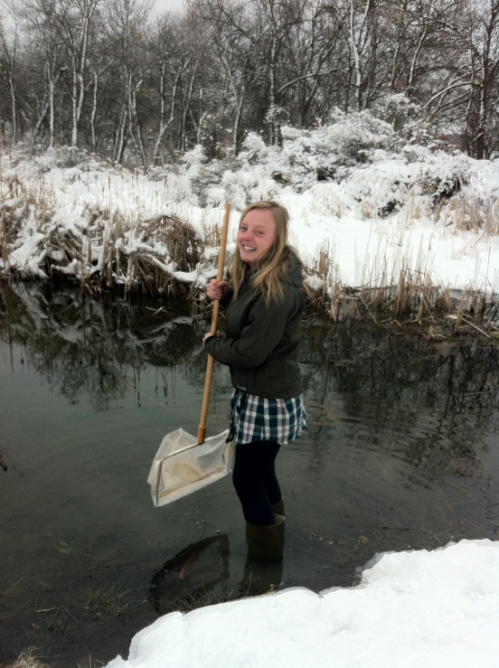
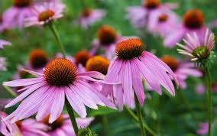
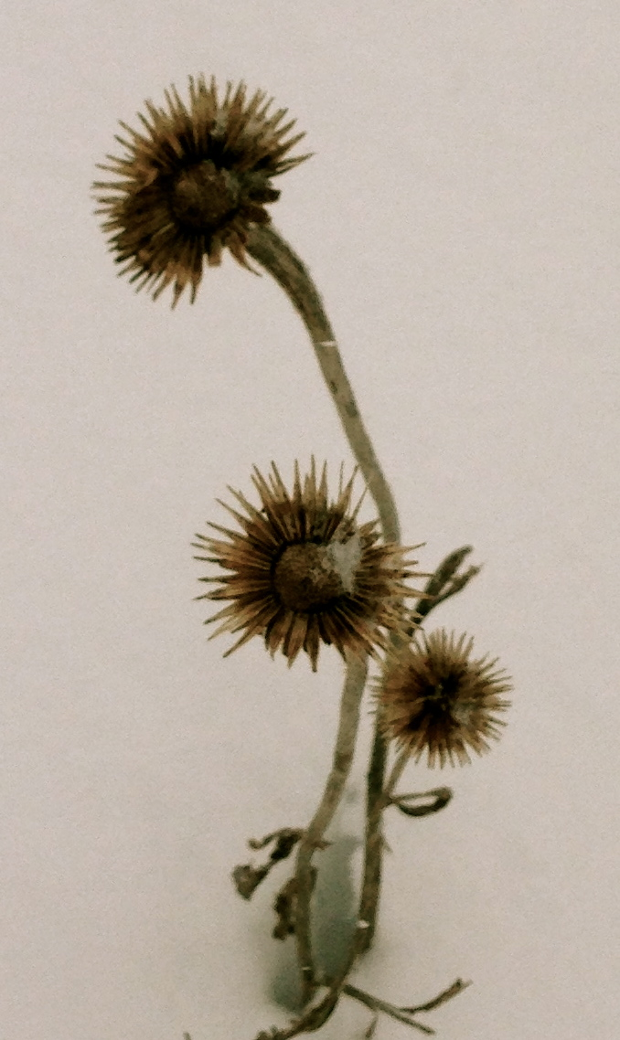
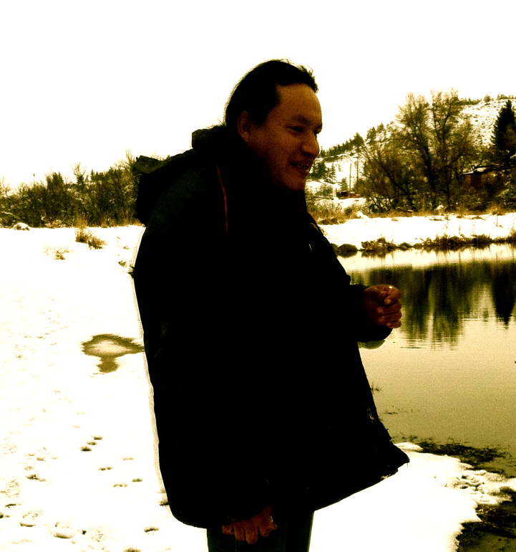
Echinacea pallida: Connecting Northern Cheyenne Medicine, Western Science, and Community Pride
By Katie Chambers (Hispanic and Latino Studies), Hannah Johnson (Environmental Science and Elementary Education) MSU-Bozeman; Meredith Tallbull, Chief Dull Knife College, Lame Deer, MT
Introduction: The importance of place-based, culture-based learning was established on the Northern Cheyenne Reservation in recent studies (Alexander 2013; Hogan and Alexander 2013). Mohkta’wise’eyo or Echinacea pallida var. angustifolia has been used as a medicinal plant by the Northern Cheyenne (Tallbull 2013) and many other tribes for thousands of years. Recently, Western Science began to study this plant.
Results: Place-based and culture- based learning can teach children about their culture and environment. To help fill this need, we developed lesson plans that include field trips to the Lame Deer Botanical Gardens and discussions focused on culturally significant ideas.
Place-Based, Culture-Based Learning
Northern Cheyenne Desired Quality of Life
Hypothesis Tested: Traditional Northern Cheyenne uses of Echinacea pallida are verified by Western culture science, thereby enhancing value of cultural, place-based learning in the community.
Results: Our Western science literature review affirmed much already known by Northern Cheyenne and led to strong support for Native Science uses of Echinacea pallida, leaves and root.
Echinacea spp. and Traditional Medicine Research
Materials and Methods:
peer-refereed literature searches.
In-depth interviews with Meredith Tallbull, enrolled Northern Cheyenne, and Lame Deer Middle School 7th and 8th grade teachers,
E-mail discussion with Northern Cheyenne Elder and ethnobotanist, Linwood Tallbull
Field (terrestrial and aquatic) exploration of Lame Deer Botanical Garden.
Northern Cheyenne Use | Alternative Use | Western Science Support
Toothache/ mouth pain | No info. found | Flannery 1999
Skin health | Acne treatment | Kindscher 1989
Sore muscle treatment | Numb a sore throat | Active Echinacea samples commonly tested
No info. found | Cold remedy | Wong, et al. 2011
Strength of Culture, Family and Community
Results: Meredith suggested a children’s book linking past usage of Echinacea pallida to modern day usage could help foster pride in Northern Cheyenne culture. That pride can cause children to grow up inspired to create positive change in their community.
Recommendations:
1) Conduct research on numbing properties of Echinacea pallida as pain reliever.
2) Provide culture-based education on Echinacea, possibly using attached children’s book for Lame Deer middle school.
3) Use Lame Deer Botanical Gardens as part of curriculum promoting place-based learning demonstrating values of Northern Cheyenne culture.
4) Host contest for local artists to write / illustrate other children’s books that pass on Northern Cheyenne knowledge and stories, fostering pride in culture and community.
5) Continue partnership between Lame Deer schools and Meredith so his enthusiasm and unique viewpoint positively impacts students.
6) Explore possibility of developing a support program with Meredith to encourage sustainable income production in community in lieu of grants.
Table 1. Peer-refereed literature search summary
Literature Cited:
Alexander, S. 2013. ***add title and complete reference. Research report for AGSC 465R Health, Poverty, Agriculture: Concepts and Action Research. MSU-Bozeman.
Hogan, B. and S. Alexander. 2013. Place-based environmental education the Northern Cheyenne Reservation. Poster presented at the Share-the-Wealth Symposium December 5, 2013. MSU-Bozeman.
Flannery, Michael. 1999. From Rudbeckia to Echinacea: The emergence of the purple cone flower in modern therapeutics. Pharmacy in History. 41 (2):52-59.
Melchart D, Linde K, Worku F, et al. 1995. Results of five randomized studies on the immunomodulatory activity of preparations of Echinacea. J Altern Complement Med . 1:145–60.
Kindscher K 1989 Ethnobotany of purple coneflower (Echinacea angustifolia, Asteraceae) and other Echinacea species. Econ Bot 43:498–507.
Roesler J, Steinmüller C, Kinderlein A, Emmendörffer A, Wagner H, Lohmann-Matthes M-L. 1991. Application of purified polysaccharides from cell cultures of the plant Echinacea purpurea to mice mediates protection against systemic infections with Listeria monocytogenes and Candida albicans. Int J Immunopharmacol. 13:27–37.
Stewart, KL. 2003. Echinacea Gold Rush: Curley Youpee fights to preserve an ancient legacy. Better Nutrition . 65(3);50-53, 55.
Wong A, Townley S. 2011. Herbal Medicines and anaesthesia. Continuing Education in Anaesthesia, Critical Care and Pain. 11(1):14-17.
Database | Keyword | Hits
Web of Science | Echinacea Medicinal Uses | 597
JSTOR | Medicinal Echinacea | 202
Web of Science | Echinacea Traditional medical uses | 43
NAITC | Echinacea | 11
Results: Echinacea spp. was available year round on the Northern Cheyenne reservation, providing a reputable and affordable medicine celebrating Northern Cheyenne culture. Echinacea spp. and others like it foster pride in the Northern Cheyenne knowledge.
Acknowledgements: We would like to thank Meredith Tallbull for sharing his time, ideas, and his commitment to his community. We also thank Linwood Tallbull for his wealth of information and Florence Dunkel for her support and encouragement. We thank our friends and families for supporting us as well.

