Slide 1




Community-Based Natural Products for Integrated Pest Management:
By the Community, for the Community
NC-213 Marketing and
Delivery of Quality Grains
and BioProcess Coproducts
Florence V. Dunkel
Department of Plant Sciences and Plant Pathology
Montana State University-Bozeman, Montana
Keriba Coulibaly
L’Institut d’Economie Rurale-Sikasso, Mali
Ashley Alvarado
Fort Belknap Community College-Fort Belknap, Montana

Slide 2
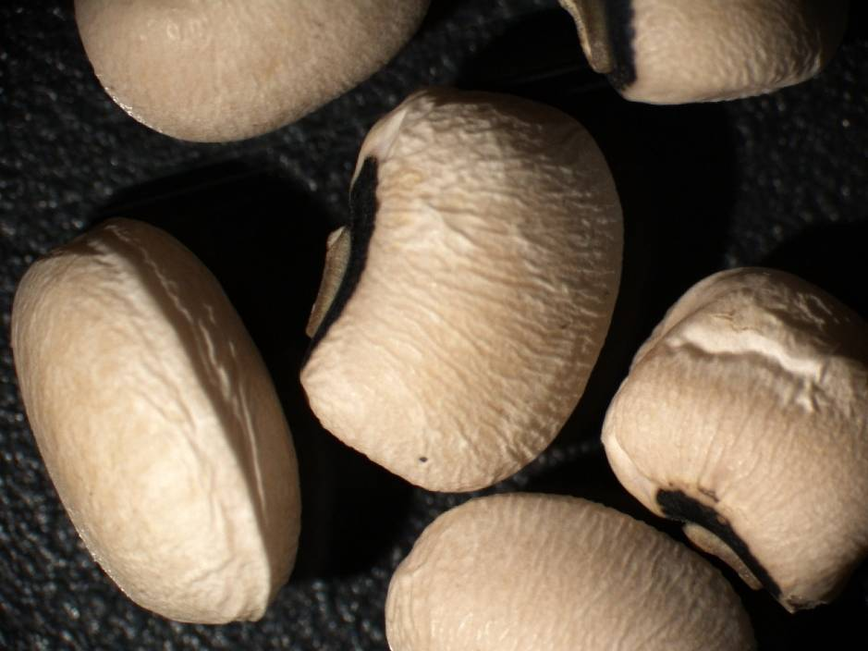
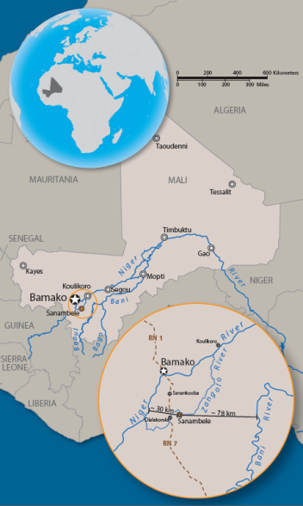

Slide 3
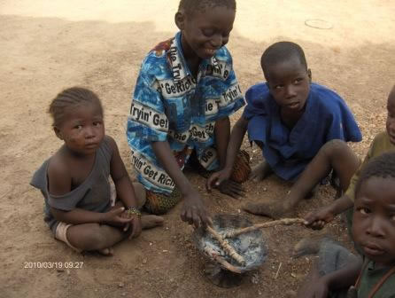
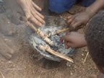
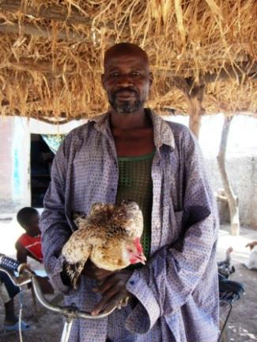
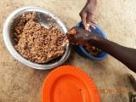
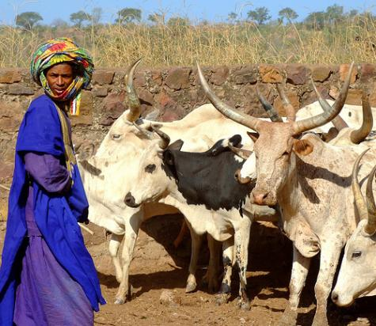
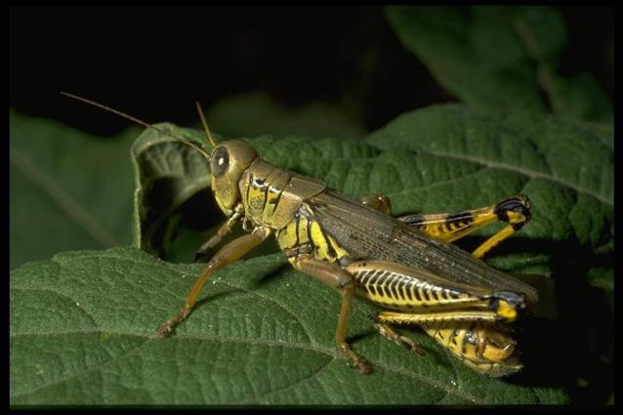
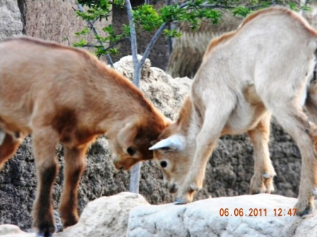

Slide 4
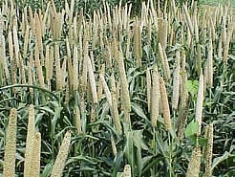
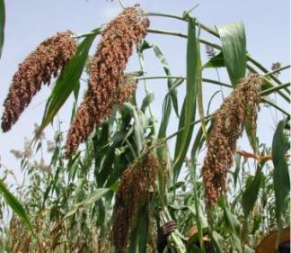
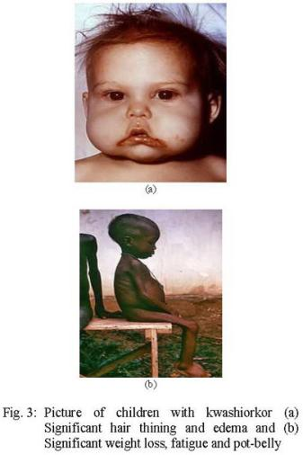
Essential Amino Acids, Micro-Nutrients Missing in a Mostly Grain Diet
Kwashiorkor, protein energy malnutrition
40% children in Mali, 0-5 years old
Delayed development, stunting in physical structure, impaired mental functions, ultimately death if not treated

Slide 5


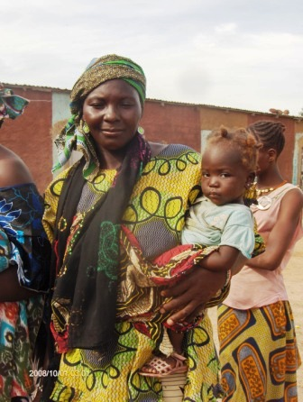
Kwashiorkor

Slide 6
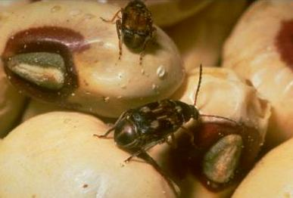
Cowpea bruchid
Callosobruchus maculatus

Slide 7
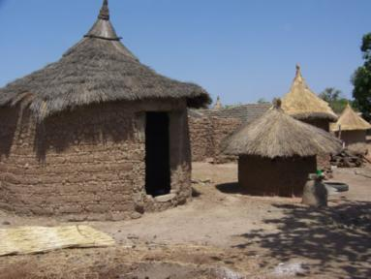
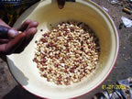
Solution Requirements
No cash cost
Produced in the village
Use no unknown technology

Slide 8
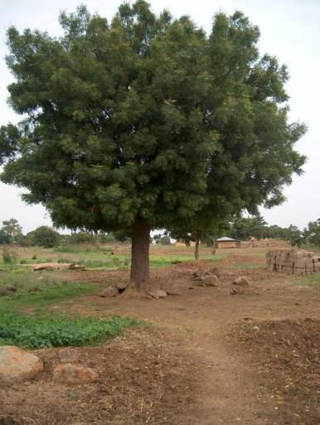
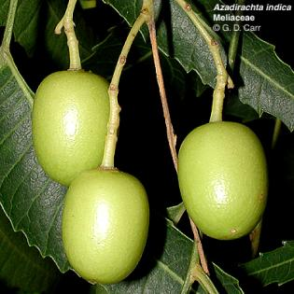
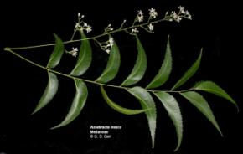
West African Village Adoption Failures
Neem Kernel Extract, Neem Kernel
Powder, Azadirachta indica
African mint, Ocimum canum
Triple plastic bags
Ashes
Crop residues

