Slide 1


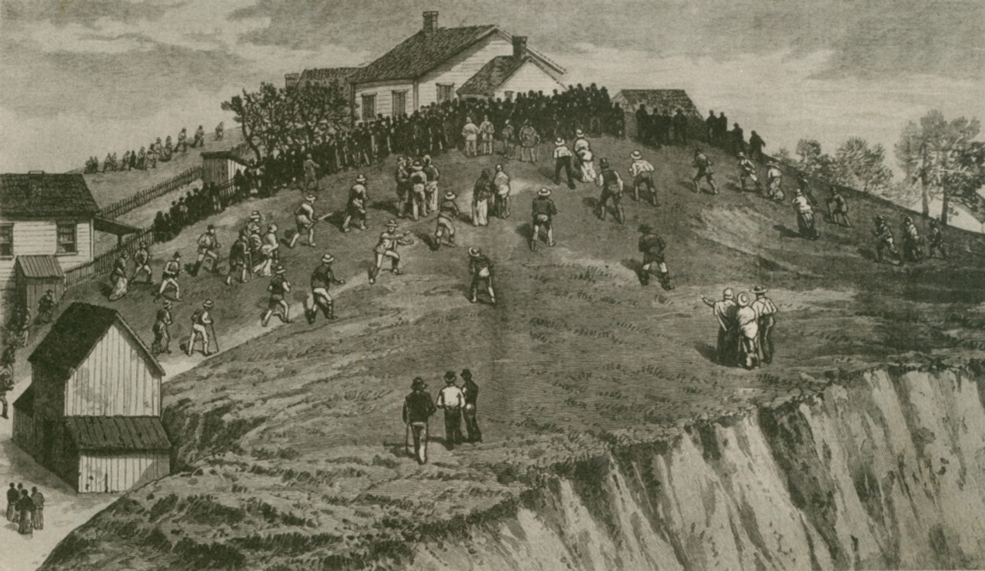
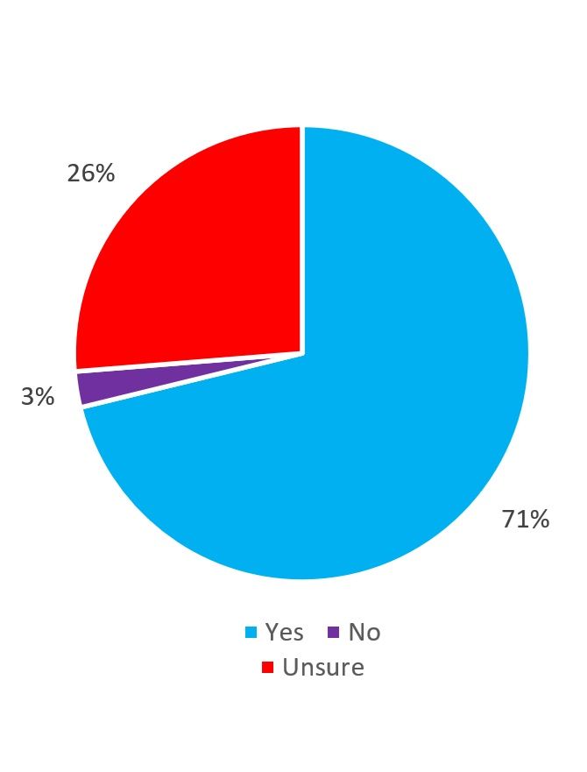
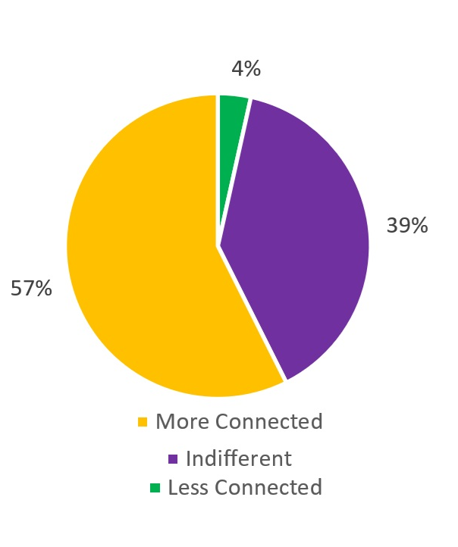
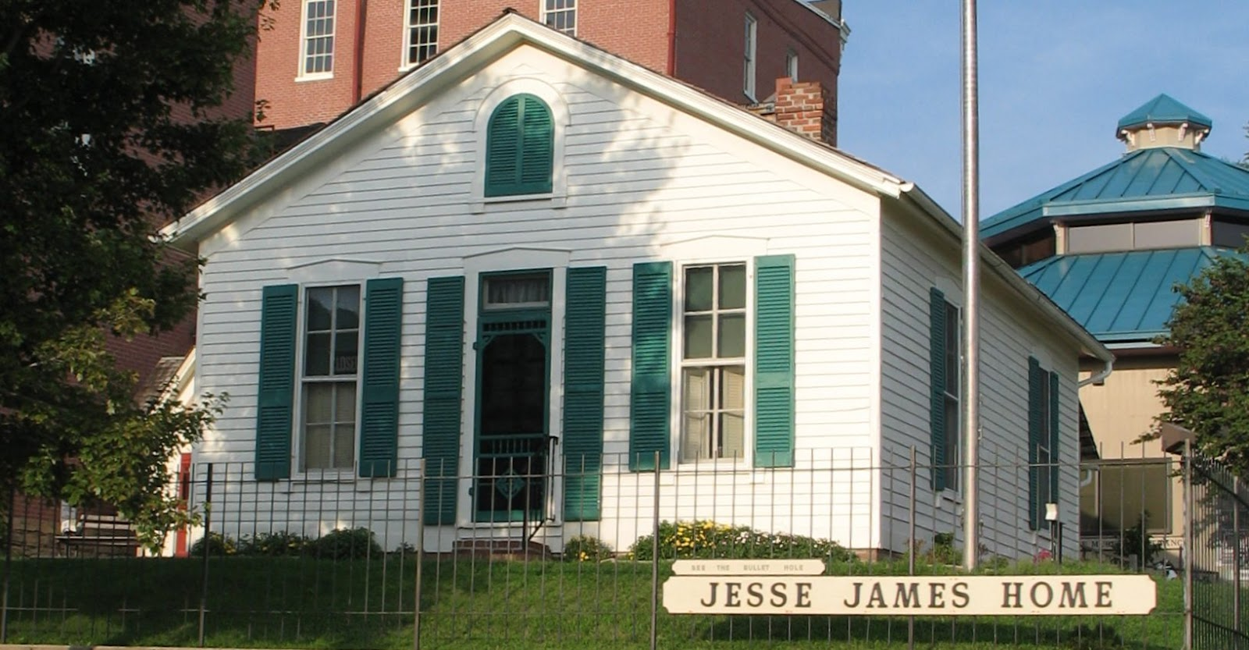
Place-based Inquiry in the High School
Environmental Science Classroom
Jacob D. Phillips, Central High School, Saint Joseph, Missouri, July 2024
Introduction
Focus Statement
Conclusion
Does the use of place-based examples help high school environmental science classroom students retain concepts? I have asked this question of my junior and senior environmental science classes at Central High School (CHS) of St. Joseph, MO. CHS has been a school since 1861 and our city has a rich history. The city’s motto is “Where the Pony Express began, and Jesse James ended,” but does this mean anything to the students?
What was the impact of using place-based examples on high school environmental science students?
71% of students polled believe that the additional information about the area helped you learn Environmental Science better.
57% of students polled feel more connected to St. Joseph and the region now.
49% of students polled feel more favorable about St. Joseph and the region.
Treatment
The Historical Photo Group consisted of 71 students, while the Current Photo Group consisted of 70 Students.
I evaluated my students using See-Think-Wonder (STW) surveys to understand how they processed upcoming lessons. The Historical Photo Group received the historical photo first, followed by the lesson, then received the current photo. The afternoon group, received the images in reverse order.
Impact on the Author
Data Collection
“PBE has shown me that I should strive to find the best, most locally available ways to present complex environmental science information to my students. Shifting toward PBE has already helped me find that school and community connection spark I’ve been looking for.”
A.) Five See-Think-Wonder Surveys of Historical v. Current Photos to teach High School Environmental Science
B.) Two Guest Speakers Surveys
- C.) One Whole-Unit Survey
D.) Anecdotal Observations
E.) Lessons, Labs, Conversations, and Nature Walks
“I felt St Joseph was a small town and that it didn't have any history behind it, but now I feel like it does have history and culture.”
“Honestly, just throughout this unit, I've been paying more attention to my surroundings when I go on walks and drive through downtown, and it's made me appreciate the scenery a lot more.”
Student Comments
Figure 3. Historical: A famous house in St. Joseph, MO, 1883.
“I have a bigger appreciation for the town even though it's still a small town the history. The environment means so much more to me. I think I have this bigger appreciation mainly because I'm also leaving for college soon and am going to miss the place I grew up.”
Figure 1. Do you believe that the additional information about the area helped you learn Environmental Science better? (N = 118)
Figure 2. Do you feel more or less connected to St. Joseph and the region now? (N = 118)
Figure 5. Student comments
Sources
City Motto: St. Joseph Convention and Visitor’s Center. https://stjomo.com/
Figure 3: The James Family Home, 1883. https://stjomo.com/jesse-james/
Figure 4. Current: The Jesse James House Museum, 2023.

