Slide 1


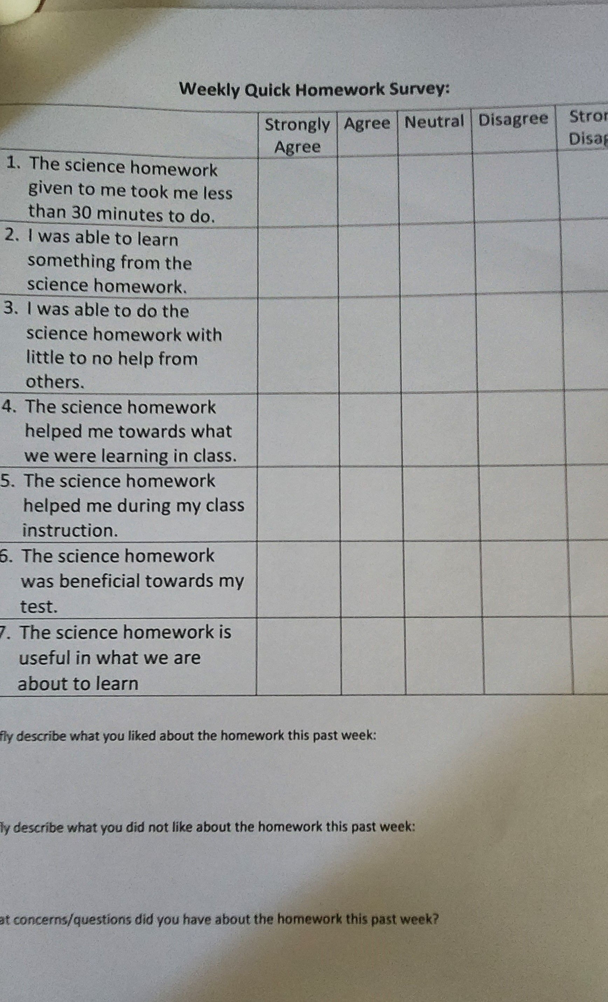
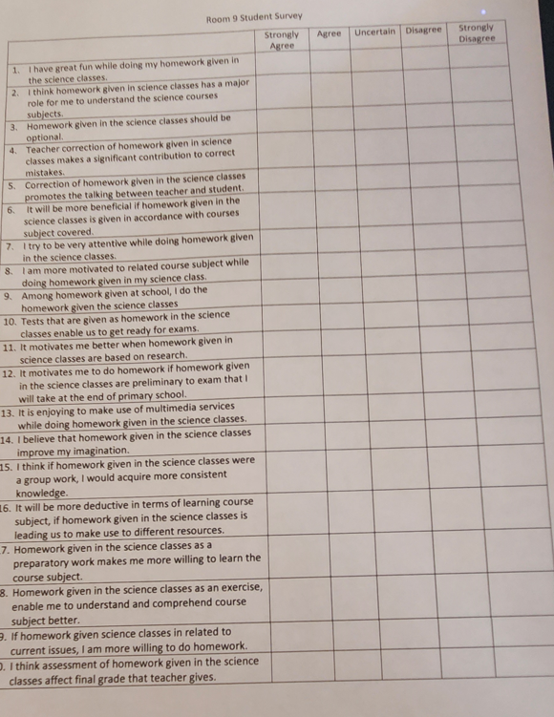
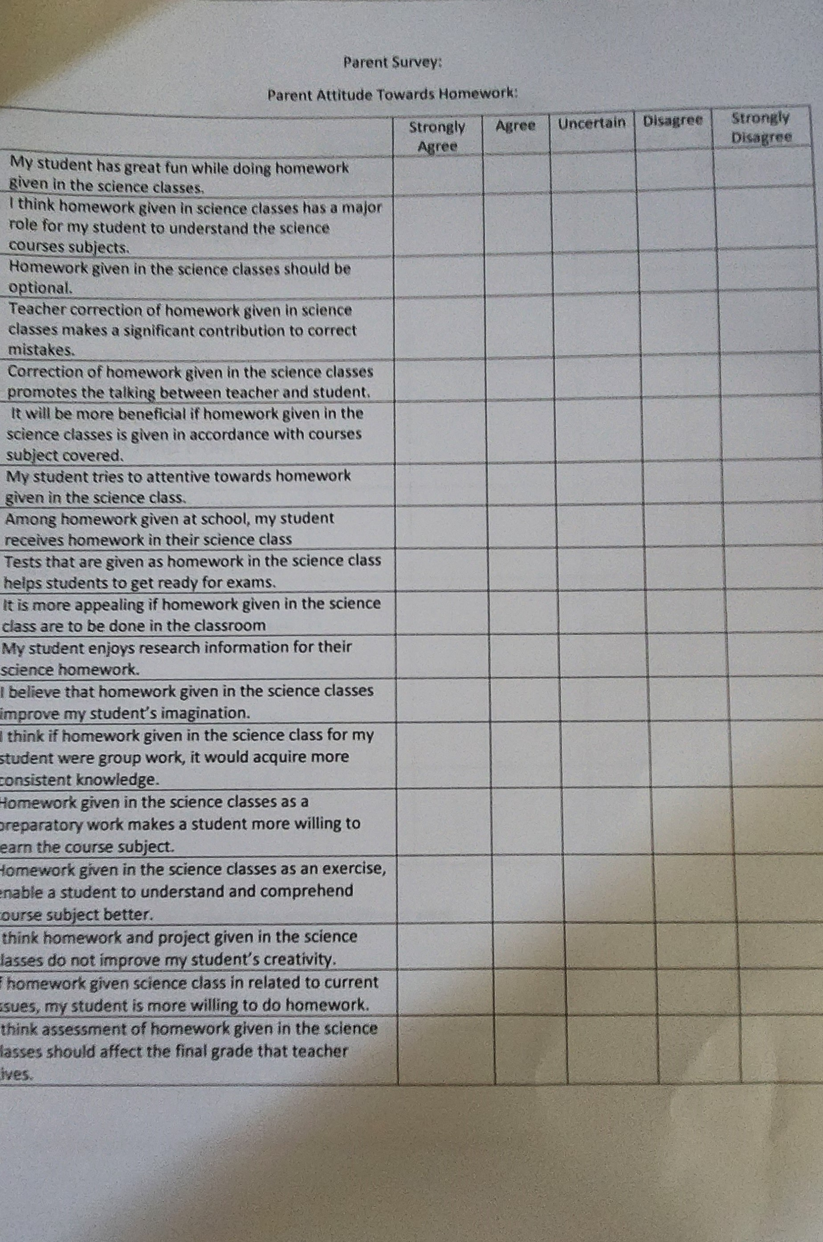
The Effectiveness of Science Homework in a 6th-grade Elementary School Classroom
Nancy Wear, Miguelito Elementary School, Lompoc, CA July 2024
RESEARCH QUESTIONS
How does science homework affect elementary school science classroom student learning?
DATA ANALYSIS
RESULTS
According to the survey, there needs to be more connection between parents and students regarding homework. The data also shows that student’s test scores slightly improved with homework. However, the type of homework that is given does affect student scores. Furthermore, students struggle with some of the homework, such as fill-in-the-blank
THE EFFECT OF HOMEWORK ON ASSESSMENT
BACKGROUND
Students at our school have very little to no science homework. When the current 6th graders were in 5th grade for the 2022-2023 school year, only 23% of the eighty students were considered proficient in science. In my class, only 5 out of 27 students, or 18%, met the standards on state testing. The students are now in 6th grade and struggle in science. Students have had little to no homework in science.
CLAIM-EVIDENCE-REASONING
Past studies on homework effectiveness for grade six showed a slight positive effect. The study I conducted reiterates the effectiveness of homework in the classroom setting. However, the type of homework given plays an essential factor in this. The type of questions students must answer affects their assessment scores. Students did better when they had multimedia homework, used their imagination, or thought critically. Students struggled with assessment questions, where they read and answered questions. One can conclude that when students use multimedia, creativity, or critical thinking, they can make a connection from homework to the classroom.
METHODOLOGY
An eighteen-question survey was given to parents and students to assess their feelings towards homework. Students were given homework two to three times a week for five weeks. At the end of each week, students were given a ten-question assessment and a ten-question post-survey to assess their feelings about the homework and the assessment.
Figure 4. Parent and student perceptions of science homework. The disconnect between the perceptions is great for having fun doing homework.
Figure 5: Comparisons of parent and student data on how science homework can affect their grade.
Parents and students have different perceptions of homework. Parents see homework as something fun for students and that they enjoy doing, while students see homework as something they are forced to do. Parents and students also see a difference in whether homework affects a student’s grades. Parents believe that it shouldn’t, and students see it as it should.
The data throughout the five weeks show that students were neutral about homework helping with class instruction. However, when analyzing the final data on students who did their homework compared to the average assessment scores, students started to make gains in week four and week five when homework was creative using observations at home, multimedia creations for homework, and thinking of questions instead of answering questions in the reading.
Figure 7. Homework and student assessment success has a slight correlation.
Figure 6: Student post-survey after homework and assessments
Figure 1:Student Post Assessment survey
Figure 2: Room 9 Student Survey
Figure 3: Family Homework Survey

