Slide 1
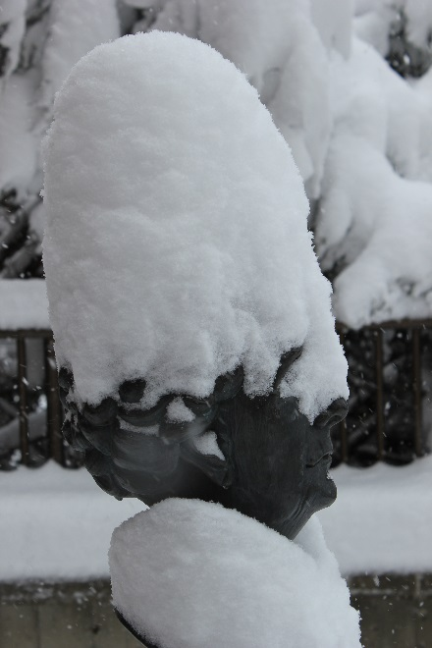
College of Nursing 2013-2014 Academic Year Hi-Lights
Anna Pearl Sherrick with a snow bonnet!

Slide 2
Goal #1. TEACHING/LEADERSHIP: LEADERS IN NURSING PRACTICE To inspire baccalaureate and graduate students, within a diverse, challenging, and engaging learning environment, to become leaders in the practice of professional nursing. | Goal #2. TEACHING/INTERACTIVE LEARNING ENVIRONMENT To create an interactive environment in which faculty and students discover, learn, and integrate knowledge into nursing practice. | Goal #3. DISCOVERY OF KNOWLEDGE: RESEARCH AND SCHOLARLY ACTIVITIES To serve as leaders in nursing by generating, translating, and disseminating knowledge through research and scholarly activities. | Goal #4. OUTREACH: PROMOTION OF HEALTH AND WELLNESS To promote health and wellness through professional practice, collaboration, consultation, civic engagement, education and leadership.
1.1 Offer high quality undergraduate and graduate curriculum based on professional and accreditation standards | 2.1 CON curriculum reflects the world at-large with diversity, national and international initiatives and standards. | 3.1 Enhance, value and support research and scholarship. | 4.1 Foster and support outreach through service learning, research, and practice at the local, national, and international levels. .
1.2 Develop and/or provide access to electives that allow students to have a diverse, challenging, and engaging experience. Includes recognizing and encouraging student-inspired learning opportunities. | 2.2 Establish new and innovative partnerships to advance the MSU CON vision. | 3.2. Increase the number and dollar amount of research grants submitted from the College of Nursing to expand depth and understanding of the problems/questions/hypotheses focused on by college researchers. | 4.2. Establish a reputation of faculty as experts in health education/ health promotion locally, nationally, and internationally.
1.3 Instill a culture of leadership where leadership, evidence-based practice, scholarship, and innovation are fostered and valued in the classroom, clinical learning setting, and point of care | 2.3. Use state of the art technology and informatics to optimize teaching outcomes and enhance student success across all campuses. | 3.3 Triple the publication productivity college-wide over a period of five years on the primary literature related to outcomes and discoveries from the aims of scholarly activity | 4.3. Promote a culture of wellness for faculty, staff and students.
1.4 Seamless* nursing education supported between ADN-BSN-MN-DNP. Includes successful promotion of the value of BSN/MN/DNP in Montana. |  | 3.4 Standards and expectations for research in the College of Nursing increased in the tenure and promotion guidelines (Policy E-1). | 4.4 Integrate staff into the outreach mission of the College
1.5 Recruit, retain and value diversity (e.g. gender, age, ethnicity) among students, staff, and faculty |  | 3.5 Create opportunities for faculty and students to collaborate in scholarly activities across all levels of nursing education.
1.6 Integrate staff into the teaching mission of the College |  | 3.6 Promote translational research
 |  | 3.7 Integrate staff into the research mission of the College

Slide 3
GOAL 1. TEACHING/LEADERSHIP: LEADERS IN NURSING PRACTICE To inspire baccalaureate and graduate students, within a diverse, challenging, and engaging learning environment, to become leaders in the practice of professional nursing

Slide 4
Admissions - Traditional Undergraduate Program (1.1)
Fall 2013 admission cycle
228 applications (24 males, 204 females)
Campus Requests
Bozeman - 78
Billings – 54
Great Falls – 23
Missoula – 55
Kalispell – 15
Cutoff GPA – 3.588
Spring 2014 admission cycle
186 applications (30 males, 156 females)
Campus Requests
Billings – 72
Great Falls – 28
Missoula – 67
Kalispell – 19
Cutoff GPA – 3.521

Slide 5
Accelerated Program (1.1)
Admissions
150 applications
Interviewed 87
32 admitted
16 Bozeman
16 Great Falls
5 males; 27 females
Third cohort will graduate in August
16 Bozeman; 16 Great Falls
100% NCLEX-RN first time pass rate for first two classes

Slide 6
Graduate Program (1.1)
Applications
DNP
50 – Family/Individual Nurse Practitioner
13 - Psych/Mental Health Nurse Practitioner
MN-DNP
3 –Family/Individual Nurse Practitioner
4 - Psych/Mental Health Nurse Practitioner
CNL – 8
Total = 78
AY 13-14 Graduates
22 FNPs
4 post-master’s FNP
6 Mental Health NP
5 post-mater’s Mental Health NP
1 CNL in May; 3 in December
Total = 37 May; 40 for the academic year

Slide 7
NCLEX-RN Scores (1.1)
October-March 2011 | April-Sept 2011 | October-March 2012 | April – Sept 2012 | October – March 2013 | April- Sept 2013
N=72 | N=91 | N=79 | N=105 | N=86 | N=130
94% | 86% | 92% | 92% | 98% | 88%

Slide 8
Faculty Certification (1.3e)
52 faculty (full or part-time ) are certified
Recertifications
Linda Torma - renewed 5 year certification as a Clinical Nurse Specialist in Gerontological Nursing
Kelli Begley - renewed 5 year board certification as a CNS in child and adolescent psychiatry
Jennifer Sofie - passed the exam to become certified on the National Registry of Certified Medical Examiners
Cary Heskett - board certification in Medical-Surgical nursing from the ANCC (summer 2013)

Slide 9
Strategic Plan Priorities
Seamless Education (1.4)
RN-MN
Approved Graduate School
Stalled in the MSU Senate
Plans – move forward in early fall
MT-CAHN
Several faculty serve on councils
Involvement with regional meetings
APIN Grant (AHEC) – Sandy Kuntz
Develop electives (1.2)
Critical Care Elective
Approved
Will be offered for the first time in fall 2014 – Steve Glow

Slide 10
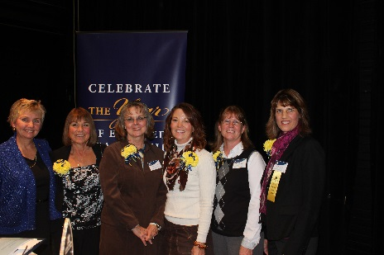
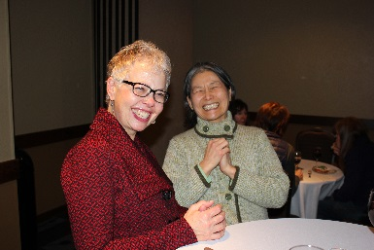
Instill a Culture of Leadership (1.3c, 1.3d) “MSU YEAR OF ENGAGED LEADERSHIP”
Leaders and Legends Awards
Charlie Winters – Outstanding Faculty
Wendy Minster - Outstanding Staff
Susan Myers-Clack – Outstanding Staff
Jeanine Brandt – Outstanding Alum
Anna Daniels – Honorary Alumna
Leadership MSU
Kay LaFrance
Sheila Matye
Women’s Health Symposium co-sponsored with
College of Education and Health and Human
Development (Teresa Wicks - “Be Good to Your Bones.” )
Book study The Growth and Development of Nursing Leaders (McBride)
Escape Fire: The Fight to Rescue American Health Care (Linda Torma and Teresa Henry)
Julie Hickethier – Engaged Leader Award (at pinning)

Slide 11
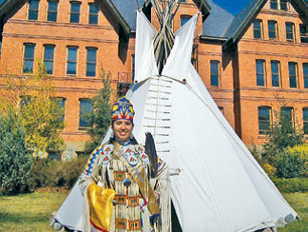
Caring for Our Own Program (1.5)
5.5% CON students American Indian – highest percentage of any college at MSU
$1,085,295 Indian Health Service 3 year grant approved for support of undergraduate students
$980,405 HRSA grant submitted January 2014
Private gift of $4,000
Staff turnover
Jenny Gorsegner – Academic Advisor
Terryn Martin – Nurse Mentor
Alana Brown – Outreach Coordinator

Slide 12
Undergraduate Student Retention (1.6) (Goal = 90% or higher)
Traditional Program
2011 |  | 2012 | 2013
88.6% |  | 85.34% | 91.1%
Accelerated Program
 |  | 2012 | 2013
 |  | 100% | 96.8%

Slide 13
GOAL 2.
TEACHING/INTERACTIVE LEARNING ENVIRONMENT
To create an interactive environment in which faculty and students discover, learn, and integrate knowledge into nursing practice

Slide 14
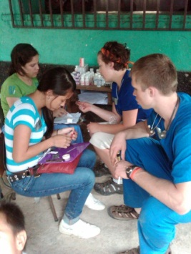
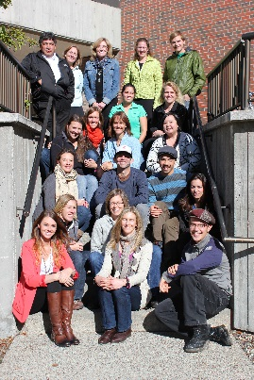
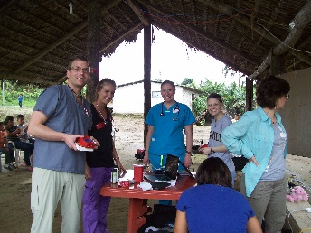
Service Learning (2.1, 2.2)
Domestic
Fort Peck Reservation
Pediatric experience for 2 groups of students
Senior student
Faculty volunteer trip last summer
International
Dominican Republic (fall) 15 students; Carolyn Wenger and Laurie Glover
Ecuador (spring) 9 students; Karrin Sax and Paul Krogue
Mongolia (summer) 3 students; Michele Sare
Endowment
Web page presence http://www.montana.edu/nursing/student/international.htm
Julie Ruff - new international coordinator

Slide 15
Technology Support (2.3)
Welcome Robert Barksdale
Increased collaboration with ITC
SUB Room 233
EFAC - $169,577
3 sim junior manikins
2 sim baby manikins
2 Student auscultation manikins
CFAC - $69,536
CON video distance infrastructure

Slide 16
GOAL 3.
DISCOVERY OF KNOWLEDGE: RESEARCH AND SCHOLARLY ACTIVITIES
To serve as leaders in nursing by generating, translating, and disseminating knowledge through research and scholarly activities

Slide 17
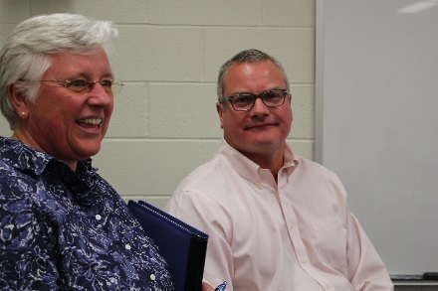
Research and Scholarship – (3.1, 3.2, 3.3)
College of Nursing Research Seminar Series
17 Publications
12 Refereed Publications
7 research
5 scholarly
17 grants submitted in 2013 - 6 funded
Teresa Seright – American Organization of Nurse Executives (research)
Brian King (Melland, PI) – Indian Health Services(training)
Elizabeth Kinion – Oral Health Nursing Education and Practice (training)
Yoshi Colclough – CON Block Grant
Susan Luparell – CON Block Grant
Donna Williams - Advanced Education Nurse Traineeship HRSA grant - $349,500. Tuition support for APRN students

Slide 18
Faculty FTE’s, TT, % TT (3.3)

Slide 19
GOAL 4.
OUTREACH: PROMOTION OF HEALTH AND WELLNESS
To promote health and wellness through professional practice, collaboration, consultation, civic engagement, education and leadership

Slide 20
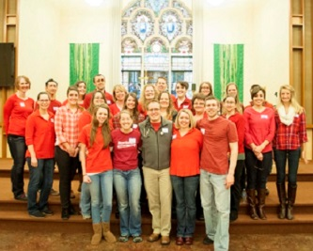
Outreach (4.1, 4.2)
St. Vincent’s flu shot clinic (Teresa Wicks)
St Jude Walk for Children (JoAnn Paterson)
Missoula Project Homeless
St. Pat’s Hospital and International Health Collaborative health screening (Brett Hollis, Sally Rappold, Teresa Henry, Michelle Huntley and Karrin Sax )
Peace Place Respite Care in Great Falls (Sheila Matye)
Out of the Darkness Walk sponsored by the American Foundation for Suicide Prevention (Julie Pullen)
Community disaster drill, simulating an airplane crash coordinated among Benefis Health Systems
Screening clinic for children in Head Start (Maria Wines)
Six faculty trained as QPR instructors

Slide 21
Gifts to the College (4.1)
380 total gifts from 332 donors
Over $175,000
Roughly $97,000 for current use
Roughly $81,000 for endowed gifts
Average gift amount of $471
26 gifts were $1,000 or more
Three planned gifts were documented
One is for $250,000
Nine Directors of Development are currently working on 46 constituents on potential gifts for the College
Current open solicitations, verbal commitments, and pending planned gift documentation total $660,000
$2,000 gift per accelerated student on Great Falls campus from Benefis

Slide 22
Faculty Pursuing the Doctoral Degree
AWESOME!!
Currently Enrolled
Julie Ruff – Montana State University
Sally Rappold – University of Montana
Stacy Stellflug – University of Colorado
Paul Krogue –University of Arizona
Jane Scharff – University of Missouri – Columbia
Emily Tesar – University of Missouri – Columbia
Julie Pullen –Concordia University in Wisconsin
Sheila Matye – American Sentinel University
Shelly Banta – MSU CON
Beginning Studies
Kathy Damberger – MSU CON
Janice Hausauer- MSU CON
Linda Kovolisky – MSU CON
Susan Raph – University of Nevada - Reno

Slide 23
Achievements
Laura Larsson - tenure
Jean Shreffler Grant – sabbatical
Kris Juliar – appointed by HRSA serve on a small group that will be advising them on the future of the AHEC system.
Carolyn Wenger has completed 26 years volunteering at the Billings Rescue Mission
Emily Tesar - Verna Adwell Rhodes Travel Scholarship to attend the International Nursing Societies Qualitative Inquiry in the Applied Health Sciences; Basel, Switzerland
Cary Heskett – awarded the KRMC Home Options Employee of the Year
Susan Raph – completed 4 year term on MSU Alumni Relations Advisory Board – MSU Alumni Foundation

Slide 24
Achievements
Deanna Babb - named a 2014 Fellow of the American Association of Nurse Practitioners (FAANP)
Laura Larsson - nominated to serve on the Institute of Medicine review panel for Human Biological Effects of Low level Ionizing Radiation: Research Directions and the Role of the Armed Forces Radiobiological Research Initiative
Teresa Henry - reappointed to a three year term on the Health Board in Missoula
Charlie Winters – appointed to PCORI Standing Panel for Improving Methods for Conducting patient-Centered Outcomes Research; Editorial Board member Nursing Research; elected to WIN Board of Governors representing nursing education; appointed to the Providence Health & Services, Western Montana Region, Community Ministry Board
Kris Juliar – appointed to the Governor’s Healthier Montana Task Force
Steve Glow - appointed to the National Emergency Management and Preparedness Committee for the Emergency Nurses Association

Slide 25
Achievements
Linda Torma – appointed as a Technical Expert Panel member for the AHRQ Effective Health Care (EHC) report entitled “Treatments for Fibromyalgia in Adult Subgroups”
Elizabeth Kinion - service as an NIH grant reviewer
Kathy Damberger – recognized by Bobcat Radio from as the CON’s Most Valuable Professor (MVP)
Stacy Stellflug - advisory committee for a HRSA State Partnership Regionalization of Care Program Grant for $200,000 titled the Montana Inclusive Model for Pediatric Emergent Care (MIMPEC) Program; service on the Billings Area Institutional Review Board as a full member and pediatric specialty representative 2013
Karen Zulkowski (content expert) – on a team behind the development of a new mobile app for smart phones; service as an expert panel member at the NPUAP Unavoidable Consensus Conference

Slide 26
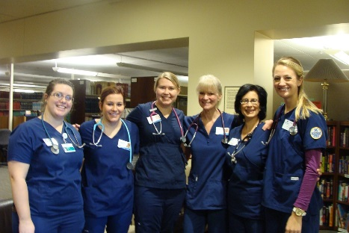
Student Accomplishments
Great Falls students held a benefit in November for one of their classmates who has a seriously ill child - raised $10,141
6 students graduating from the Honors program
Awards for Excellence
Leann Dorvall, Student; Kimberly Peterson, Faculty Mentor
Jill Pennington, Student; Jeannie Osellame, Faculty Mentor
Noel Yelvington, Student; Susan Luparell, Faculty Mentor
Emilie Kuster, Student; Laura Larson, Faculty Mentor
Emilie Kuster - Torlief Aasheim Award – one of 7 graduating MSU seniors
Corliss Ledington – DNP student – selected to attend the AACN Policy Summit
Sydney Hirst – (J1) - Paramedic of the Year
Sponsored 4 students to national NSA
Kellie Phillips – (J2 – Billings) Honorable Mention from the Udall Scholarship program -second year in a row

Slide 27
Welcome to New Staff
Dona Hall – Missoula campus Administrative Associate II
Sharon Poore – Billings campus Administrative Associate II
Martha Peters – Director of Administration and Finance
Robert Barksdale – CON IT Coordinator
Patricia LaDue – Undergraduate Program Assistant

Slide 28
Personal Milestones
Marriages
Becky Wolff was married to Bob Muller on Valentine’s Day
Births
Maria Wines and family on the birth of their second child, Riggs Daniel
Grandchildren born
Glenna Burg has a new granddaughter
Helen Melland has a new grandson
Retirement
Mary Ann Prawdzienski
Lynn Taylor
Graduation
Becky Wolff Muller graduated with her Post Master’s FNP.
Janet Smith completed her masters in International Health and started the CNL.
Denise LaSalle – Masters in Nursing University of Phoenix (summer 2014)

Slide 29
Upcoming Events
CCNE Continuous Improvement Progress Report – June 1
Update your presentations – 2011-2014 in Activity Insight by May 15
International Rural Health & Rural Nursing Research Conference – July 29-31, Bozeman
http://eu.montana.edu/rural/health/
Montana Center to Advance Through Nursing (MT-CAHN) Summit - June 9-10, Great Northern Hotel, Helena
Workforce needs
Nursing education preparation to meet future healthcare needs
http://mtcahn.org/
Leaders and Legends Awards Homecoming Reception – September27
http://msuaf.org/s/1584/index.aspx?sid=1584&gid=1&pgid=882
December 11-12: Winter meeting and pinning
May 2015 – spring meeting in renovated SUB!
August 2015 – fall meeting in Billings

Slide 30
Have a great summer…… thank you for all you do!

