Slide 1
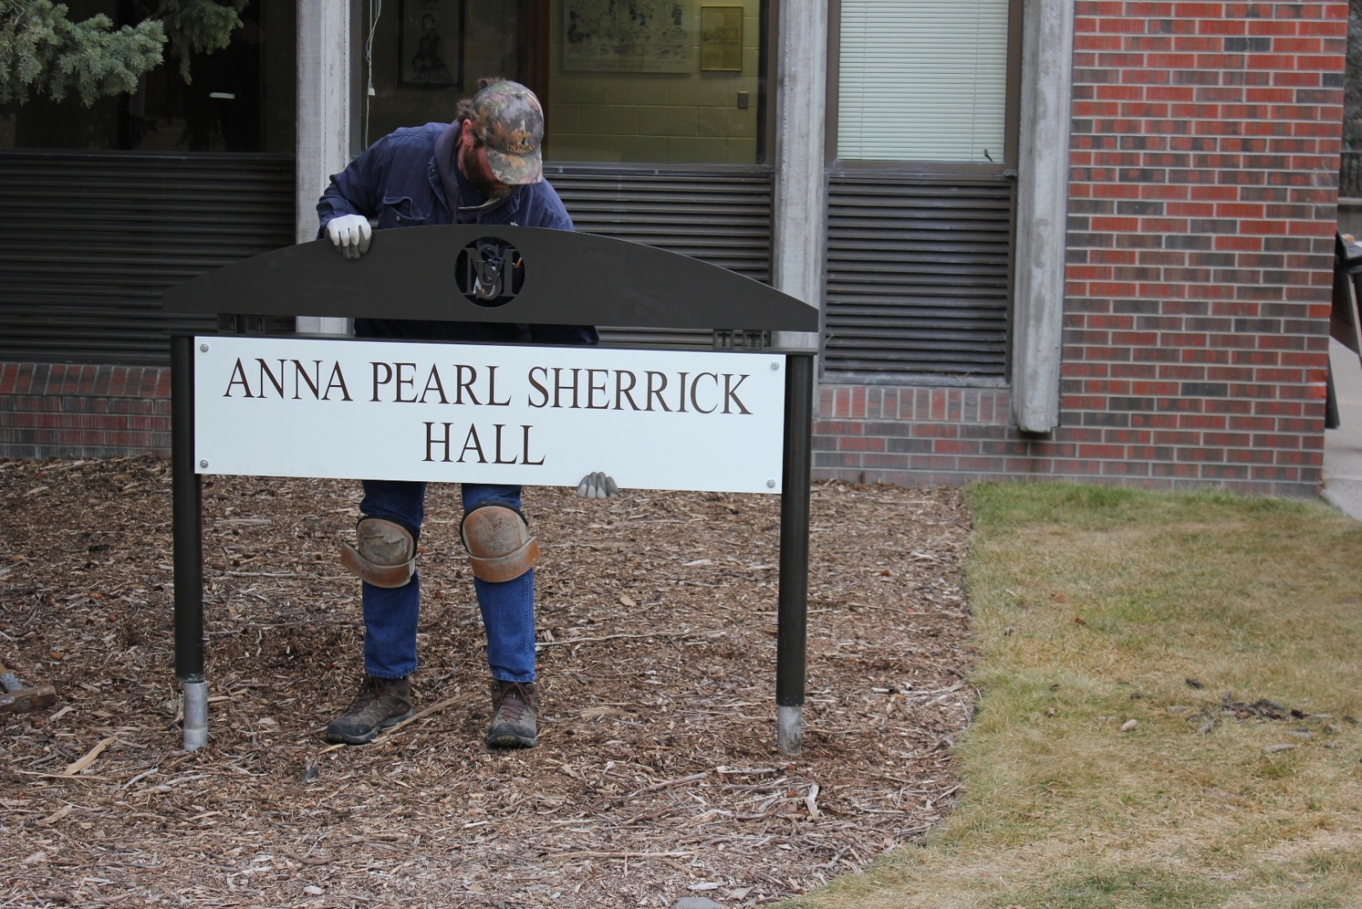
College of Nursing
2014-2015

Slide 2
Goal #1. TEACHING/LEADERSHIP: LEADERS IN NURSING PRACTICE To inspire baccalaureate and graduate students, within a diverse, challenging, and engaging learning environment, to become leaders in the practice of professional nursing. | Goal #2. TEACHING/INTERACTIVE LEARNING ENVIRONMENT To create an interactive environment in which faculty and students discover, learn, and integrate knowledge into nursing practice. | Goal #3. DISCOVERY OF KNOWLEDGE: RESEARCH AND SCHOLARLY ACTIVITIES To serve as leaders in nursing by generating, translating, and disseminating knowledge through research and scholarly activities. | Goal #4. OUTREACH: PROMOTION OF HEALTH AND WELLNESS To promote health and wellness through professional practice, collaboration, consultation, civic engagement, education and leadership.
1.1 Offer high quality undergraduate and graduate curriculum based on professional and accreditation standards | 2.1 CON curriculum reflects the world at-large with diversity, national and international initiatives and standards. | 3.1 Enhance, value and support research and scholarship. | 4.1 Foster and support outreach through service learning, research, and practice at the local, national, and international levels. .
1.2 Develop and/or provide access to electives that allow students to have a diverse, challenging, and engaging experience. Includes recognizing and encouraging student-inspired learning opportunities. | 2.2 Establish new and innovative partnerships to advance the MSU CON vision. | 3.2. Increase the number and dollar amount of research grants submitted from the College of Nursing to expand depth and understanding of the problems/questions/hypotheses focused on by college researchers. | 4.2. Establish a reputation of faculty as experts in health education/ health promotion locally, nationally, and internationally.
1.3 Instill a culture of leadership where leadership, evidence-based practice, scholarship, and innovation are fostered and valued in the classroom, clinical learning setting, and point of care | 2.3. Use state of the art technology and informatics to optimize teaching outcomes and enhance student success across all campuses. | 3.3 Triple the publication productivity college-wide over a period of five years on the primary literature related to outcomes and discoveries from the aims of scholarly activity | 4.3. Promote a culture of wellness for faculty, staff and students.
1.4 Seamless* nursing education supported between ADN-BSN-MN-DNP. Includes successful promotion of the value of BSN/MN/DNP in Montana. |  | 3.4 Standards and expectations for research in the College of Nursing increased in the tenure and promotion guidelines (Policy E-1). | 4.4 Integrate staff into the outreach mission of the College
1.5 Recruit, retain and value diversity (e.g. gender, age, ethnicity) among students, staff, and faculty |  | 3.5 Create opportunities for faculty and students to collaborate in scholarly activities across all levels of nursing education.
1.6 Integrate staff into the teaching mission of the College |  | 3.6 Promote translational research
 |  | 3.7 Integrate staff into the research mission of the College

Slide 3
GOAL 1.
TEACHING/LEADERSHIP: LEADERS IN NURSING PRACTICE
To inspire baccalaureate and graduate students, within a diverse, challenging, and engaging learning environment, to become leaders in the practice of professional nursing

Slide 4
Undergraduate Program (1.1)
Curriculum
  Critical Care elective (1.2)
Pedagogy
  Faculty Development tomorrow “Flipped Classroom”
  Elsevier Boot Camp
Accelerated - 4th cohort to graduate in August
  NCLEX – RN
  Expansion?
Campus visits
  Critical thinking
  Problem solving
Applications and admissions - steady

Slide 5


Slide 6
NCLEX-RN: April 2010-March 2015 (1.1)

Slide 7
Graduate Program (1.1)
  Applications for fall 2015
    DNP
      38 – Family/Individual Nurse Practitioner (37 BSN-DNP; 1 MN-DNP)
      15 - Psychiatric Mental Health (13 BSN-DNP; 2 MN-DNP)
    CNL – 1
  Admissions for fall 2015
    20 - Family/Individual Nurse Practitioner
    13 – Psychiatric Mental Health Nurse Practitioner
    1 - CNL
  Enrollment December 2014
    75 students
      11 CNL
      10 FNP (MN)
      7 FPMHNP (MN)
      41 DNP (Family/Individual)
      5 DNP (Psych/MH)
  ADRN-MN - applications being accepted
  Funding support: AENT HRSA ($346,00 – 2 years) APRN students only

Slide 8
DNP Applications and Admissions
s

Slide 9
Culture of Leadership (1.3c, 1.3d)
Leaders and Legends Awards
  Dr. Kay Chafey, Professor Emeritus– Outstanding Faculty
  John Maccagnano - Outstanding Staff
  Matt Rognlie – Outstanding Alum
  Joyce Dombrouski – Alumni Achievement Award
Leadership MSU
  Brian King
Dean’s Award for Excellence - Pat Wilson
President-Elect of WIN - Charlie Winters

Slide 10
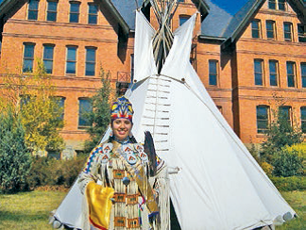
Caring for Our Own Program (1.5)
  5.5% CON students American Indian – highest percentage of any college at MSU
  $1,085,295 Indian Health Service 3 year grant approved for support of undergraduate students (Year #2)
  $980,405 HRSA grant approved; not funded; waiting; may receive 2 years of funding
  Staff turnover
    Shane Doyle – Outreach Coordinator
    Mariya Waldenburg – Pre-Nursing Advisor
    Terry Lee Altemus – Nursing Advisor
    Jennifer Show – Tutor

Slide 11
GOAL 2.
TEACHING/INTERACTIVE LEARNING ENVIRONMENT
To create an interactive environment in which faculty and students discover, learn, and integrate knowledge into nursing practice

Slide 12
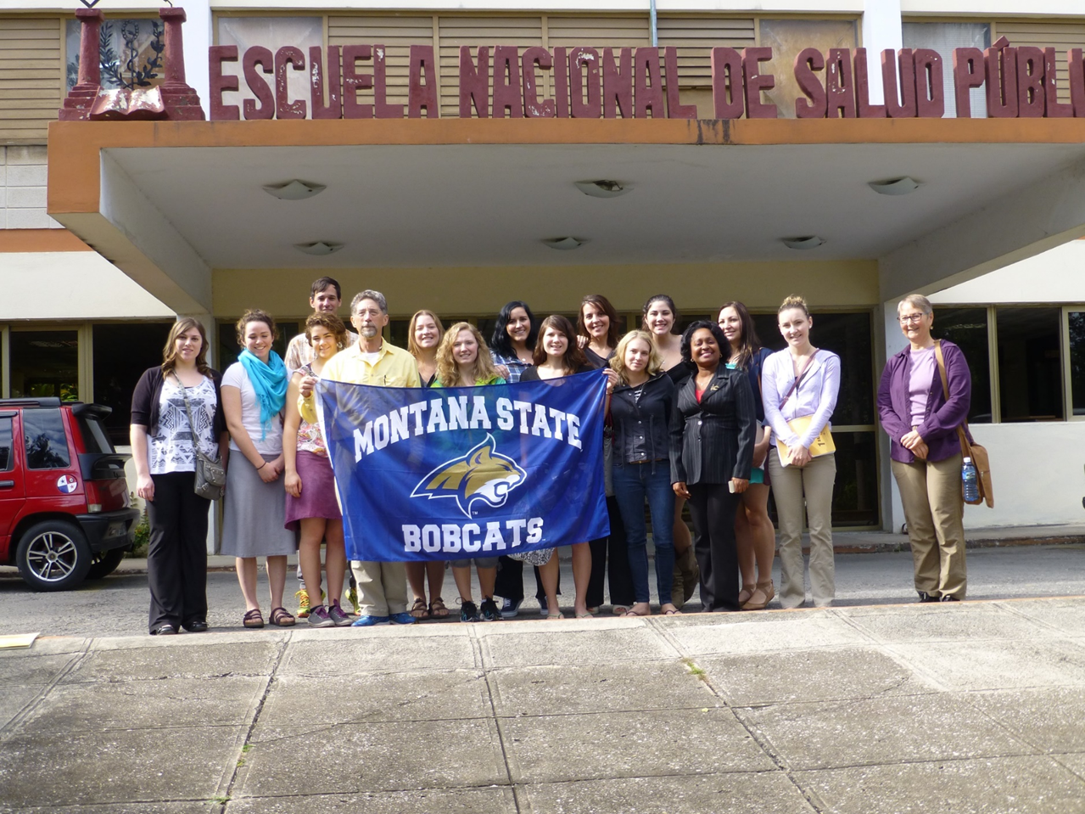


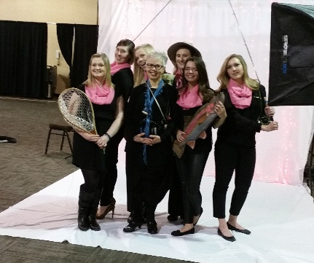
Domestic and International Outreach (2.1, 2.2, 4.1)
Domestic
  “Improving Health in Ravalli County through Assessment, Education, and Evaluation” – Heman Foundation grant for $126,775 over 3 years
  Fort Peck Reservation experience for junior students
International
  Ecuador (spring) 9 students; Karrin Sax, Paul Krogue, and Michelle Noftsinger
  Mongolia – 3 students and Michelle Sare (2014); 3 students with WWAMI (2015)
  Cuba – Steve Glow and 13 students; focus to learn about health care system

Slide 13
Technology Support (2.3)
Health Information Exchange of MT (HIEM) Network –between Missoula and Kalispell (425 mile fiber optic cable) and…thank you Pat Wilson!
  KRH paid for installation
EFAC - $73,924
  Infusion pumps
  Defibrillators
  Sim Junior Manikin
  Interactive video system/tablets for teaching
  Vision screening machines
  Simulation software suite
CFAC - $94,198
  Heim network support ($11,400)
  Video-conference bridge support (campus-wide)
  TVs, Computers for student labs/classrooms

Slide 14
GOAL 3.
DISCOVERY OF KNOWLEDGE: RESEARCH AND SCHOLARLY ACTIVITIES
To serve as leaders in nursing by generating, translating, and disseminating knowledge through research and scholarly activities

Slide 15
Research and Scholarship – (3.1, 3.2, 3.3)
Research Seminar Series
Request for Applications – CON support (VPR funds)
  TT Faculty
    Manuscript to Publication
    Publications leading to next pilot study
    Grant reviewers comments leading to need for more data
    Buyout of one course to write a grant
  NTT Faculty
    Scholarship manuscript proposal support
MSU
  VPR Support
  Statistical Consulting and Research Services – Dr. Lillian Lin
  Human Ecology Learning & Problem Solving
  Research and Sponsored Programs Expenditures – FY 14: $5,887,418
Faculty Funding
  Elizabeth Kinion – “Increasing Access to Oral Health Care: Evaluating the Outcomes of a Community Health Worker” (1 of 4 projects in the $10.7 million COBRE grant)
  Jean-Shreffler Grant – National Network of Libraries of Medicine
  Polly Peterson – Sigma Theta Tau, ZU Chapter
  Linda Torma - National Institutes of Health Nurse Loan Repayment Program

Slide 16
Faculty FTE’s, TT, % TT (3.3)
(5 year change in % TT = 20.7%; 10 year change = 22.9%)

Slide 17
State Expenditures
(5 year % change – 16.2%; 10 year % change – 49.9%)

Slide 18
Majors/Faculty FTE

Slide 19
Degrees Awarded

Slide 20
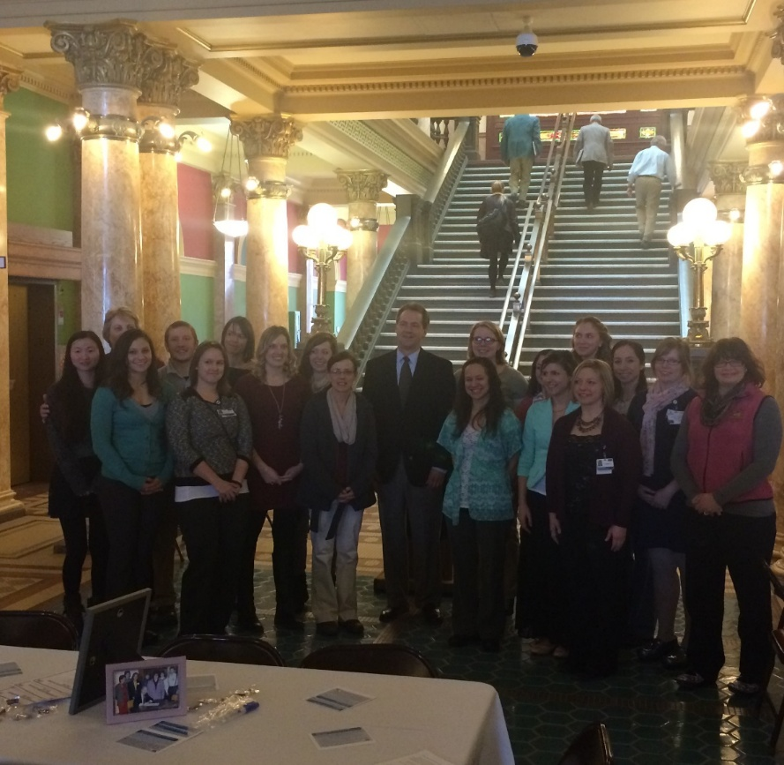
Student Successes
Four students presented posters at WIN
Three students attended the National Student Nurses Association conference in Phoenix
Jessie Hardin - Torlief Aasheim Community Involvement Award (1 of 7 graduating MSU seniors)
Kellie Phillips
  2015 Outstanding Nursing Student Award from the MT-CAHN
  Honorable Mention, Udall Scholarship, Tribal Health Category
  Emerging Scholars Award

Slide 21

Faculty Pursuing the Doctoral Degree
  Currently Enrolled
    Julie Ruff – Montana State University
    Sally Rappold – University of Montana
    Stacy Stellflug – University of Colorado
    Paul Krogue –University of Arizona
    Jane Scharff – University of Missouri – Columbia
    Emily Tesar – University of Missouri – Columbia
    Sheila Matye – American Sentinel University
    Shelly Banta – MSU CON
    Kathy Damberger – MSU CON
    Janice Hausauer- MSU CON
    Susan Raph – University of Nevada – Reno
Graduations
    Julie Pullen, DNP – Concordia University in Wisconsin (Dec 2014)

Slide 22
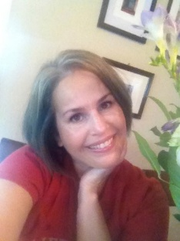


Changes in Admin Folks
Dr. Sandra Benavides Vaello – new CD on Missoula/Kalispell campus
Dr. Susan Ahrens – new CD on the Billings campus
      Farewell to Gretchen…… and
Thanks to Teresa for assuming the Interim role

Slide 23
Gifts to the College (4.1)
  Gifts > $25,000
    $38,000 – Endowment for Undergraduate Scholarships
    $25,000 – Endowment for Undergraduate Scholarships
    $80,000 – Undergraduate Planned Gift
    $25,000 – Discretionary Use
    Scholarship gifts to students – KRH, Benefis
  Sofie Malinowski – new gifts officer for the CON
  MSU Comprehensive Campaign
    People:
      Endowed chair - $2 million
      Scholarships - $1.5 million
      Faculty Research and Leadership Grants
      Endowed Chair - $2 million
    Programs:
      Domestic and International Initiative - $1 million

Slide 25
Interesting MSU Application Data
# of Applications
  Over the course of one year, MSU contacts 550,000 prospective students through leads generated by Royall & Co.
  140,000 of those are contacted a second time
  Approximately 70,000 show interest in MSU
  20,000 apply
  Approximately 4,500 enroll in the fall
Application Submission Process
  In 2010, 5% of MSU’s applicants submitted their application to MSU via a mobile device
  In 2014, 60% of MSU’s applicants submitted via a mobile device
  Relevance of this trend to the CON?

Slide 26
Upcoming Events
DNP Accreditation onsite visit: October 14-16 2015
  Update your CV on Activity Insight by May 15th
Montana Nursing Education and Practice Summit Center to Advance Through Nursing Summit (MT-CAHN) - June 8-9; Great Northern Hotel, Helena, http://mtcahn.org
  Simulation
  MT HealthCARE Grant and Curriculum Revision
  Mentoring and Precepting Projects
December 10-11: Winter meeting and pinning

Slide 27

Have a great summer…… thank you for all you do!

