Slide 1
College of Nursing 2015-2016

Slide 2
Undergraduate Program
Curriculum – Lots of discussions
Revision?
Testing?
Electives
Simulation
Accelerated - 5th cohort to graduate in August
Expansion to Missoula/Kalispell? 8 each community
Traditional
Expansion in Bozeman?
Campus visits
Student issues
Skills

Slide 3
Undergraduate Program(traditional) Admission Data
 | Fall 2015 Application | Spring 2016 Application
Total Application | 217 Applicants; 104 Admitted | 158 Applicants; 88 Admitted
Bozeman GPA cutoff | 3.957
Billings GPA cutoff | 3.697 | 3.577
Great Falls GPA cutoff | 3.730 | 3.619
Missoula GPA cutoff | 3.776 | 3.733
Kalispell GPA cutoff | 3.843 | 3.821

Slide 4
NCLEX Program Reports; Mountain Measurement Inc. (Mean = 88.75)

Slide 5
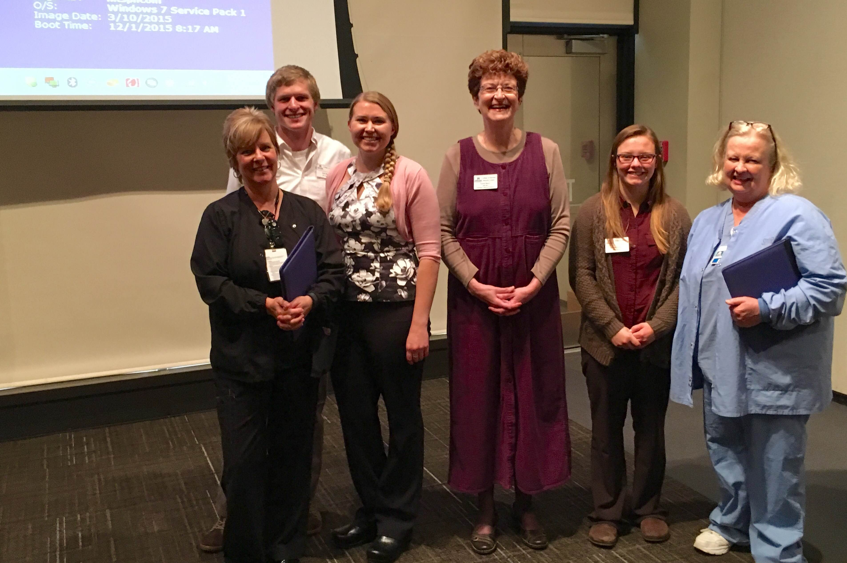
Missoula Preceptor Awards

Slide 6
Graduate Program
Admissions for fall 2016
23 - Family/Individual Nurse Practitioner
5 – Psychiatric Mental Health NP
6 – CNL
5 - ADRN-MN (CNL)
TOTAL = 39
Wait List: 18 qualified DNP applicants
8 DNP graduates – May 2016
CCNE Accreditation
ADRN-MN –3 applicants recommended for admission for fall; hold until spring semester, 2017

Slide 7
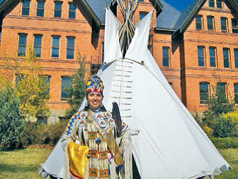
Caring for Our Own Program
4 % CON students American Indian; goal ~ 6%
$1,085,295 Indian Health Service 3 year grant approved for support of undergraduate students (Year #3); new grant submission due June 1
$310,726/year for 2 years HRSA grant approved (Year #1)

Slide 8
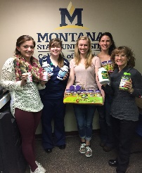
Domestic and International Outreach
Domestic – many! (Examples only)
Billings: Rescue Mission
Bozeman: Fort Peck Reservation experience for junior students; Hands Only CPR - Catapalooza
Great Falls: Rescue Mission, Great Falls Community Garden
Kalispell: Head Start Hats and Gloves: Helmet Safety Event
Missoula: “Improving Health in Ravalli County through Assessment, Education, and Evaluation” – Heman Foundation grant for $126,775 over 3 years; Child abuse prevention project
International
Ecuador - 12 students; Karrin Sax, Maria Wines; focus on primary care
Cuba – 13 students; Steve Glow; focus is to learn about health care system

Slide 9
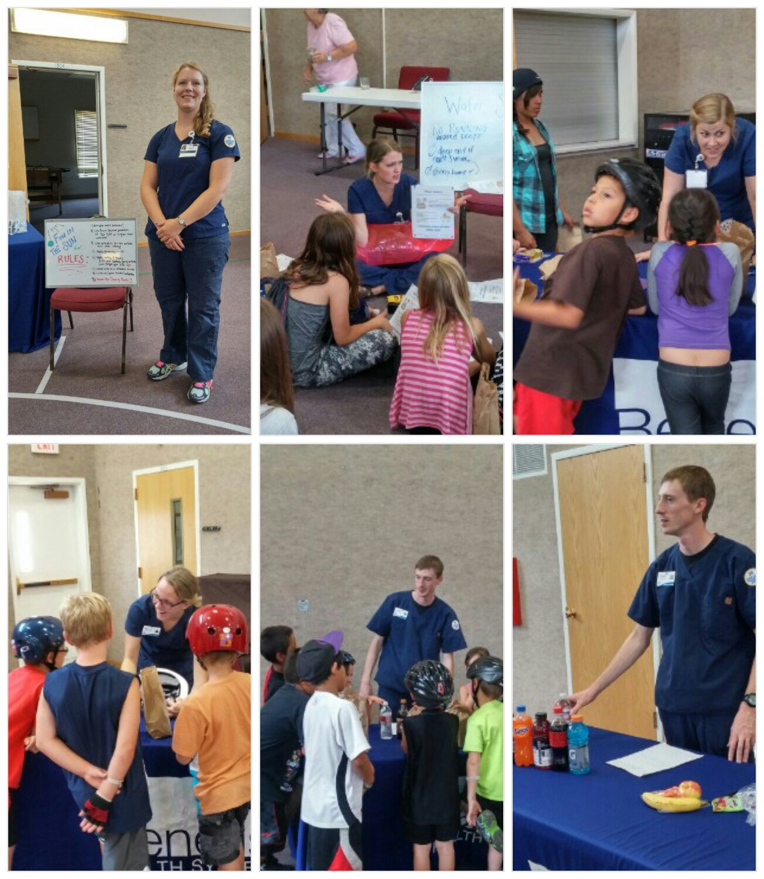

Slide 10
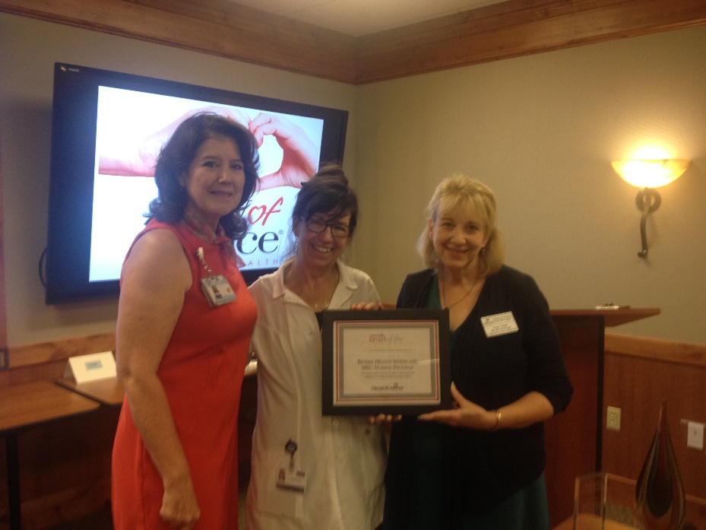
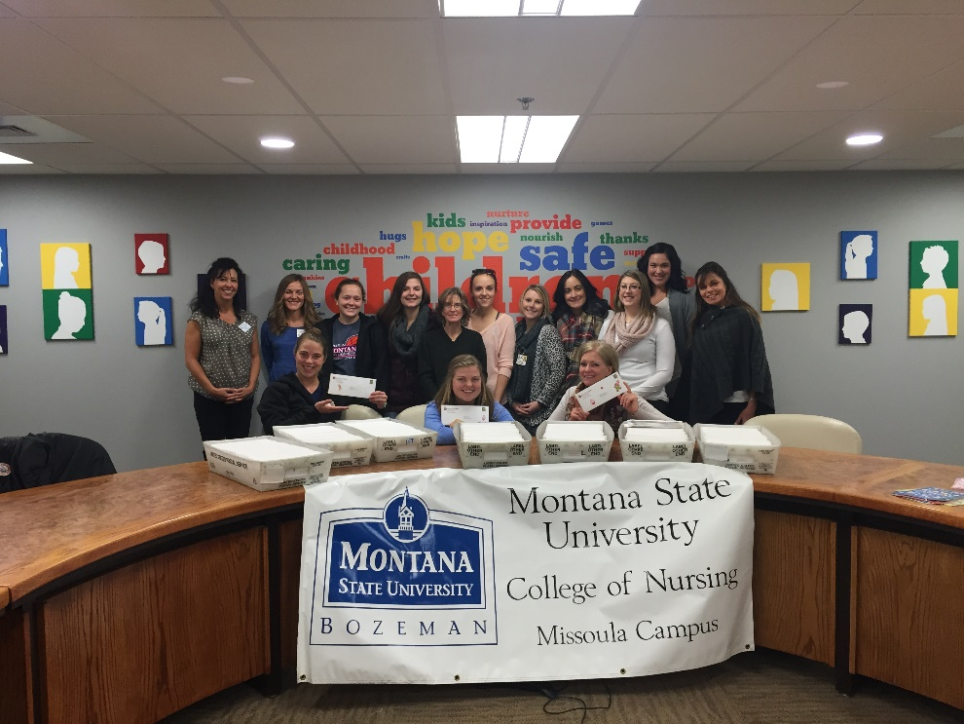
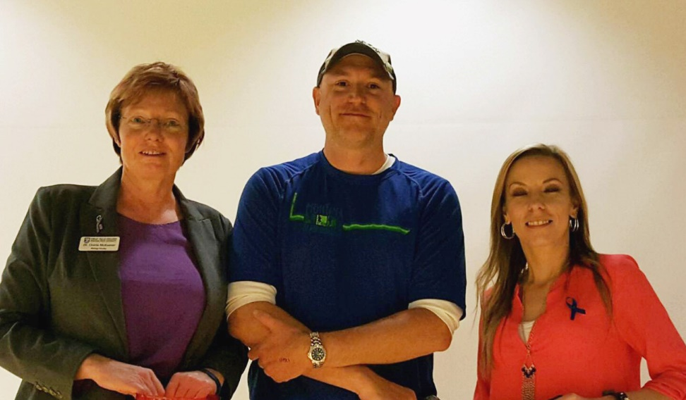

Slide 11
Research and Scholarship
23 Peer Reviewed Journal Articles and Book Chapters
5 Research Seminars – (CON Presenters – S. Luparell, P. Buerhaus, and C. Sieloff)
Faculty Funding (7/1/15-5/3/16)
Buerhaus - Gordon and Betty Moore Foundation; $1,580,497; workforce center
Melland/King – HRSA; $624,685; CO-OP
Shreffler-Grant/Nichols/Weinert; $373,624; CAM health literacy
Buerhaus – HRSA; $21,891; workforce leaders meeting
Hill – Denver Health and Hospital Authority; $2,200
Winters – Sigma Theta Tau; $1,500; community visit to support NIEHS grant ptoposal
Submissions
Winters and team – PCORI; new care model in rural settings
Hill – HRSA; expanded primary care clinical learning experiences for undergraduate students
Winters/Kuntz (Pfau – PI) - NIEHS Superfund Research Program; environmental health
Williams – NIH – RO1; capillary permeability

Slide 12
Technology Support
IT Council
Box, WebEx, Identify Finder etc.
EFAC - $66,000
Manikin maintenance
Hospital bed for simulation manikin – Missoula
OmniCell Medication Cabinet
CFAC - $86,176
Cisco Server for telepresence
Telepresence system, TV, and desktop for simulation labs – each campus
20 computers for student labs in Missoula and Kalispell
HIEM annual network charge

Slide 13
Faculty and Staff
Three new TT faculty (Tracy Hellem, Sandra Benavides-Vaello, Peter Buerhaus)
Janet Smith - Pure Gold winner.
Charlie Winters – President of WIN
Peter Buerhaus- Excellence in Writing Award in Nursing Outlook
Peter Buerhaus – Honorary Fellow in the American Academy of Nurse Practitioners
Teresa Seright – Outstanding Nurse of Year Award – MT CAHN
Kay LaFrance – MSU Service Excellence Award
CON Outstanding Teacher; Outstanding Researcher; Outstanding Staff – to be announced at dinner tonight!
Robert Barksdale – Leadership MSU

Slide 14
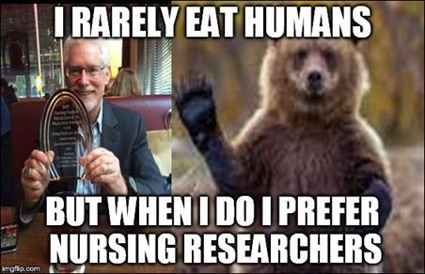

Slide 15
Faculty/Staff Pursuing and EARNING the Doctoral Degree
Currently Enrolled
Shelly Banta – MSU CON
Casey Cole – University of Arizona
Kathy Damberger – MSU CON
Janice Hausauer- MSU CON
Paul Krogue –University of Arizona
Julie Ruff – Montana State University
Sally Rappold – University of Montana
Jane Scharff – University of Missouri – Columbia
Graduations
Martha Peters, PhD
Susan Raph, DNP
Stacy Stellflug, PhD

Slide 16
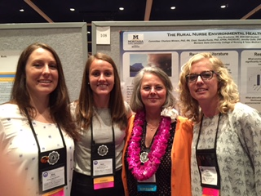
Students
Two students attended the AACN Student Policy Summit in Washington DC (Evan Thompson; Estella Wilmarth)
Four graduate students (Kira Kitchens, Kara Christiansen, Amy Braaksma, Shohannah Seed) presented a poster at WIN and one undergraduate student (Evan Thompson)
Eight of 12 MSNA officers are from MSU; Evan Thompson State President
Awards for Excellence:
Evan Thompson; Mentor: Susan Luparell
Student: Karen Thornberg; Mentor: Carolyn Mack
Student: Katie Hogamark; Mentor: Janet Smith
Karen Thornberg - Torlief Aasheim Community Involvement Award

Slide 17
MSU Comprehensive Campaign Goals and Money Raised - CON

Slide 18
Gifts to the College
Gifts (July 1, 2015 – May 5, 2016)
Student Support = $980.000
$23,000 Undergraduate scholarships
250,000 Accelerated Nursing scholarships
$25,000 Student Support
$24,000 Student Support
$130,000 Scholarship support for DNP students
$500,000 Scholarship support
28,000 Scholarship Support
Endowed Chair Support = $20,000
Undesignated College Support = $2,717,394
$30,000 Undesignated College Support
$118,000 Undesignated College Support
$20,000 Undesignated College Support
$20,000 Undesignated College Support
$50,000 Undesignated Support for the College
$165,000 Undesignated College of Nursing Support
$200,000 Undesignated Support for the College of Nursing
Research Support = $55,000
Campaign Gifts (since 2010)
Programmatic ($5.5 million)
$3,479,868 Grants (Foundations; NOT federal dollars)
$2,124,395 Undesignated Support for the CON
$36,785 Domestic and International Outreach
People ($4.0 million)
Student Support
Endowed Chair

Slide 19
Upcoming Events
Fall meeting – Billings will host! August 18-19
2016 MT CAHN Nursing Education and Practice Summit: Nursing Practice and Education Growing Together to Produce a Culture of Health in Montana - June 6-7; Great Northern Hotel, Helena, http://mtcahn.org
December 16: Winter pinning
December 17: Winter commencement

Slide 20
The Future?
Better ways to connect campuses?
Recruitment of TT faculty?
New strategic plan?
Eastern MT?
Any new APRN options?
Your thoughts?

Slide 21
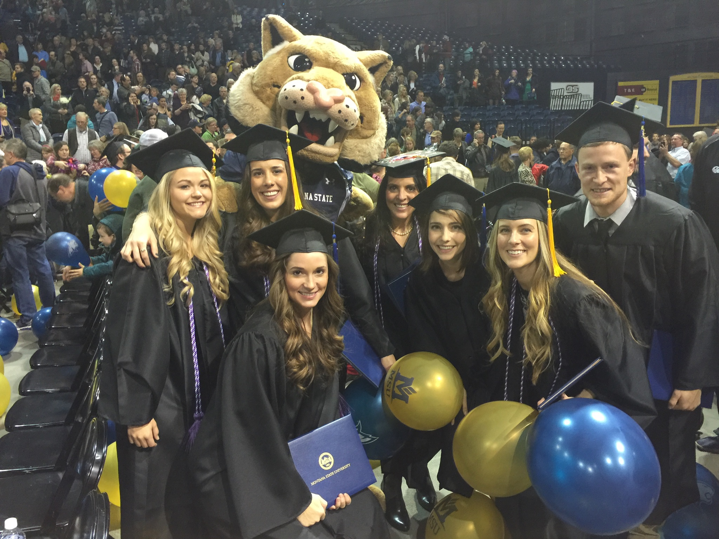
…and this makes it all worthwhile!

Slide 22
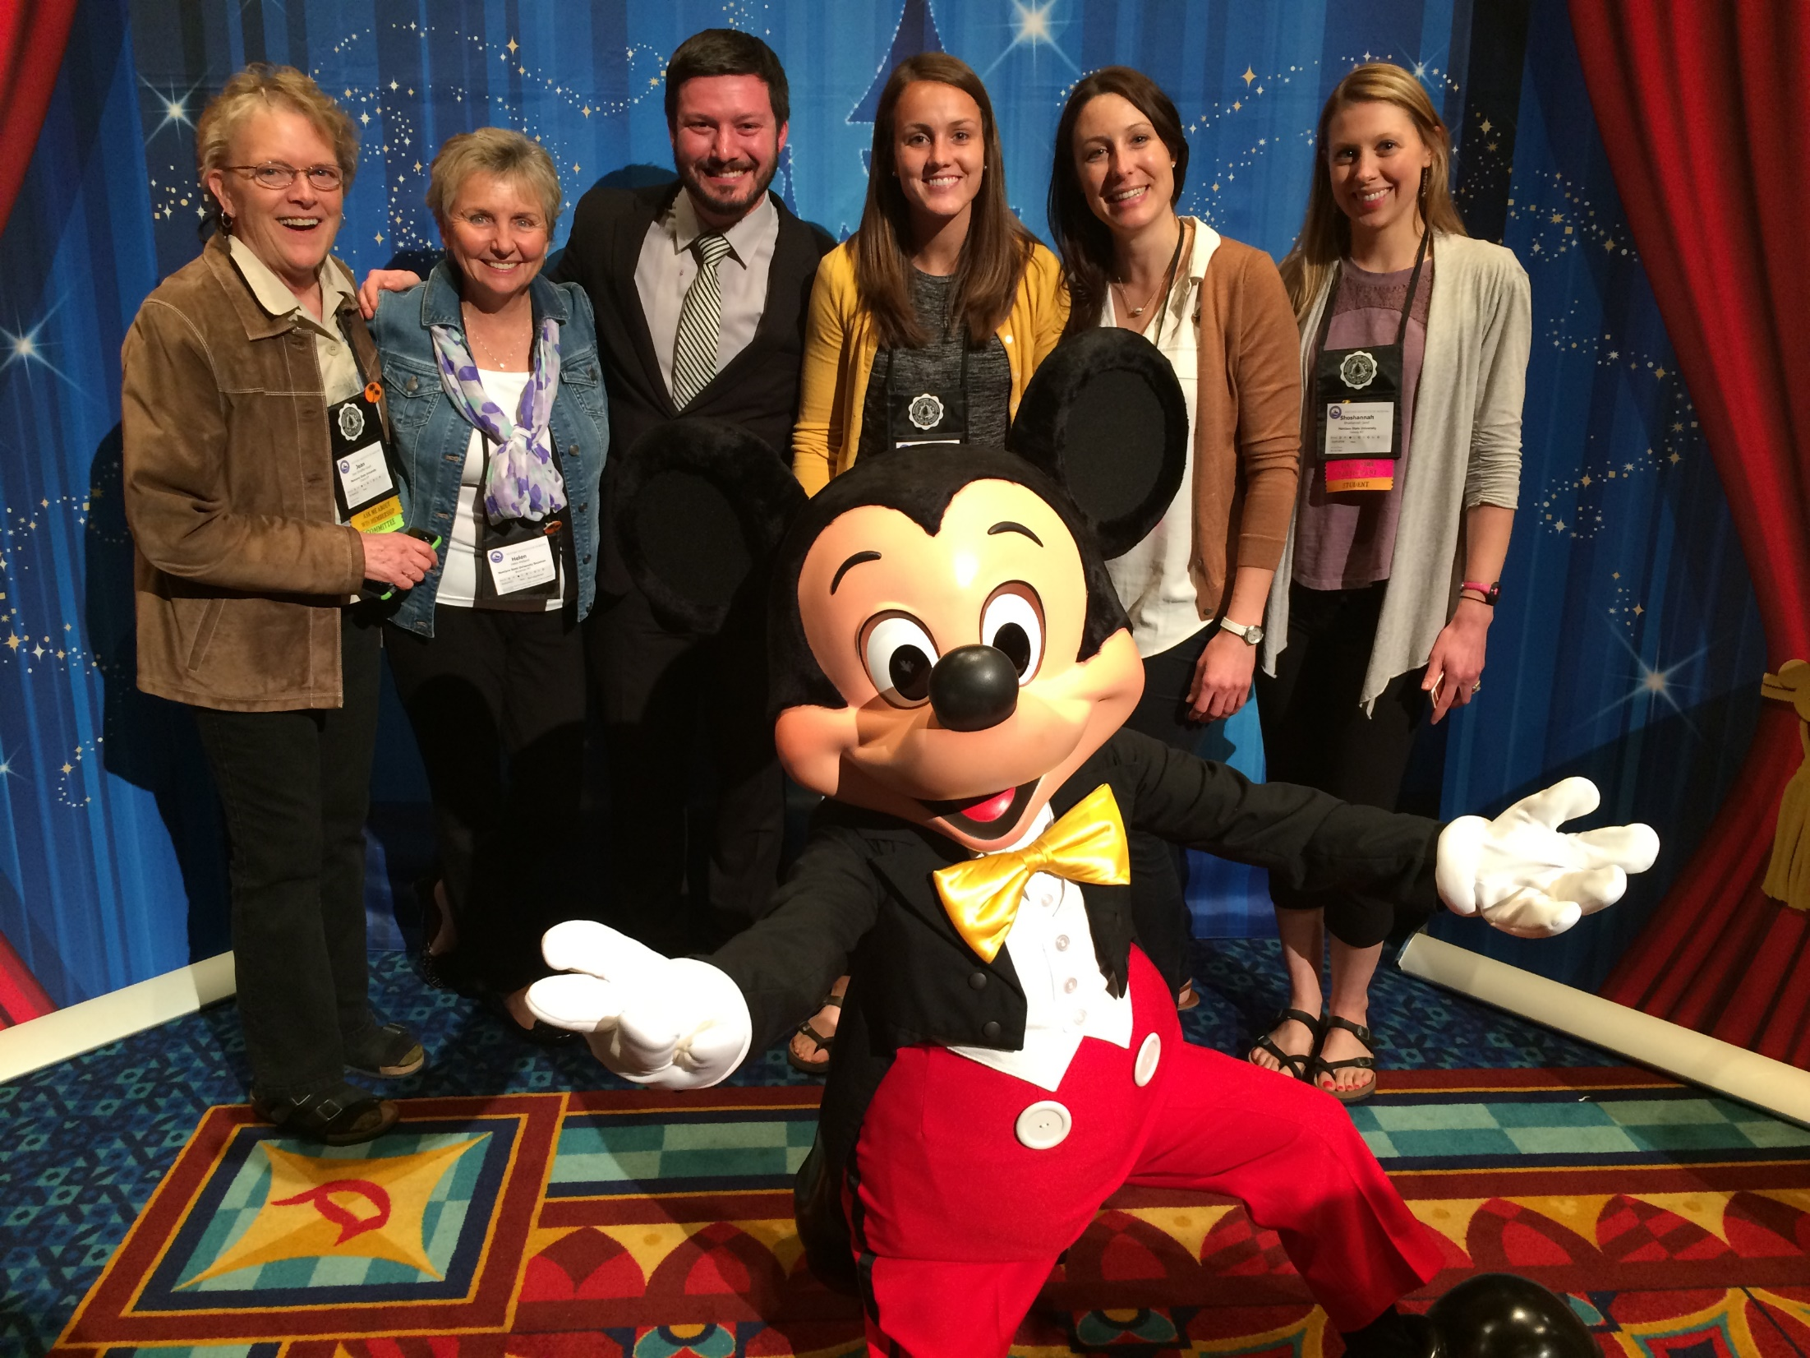
Go CATS!

