Slide 1
Looking Backward and Forward (2009-2017)

Slide 2
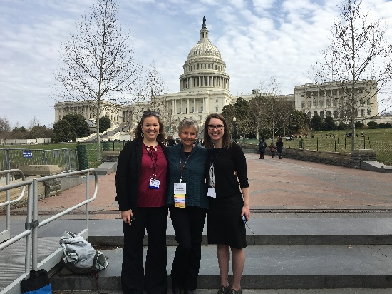
Strategic Plan GOAL1: Teaching/Leadership-Leaders in Nursing Practice
To inspire baccalaureate and graduate students, within a diverse, challenging, and engaging learning environment, to become leaders in the practice of professional nursing

Slide 3
Metric 1.1: Academic programs retain rigor

Slide 4
Upper Division Admission Numbers (192/year → 256/year)

Slide 5
Metric 1.4: Seamless education promoted
Accelerated Bachelor in Science in Nursing (ABSN) program
All students have a degree in a discipline other than nursing
Program is 15 months in length
Same pre-requisites, same curriculum, same # of clinical hours
Started with 16 students on Bozeman campus in 2011
As of May 2017 will be admitting 48 students (Bozeman, Great Falls, Missoula, Kalispell)
Doctor of Nursing Practice Degree (DNP) program
Launched in 2013
Accredited in spring of 2016
8 students graduated in 2016; 19 will graduate in May 2017
100% passed national certification exam on first attempt
Associate Degree RN → MN program
2 semester undergraduate baccalaureate courses
5 semester CNL master’s curriculum
5 students have now progressed into master’s curriculum

Slide 6
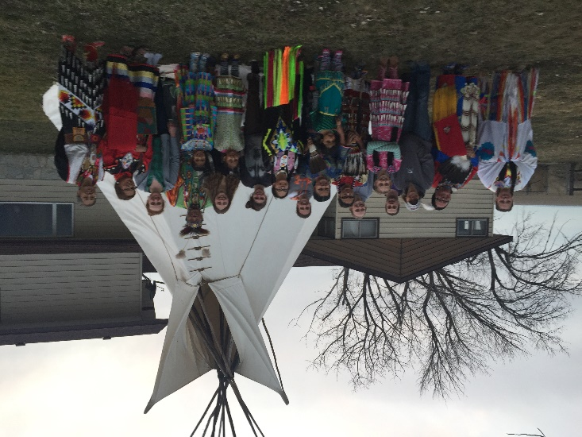
Metric 1.5: Recruit, retain, and value diversity
CO-OP program
New federal funding:
HRSA: $974,777 (2011-2015)
HRSA: $624,686 (2015-2017)
IHS: $764,924 (2013-2016)
IHS: $977,685 (2016-2019)
Total new federal funding: $3,342,027
6.1% of CON students are American Indian
One of 8 graduates in first DNP class was Native; recipient of Outstanding DNP Student Award was Native and is working in MT
Supportive of MSU’s Diversity Initiative
Mini-Diversity Summit, December 2016
Presentation: “Affirming Care for Transgender Youth and Adults” April 2017
Holistic admissions initiative

Slide 7
Percent of American Indian Students Enrolled at MSU by College - Fall 2016 (MSU Planning and Analysis)

Slide 8
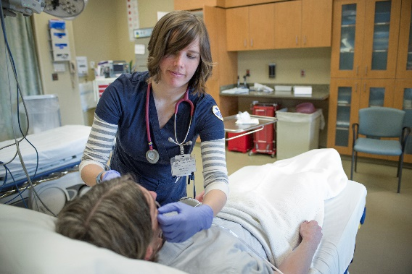
Strategic Plan GOAL2: Teaching/Interactive Learning Environment
To create an interactive environment in which faculty and students discover, learn, and integrate knowledge into nursing practice

Slide 9
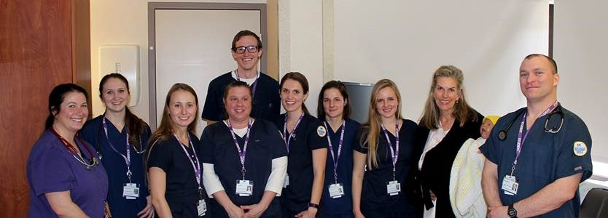
Metric 2.2: New and innovative partnerships
Interprofessional Education
U of MT – Pharmacy, PT, Social Work, SLP, Nursing
WWAMI and Nursing - simulations
MSU College of Engineering
Pediatricians in Great Falls
Ft. Peck Indian Reservation undergraduate experience
Deeper relationships with clinical partners (e.g. Bozeman Health, Benefis, St. Patrick’s Providence, St. Vincent’s, Billings Clinic, Kalispell Regional Health)

Slide 10
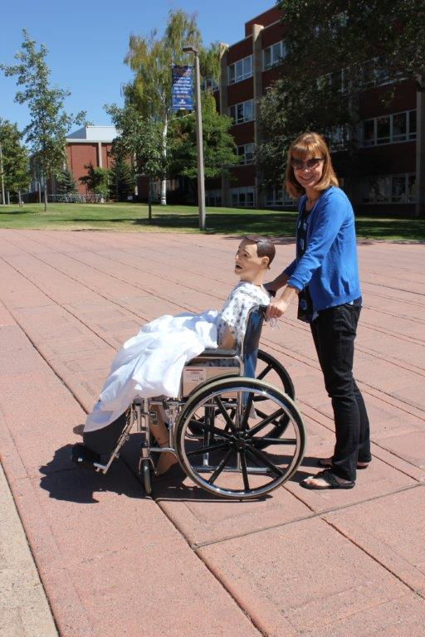
Metric 2.3: State of the art technology and informatics to optimize outcomes
Annual updates to telepresence system, TVs, and desktops on each campus
HIEM network between Kalispell and Missoula
EFAC ($150,000 – FY18); Birthing manikin, SimPad, Medical dispensing cart
CFAC ($52,000 – FY 18); Videoconference equipment
Box, WebEx, etc.
Simulation emphasis – faculty development, ad hoc simulation group
IT Council

Slide 11
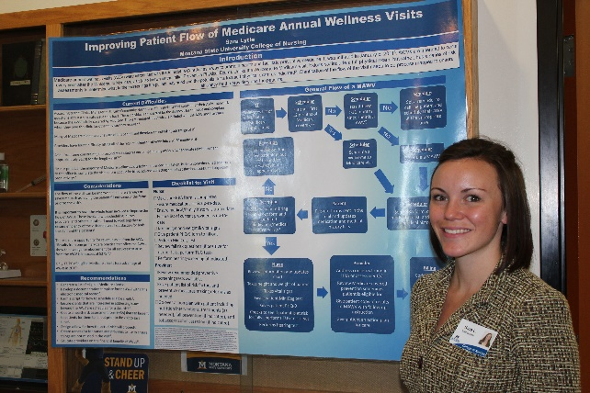
Strategic Plan GOAL #3: Discovery of Knowledge-Research and Scholarly Activities
To serve as leaders in nursing by generating, translating, and disseminating knowledge through research and scholarly activities

Slide 12
Metric 3.1: Enhance, value and support research and scholarship
Research Topics of Current Tenure Track Faculty (from Continuum, Issue #3)
Dr. Sandra Benavides –Vaello: Sociocultural aspects of chronic disease in the Latino population (funded)
Dr. Peter Buerhaus: Economics of the nursing and medical workforce (funded)
Dr. Yoshi Colclough: Generational and cultural differences in end-of-life care (funded)
Dr. Tracy Hellem: Novel approaches to manage mood symptoms in those with and without substance use disorders (funded)
Dr. Wade Hill: Determinants of human environmental exposures (funded – training grant)
Dr. Elizabeth Kinion: Oral health and health disparities in rural and American Indian communities (funded)
Dr. Sandy Kuntz: Environmental health and health disparities
Dr. Laura Larsson: Risk communication research with vulnerable groups (funded)
Dr. Susan Luparell: Incivility in nursing and nursing education
Dr. Polly Petersen: Characteristics of APRN practice
Dr. Alice Running: Use of complementary/integrative therapies
Dr. Jean Shreffler-Grant: Health literacy about complementary care among rural residents (funded)
Dr. Christina Sieloff: The impact of empowerment on care outcomes
Dr. Donna Williams: Microcirculation and control of water permeability by intact, living capillaries (funded – traineeship)
Dr. Charlie Winters: Rural health issues especially related to asbestos-related disease
Many Non-Tenure Track faculty doing evidence based practice scholarly projects

Slide 13
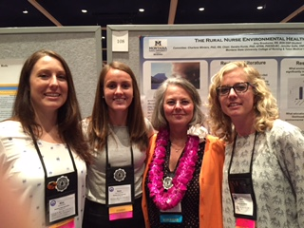
Metric 3.2: Increase the number and dollar of research grants submitted Research and Sponsored Programs Funding

Slide 14
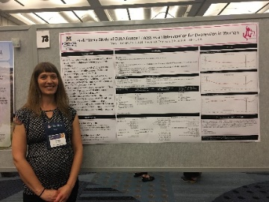
Metric 3.3 Tripled refereed publication productivity

Slide 15
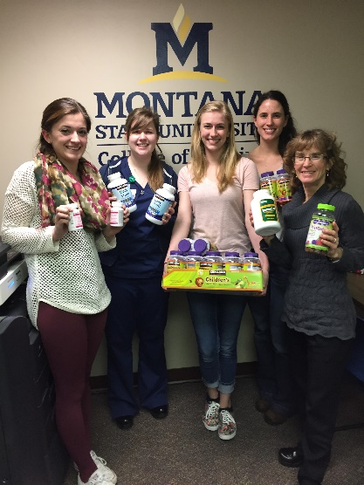
Strategic Plan GOAL4: Outreach -Promotion of Health and Wellness
To promote health and wellness through professional practice, collaboration, consultation, civic engagement, education, and leadership

Slide 16
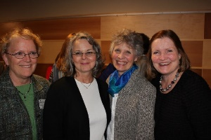
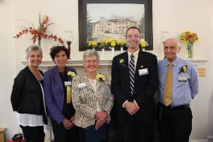
Awards established: Recognition of faculty, staff, alumni, and clinical partners
Internal College Awards
MSU Homecoming Awards
Internal College awards ($1000)
Outstanding Researcher
Elizabeth Kinion – 2015
Christina Sieloff – 2016
???- 2017
Outstanding Staff
Jennifer McCall – 2015
Michelle Baker – 2016
???- 2017
Outstanding Teacher
Steve Glow – 2015
Teresa Wicks – 2016
???- 2017
Community Partner Award
Julie Hickethier, Benefis – 2014
Pat Wilson, KRMC – 2015
Mari Dominguez , BridgerCare – 2016 (spring)
BJ Gilmore, St. Vincent’s Healthcare – 2016 (winter)
Kenny Smoker, Ft. Peck, 2017
2013:
Jeanine Brandt, Distinguished Alumni
Charlie Winters, Distinguished Faculty
Susan Myers-Clack, Distinguished Staff
Wendy Minster, Distinguished Staff
2014:
Kay Chafey, Distinguished Faculty
Joyce Dombrouski, Distinguished Alumni
John Maccagnano, Distinguished Staff
Matt Rognlie, Honorary Alumni
2015: No awards; Campaign kickoff
2016:
Keven Comer, Outstanding Alumni
Marcia Ward, Outstanding Alumni
Nora Gerity, Honorary Alumni
Kris Juliar, Honorary Alumni

Slide 17
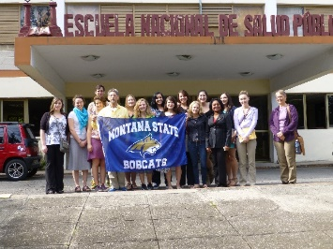
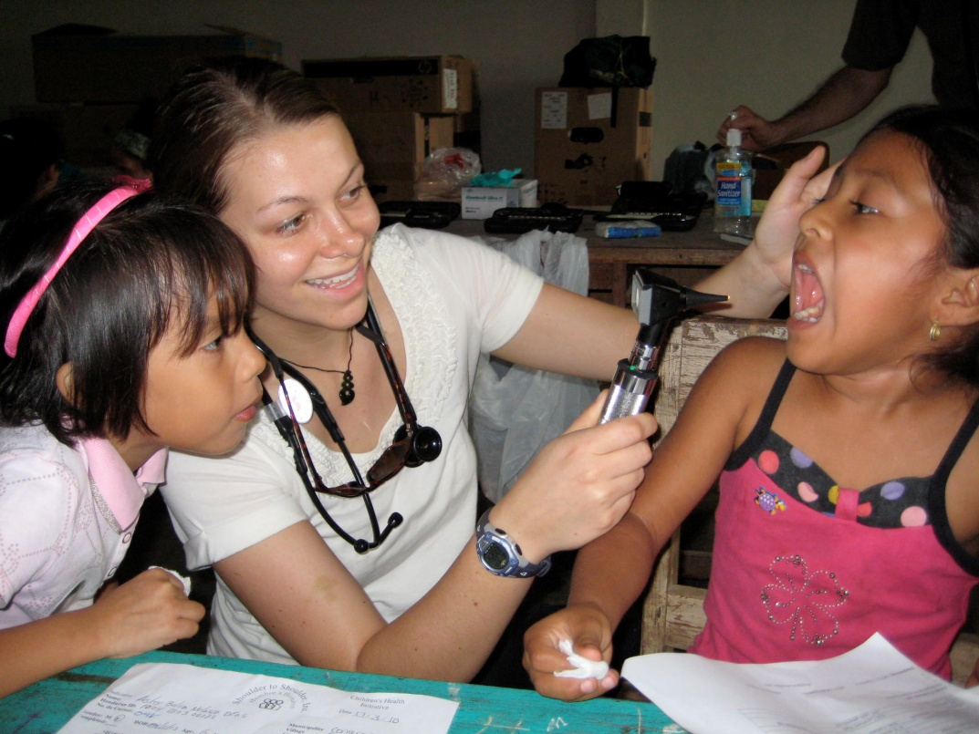
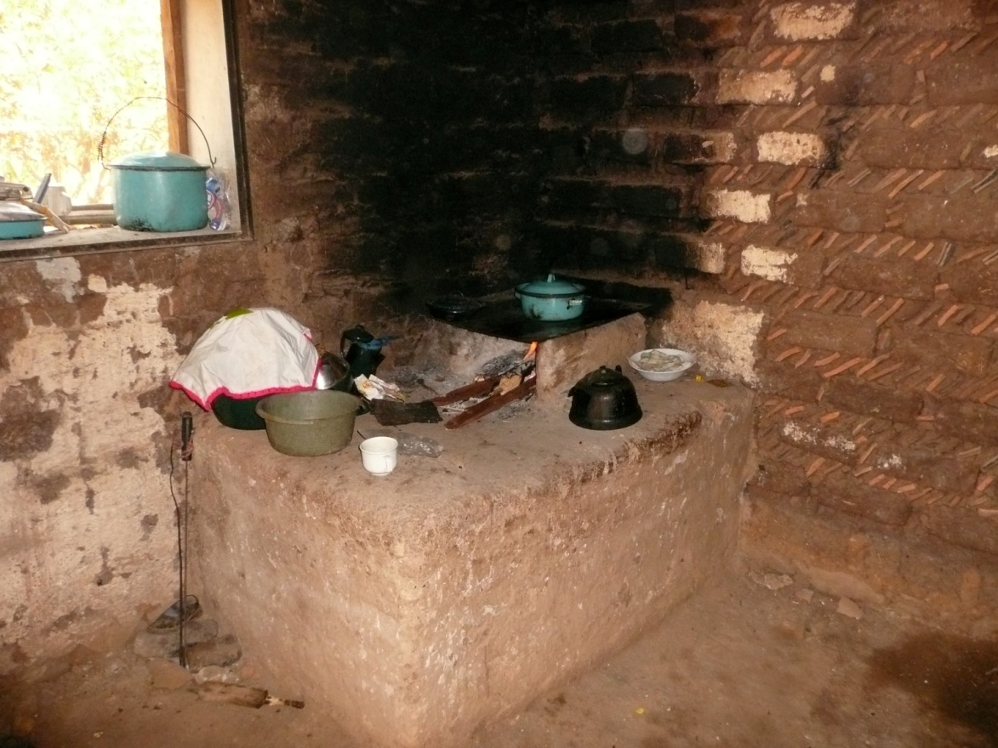
Metric 4.1: Foster and support service learning (domestic and international)
Domestic: too many to list – a sampling….
Child abuse prevention
Community assessments and interventions
Disaster preparedness
Dental screening and sealants applications
Ft. Peck reservation experience
Head Start
Heart Expo
Helmet safety
Peace Place
Rescue Mission
Lunch for those with mental illness
Cuba Experience – (2015, 2016, 2018) – “Gain
an understanding and appreciation of the Cuban
culture, environment, and healthcare system”
Central America Service Learning – (every year) –
“Work with local efforts in collaboration with Timmy Global
Health to work with local health outreach efforts to provide
primary care services”

Slide 18
Ecuador Trip – March 2017

Slide 19
MSU Comprehensive Campaign CON Goals and Money Raised (161% or Goal)

Slide 20
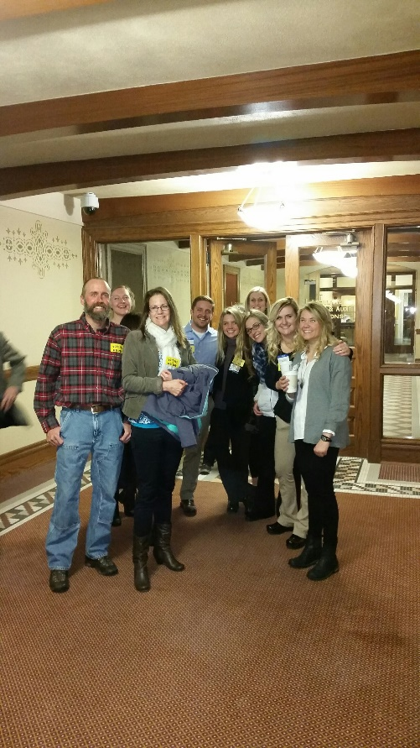
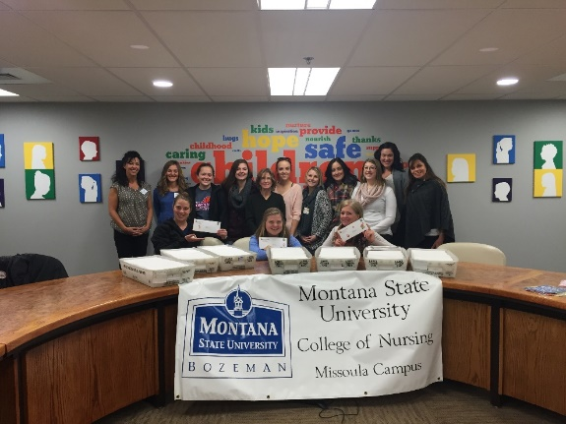
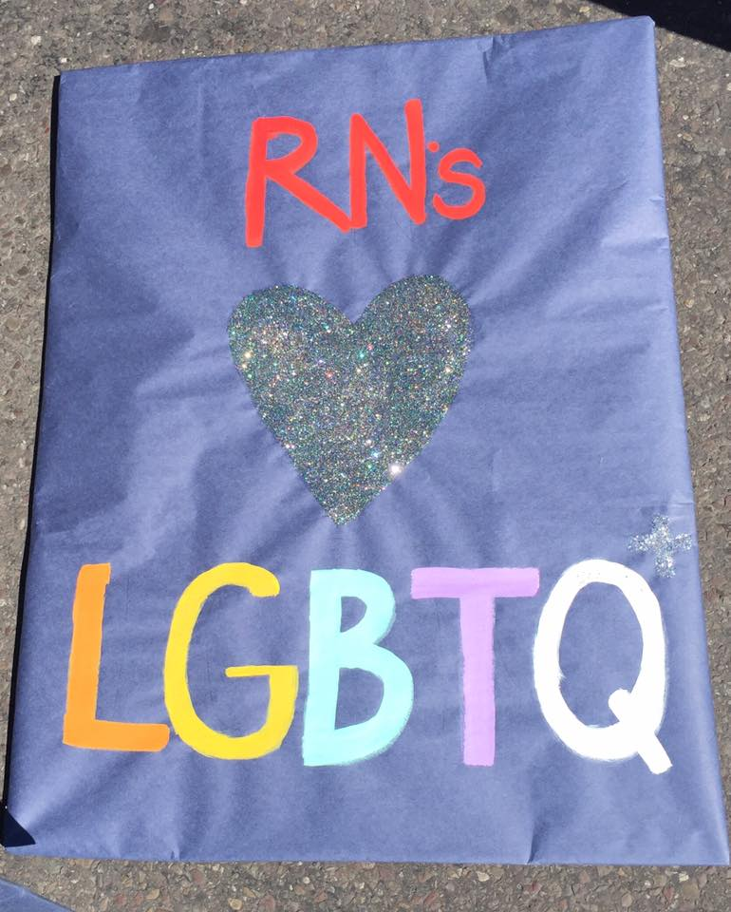
Photo Memories…..

Slide 21
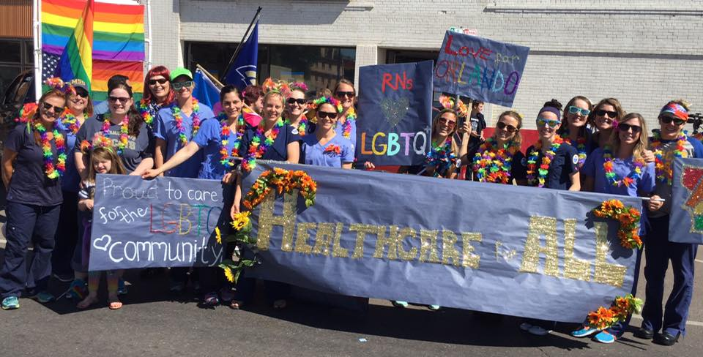
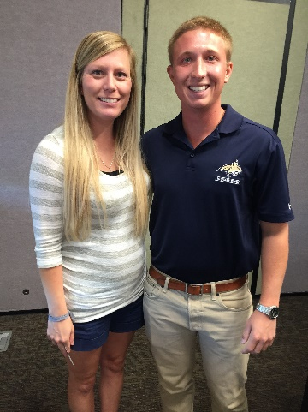
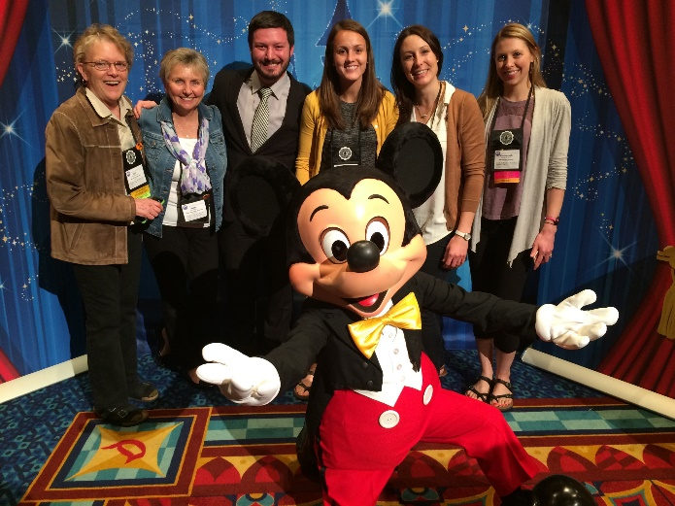
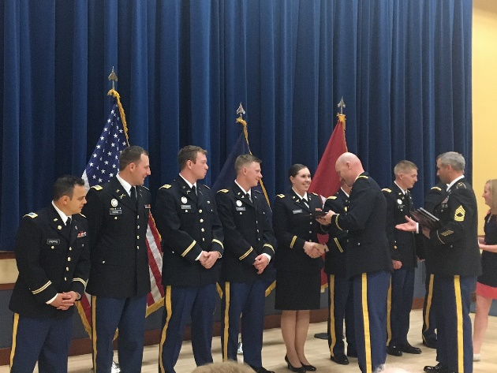
Just a few more….

Slide 22
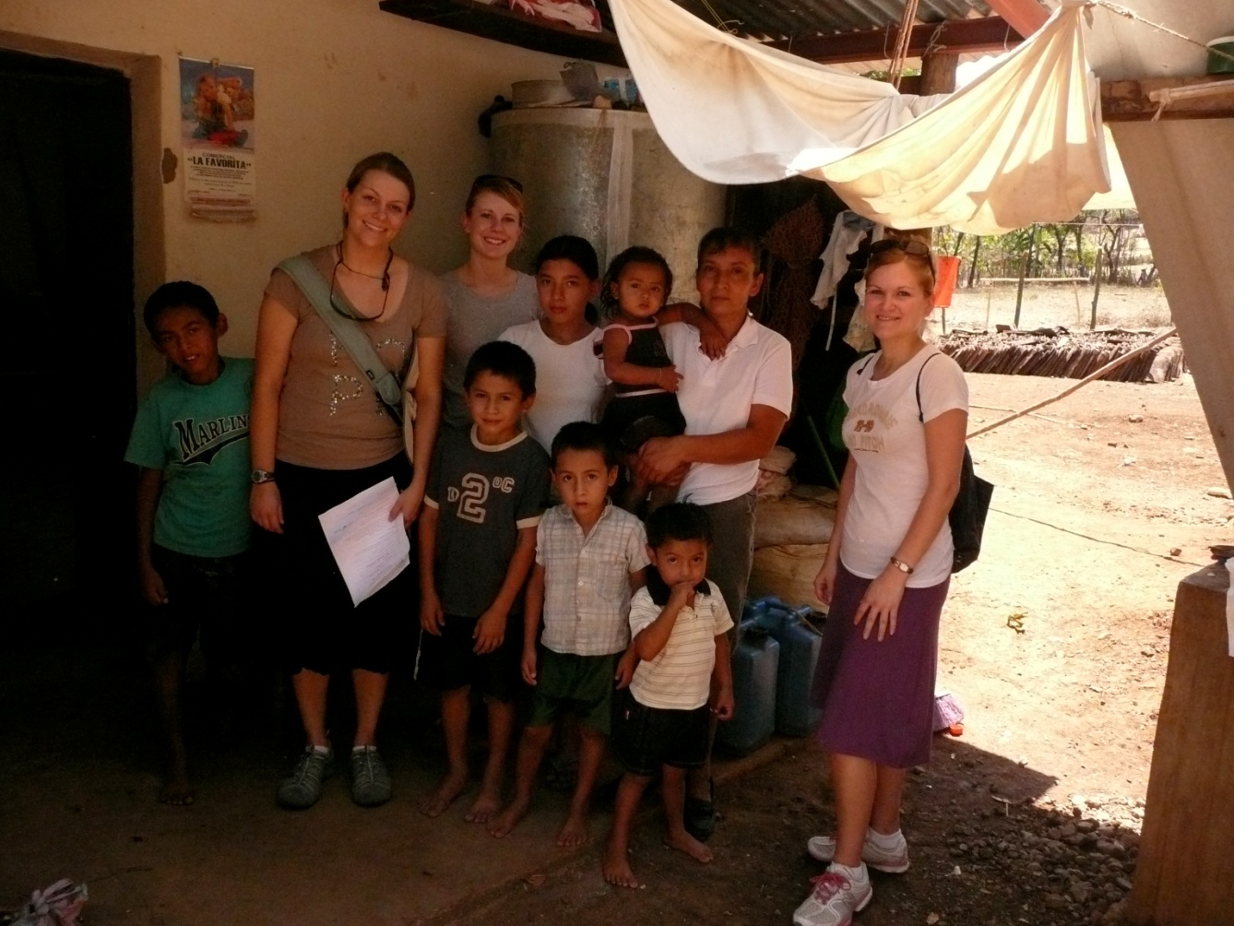
Yet to come in the CON?
New Strategic Plan
ADRN growth
Acute care NP
Eastern campus
Increase percent of TT faculty
More funded faculty research

Slide 23
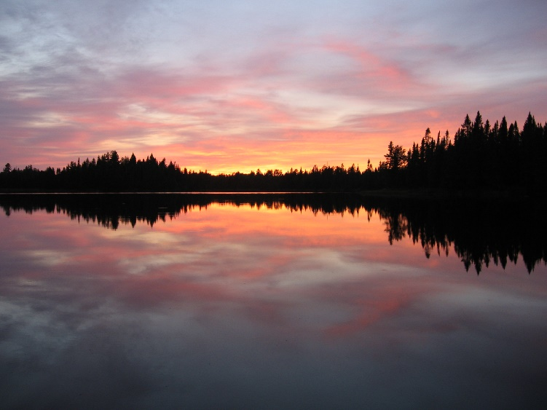
And here’s what ahead for me!
Grandma!

