Slide 1
Simulating Spatial Hearing Cues
With
Digital Signal Processing
Robert C. Maher, Ph.D.
Digital Audio Signal Processing Lab

Slide 2
Outline
What does “spatial hearing” mean?
Some basics of acoustics
Characteristics of human hearing
Simulating natural acoustical environments with digital processing
Some examples

Slide 3
Spatial Hearing
The brain interprets the sound waves arriving at each ear in order to deduce the direction and distance of a sound source.
The brain can also estimate the size, shape, orientation, and relative motion of the source, as well as the size and composition of the surrounding space.

Slide 4
Spatial Hearing
Sound Source

Slide 5
Basics of Acoustics
Sound propagates through air as a longitudinal wave
Speed of sound:
  343 m/s @ 20°C (331 m/s @ 0°C)
  About 1125 ft/s (5 seconds per mile)
  About 1 ft/ms (light travels about 1 ft/ns)
Audible wavelengths: 1.7cm to 17m

Slide 6
Human Hearing Characteristics
Frequency sensitivity roughly 20 Hz – 20kHz
  3 decades, or 10 octaves
  Compares to less than one octave for human visual system (wavelengths: 3800 – 7600 angstroms)
Amplitude sensitivity roughly 20μPa – 20Pa
  Atmospheric pressure: 10⁵ Pa
  Minimum audible sound corresponds to motion a fraction of diameter of hydrogen atom!
Difference judgments good,
absolute judgments poor

Slide 7
Basics of Spatial Hearing
Two ears: stereo measurements
  Interaural time difference (ITD)
    Effective below about 1.5kHz
  Interaural intensity difference (IID)
    Effective above about 1.5kHz
Learned experience with pinnae, head diffraction, reflections and reverberation

Slide 8
Spherical Frame of Reference
-
+
Θ
Φ
+
-
Azimuth (top view)
Elevation (side view)

Slide 9
Interaural Differences
Sound Source
ITD = (d/c)*(Θ+ sin(Θ))
IID due to “head shadow”
A(ω)
S(ω)
Θ
Contralateral = ear on opposite side as source
Ipsilateral = ear on same side as source
L_{E}(ω)
R_{E}(ω)
d

Slide 10
Transfer Function
Linear Time-Invariant (LTI) systems can be fully described by an impulse response
Fourier Transform of the impulse response is the transfer function
Acoustical path from a sound source to the listener’s ear is LTI, so we can describe the acoustical system with a transfer function

Slide 11
Diffraction and Pinna Effects: Head-Related Transfer Function
HRTF measured by placing a probe microphone into ear canal to record the impulse response from source to eardrum
HRTF varies with azimuth and elevation: must take a lot of measurements

Slide 12
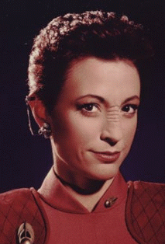
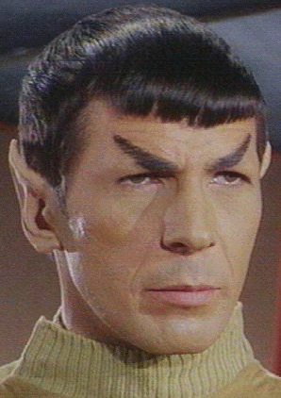
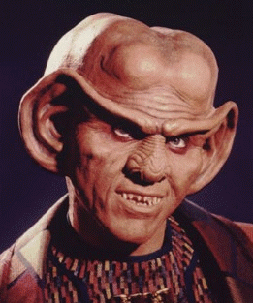
Anatomical details are important:
HRTFs differ from one individual to another…

Slide 13
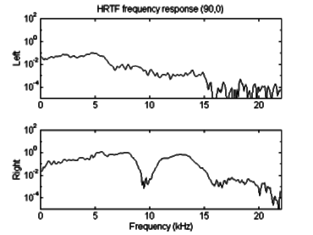
HRTF Characteristics

Slide 14
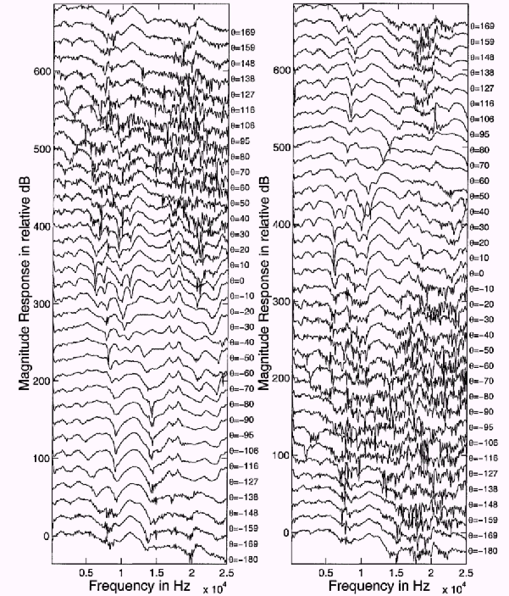

Slide 15
Reflections and Reverberation
Direct sound arrival is followed by reflections from room surfaces
Overlapping reflections are heard as reverberation
Direct-to-Reverberant ratio gives cues to size of room, type of room surfaces, and distance from source

Slide 16
Simulation of Acoustic Environment with DSP
Start with monophonic sound source
Calculate geometry and HRTFs
Process source signal with acoustic transfer functions
Compensate for playback system (headphones or loudspeakers)

Slide 17
Cross Talk Cancellation
How to get left signal only to left ear and right signal only to right ear when using speakers?
L(ω)
R(ω)
Audio Inputs
Cross Talk Compensation
Network
L_{P}
L_{P}(ω)
R_{P}(ω)
Speakers
R_{P}
A(ω)
A(ω)
S(ω)
S(ω)
L_{E}(ω)
R_{E}(ω)

Slide 18
Second-Order Effects
Simulate Doppler frequency shift for moving sources
Take into account the directional characteristics of the source
Calculate reflections and reverberation

Slide 19

Audio Examples
Example 1
  Spatial drums
  Circling sounds
Example 2
  Soundtrack for action computer game
Example 3
  Spatialized enhancement (single-ended process)

Slide 20
Significant Applications
“Auralization” of acoustical environments
Entertainment
  music production, computer games, movie soundtracks
“Immersive” simulation and training systems
  military, aerospace, and law enforcement
Improved detectability and intelligibility of audible warning and communication signals

