Slide 1
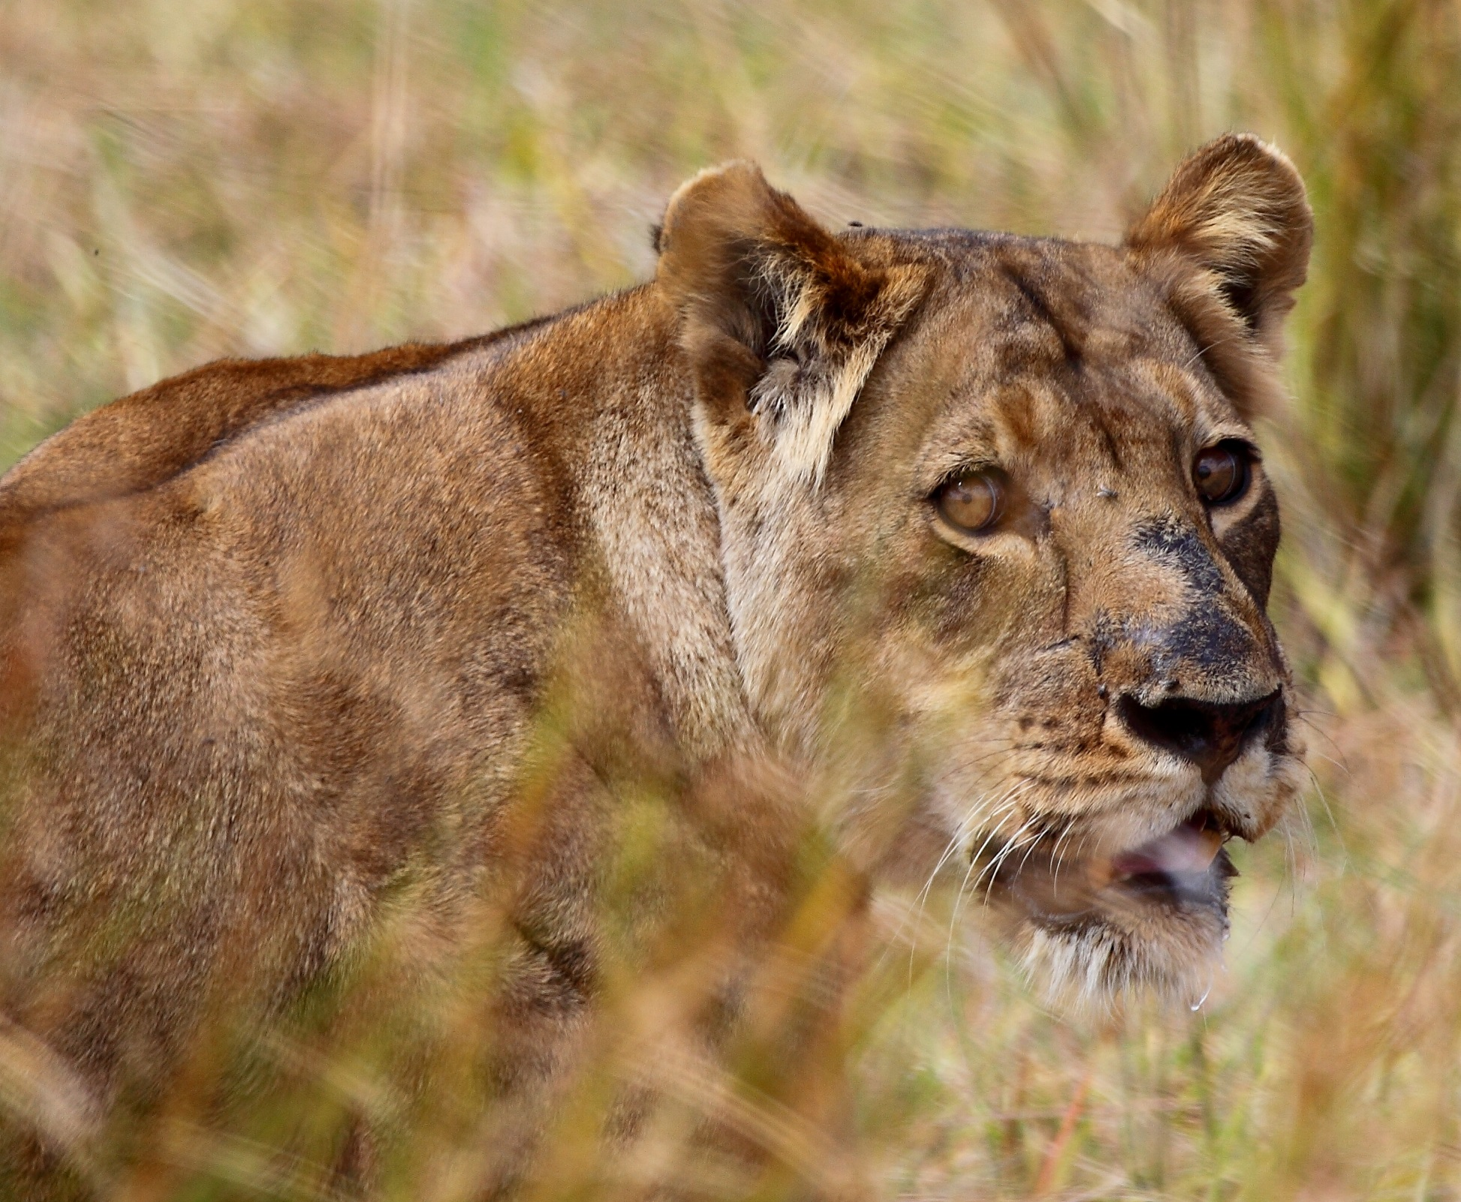
Predation risk effects and population dynamics

Slide 2
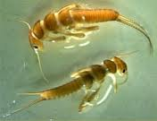
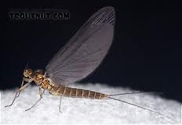
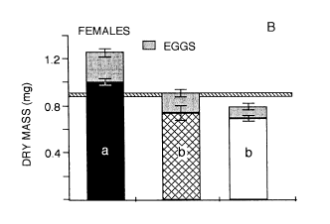
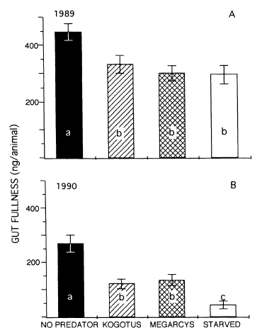

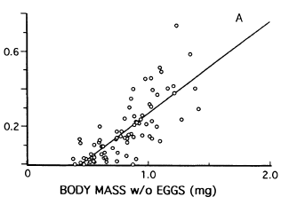

Peckarsky et al. (1993) Ecology 74, 1836 - 1843

Slide 3
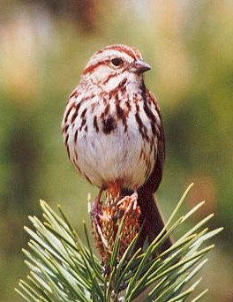
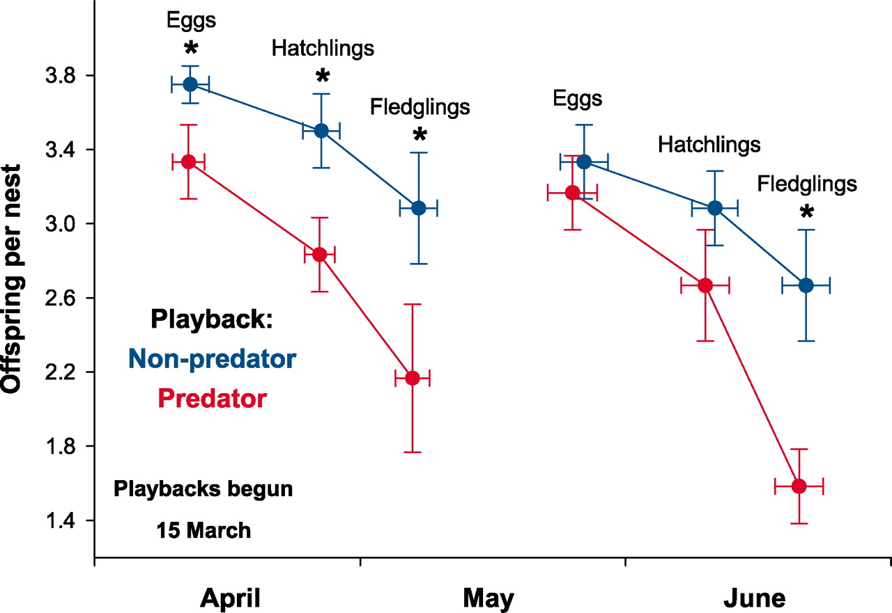
Zanette et al. (2011) Science 334, 1398.

Slide 4
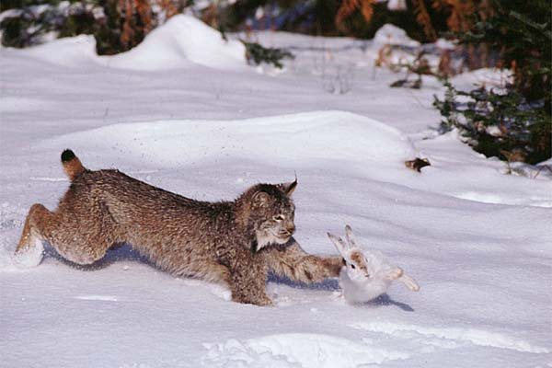
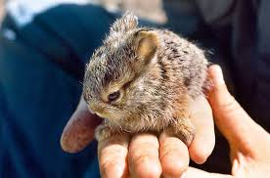
In lynx hare cycles, much of the decline
phase for hares is driven by lower
reproduction, not just higher
adult mortality.

Slide 5
Predation Pressure
Direct Predation
Behavioral
Response
Energetic
Consequences
Physiological
Consequences
Survival
Population
Dynamics
Reproduction
Creel & Christianson (2008) Trends Ecol Evol 23: 194-201

Slide 6
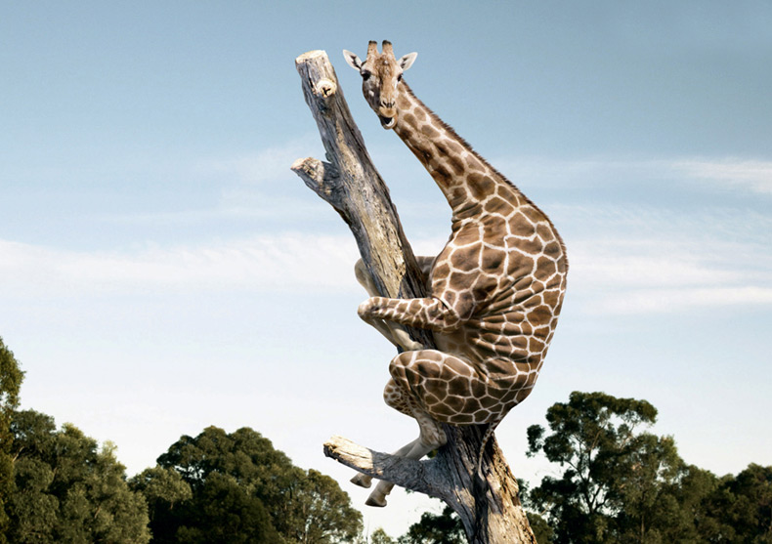

Slide 7
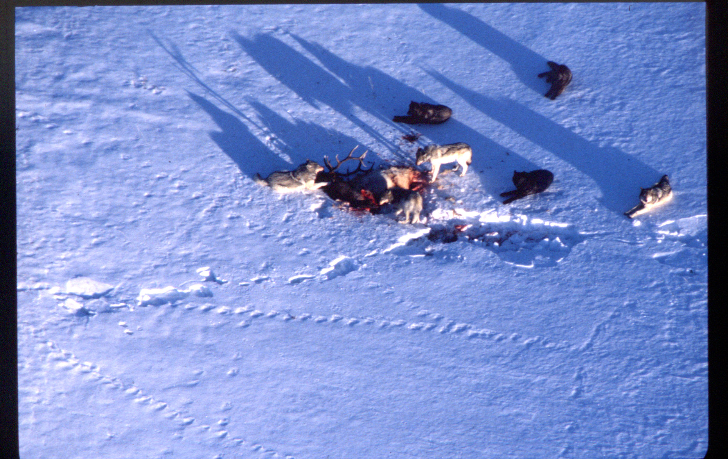

Slide 8
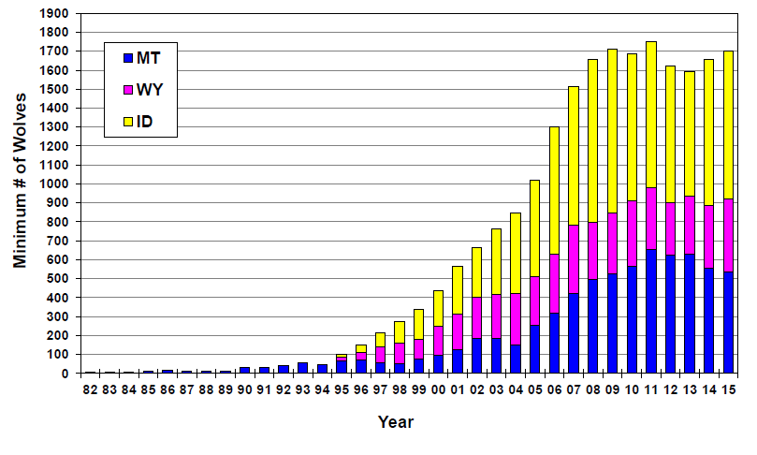
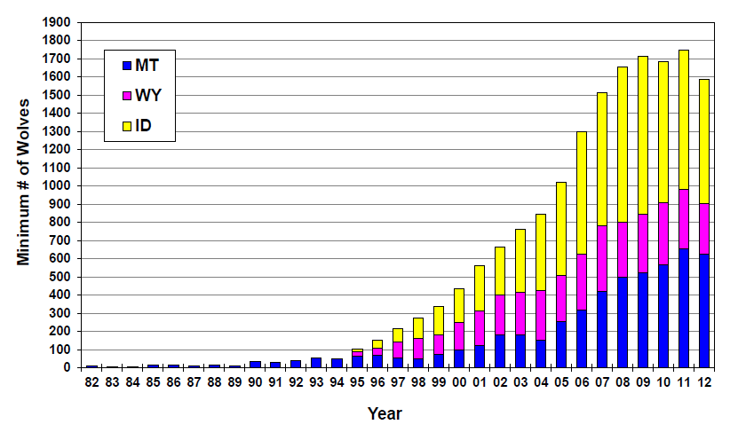
USFWS 2016

Slide 9
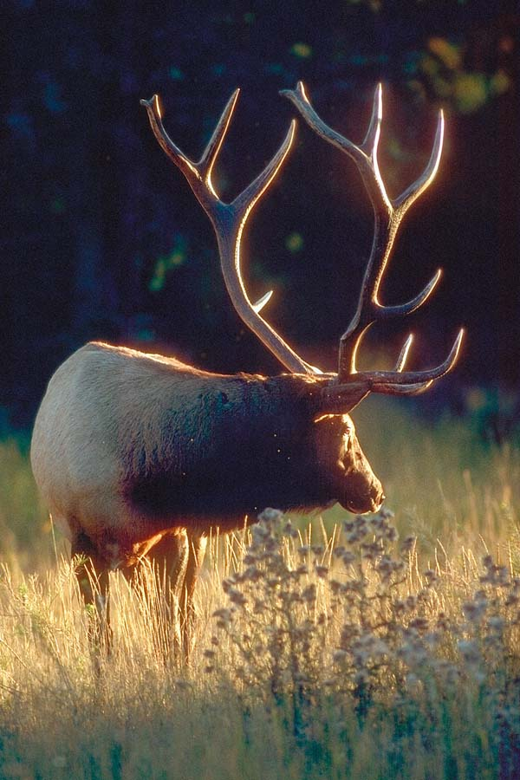
EIA Predator-prey models

Slide 10
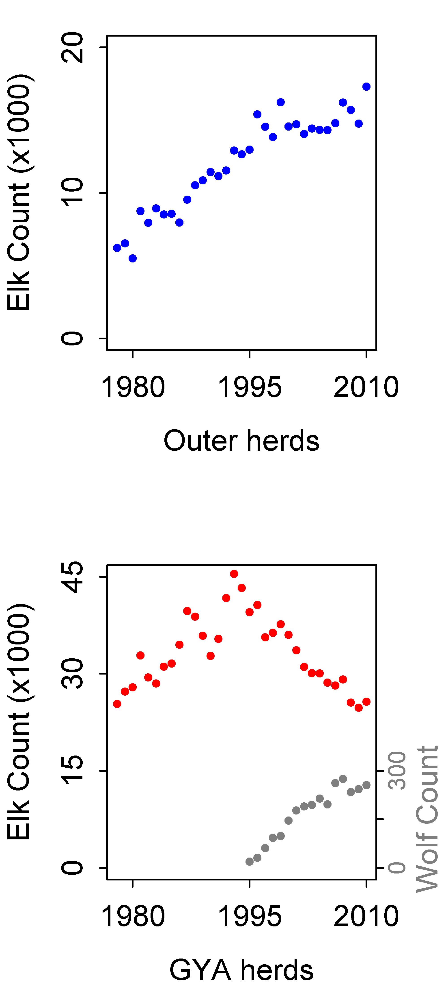
7
8
M O N T A N A
2
1
5
12
3
4
11
I D A H O
6
W Y O M I N G
9
10
Outer elk herds
GYA elk herds
12 herd units where elk were annually counted and classified in midwinter (calves/100 cows) by agencies and/or published studies from 1978 to 2010.
6 herds recolonized by wolves (with pre-post data), 6 herds continuously uncolonized by resident packs as of 2010

Slide 11
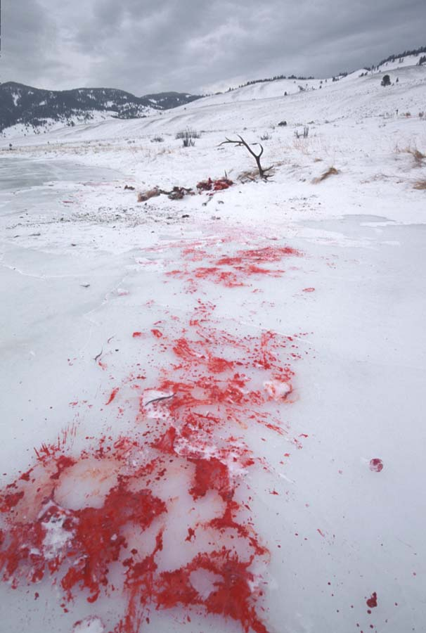
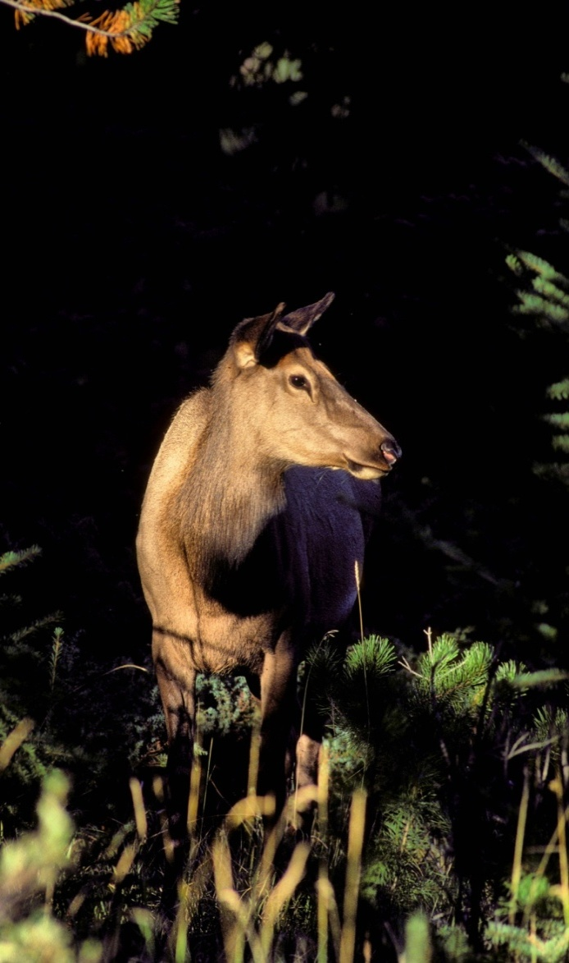
What are the relative magnitudes of direct and risk effects?

Slide 12
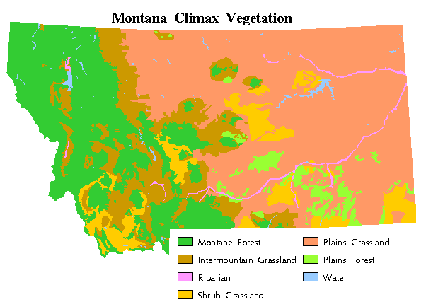
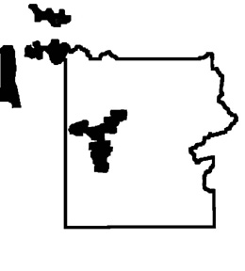
Gallatin
Canyon
Site
YNP

Slide 13
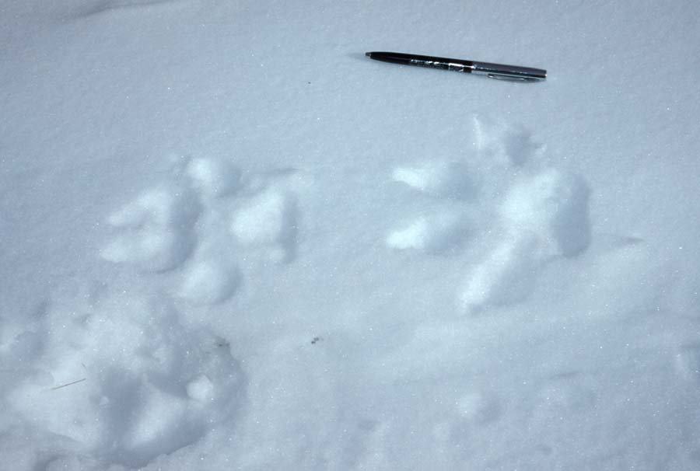
Determine wolf presence/absence
within a drainage on a given day
sightings
radio-telemetry
fresh tracks or kills

Slide 14
GPS collars: Elk moved into woodland when wolves were present
Creel et al. 2005 Ecology 86:3387-3397

Slide 15
And disaggregated into smaller herds.
Wolves absent
Wolves present
Creel & Winnie 2007 Anim. Behav. 69:1181-1189

Slide 16
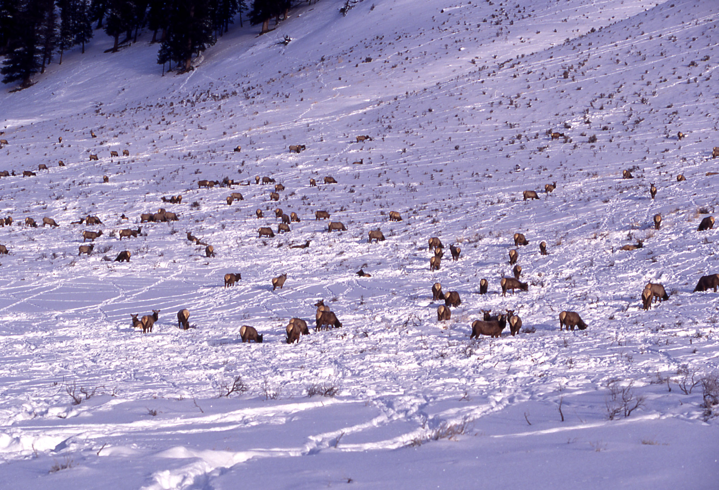
1. These responses reduce the rate of encounter with wolves … but consequently less time, in smaller groups, within preferred foraging habitat
2. There is context – dependent variation among populations in these responses

Slide 17
Female (but not male) elk increase vigilance when wolves are present ….
Adult Females
Winnie & Creel 2007 Anim. Behav. 71: 215 - 225

Slide 18
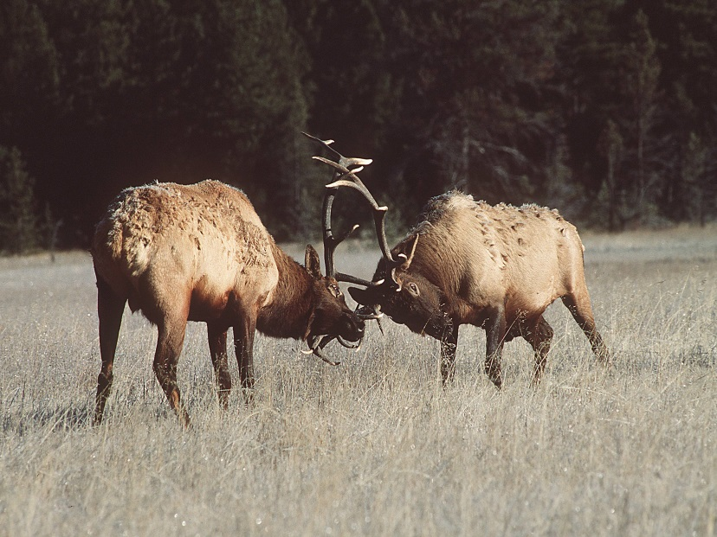
Physical condition varies by sex

Slide 19
…with consequences for foraging...
Adult Females
Winnie & Creel 2007 Anim. Behav. 71: 215 - 225

Slide 20
…and nutrition...
Christianson & Creel 2008 Behav Ecol 19: 1258 – 1266
Christianson & Creel 2010 Ecology 91:1184-1191

Slide 21
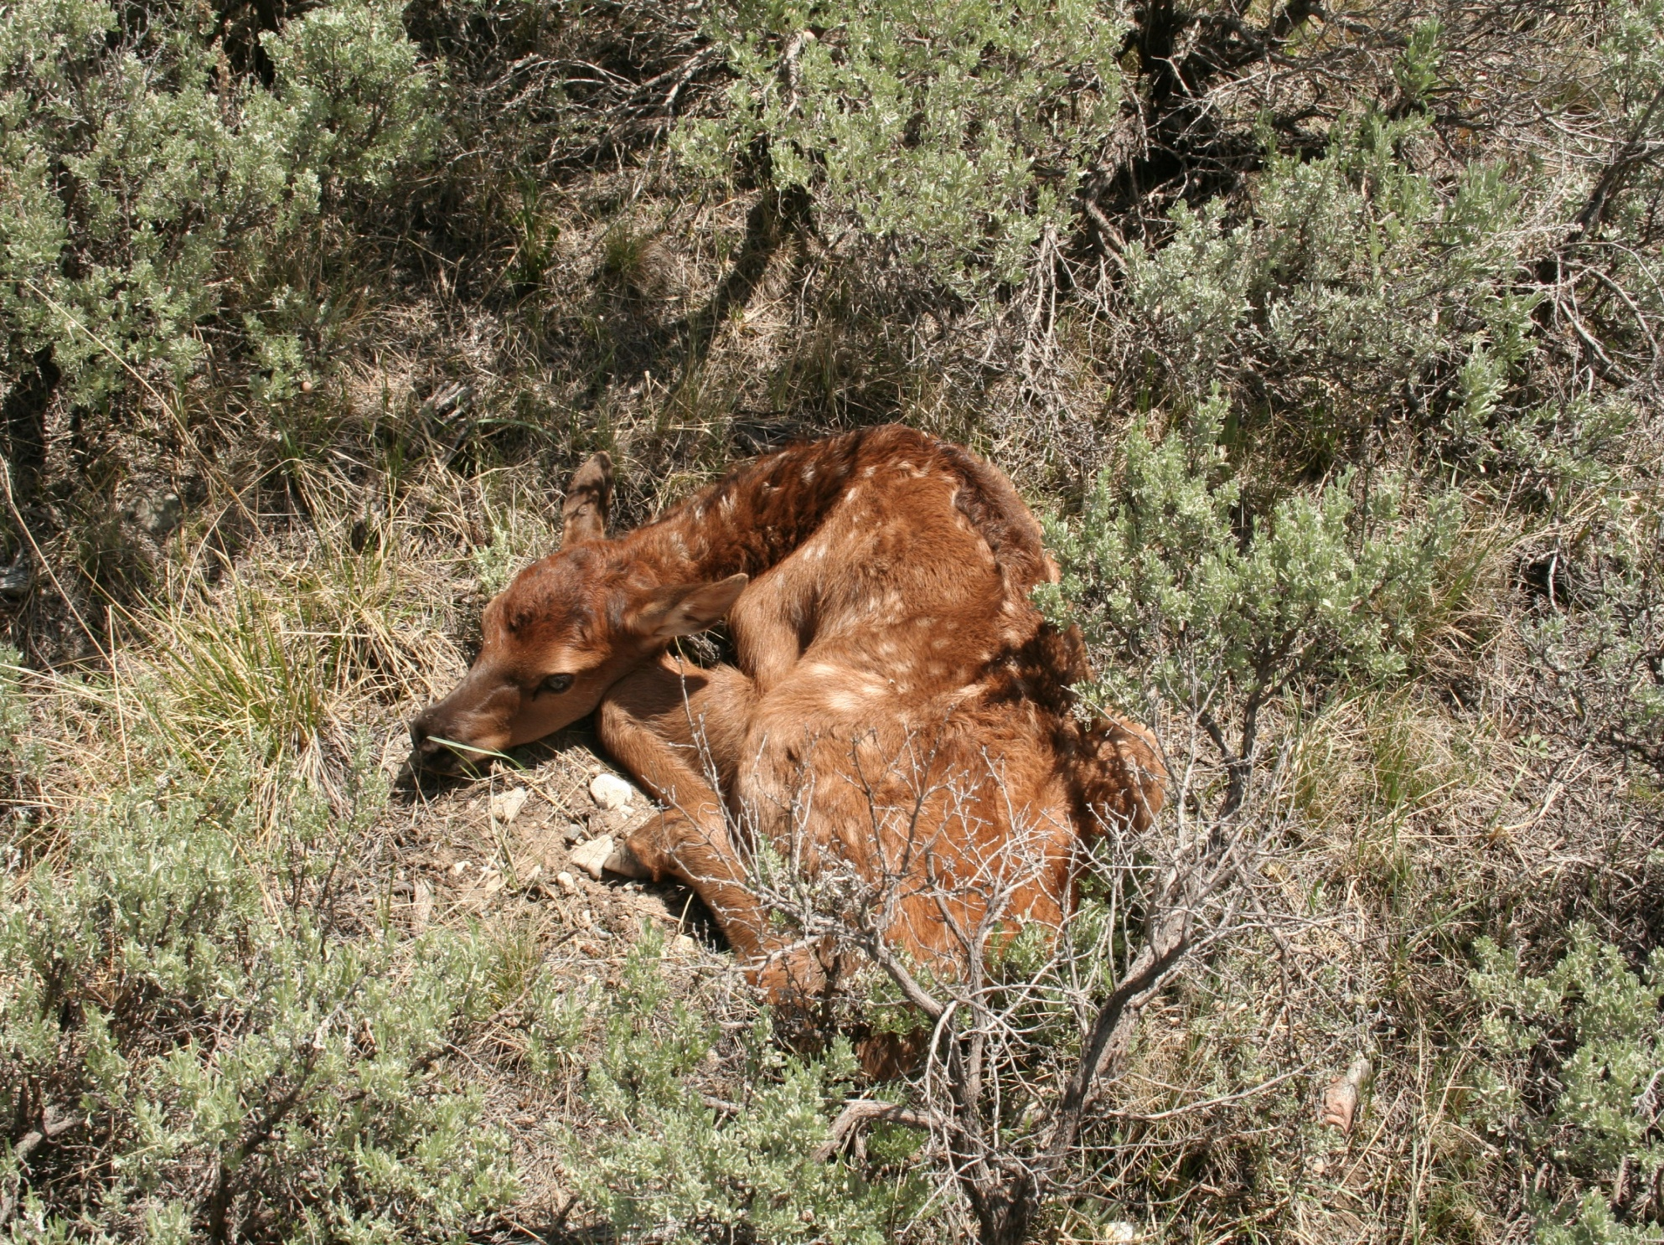

Slide 22
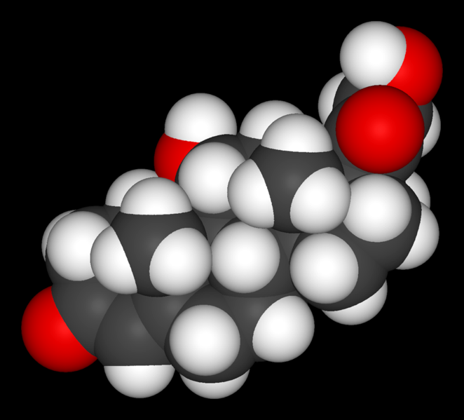
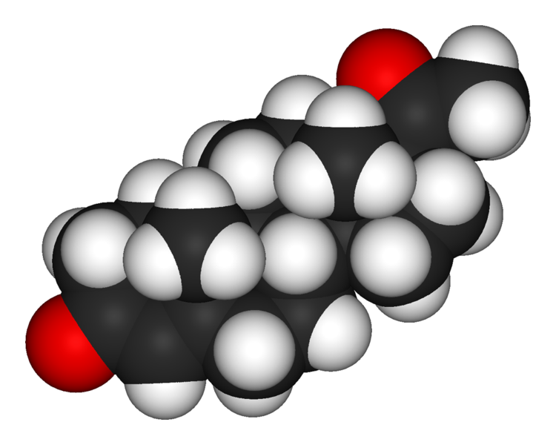
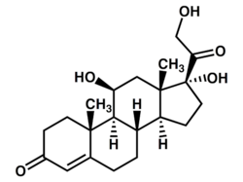
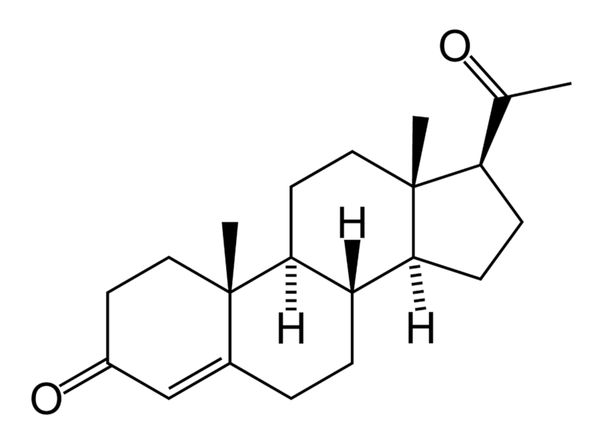
Cortisol
Progesterone

Slide 23
Fecal progesterone decreases with increasing predation risk…
1495 fecal samples
Samples at 2 week intervals
after 15 March
Symbol types denote annual
population means
Tests controlled for herd composition
High Risk
Low Risk

Slide 24
… and progesterone concentration predicts calf recruitment.
Calves/100 Cows
In following season

Slide 25
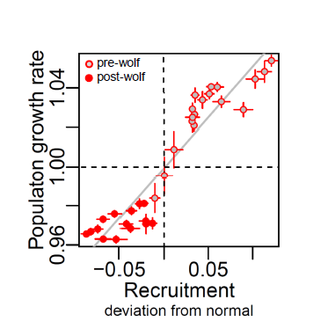
Calf recruitment is a strong driver of population dynamics in elk (as in most ungulates)

Slide 26
Calves per 100 cows
GYA Herds
Outer Herds

Slide 27
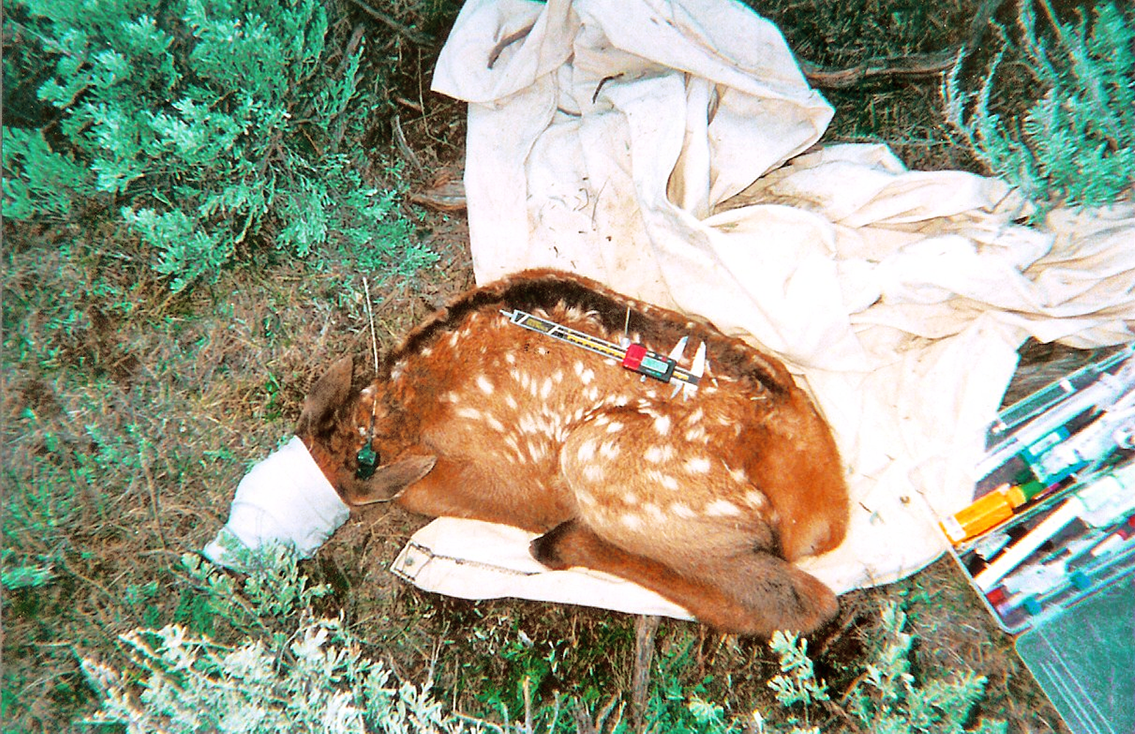
Griffin et al. (2011) review of 1,999 radio-collared calves in 12 populations found that “wolf predation was low and most likely a compensatory source of mortality”.
Creel & Christianson 2008 Trends in Ecology & Evolution 23: 194-201

Slide 28

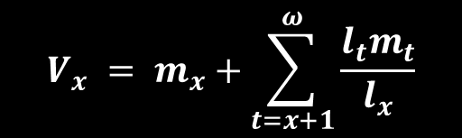
$$V_{x} = m_{x}+\sum_{t=x+1}^{ω}{\frac{l_{t}m_{t}}{l_{x}}}$$
Elk are a highly K-selected species:
1 single offspring per bout
2 long lived
3 highly iteroparous
R.A. Fisher (1930)

Slide 29
7
8
M O N T A N A
2
1
3
5
12
4
11
I D A H O
6
W Y O M I N G
9
10
Outer elk herds
GYA elk herds
Additive direct mortality is too small to yield this pattern. For 2,746 radio-collared elk in 45 populations, Brodie et al. (2013) found that “wolves and all carnivore species combined had additive effects on elk mortality, but only reduced survival by <2%”.
Widespread reductions in pregnancy rate have been >10X larger than observed effects on mortality, spatiotemporally aligned with wolf recolonization and changes in elk dynamics.
Other plausible limiting factors have not shown the spatiotemporal patterns of change that would produce these changes in elk dynamics.

Slide 30
GYE Elk Calf Recruitment
… and recent changes in recruitment
Elk Density
Winter Severity
Growing Season Rainfall
Human Harvest
Predation
Risk
Wolves
Offtake
Bears

Slide 31
Can HARVEST patterns explain the observed differences in calf recruitment?
Uncolonized Herds
Wolf-colonized Herds

Slide 32
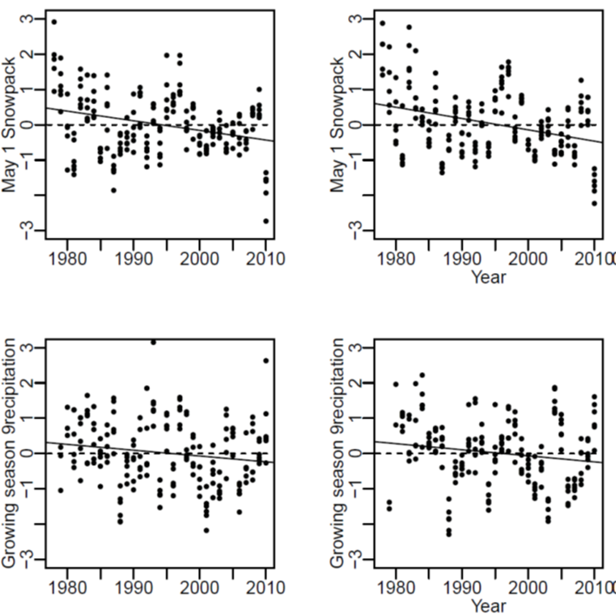
Can changes in CLIMATE explain the observed differences in calf recruitment?
UNCOLONIZED HERDS WOLF COLONIZED HERDS
WINTER SNOW ACCUMULATION
GROWING SEASON
PRECIPITATION

Slide 33
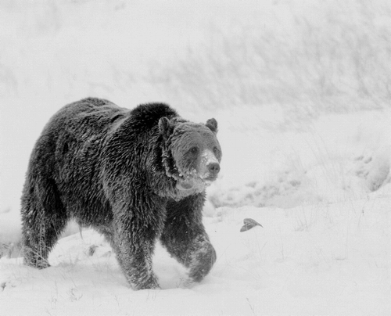
Do changes in GRIZZLY BEAR NUMBERS explain observed changes in calf recruitment?
Schwartz et al. 2006, Wildlife Monographs 161: 1-68

Slide 34
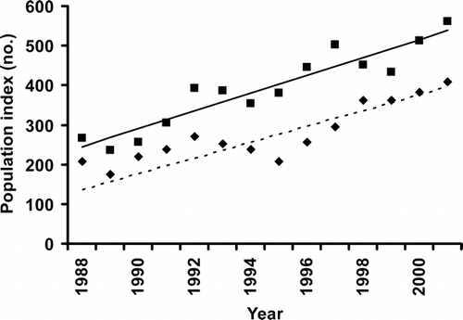
Changes in Grizzly Bear Numbers
Adjusted Estimate
Count
Schwartz et al. 2006, Wildlife Monographs 161: 1-68

Slide 35
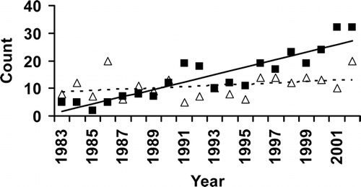
Changes in Grizzly Bear Numbers
Outside YNP
Within YNP
“Figure 5. Counts of unique female grizzly bears with cubs-of-year from 1983 to 2002 inside Yellowstone National Park (YNP) (open triangles) and outside YNP (solid squares). The slope of the fitted line inside YNP (dashed line) was not different from zero, whereas the slope for counts outside YNP (solid line) was significantly different from zero (P ≤ 0.001). “
Schwartz et al. 2006, Wildlife Monographs 161: 1-68

Slide 36
What are the relative magnitudes of direct and risk effects?

Slide 38
