Slide 1
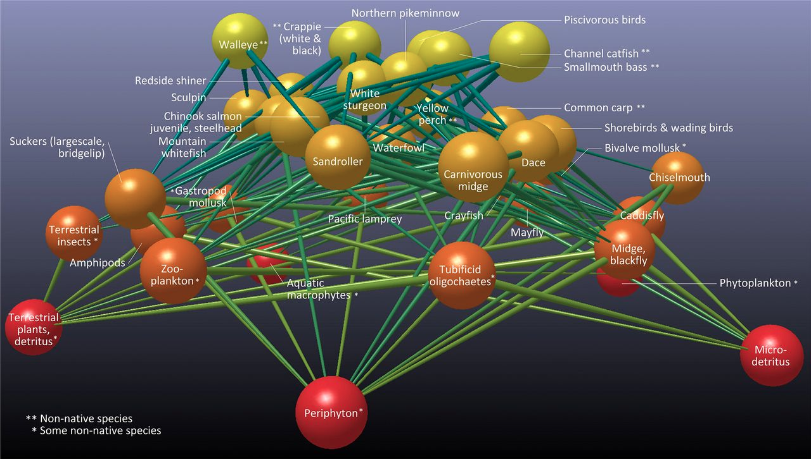
Community and Ecosystem Ecology
Community = set of populations that occupy a given area, interacting directly or indirectly
CH 16, 19.6 – 19.9, OH Set 18 & 19

Slide 2
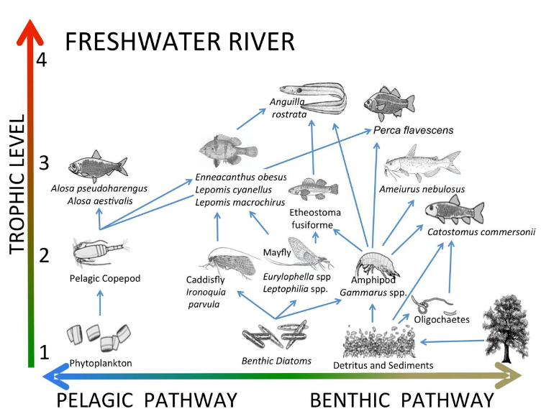
Community Structure & Function
Communities have emergent properties above the population level
Number of species
Relative abundance of each species
Coadaptation of species within community
Trophic links between species
Flow of energy or nutrients
Stability/Instability
Community
Ecology
Ecosystem
Ecology

Slide 3
Community Structure and Diversity
Species richness (S) = the number of species in the community
Species evenness (or relative abundance) = the proportion that individuals of each species contribute to total individuals of all species

Slide 4
Two measures of community diversity
Simpson’s index
D = 1/(Σ(p_{i}²))
p_{i} = relative abundance of species i = n_{i} / N
D = 1 if only 1 species is present (no diversity)
D_{max} = S if all species have equal numbers
(perfect evenness)
Excel worksheet “Simpson and Shannon example”

Slide 5
Two measures of community diversity
Shannon (or Shannon-Weiner or Shannon-Weaver) index
H = -Σ(p_{i})(lnp_{i})
p_{i} = relative abundance of each species
= n_{i} / N
H = 0 if only 1 species is present (no diversity)
H_{max} = ln(S) if all species have equal numbers
(perfect evenness)
Excel worksheet “Simpson and Shannon example”

Slide 6
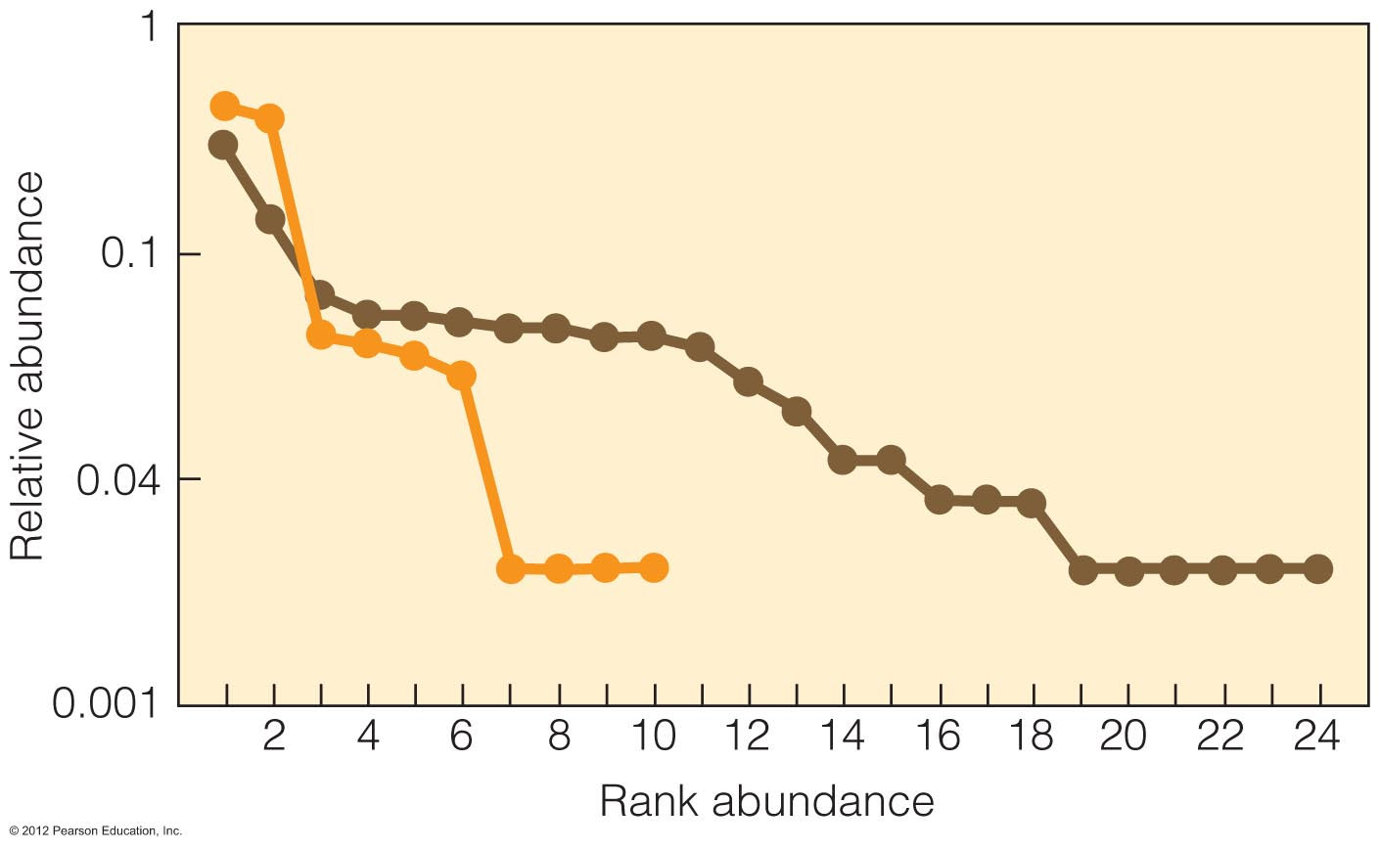
Species Rank - Abundance Curves incorporate both
richness and even-ness
Notes:
Figure 17.2
The most abundant species is given rank 1
Richness shown by just total number of species that are ranked
Evenness shown by steepness of the slope
steep slope means low evenness because high ranking species have really high abundance
Shallow slope means high evenness because abundance of many species' is similar
Horizontal line (aka no slope) means perfect evenness

Slide 7
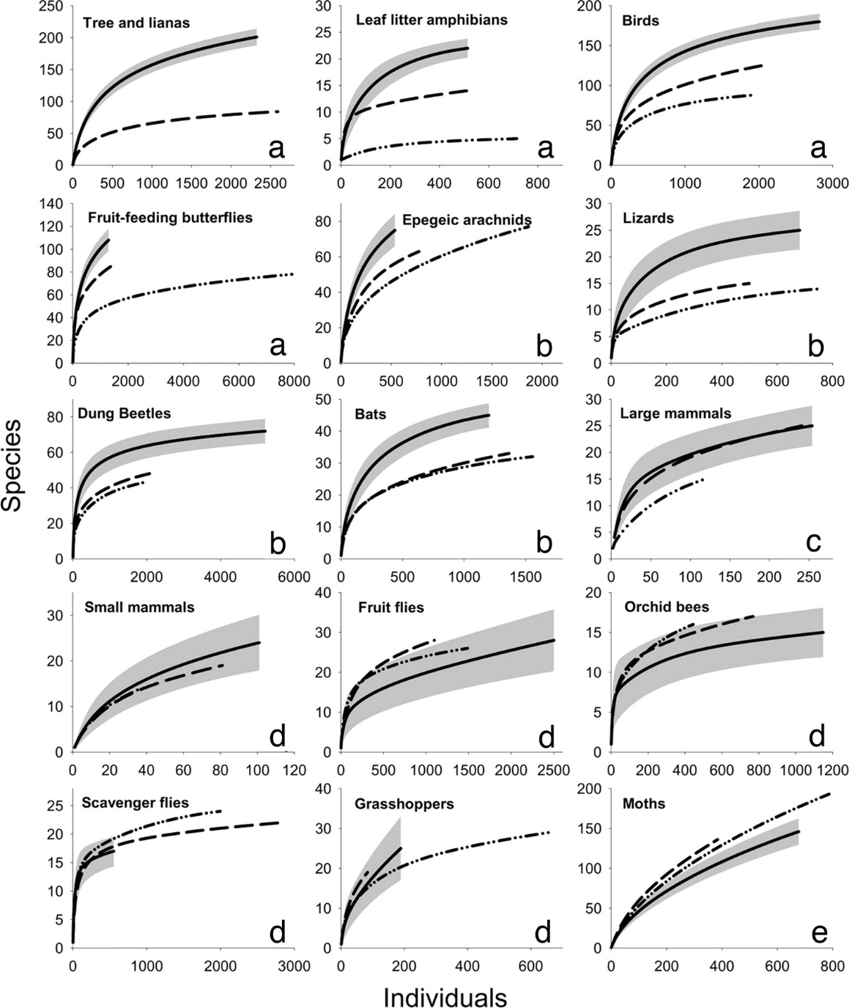
Species Accumulation Curves
also reveal richness and
evenness
primary forest
secondary forest
plantation forest
Allow comparison of diversity between taxonomic groups, ecosystems,
sampling efforts ...
Barlow et al. PNAS 2007;104:18555-18560
Notes:
Shallow slope=only a few species, and each one of those has with many individuals – low diversity
Steep slope= a lot of species with few individuals per species – high diversity
Individual-based species accumulation curves for primary (unbroken line with shaded 95% confidence intervals) and secondary forests (dashed line) and Eucalyptus plantations (dotted-dash line). (Letters a–e) Five response types, grouping taxa according to our analytical criteria (see Materials and Methods) that showed the following: significant differences between samples from all habitat types (letter a), no clear significant difference between samples from secondary forest and Eucalyptus (letter b), no clear significant difference between samples from primary and secondary forest (letter c), no clear difference between any habitat (letter d), and primary forest appearing as less species-rich than other forest habitats (letter e).

Slide 8
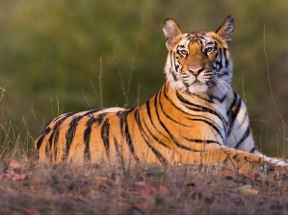
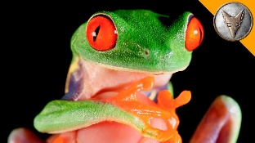
Not all species within a community are equivalent
KEYSTONE
DOMINANT
Species Ecological
Effect
RARE
UMBRELLA
INDICATOR
Species abundance (or biomass)
Notes:
Umbrella: a species used for conservation purposes whose habitat encompasses habitat for others in the community, and protection of the umbrella species and its habitat therefore protect the community; Ex: large predators such as lions or wolves, sage grouse
Indicator: a species that provides information on the state of an ecosystem. Could indicate deteriorating conditions or simply what kind of conditions are there. Ex: stoneflies in rivers require cool and clean water

Slide 9
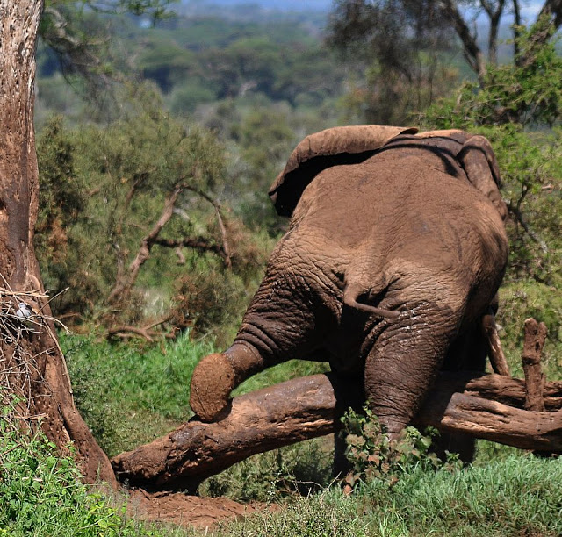

Slide 10
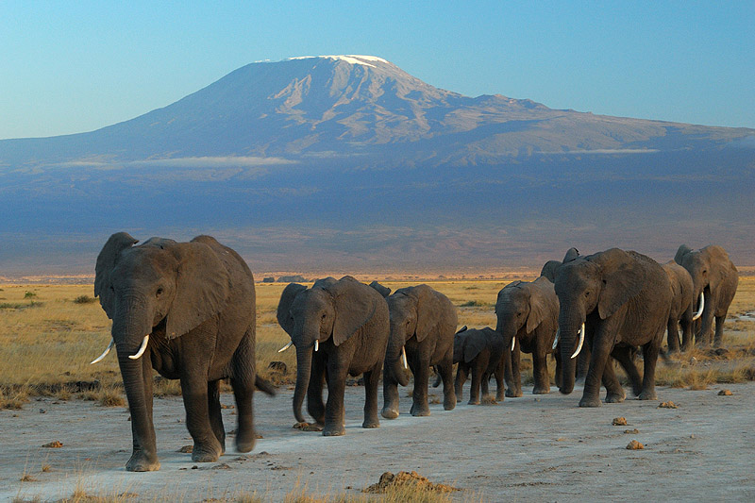

Slide 11
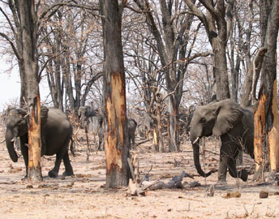
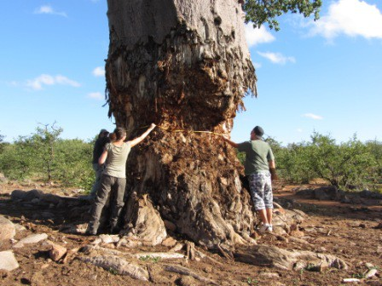

Slide 12
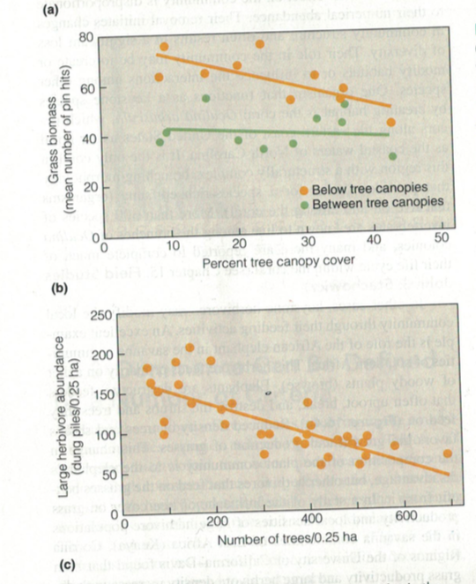
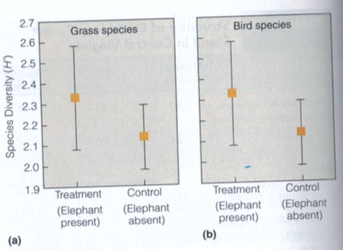
Elephants as keystone species
Figs 16.4 and 16.5
Notes:
Elephant browsing damages trees and reduces tree density. Reduced tree density increases grasses below the remaining trees and thus increases large herbivores. Herbivore counts based on dung counts
Elephant present treatments also had higher grass diversity and bird diversity, measured as shannon’s index

Slide 13
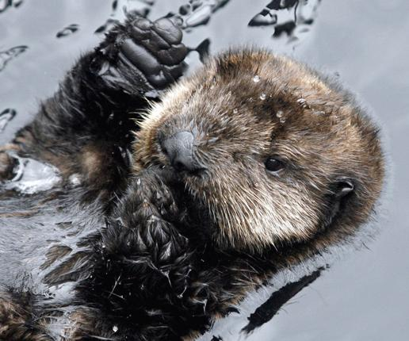
Sea otter

Slide 14
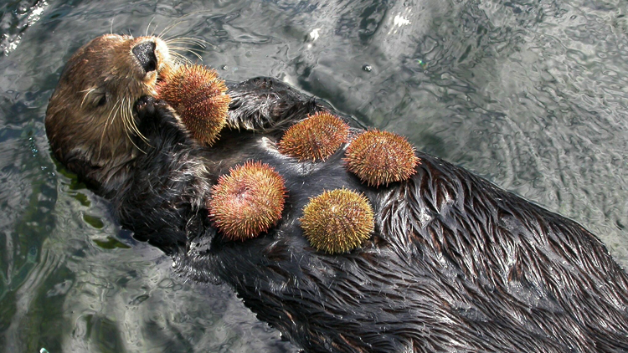

Slide 15
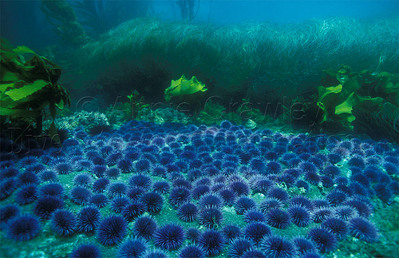
Sea urchin

Slide 16
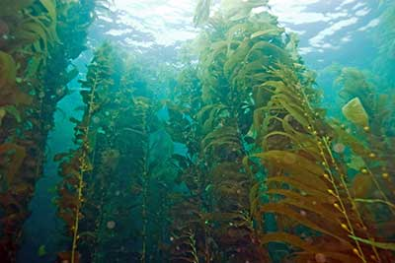
Kelp

Slide 17
Trophic
Cascade
Otter biomass
1
Time
urchin biomass
2
Time
Kelp density
3
Time

Slide 18
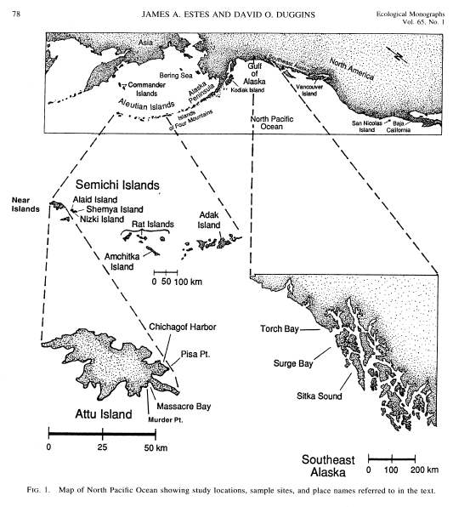

Slide 19
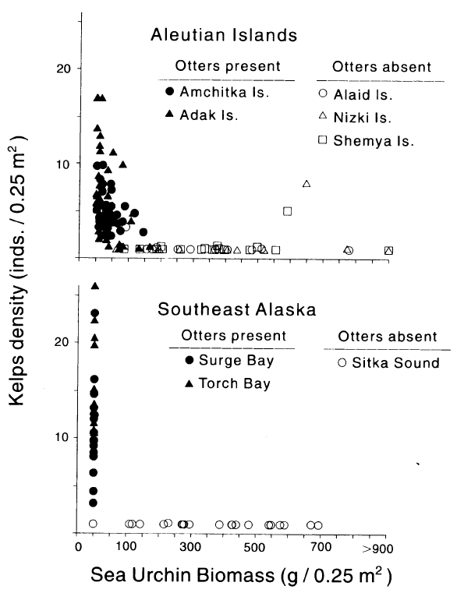
Otter¹ presence increases
kelp² density…
… by decreasing urchin³ density.

Slide 20
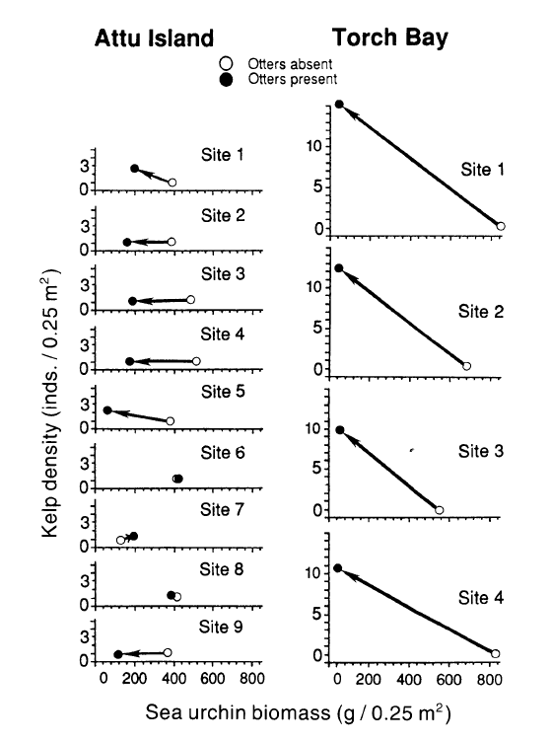
OTTER RECOLONIZATION
Typically leads to urchin declines…
… and kelp increase in some cases …
…but not in others (hysteresis)

Slide 21
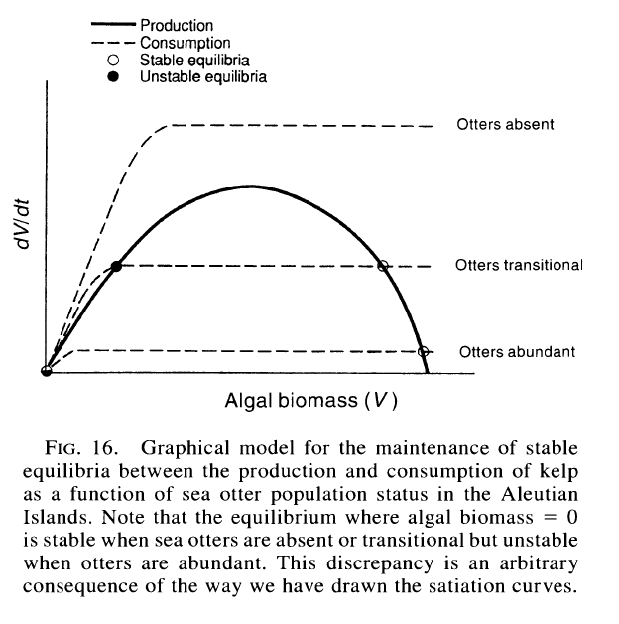
Recruitment (of kelp) vs Offtake (of kelp by urchins)
in a heuristic model
Kelp recruitment curve
dV/dt
Urchin offtake
or
Estes and Duggins. 1995. Eco Monographs

