Slide 1
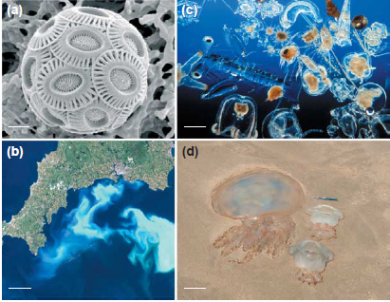

Slide 2
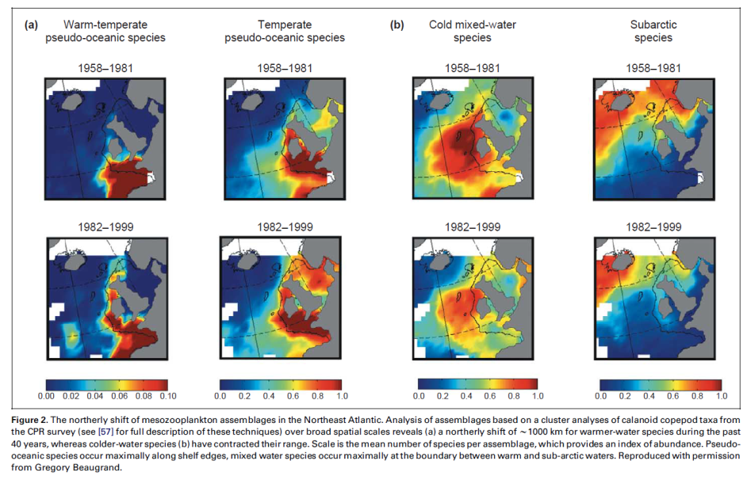

Slide 3
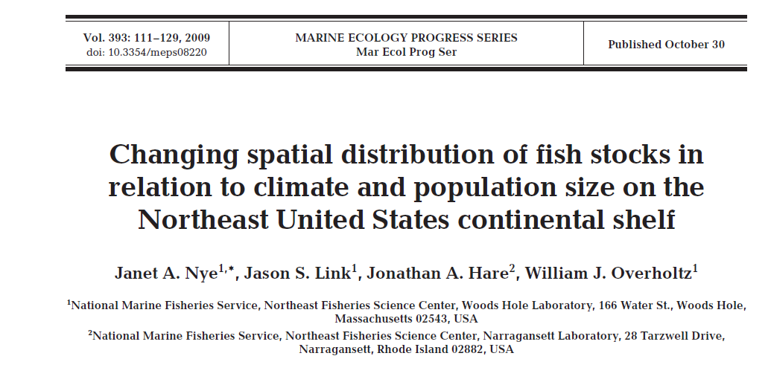
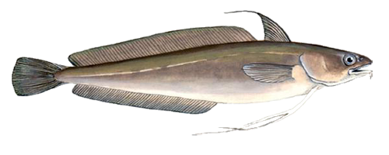
Red Hake Urophycis chuss

Slide 4
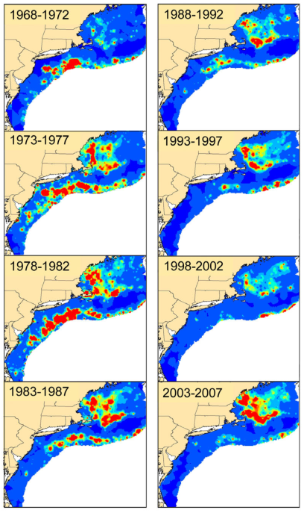
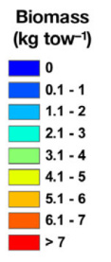
Red Hake Urophycis chuss

Slide 5
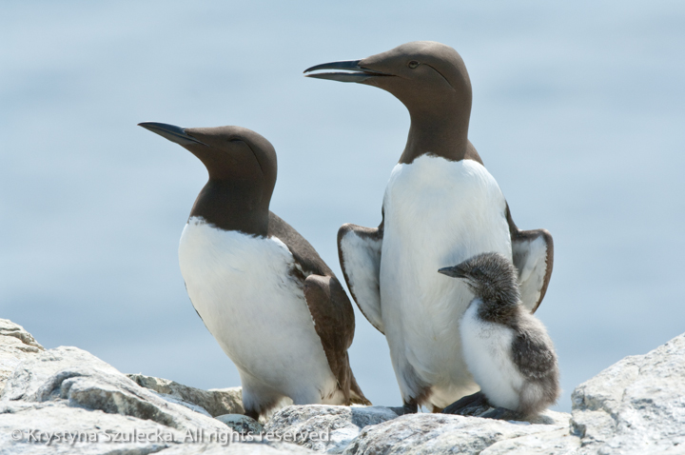

Slide 7
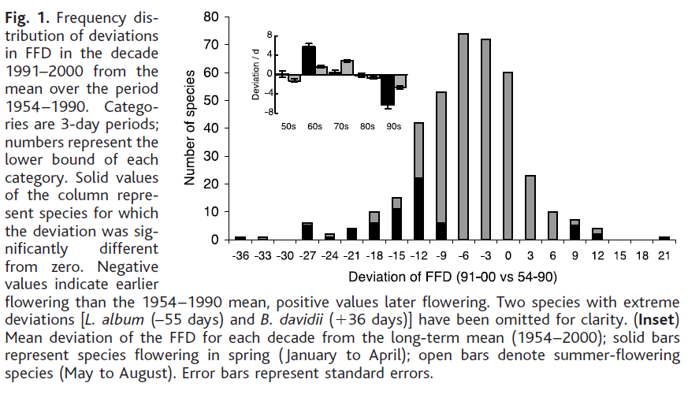

Slide 8
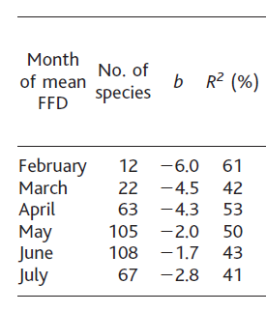
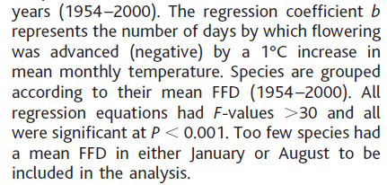
Direct test of flowering date dependence on temperature

Slide 9
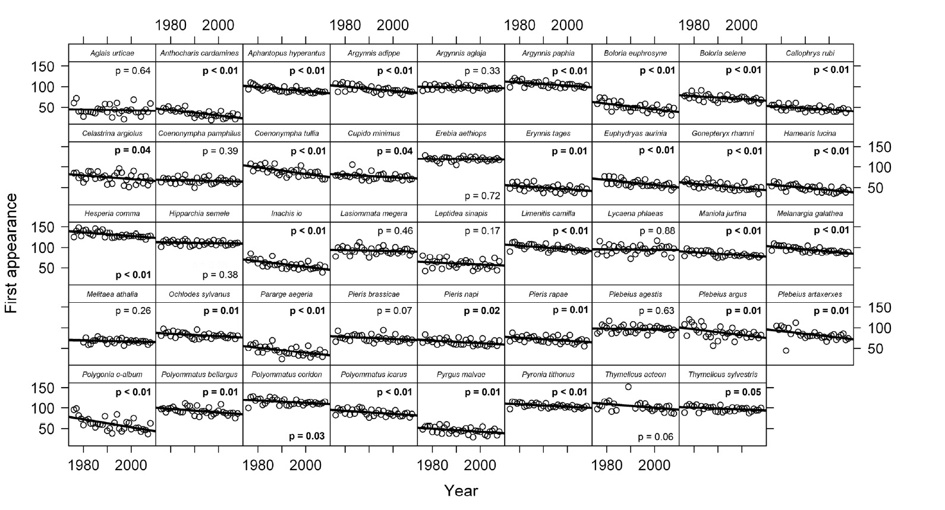
Sarah Diamond et al.2011. Species' traits predict phenological responses to
climate change in butterflies. Ecology 92:1005–1012
44 species
in CO

Slide 10
Data mainly address PRIMARY ecological responses
Distribution
Abundance
Phenology
of single species

Slide 11
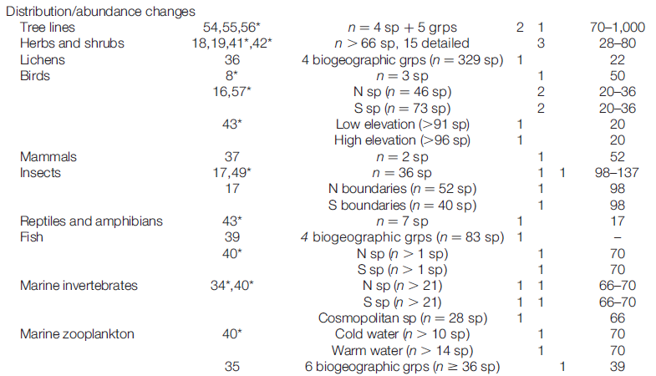
DISTRIBUTION & ABUNDANCE RESPONSES

Slide 12
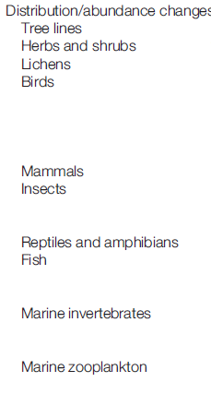
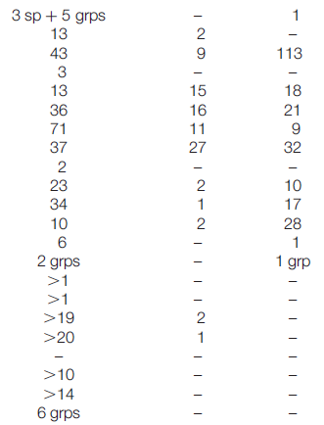

Slide 13
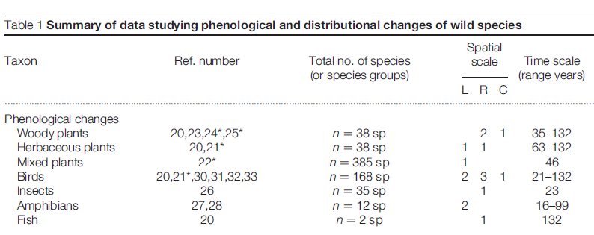
PHENOLOGiCAL RESPONSES
results next slide

Slide 14
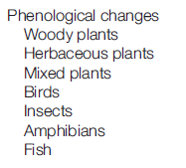
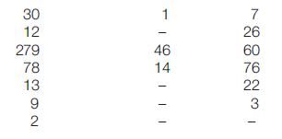

Slide 15
PRIMARY ecological responses
Distribution
Abundance
Phenology
of single species
cause SECONDARY ecological responses
Community structure
Communiy function
interactions
among species

Slide 16
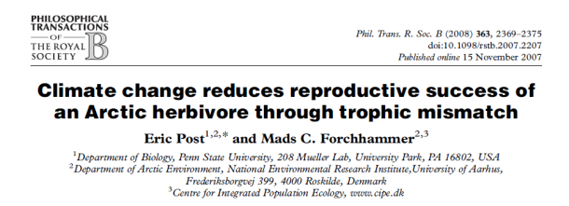
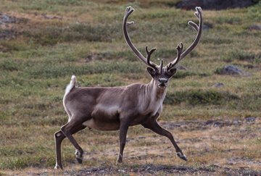

Slide 17
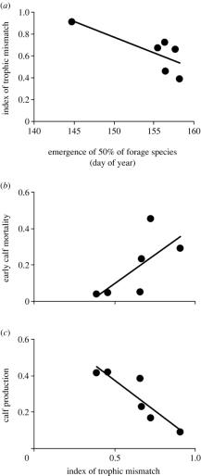
(a) Relation between the midpoint of the plant-growing season and the index of trophic mismatch between caribou calving and plant phenology each year; an earlier occurrence of the midpoint of the plant-growing season leads to greater trophic mismatch.
Eric Post, and Mads C Forchhammer Phil. Trans. R. Soc. B 2008;363:2367-2373
© 2007 The Royal Society
Notes:
(a) Relation between the midpoint of the plant-growing season and the index of trophic mismatch between caribou calving and plant phenology each year; an earlier occurrence of the midpoint of the plant-growing season leads to greater trophic mismatch. (b) Relation between the magnitude of trophic mismatch between caribou calving and plant phenology and early calf mortality. Calf mortality is calculated according to equation (2.3) in §2. (c) Relation between the magnitude of trophic mismatch between caribou calving and plant phenology and calf production. Calf production is estimated as the final proportion of calves observed each year according to the approach described in §2.

Slide 18
(a) Relation between the midpoint of the plant-growing season and the index of trophic mismatch between caribou calving and plant phenology each year; an earlier occurrence of the midpoint of the plant-growing season leads to greater trophic mismatch.
Eric Post, and Mads C Forchhammer Phil. Trans. R. Soc. B 2008;363:2367-2373
© 2007 The Royal Society
Notes:
(a) Relation between the midpoint of the plant-growing season and the index of trophic mismatch between caribou calving and plant phenology each year; an earlier occurrence of the midpoint of the plant-growing season leads to greater trophic mismatch. (b) Relation between the magnitude of trophic mismatch between caribou calving and plant phenology and early calf mortality. Calf mortality is calculated according to equation (2.3) in §2. (c) Relation between the magnitude of trophic mismatch between caribou calving and plant phenology and calf production. Calf production is estimated as the final proportion of calves observed each year according to the approach described in §2.

Slide 20
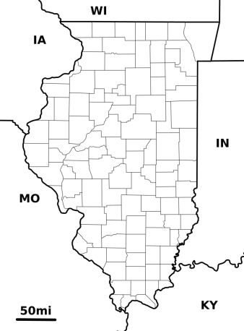
2 degree C local climate change
Repeat surveys in 2009 -2010
1880 – 3117
2010 – 5917

Slide 21
Plant
bar & line width = importance
Bee
Interaction
black: persisted 1880 - 2010
red: lost, due to local extirpation
blue: lost, bee still present

Slide 22
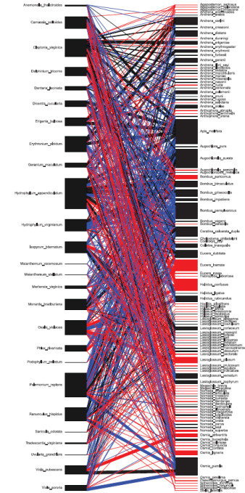
532 interactions
407 lost (76%)
183 bee extirpation:
community structure
224 bee still in system:
community function
121 new interactions:
community function

Slide 23
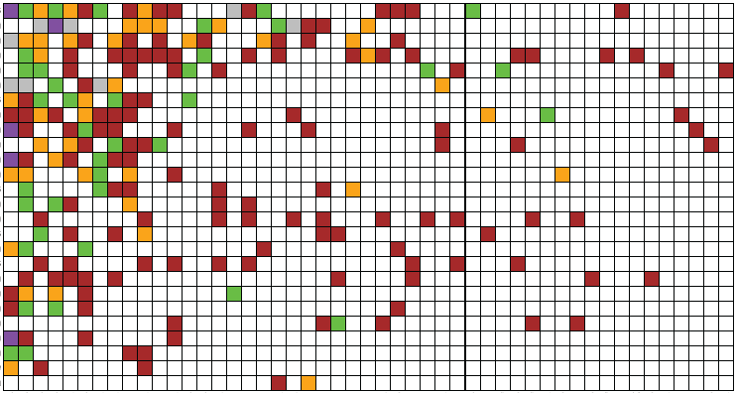
Plant
Bee
224 lost interactions due to altered community function
Grey: no overlap in time (phenology),
Green: no overlap in space (distribution)
Purple: no overlap in time or space (both)
Orange: no overlap in time where they overlap in space (both)
BROWN: 133 (59%) – interaction lost despite spatiotemporal overlap

