Slide 1
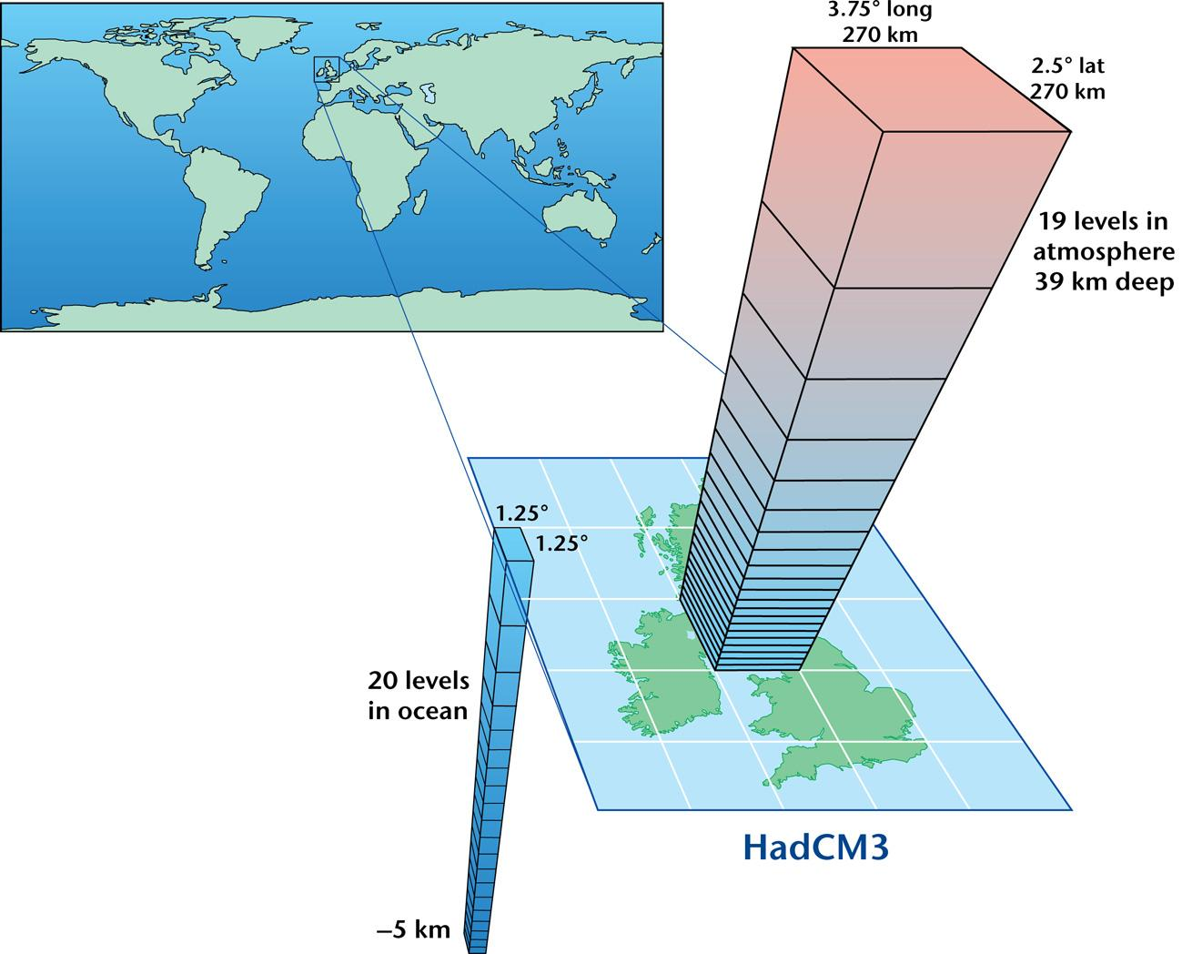
= 133,152 cells

Slide 2
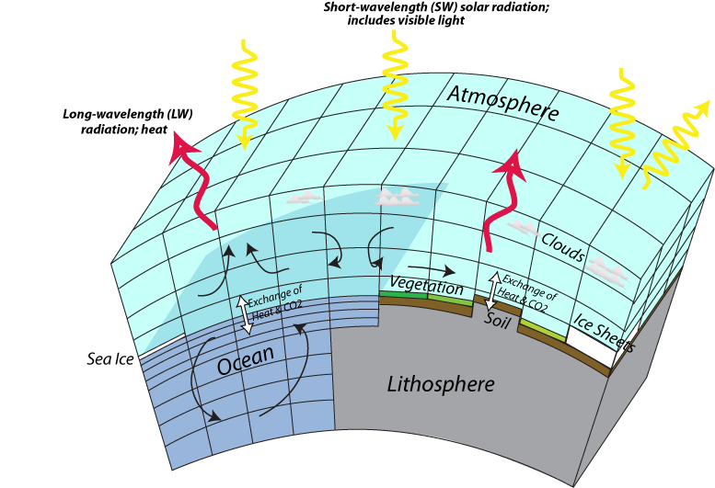

Slide 3
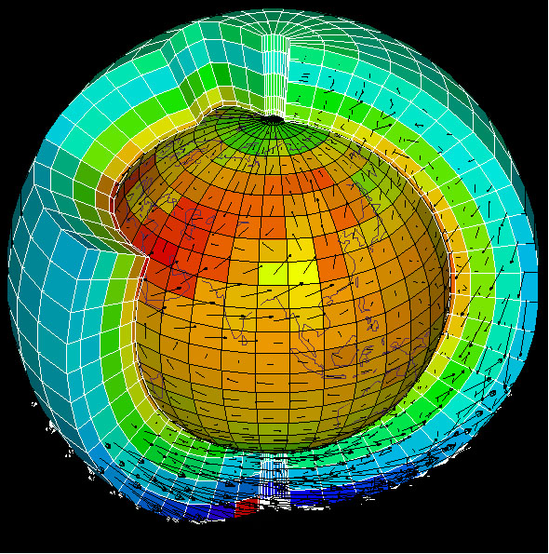
Also see animation for projections of GCM through time

Slide 4
