Slide 2
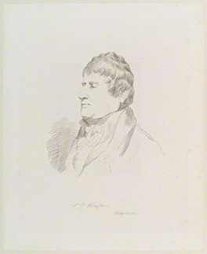
Sir Charles Brian Blagden
1748 –1820
Blagden's Law: the freezing point of a solution decreases in direct proportion to the concentration of the solution

Slide 3
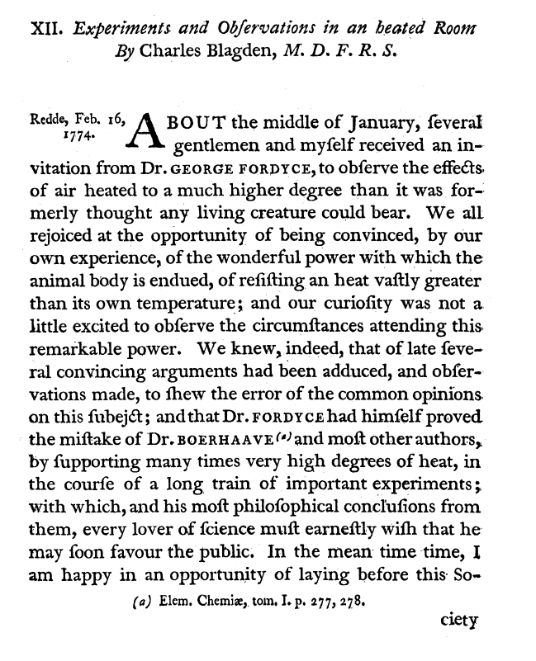
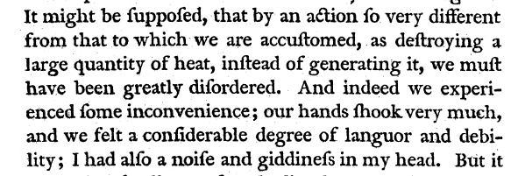
Blagden, CB (1775) Experiments and Observations in a Heated Room.
Phil. Trans. Roy. Soc. Lond. 65:11-123.

Slide 4
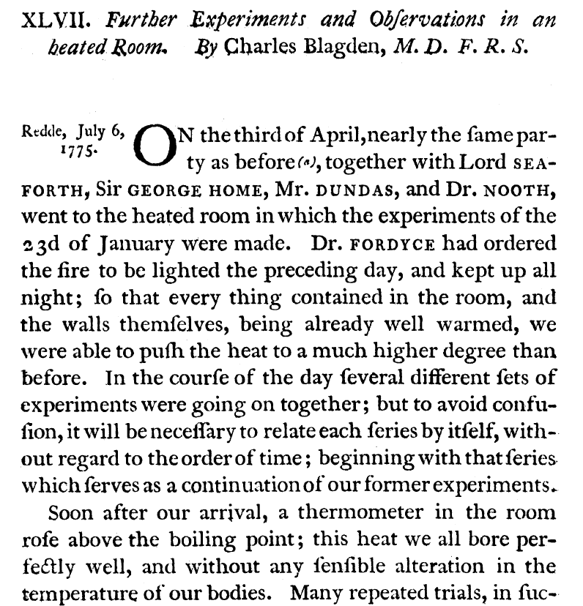
Blagden CB (1775) Further Experiments and Observations in an Heated Room. Phil. Trans. Roy. Soc. Lond. 65: 484-494

Slide 6
