Slide 1
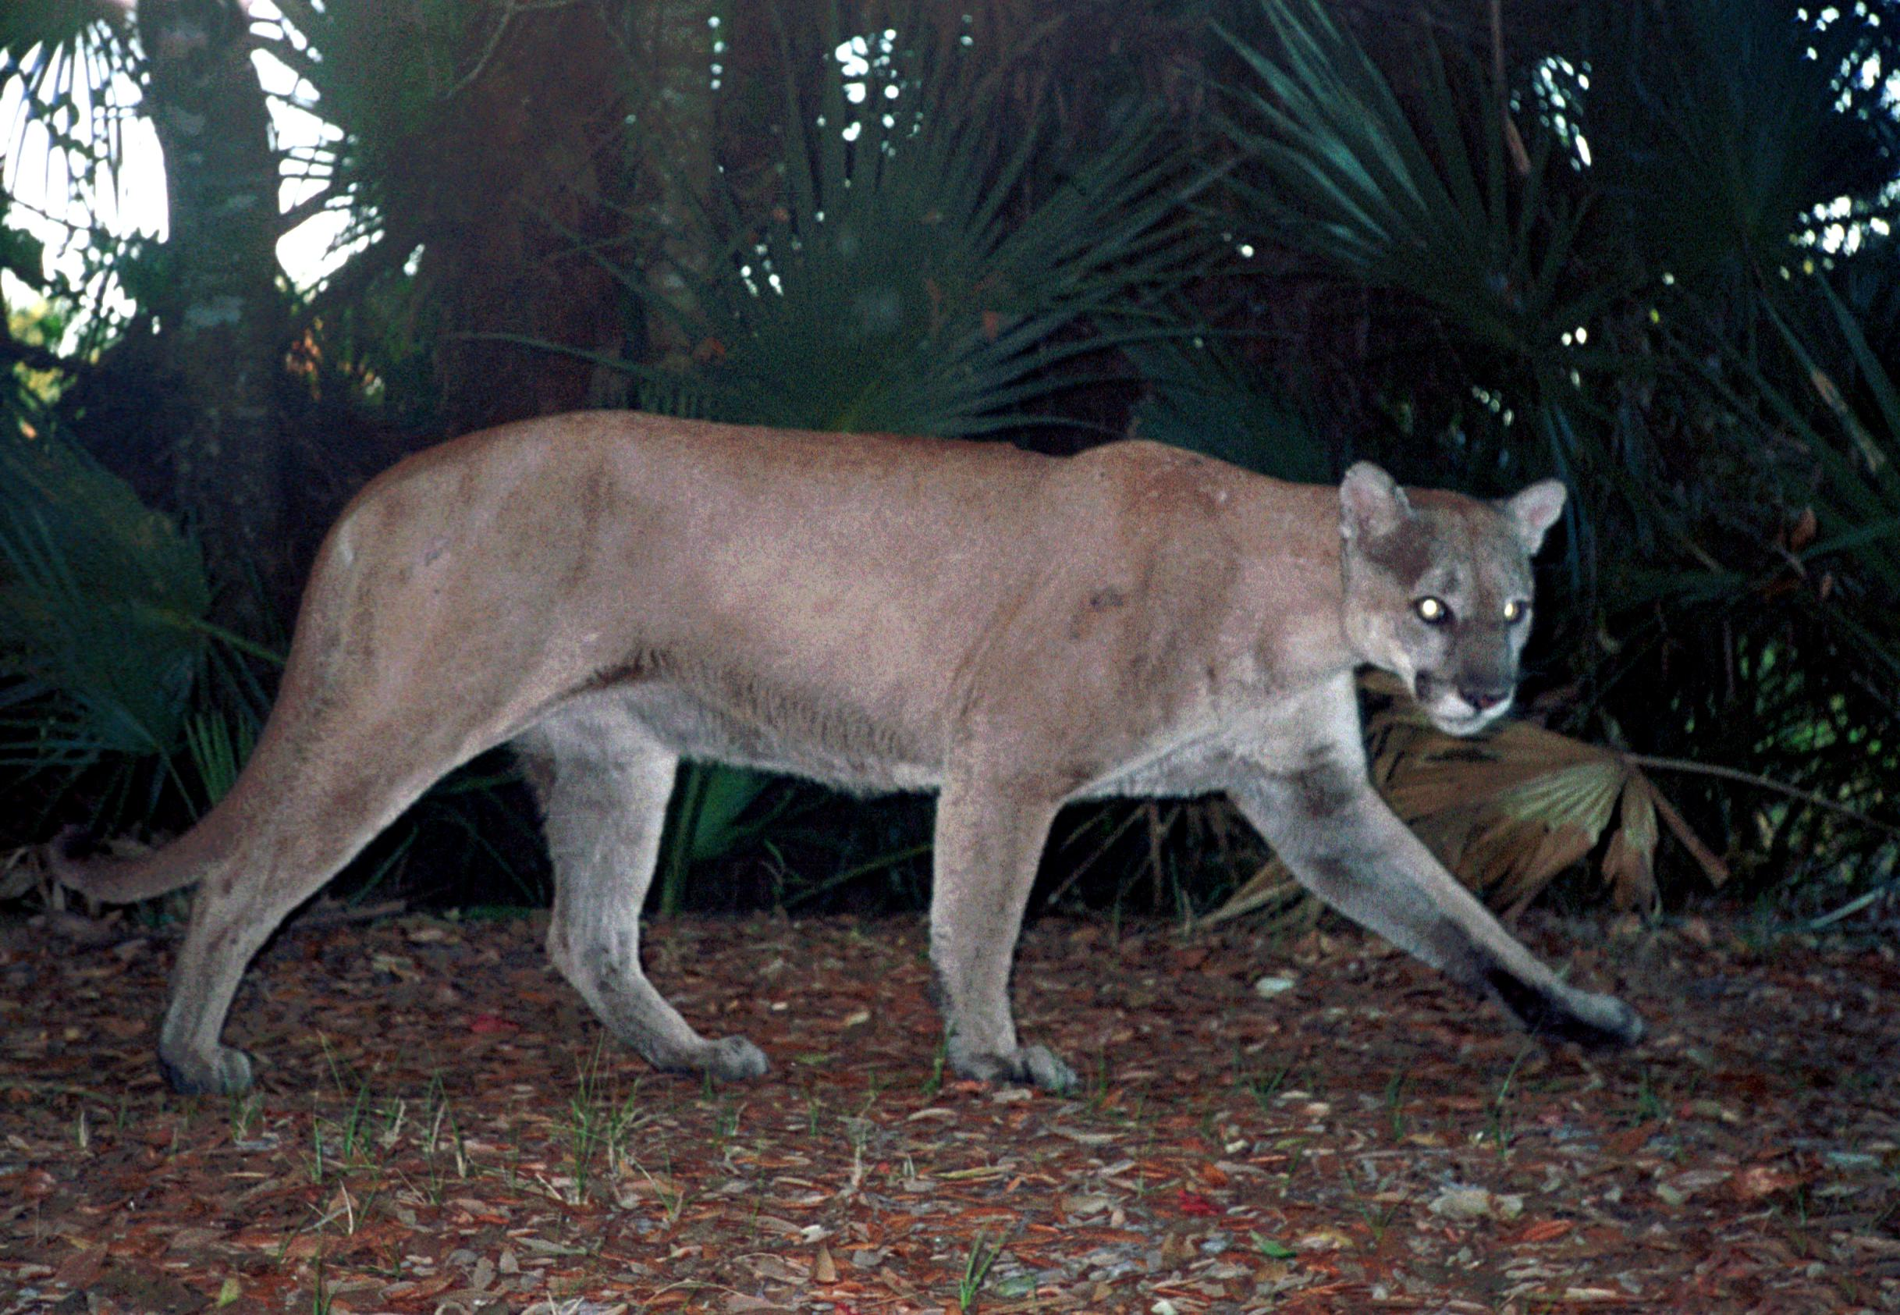
Florida panther - Puma concolor

Slide 2
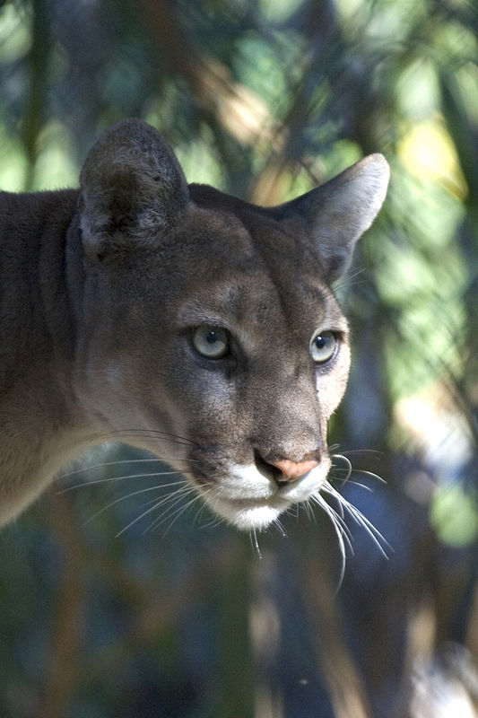
-currently occupies 5% of its historic range.
-1970s: estimated 20 Florida panthers in the wild
-2011-2103: 100 to 160

Slide 3
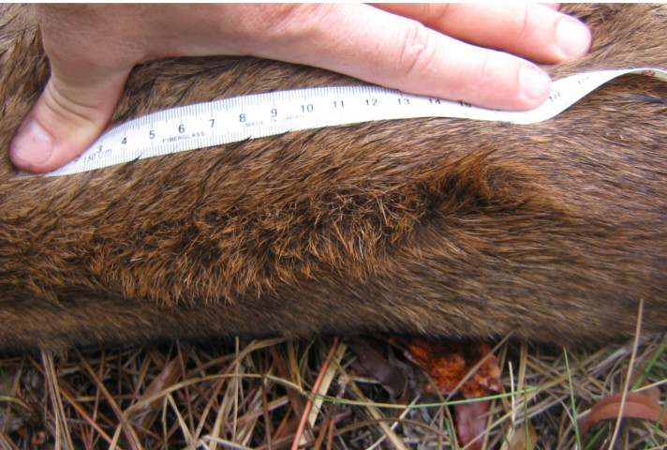
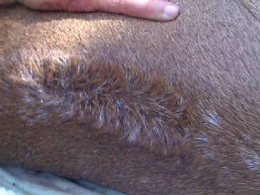
Cowlick in fur along the spine

Slide 4
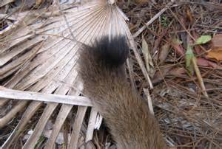
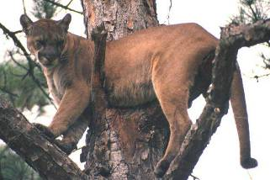
Kink in the final vertebra of the tail

