Slide 1
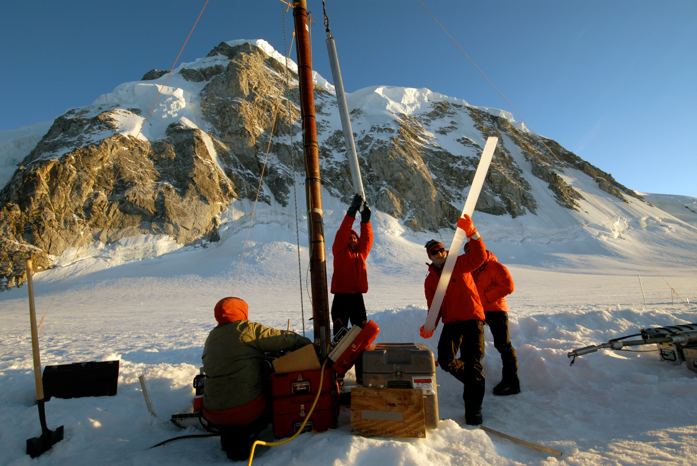

Slide 2
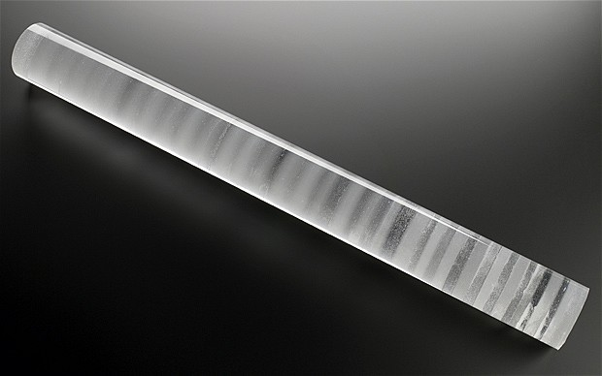

Slide 3
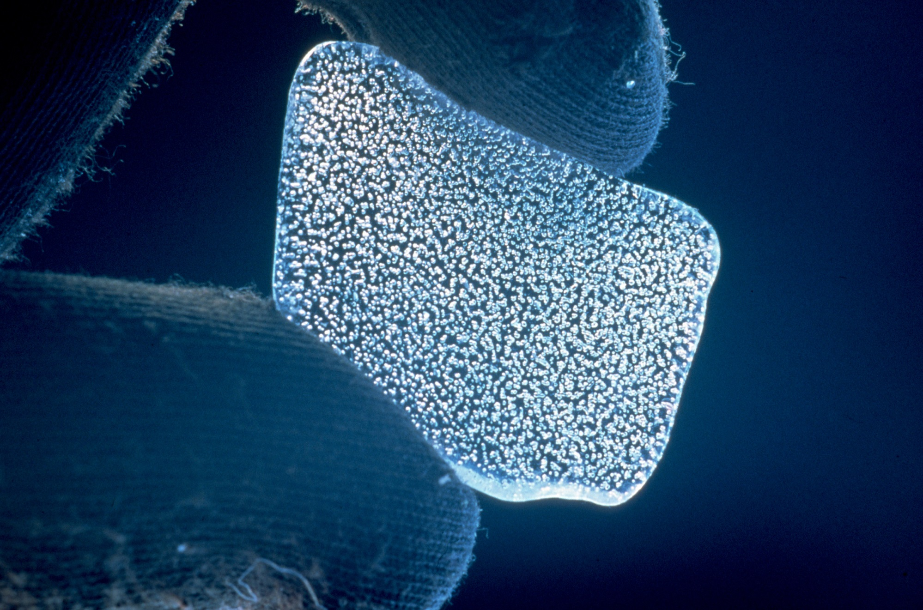

Slide 4
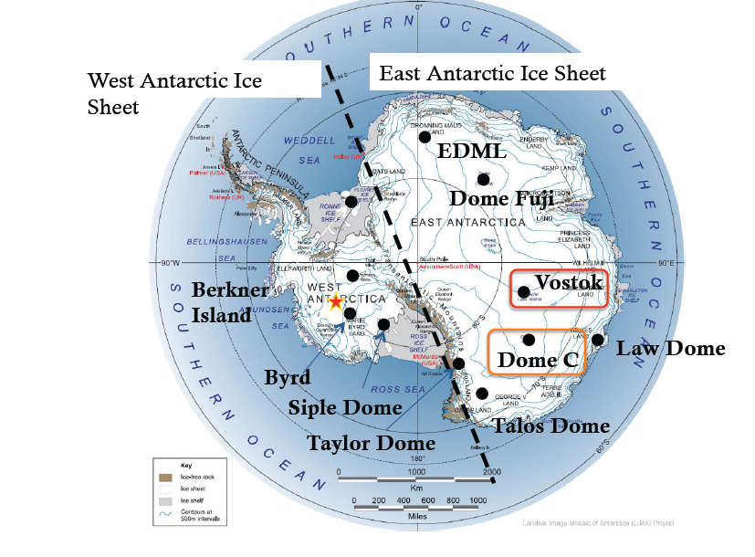

Slide 5
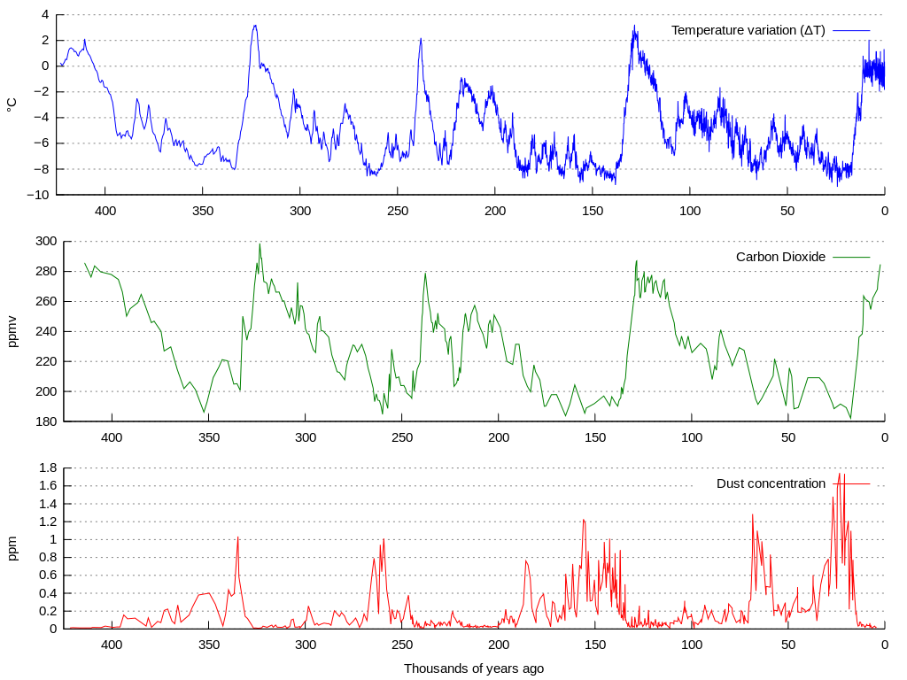
Vostok Ice Core Data

Slide 6
Oxygen isotopes in H2O

Slide 7
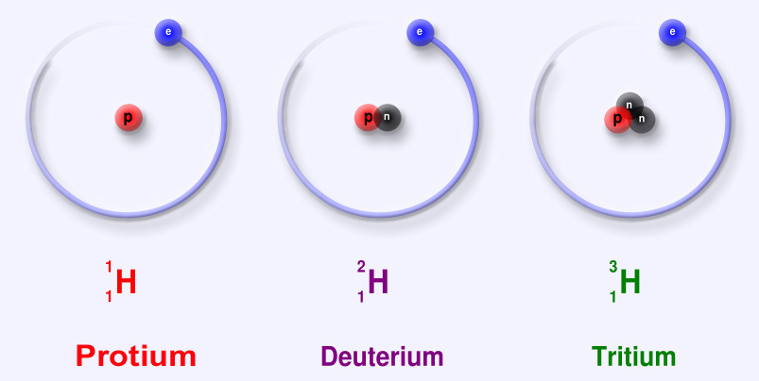
Hydrogen isotopes (also occur in H2O)

Slide 8
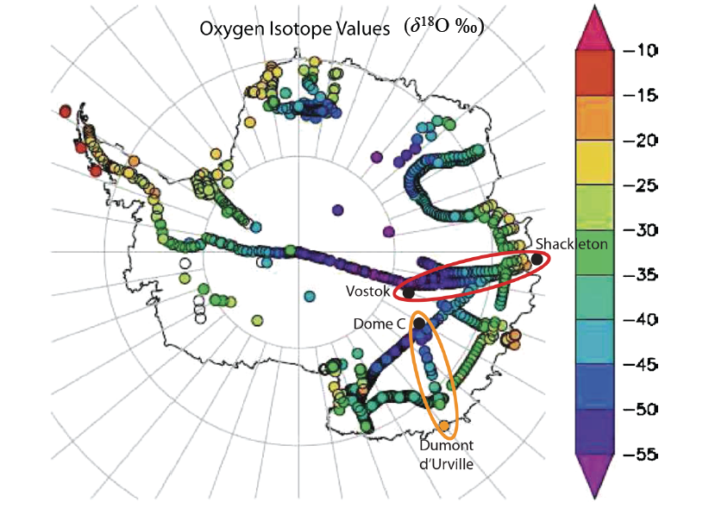
Surface

Slide 9
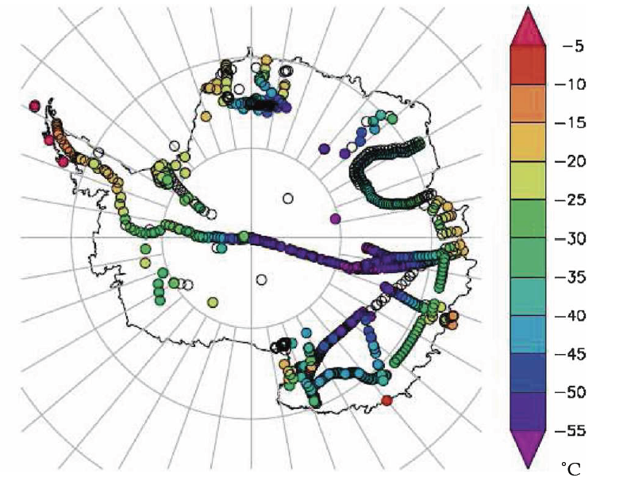
Surface Temperature Values

Slide 11
Vostok Ice Core Data

