Slide 1
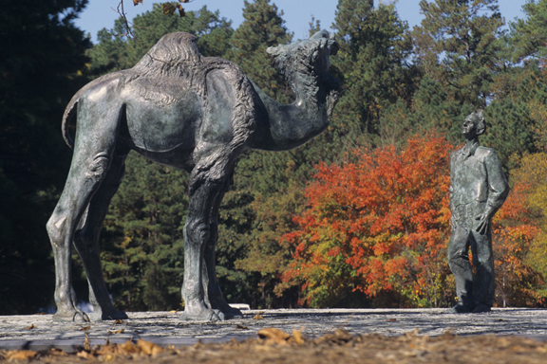
Why is this man standing with a camel?
Knut Schmidt-Nielson, a founder of animal physiological ecology

Slide 2
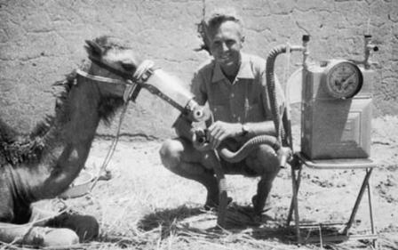
Knut Schmidt-Nielson, a founder of animal physiological ecology

Slide 3
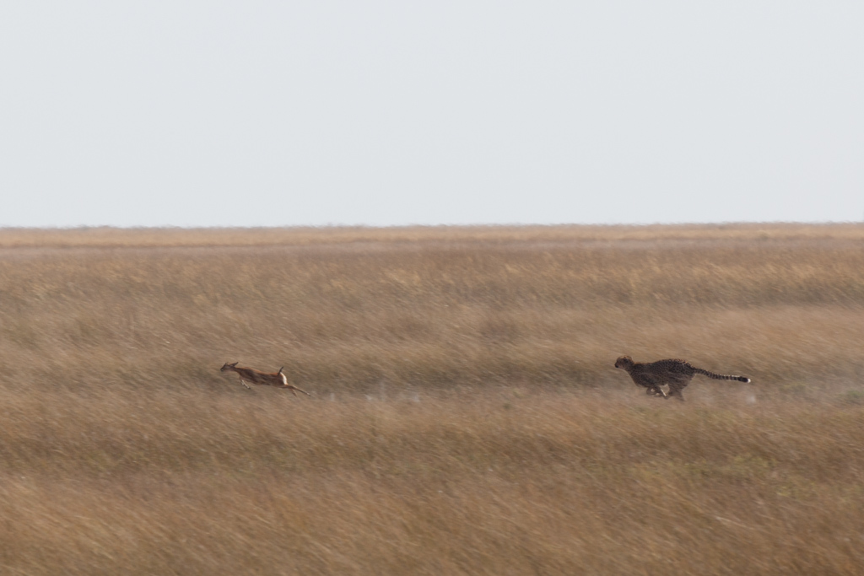

Slide 4
