Slide 1
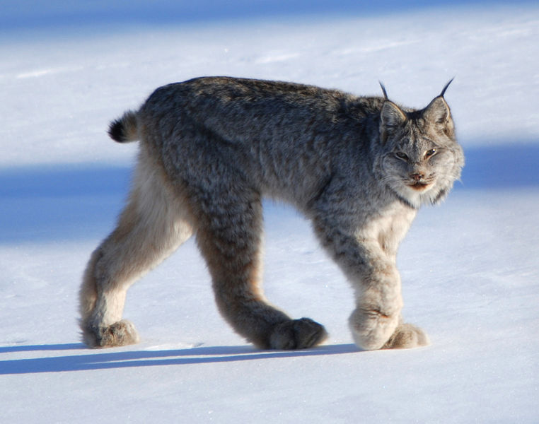

Slide 2
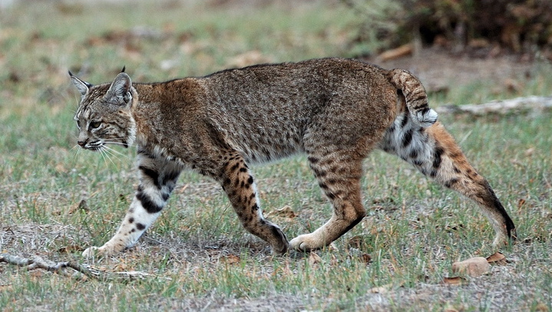

Slide 3
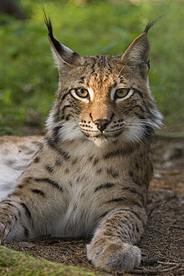
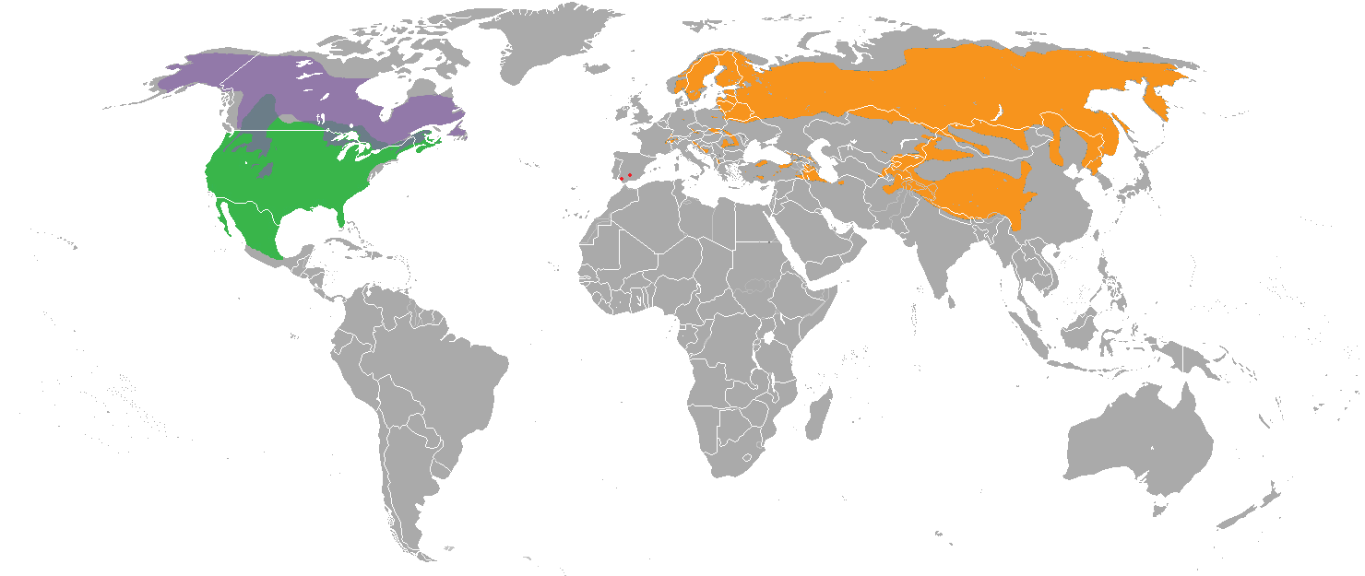
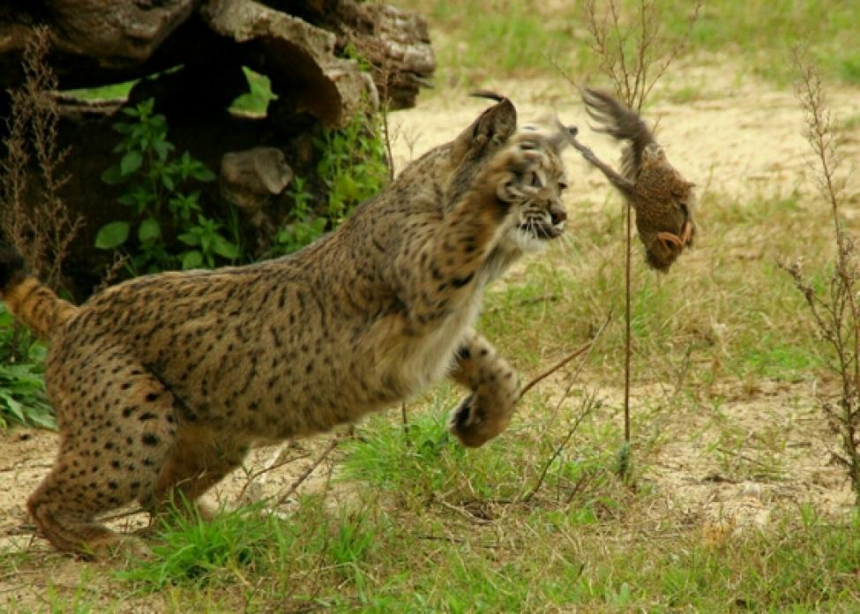

Slide 4
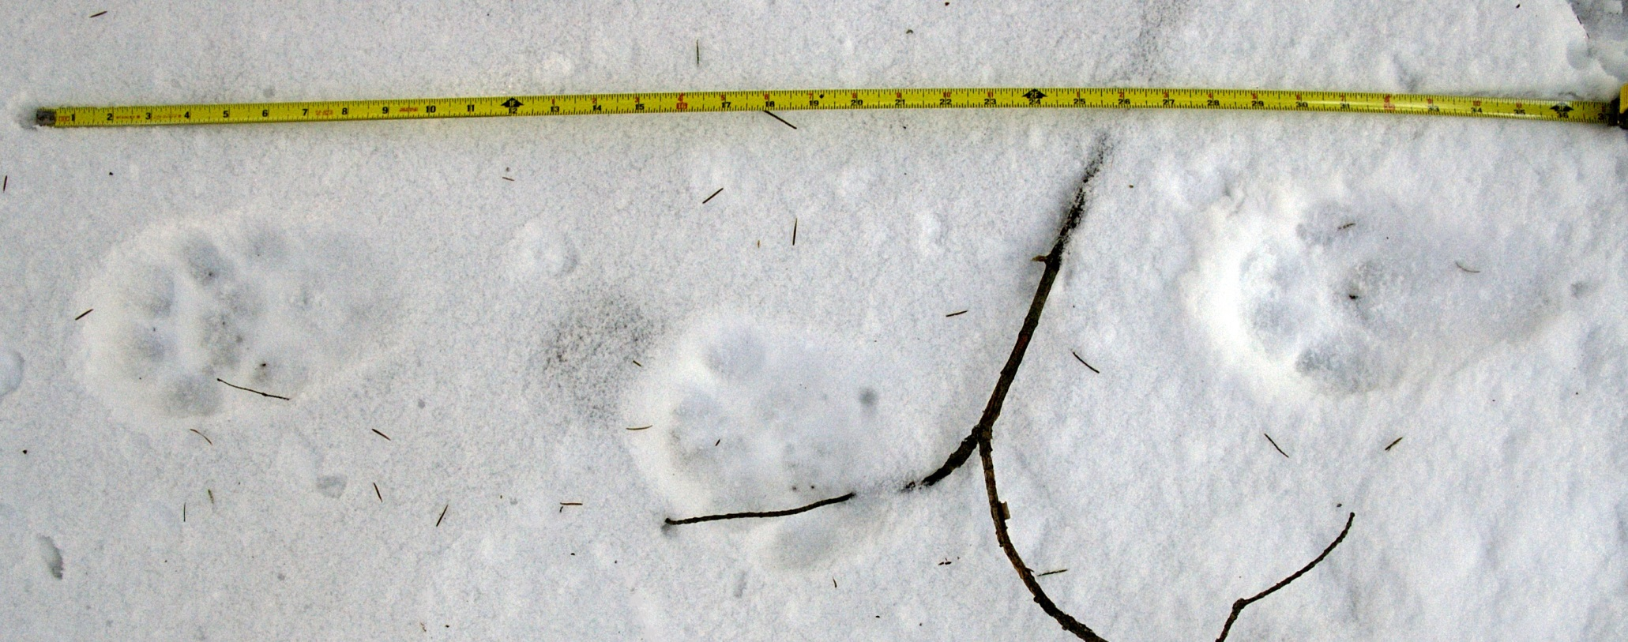

Slide 5
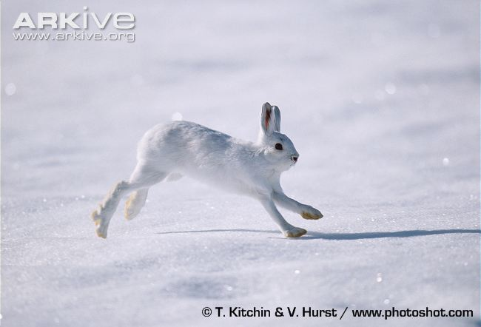

Slide 6
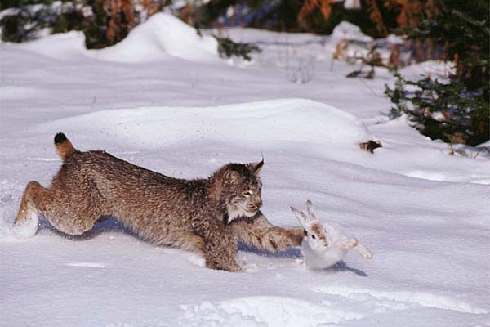

Slide 7
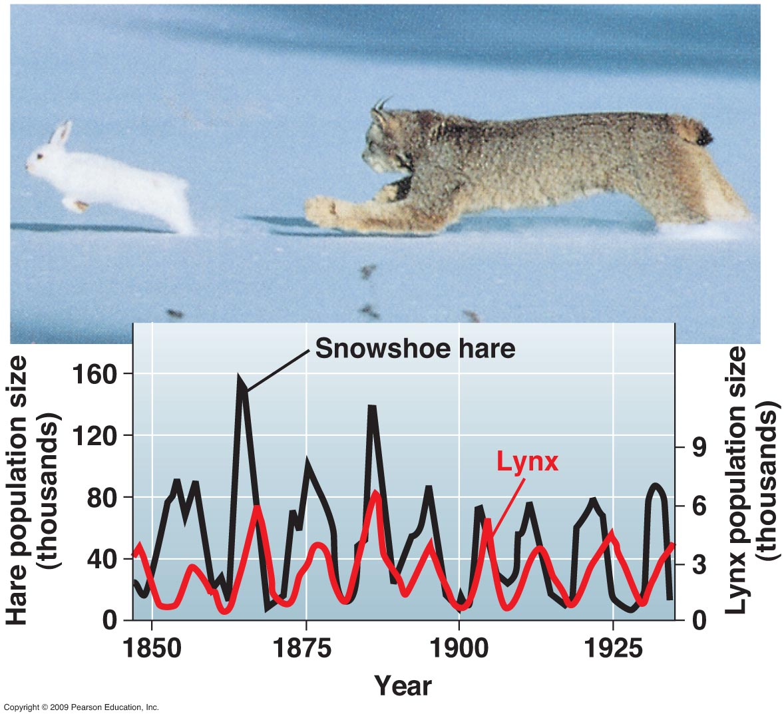

Slide 8
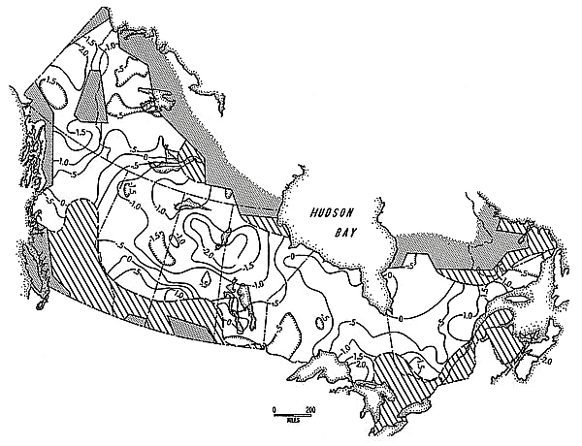
Many decades, huge area – spatially and
temporally extensive cycling

Slide 9
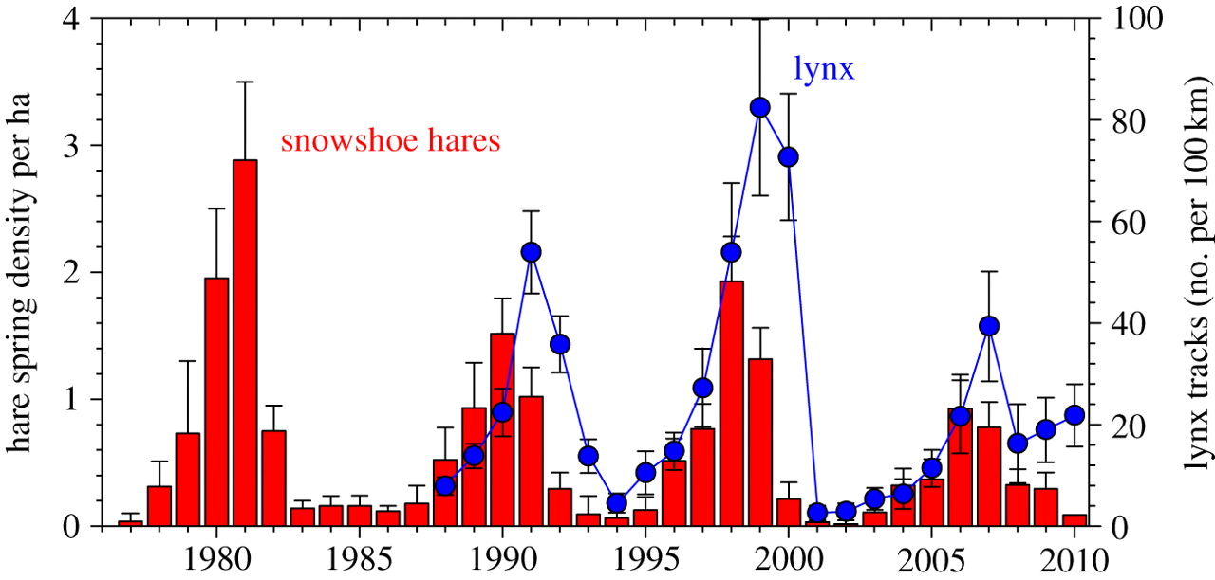
More direct data on population density (not simply the harvest data)

Slide 10
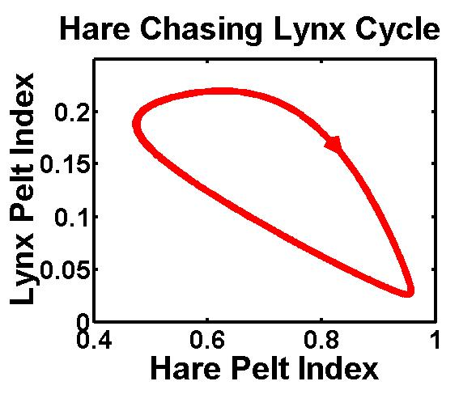
The data align well with Lotka-Volterra Predator-Prey Model predictions

Slide 11
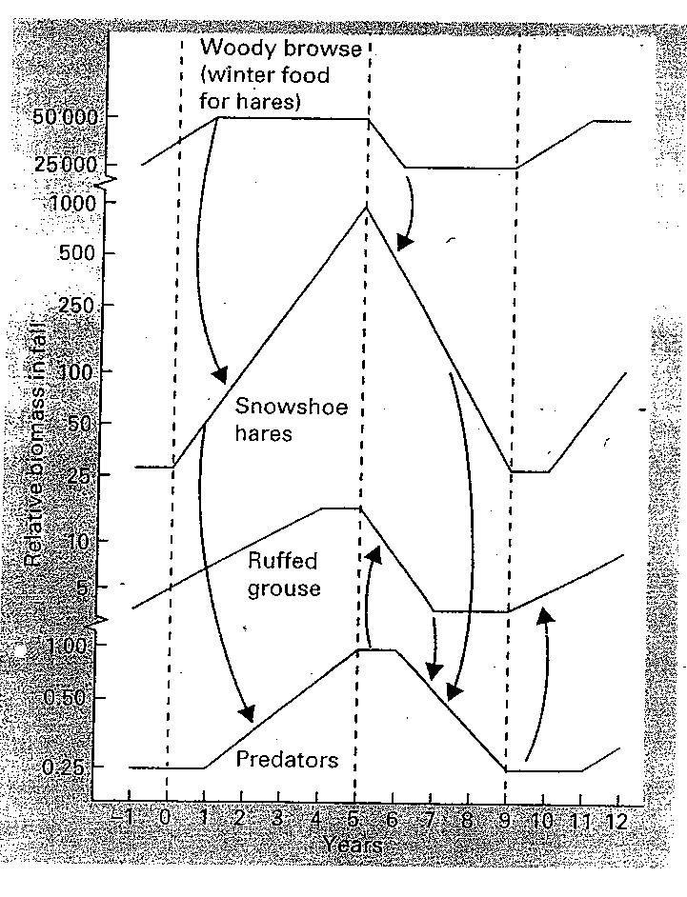
But might in reality be
more complicated than
LV model…
Abundance
(Biomass)
0 5 10
Year

Slide 12
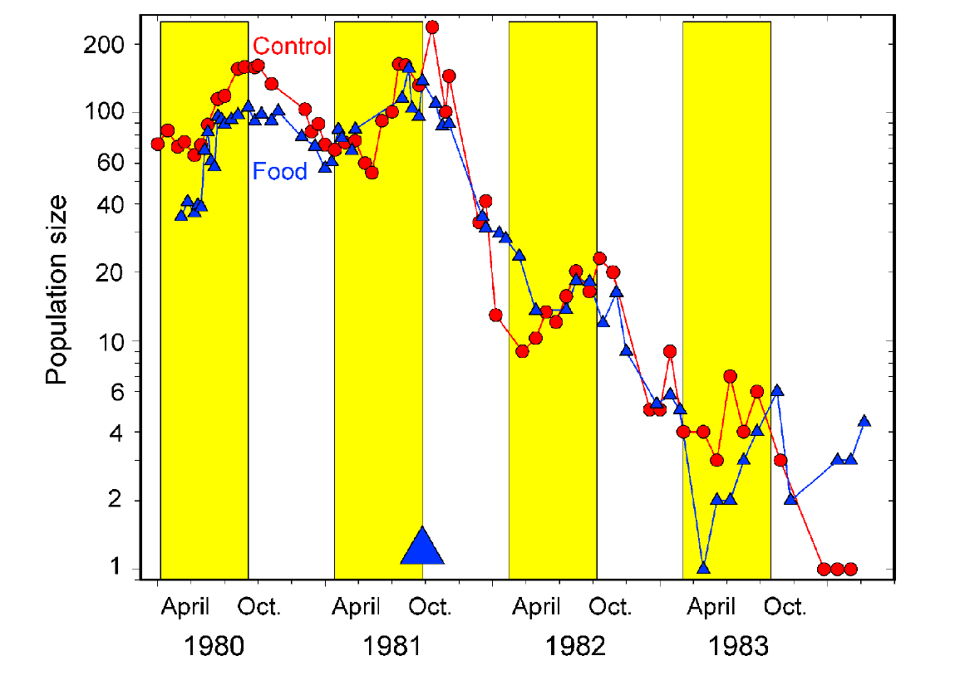
Experiment in decline phase of cycle with food supplementation and control.

Slide 13
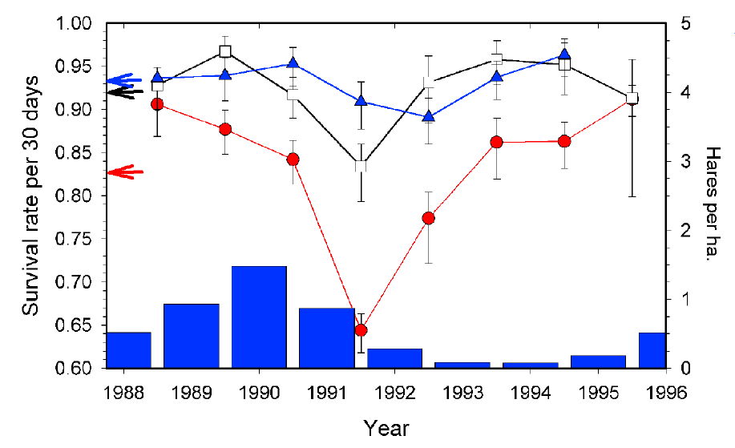
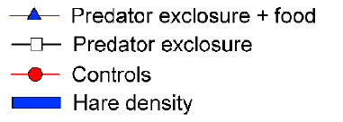
Effects of predator exclusion and food
Supplementation on ADULT SURVIVAL

Slide 14
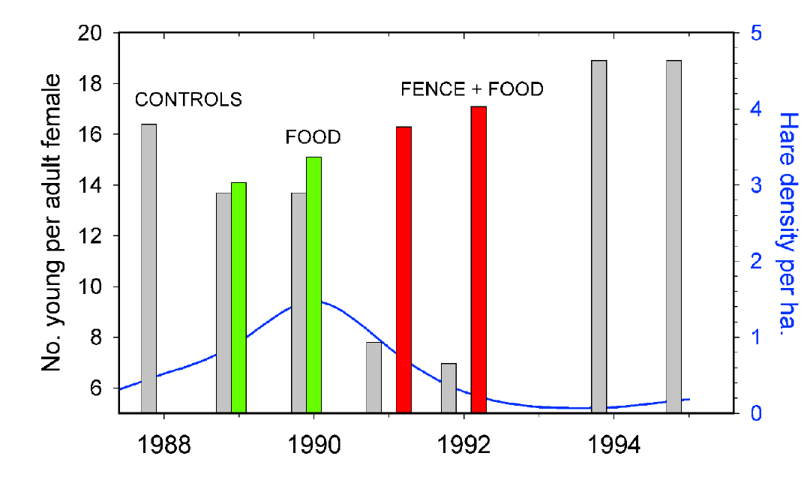
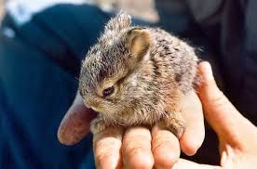
Effects of food supplementation and
predator exclusion on REPRODUCTION

Slide 15
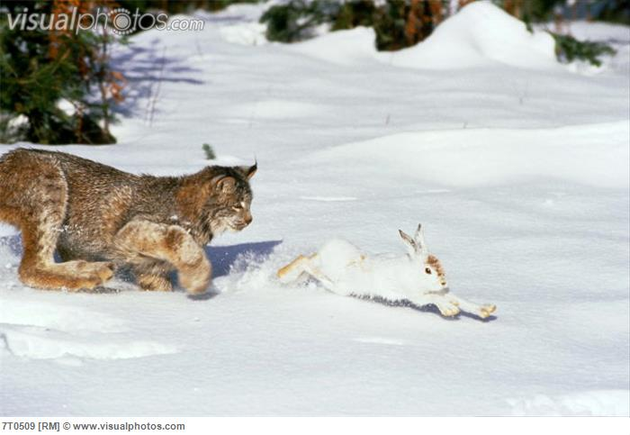
The data confirm that this is largely a single predator – single prey cycle
(with minor complications)
~2 hare kills per 3 days at peak of cycle

Slide 16
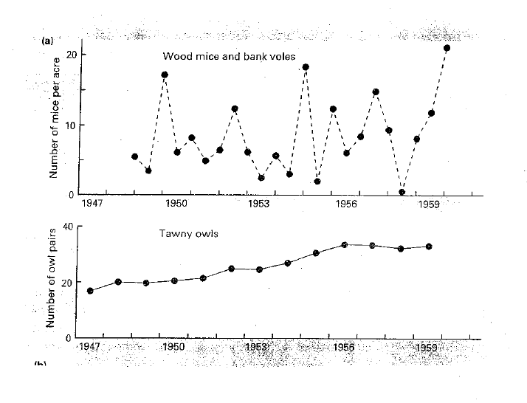
Generalist predator
Prey switching in decline phase of prey
Decouple the dynamics of predator and prey – breaks down LV cycles

