Slide 1
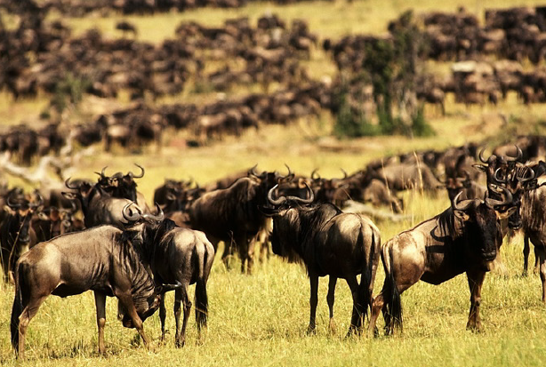
Serengeti Wildebeest: Density-dependent population growth

Slide 2
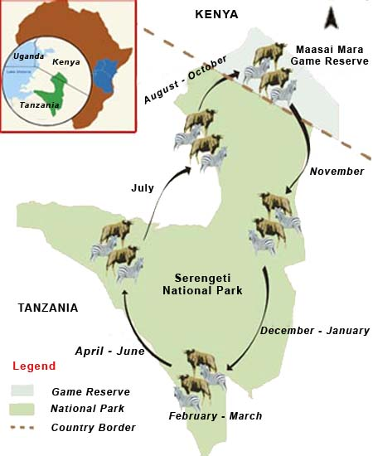
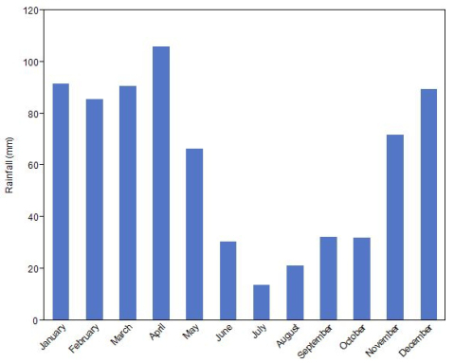
Rainfall (mm)
Month

Slide 3
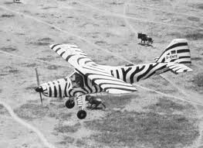
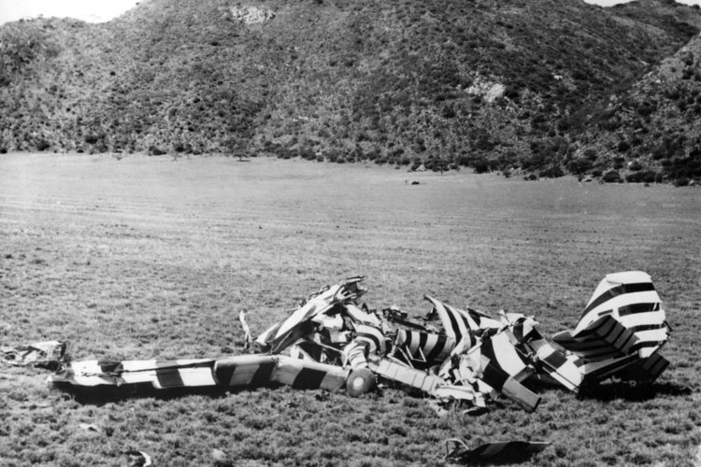

Slide 4
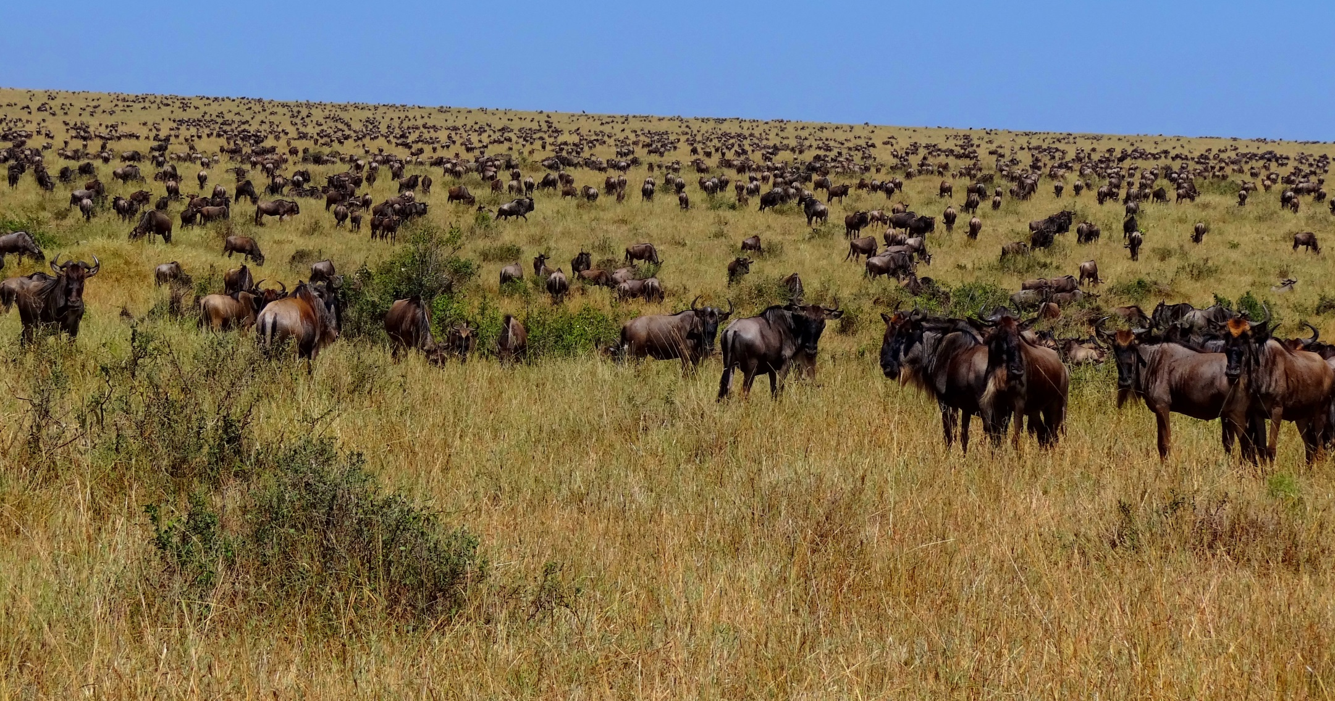
Dry season vegetation type = long grass & open woodland

Slide 5
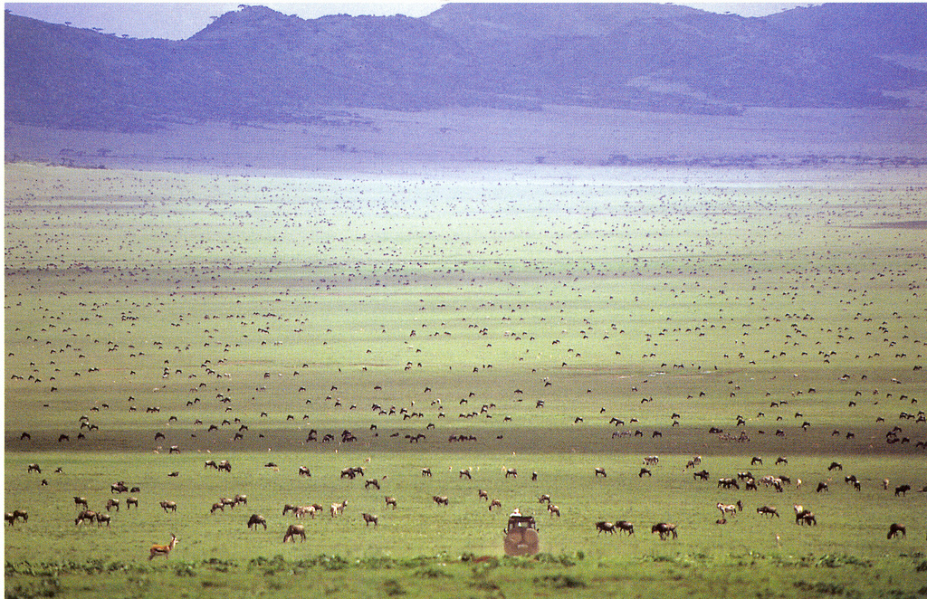
Wet season vegetation type = short grass plains (productivity, nutrients)

Slide 6
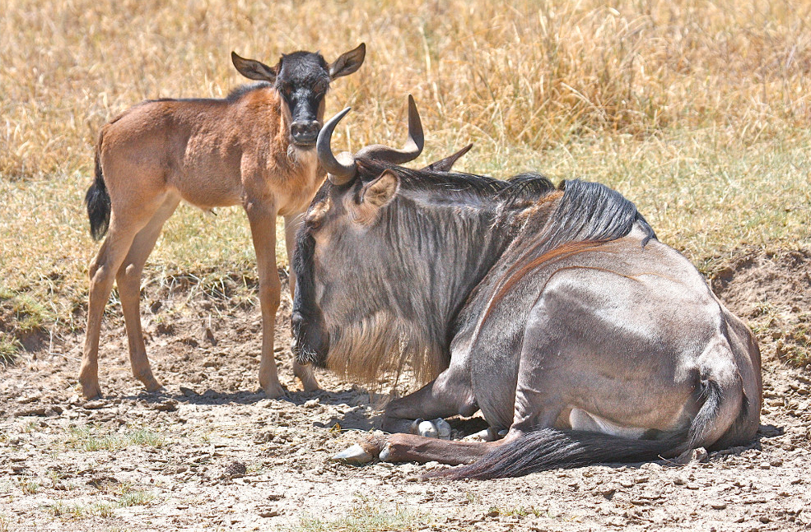
Synchronized birth pulse, precocial offspring

Slide 7
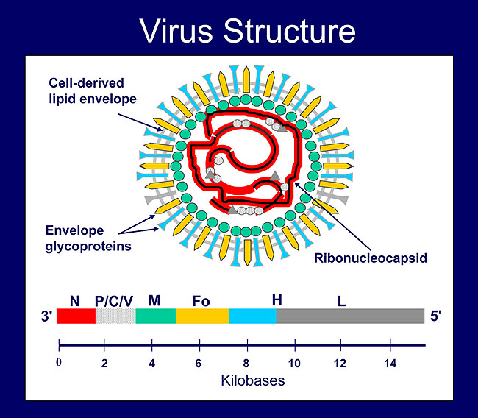
RPV

Slide 8
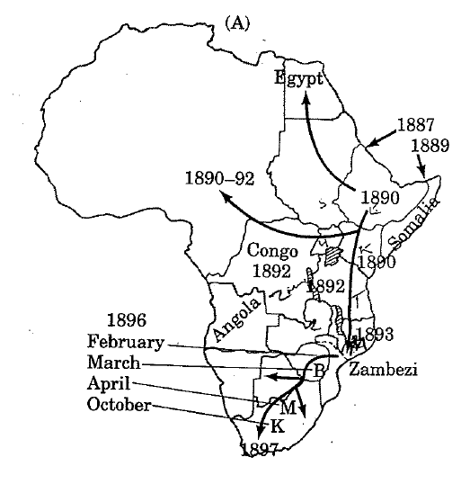
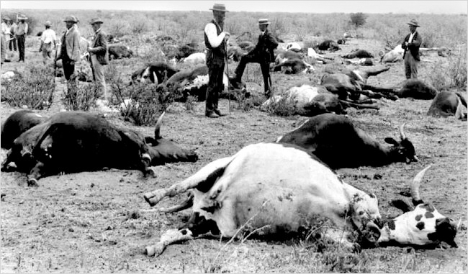
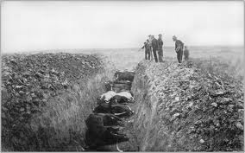
Rinderpest Virus
1889 – Italian army makes a big mistake
1897 – 5 million cattle and 30 million wild ungulates have died

Slide 9
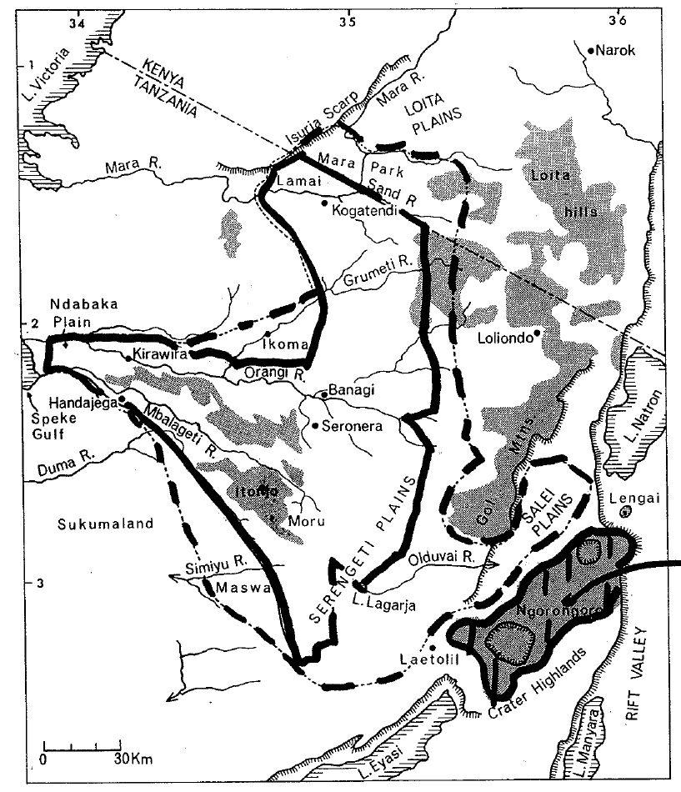
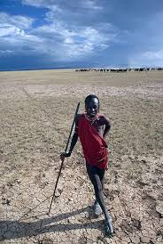
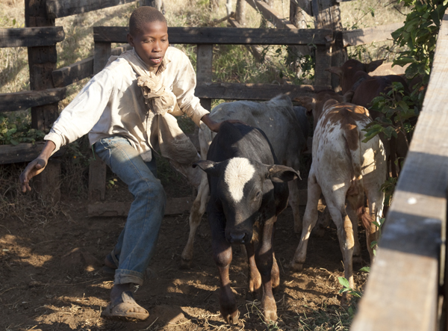
Large cattle population

Slide 10
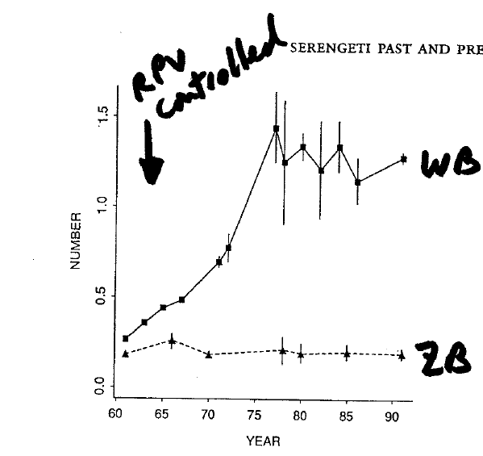
RPV is a morbilivirus
that only affects ruminants

Slide 11
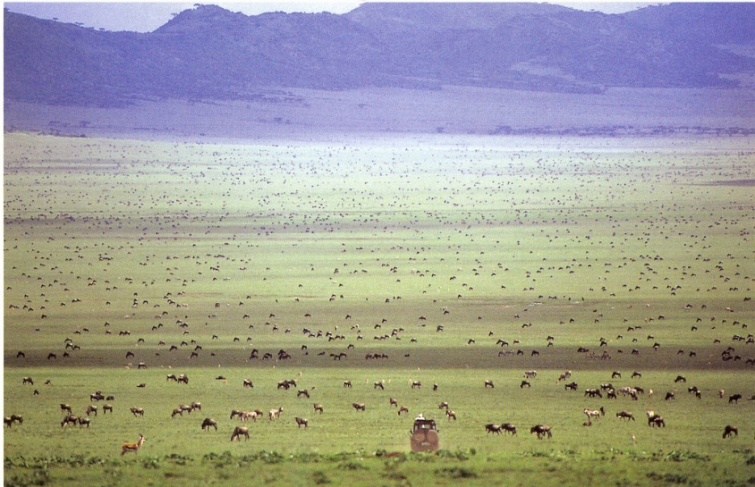
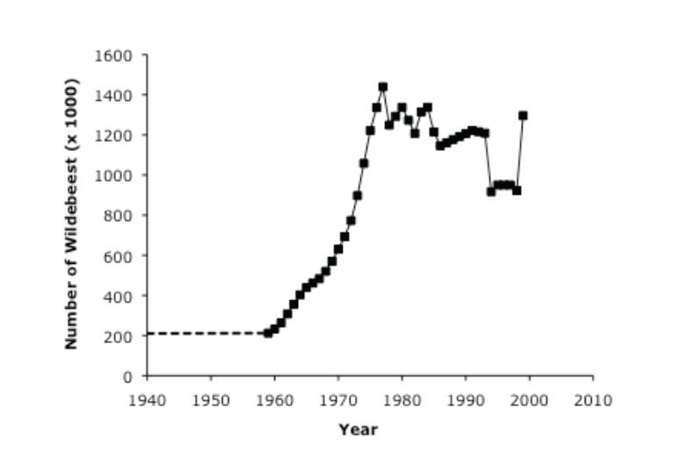

Slide 12
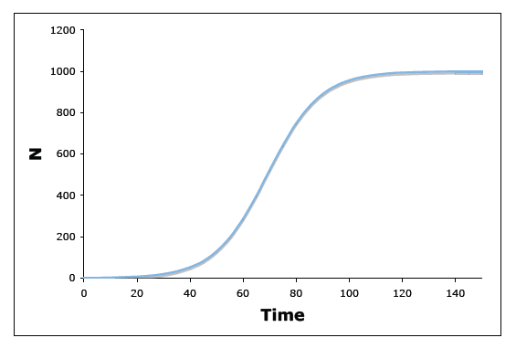


Overall population growth rate, differentiated form
Population size, integrated form

Slide 13
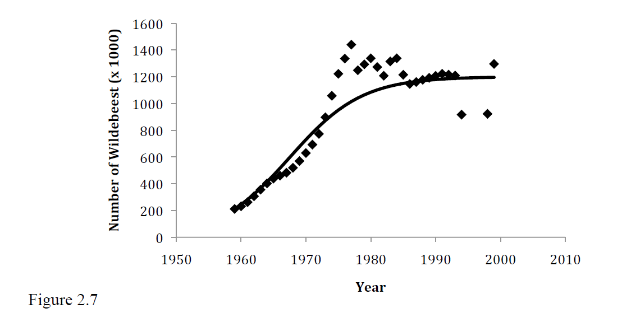
Carrying Capacity
K = 1.2M

Slide 14
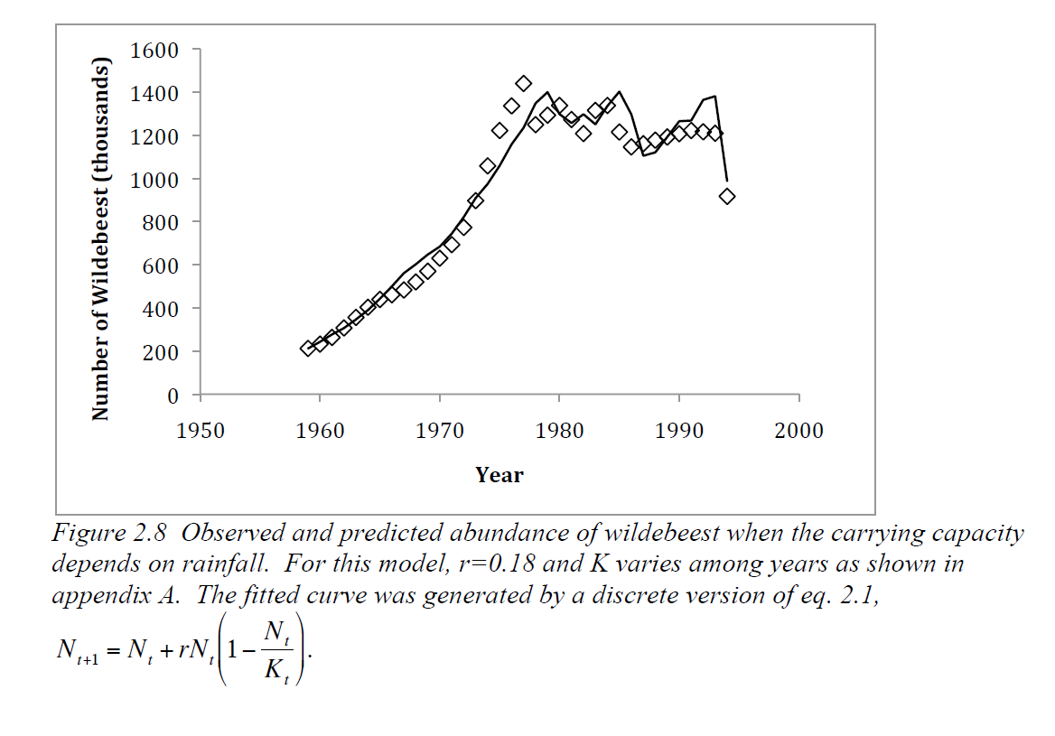
K = fn(Rain)
Fit to data so that
mean K = 1.2M

Slide 15
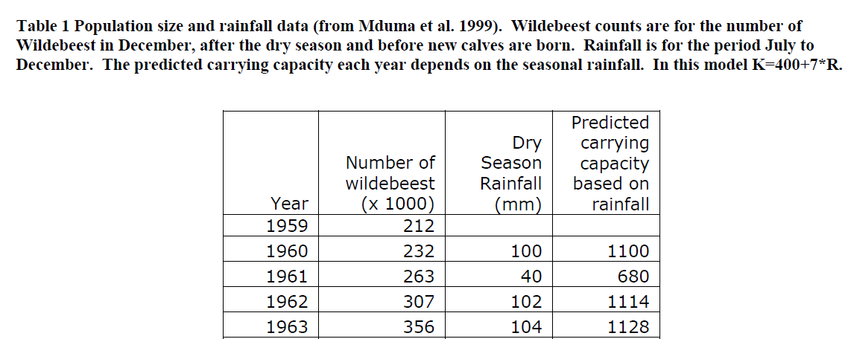
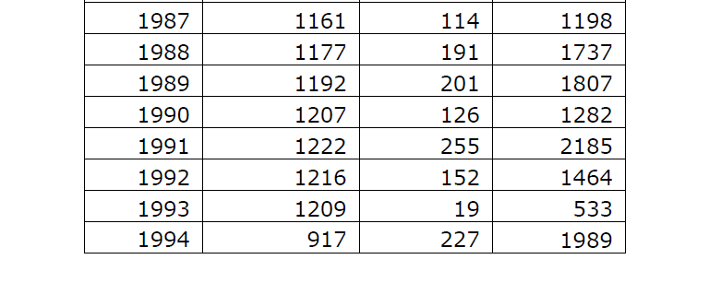

Slide 16
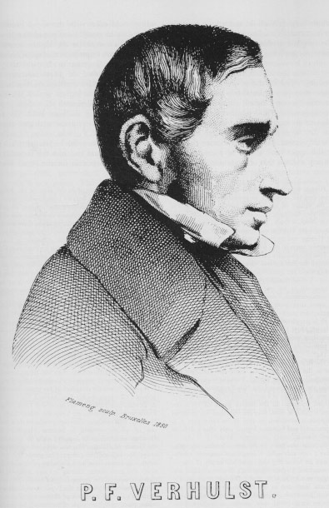
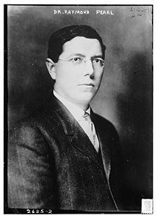
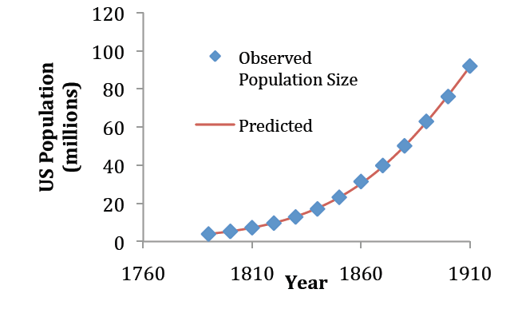
Verhulst-Pearl Model
- Logistic population growth
- Density dependent population growth
- Intraspecific competition for resources
1838
Model
1926
Application to human population data
1. Examine some details of P-V model of DD growth.
2. Comparison to OTHER models of DD growth

