Slide 1
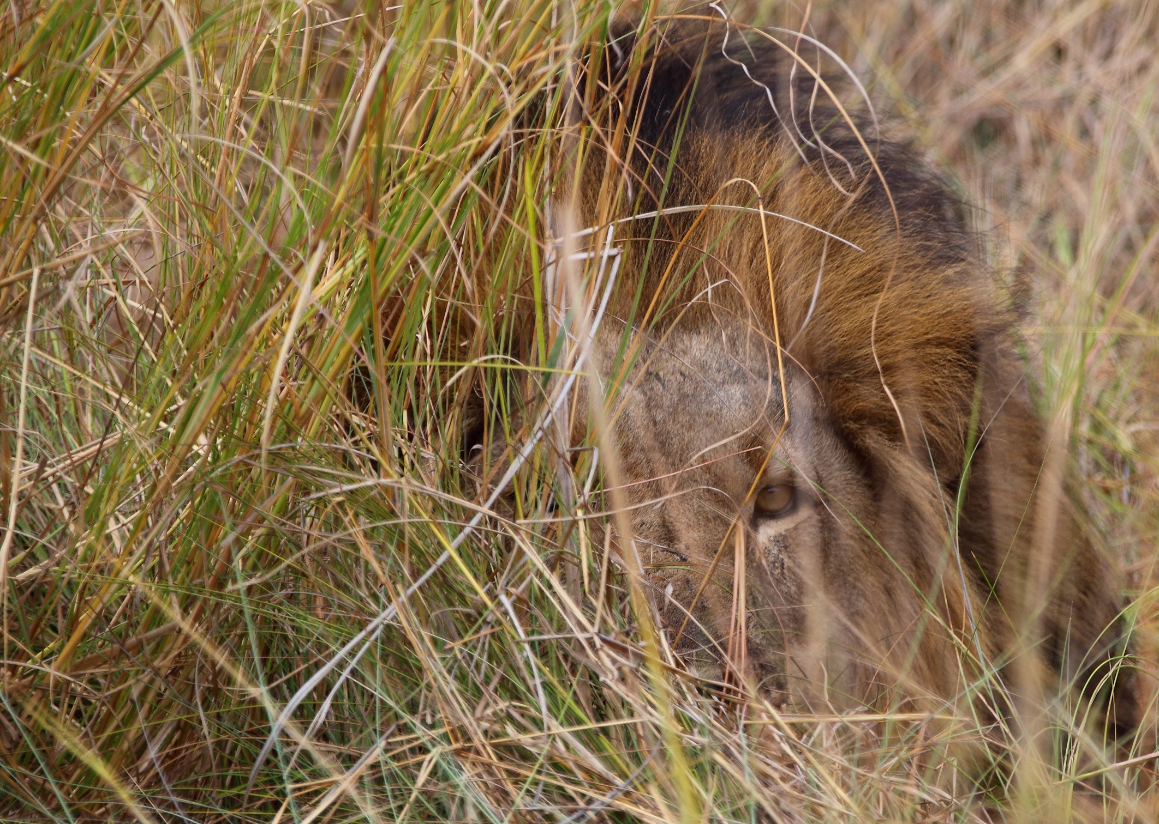

Slide 2
Figure 1: Intensive study area of the South Luangwa lion population in Eastern Province, Zambia. Comprising both strictly protected areas and community Game Management Areas the study encompassed the array of biological and human factors likely to impact Zambian lions.

Slide 3
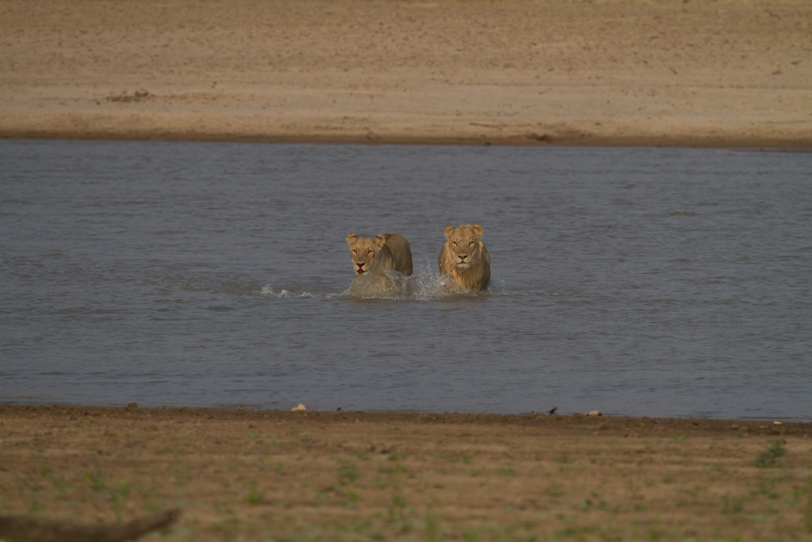

Slide 4
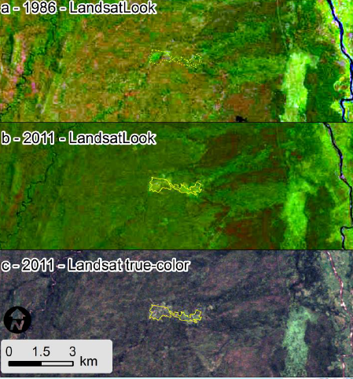
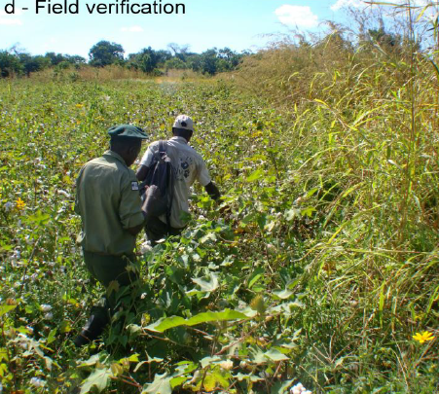

Slide 5
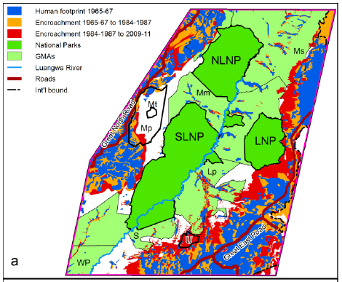

Slide 6
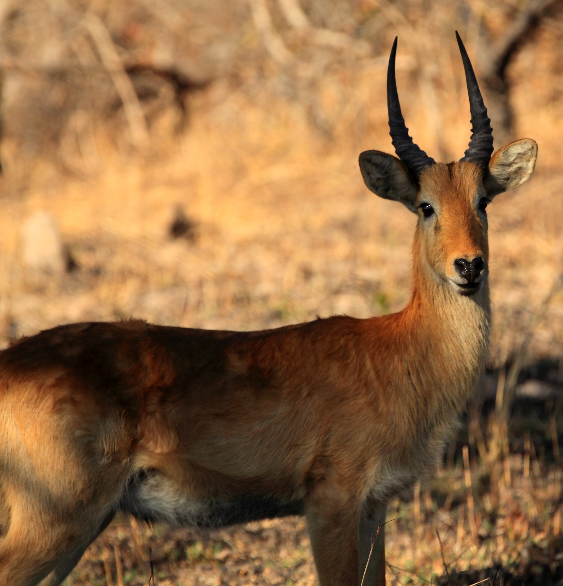

Slide 7
Impala
Puku
Zebra
Warthog
Protection Gradient
High Low
PW PE GMA

Slide 8
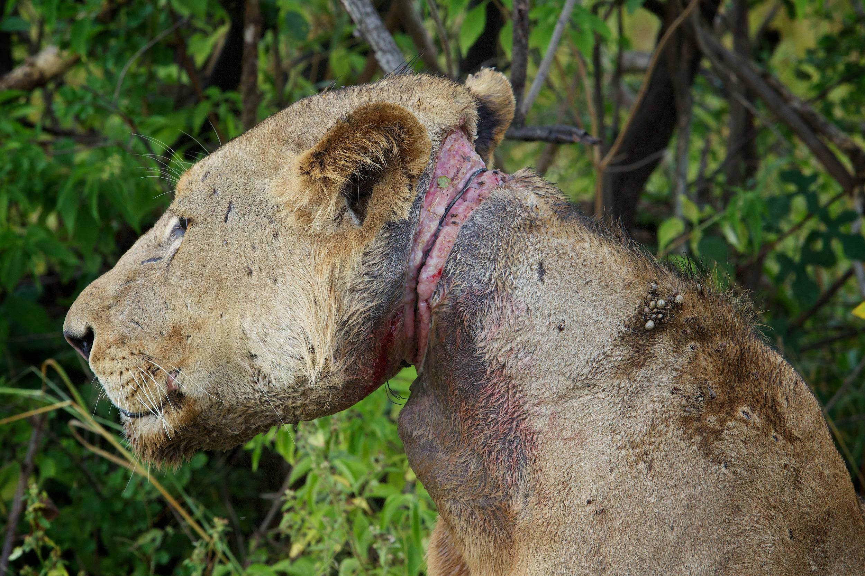

Slide 9
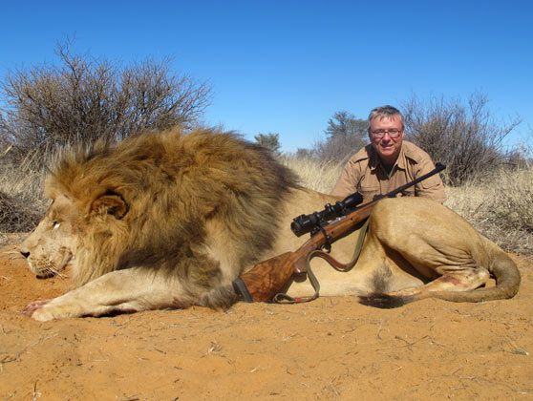

Slide 11
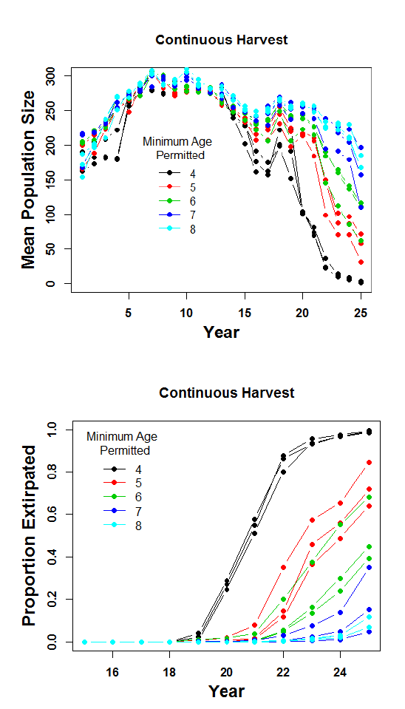

Slide 12
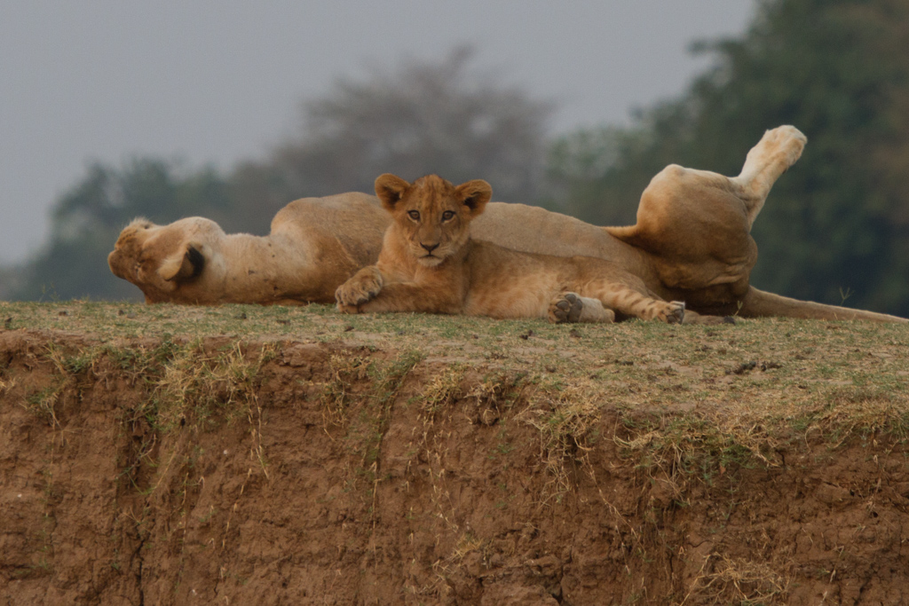

Slide 13
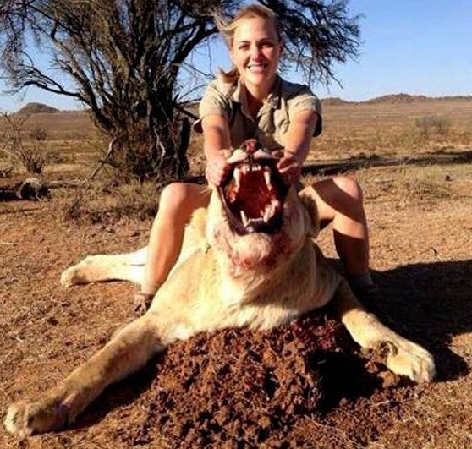

Slide 15

/* 113 */ 11001000 1;
/* 115 */ 11001000 1;
/* 116 */ 11001000 1;
/* 117 */ 11001100 1;
/* 118 */ 11001000 1;
/* 119 */ 11000000 1;
/* 121 */ 01000000 1;
/* 122 */ 11001100 1;
/* 152 */ 00010000 1;
/* 153 */ 00010100 1;
/* 154 */ 00111100 1;
/* 157 */ 00000100 1;
/* 158 */ 00010100 1;
/* 159 */ 00010100 1;
/* 161 */ 00010100 1;
/* 162 */ 00010100 1;
/* 163 */ 00010100 1;
/* 167 */ 10011111 1;
/* 168 */ 10011111 1;
/* 169 */ 10011111 1;
/* 170 */ 01111101 1;
/* 171 */ 01100000 1;
/* 213 */ 00000100 1;
/* 214 */ 00000100 1;
/* 215 */ 00000100 1;
/* 216 */ 00000100 1;
/* 217 */ 00000100 1;
/* 218 */ 10011110 1;
/* 219 */ 00000100 1;
/* 220 */ 10011110 1;
/* 221 */ 10011110 1;
/* 222 */ 10011010 1;
/* 223 */ 10011010 1;
/* 224 */ 10011110 1;
/* 225 */ 10011110 1;
/* 227 */ 10011110 1;
/* 1203728 */ 00001100 1;
/* 1203729 */ 00001100 1;
/* 1203730 */ 00001100 1;
/* 1203731 */ 00001100 1;
/* 1203732 */ 10000111 1;
/* 1203733 */ 10000111 1;
/* 1203734 */ 10001111 1;
/* 1203735 */ 10000111 1;
Capture histories
in format of
Program MARK
/* 113 */ 11001000 1;
$$\hat{N}= \frac{C}{\hat{p}}$$

Slide 17
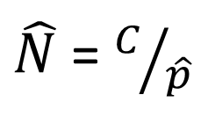
$\hat{N}$ = $C/{\hat{p}}$
These estimates of
population size are from
‘Huggins heterogeneity’
model
- p(low)
- p(high)
- mixing parameter π

Slide 18
This is of value, but does not reveal much, if anything about the cause of decline.
Analysis of demographic rates (survival and reproduction of each age/sex class):
1. Yields parallel information on population growth (a good cross-check).
2. Yields information on where the problems are, demographically.
3. Which often yields information about the factors driving the observed
population trends.

Slide 19

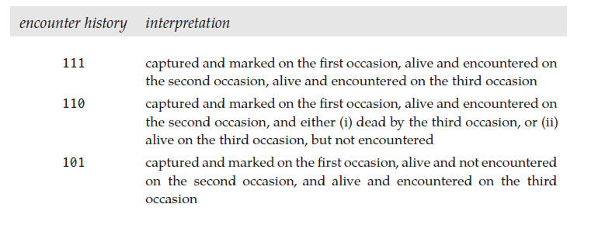
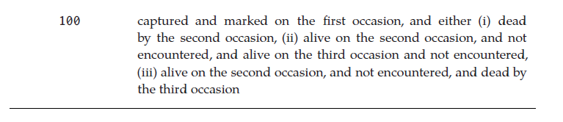
Three occasion capture history
p – probability of detection during a sampling session
φ - probability of survival from one sampling session
to the next session

Slide 20
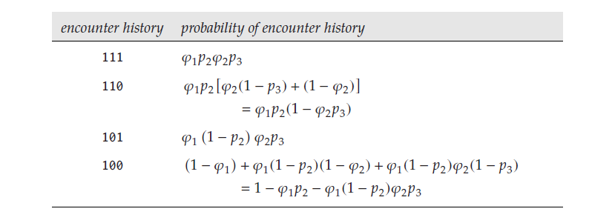
p – probability of detection during a sampling session
φ - probability of survival from one sampling session to the next session

Slide 21
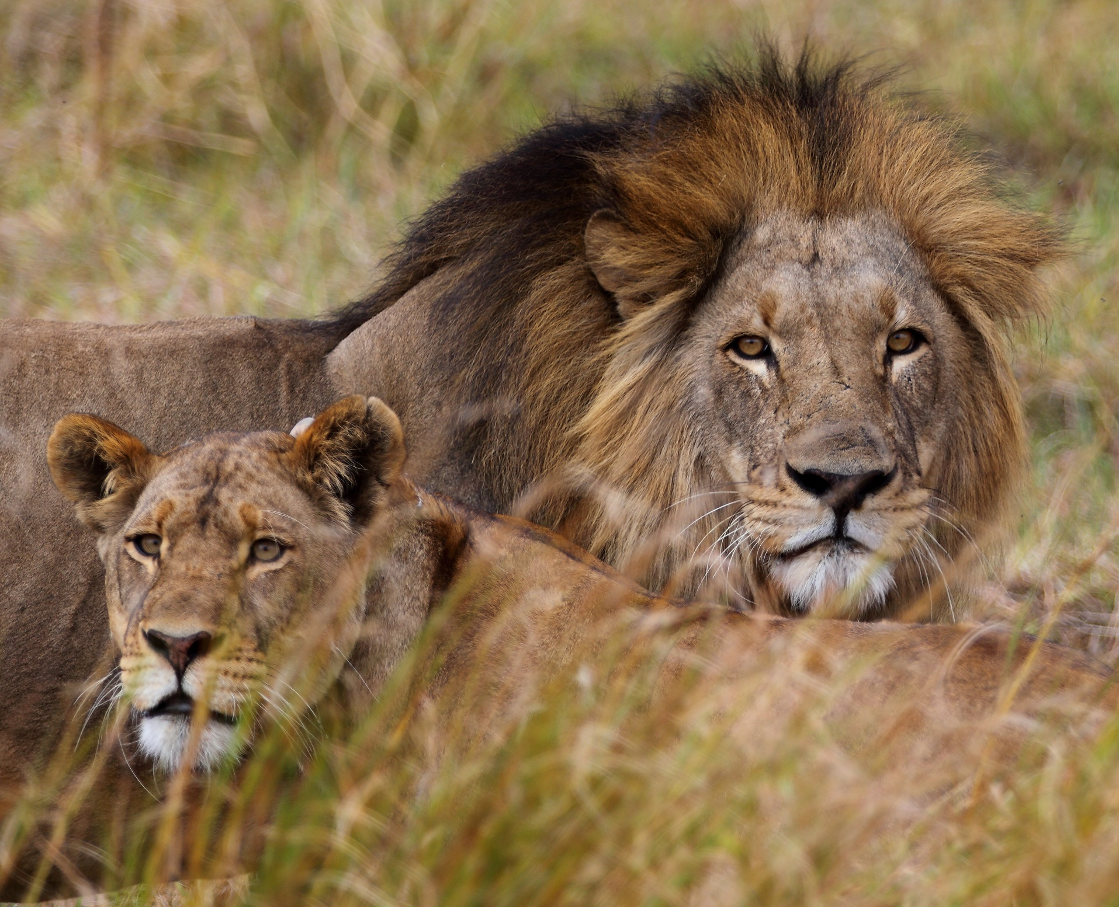

Slide 22
Divergence in sex-specific
survival rates at onset of
harvested age classes

Slide 23
Male depletion in preferred trophy
age-classes
Senescing female population –
Prolonged effects on recruitment

Slide 24
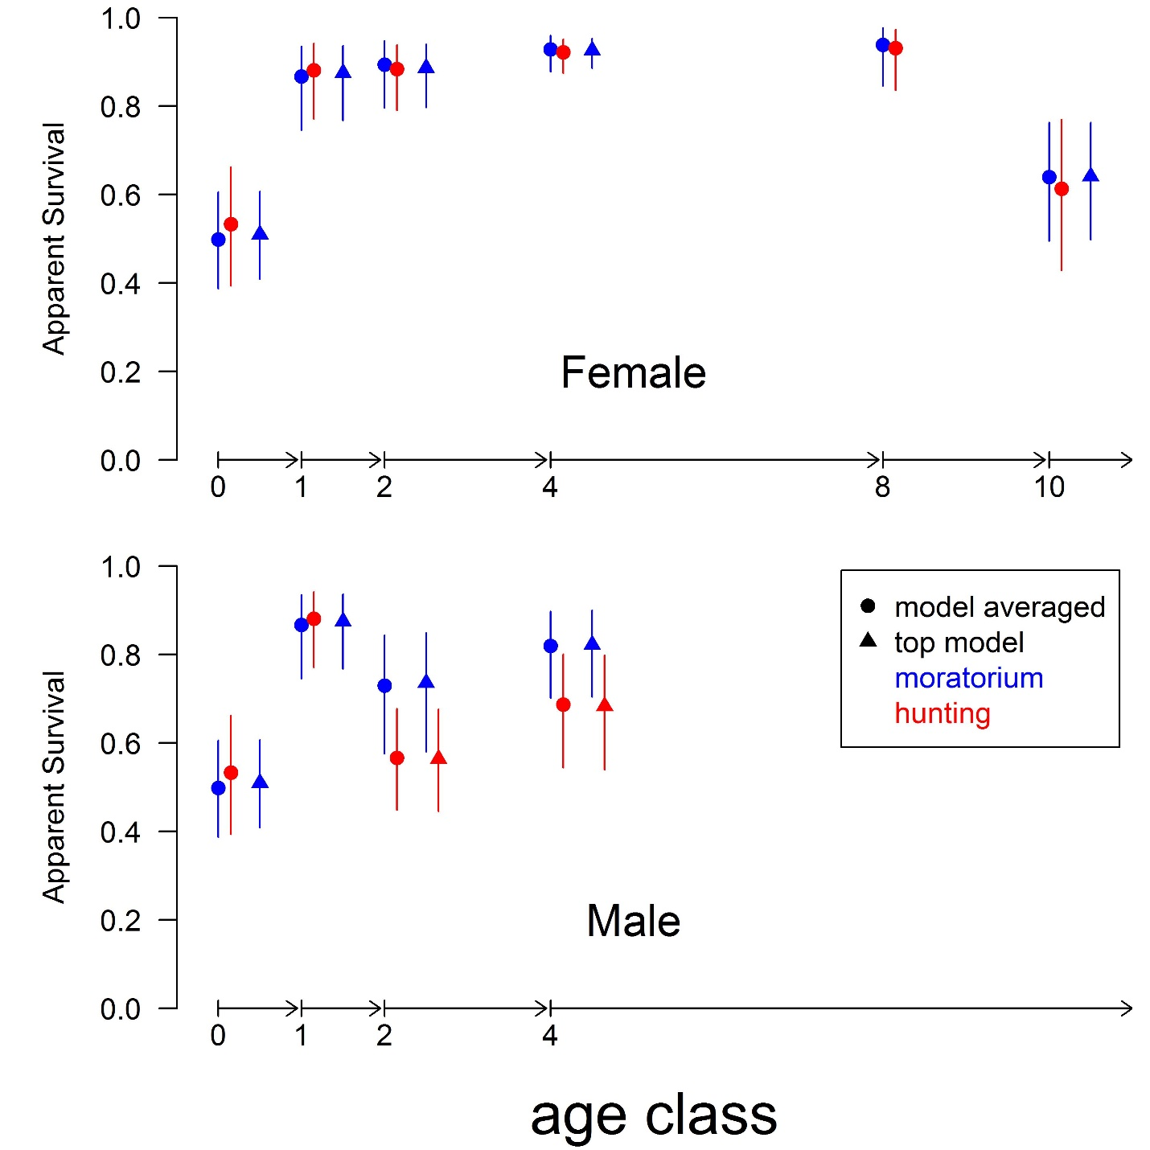

Slide 25
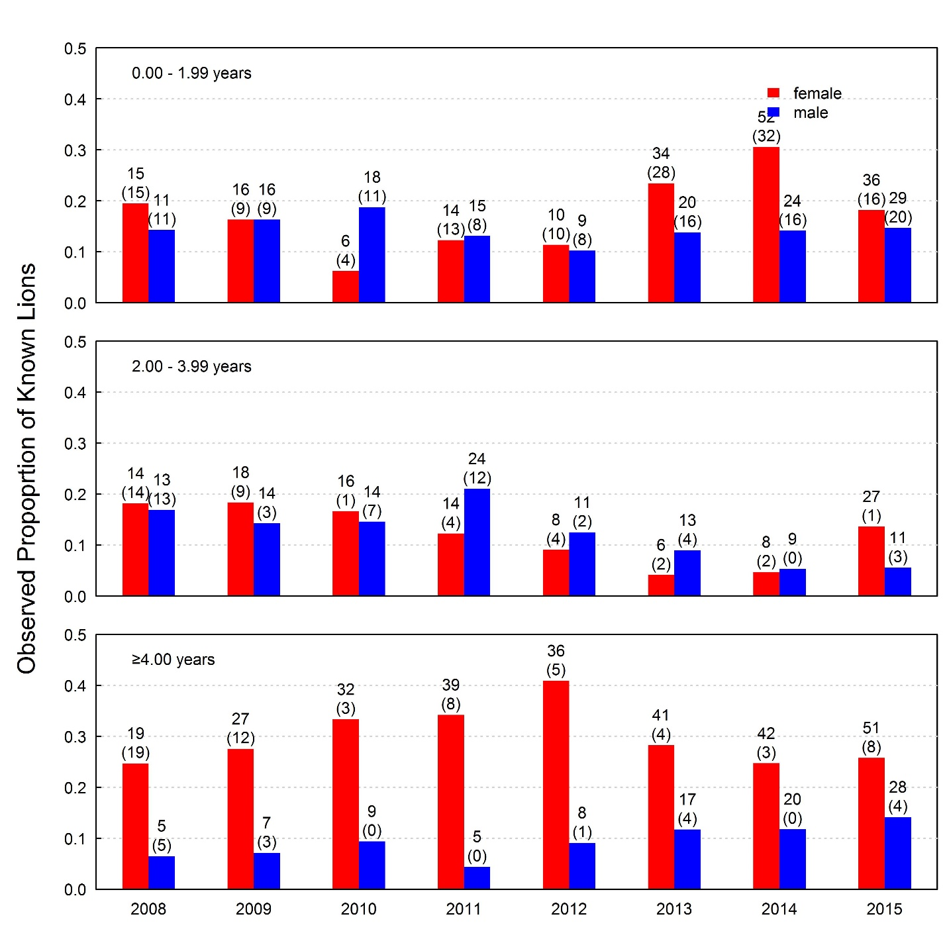

Slide 26
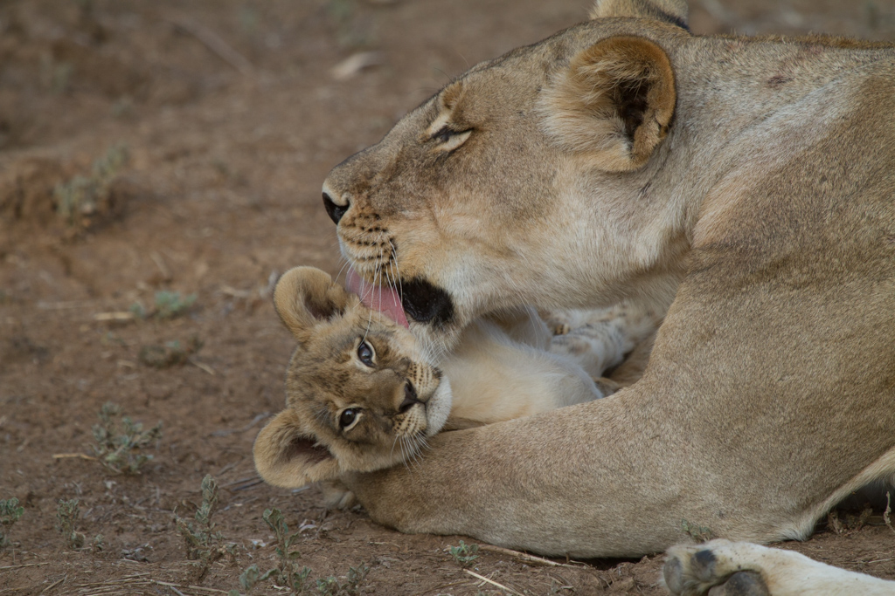

Slide 27
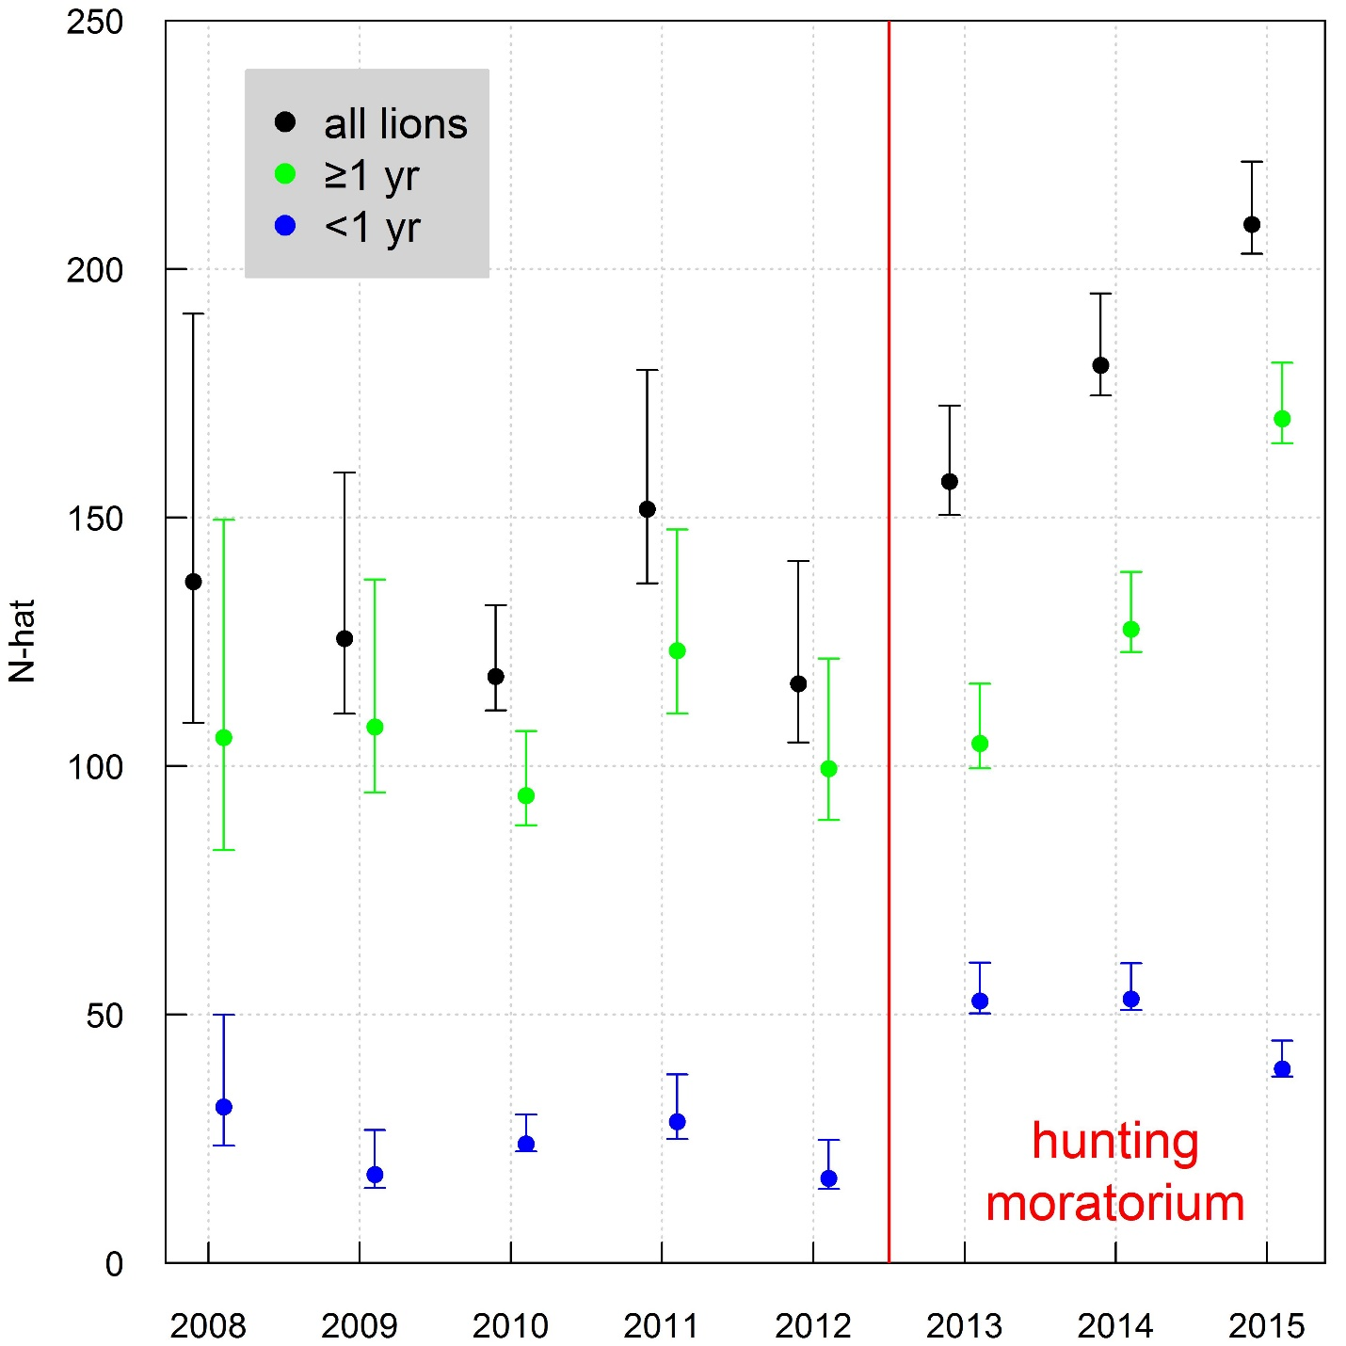

Slide 28
