Slide 1
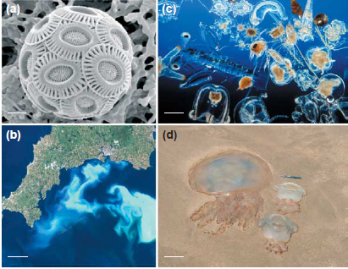
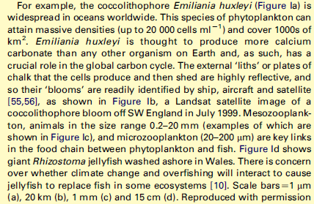

Slide 2
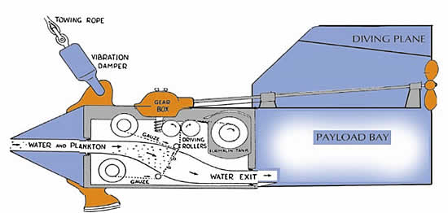
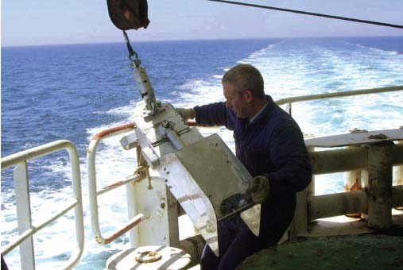
Continuous Plankton Recorder

Slide 3
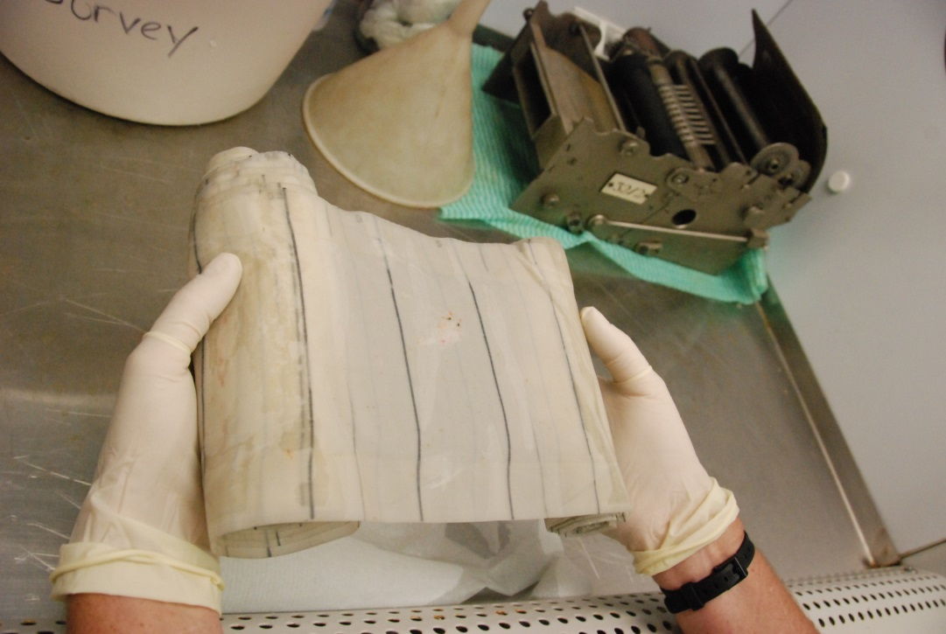
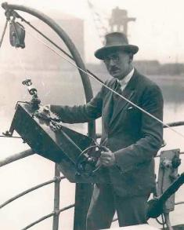

Slide 4
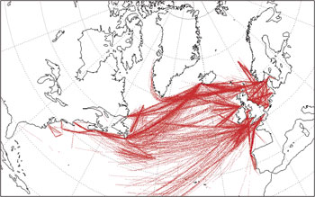
http://www.sahfos.ac.uk/

Slide 5
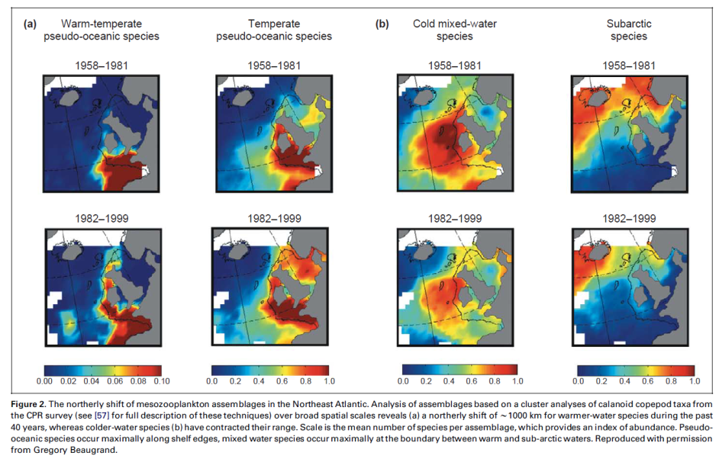

Slide 6
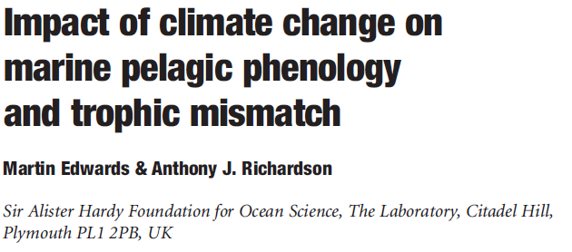
Five ecologically
distinct functional groups
Three trophic levels

Slide 7
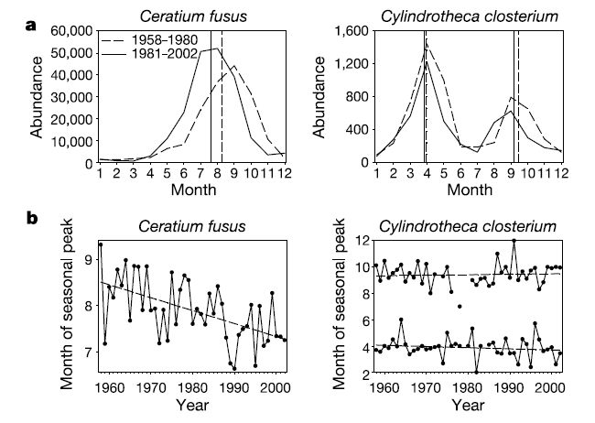
A dinoflagellate, showing the typical
results for dinoflagellates and zooplankton
A diatom, showing the typical results
for diatoms and copepods

Slide 8
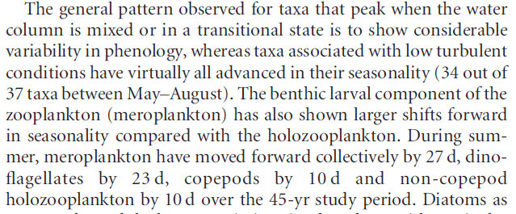
Phytoplankton
Producers
Zooplankton
Meroplankton
Consumers

Slide 9
Phytoplankton
Producers
Timing dependent on light
Timing dependent on temperature
Zooplankton
Meroplankton
Consumers

Slide 10
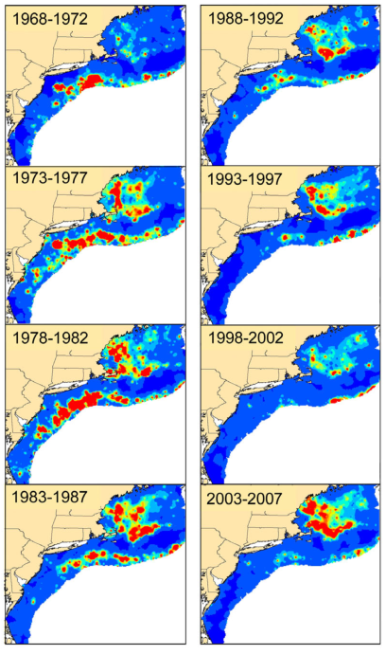
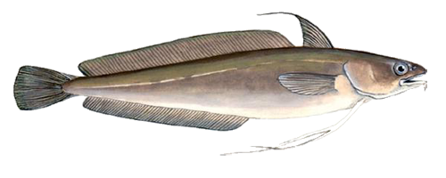
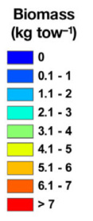
Red Hake Urophycis chuss

Slide 11
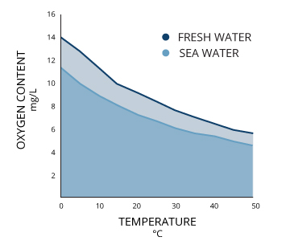

Slide 12
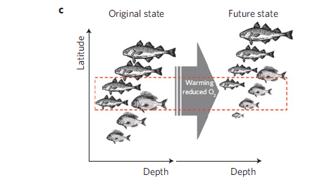

Slide 13
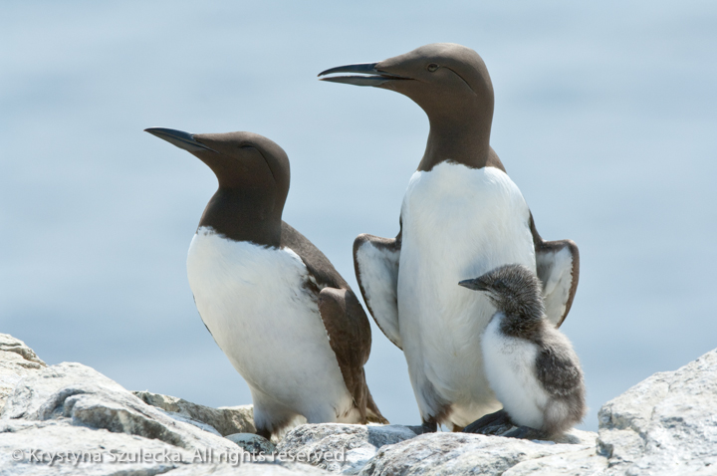
Another example…

Slide 14
Broad summary of observed responses to past climate change
http://www.montana.edu/screel/teaching/bioe-440r-521/documents/parmesan.pdf

Slide 15
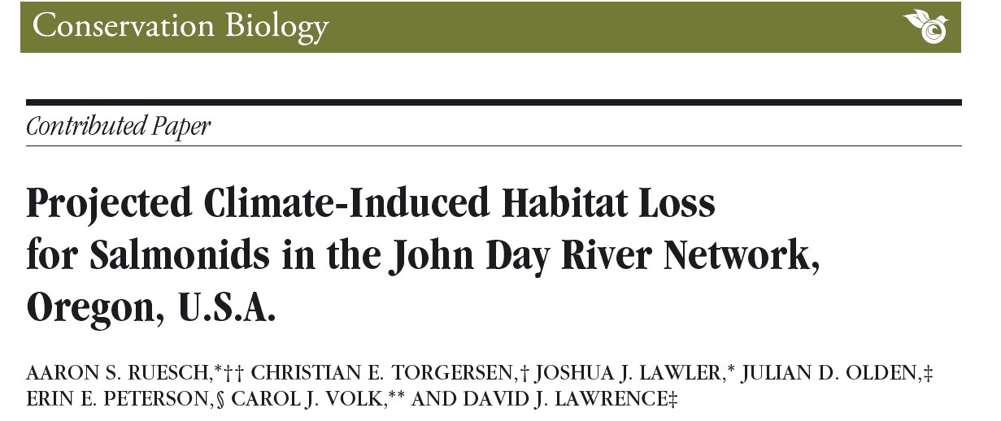
Example of climate envelope modelling to project
Future responses to climate change

Slide 16
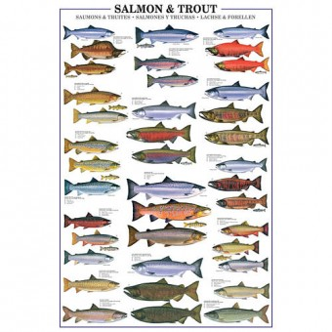
Chinook and RBT: 24 C thermal tolerance
Bull trout: 14.4 C thermal tolerance
95th percentile of frequency distribution
on a weekly scale
John Day River system
Hobo temperature loggers

Slide 17
Max stream temperature = fn (max air temp + solar radiation)

Slide 18
AIR
TEMPERATURE PROJECTIONS
A1B emissions
scenario

Slide 19
Historic (1993-2009)
Projection (2070-2099)
Chinook and RBT: 24 C thermal tolerance
Bull trout: 14.4 C thermal tolerance

Slide 21
2070 -2099
vs
1993 - 2009
MS – main stems
TRB – tributaries
ALL - combined
L – loss by reach length
V- loss by reach volume

Slide 22
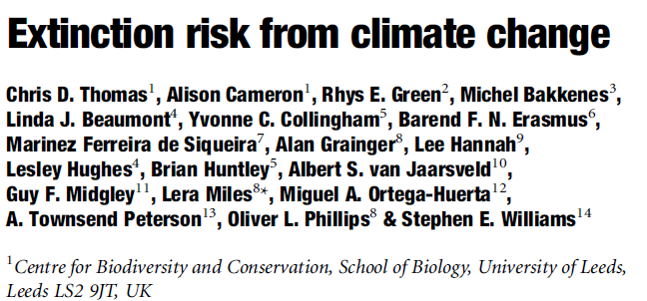
Broad summary of climate envelope modelling projections
http://www.montana.edu/screel/teaching/bioe-440r-521/documents/thomas%20climate%20extinction.pdf

