Slide 1
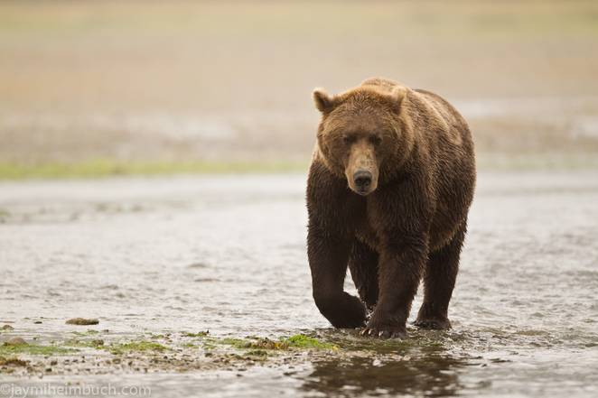

Slide 2
“The estimated Greater Yellowstone Ecosystem grizzly bear population increased from 136 in 1975 to between 674 and 839 in 2014…”
- first line of https://www.nps.gov/yell/learn/nature/gbearinfo.htm

Slide 3
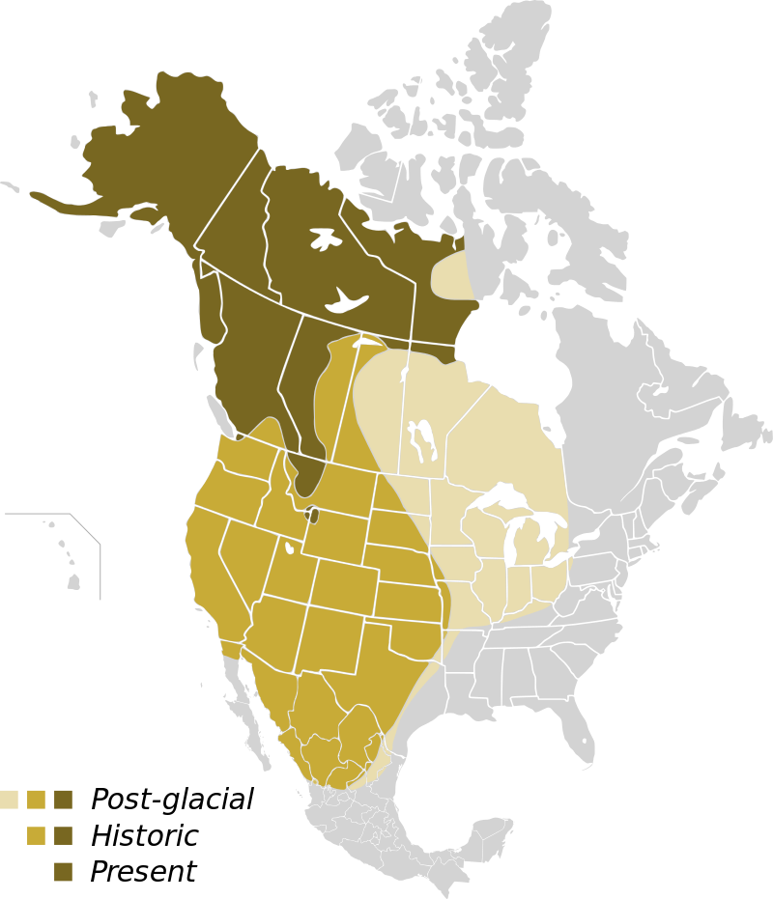

Slide 4
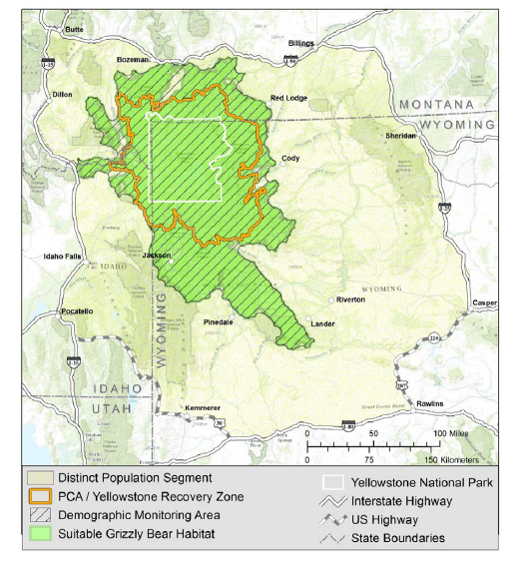

Slide 5
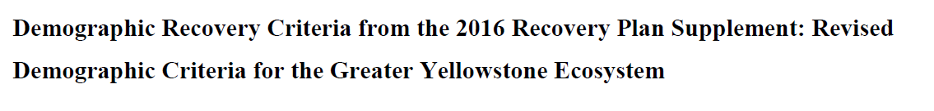
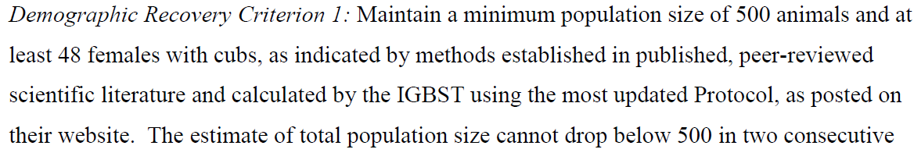
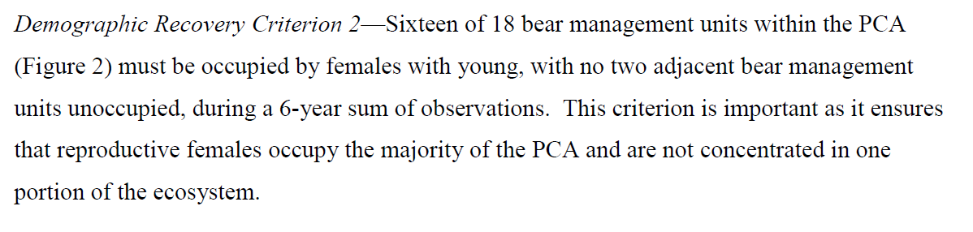
* TOTAL POPULATION SIZE & EFFECTIVE POPULATION SIZE
* SPATIAL EXTENT

Slide 6
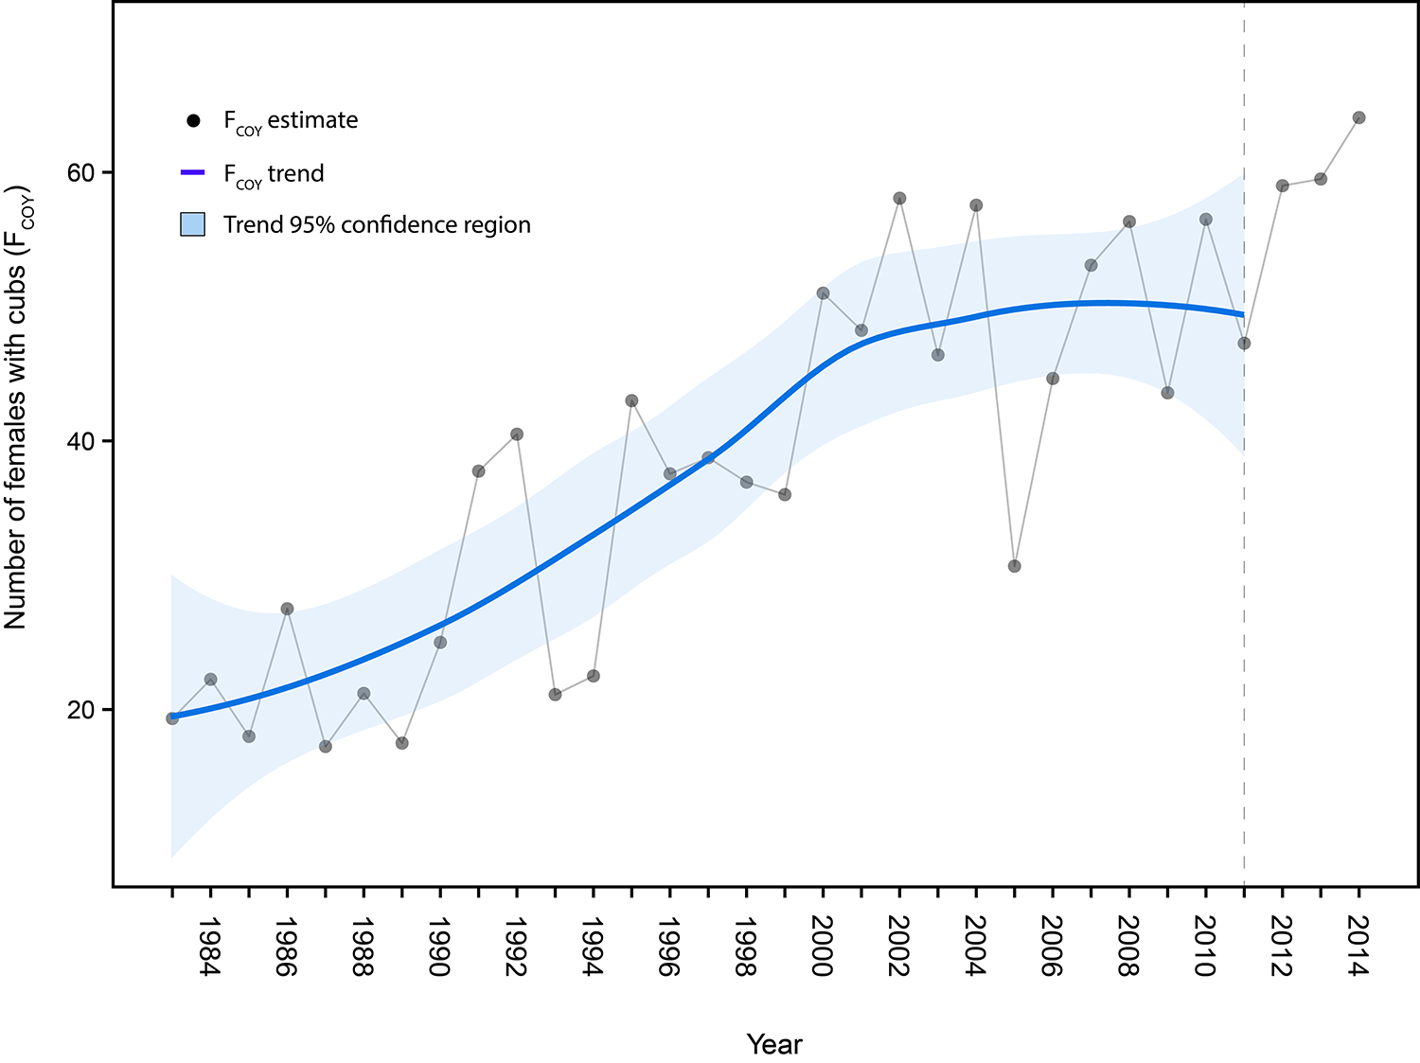
USFWS proposes delisting
Van Manen et al 2016. Yellowstone Science 23: 17-25

Slide 7
“The estimated Greater Yellowstone Ecosystem grizzly bear population increased from 136 in 1975 to between 674 and 839 in 2014…”
- first line of https://www.nps.gov/yell/learn/nature/gbearinfo.htm
USFWS proposes delisting
Van Manen et al 2016. Yellowstone Science 23: 17-25

Slide 8
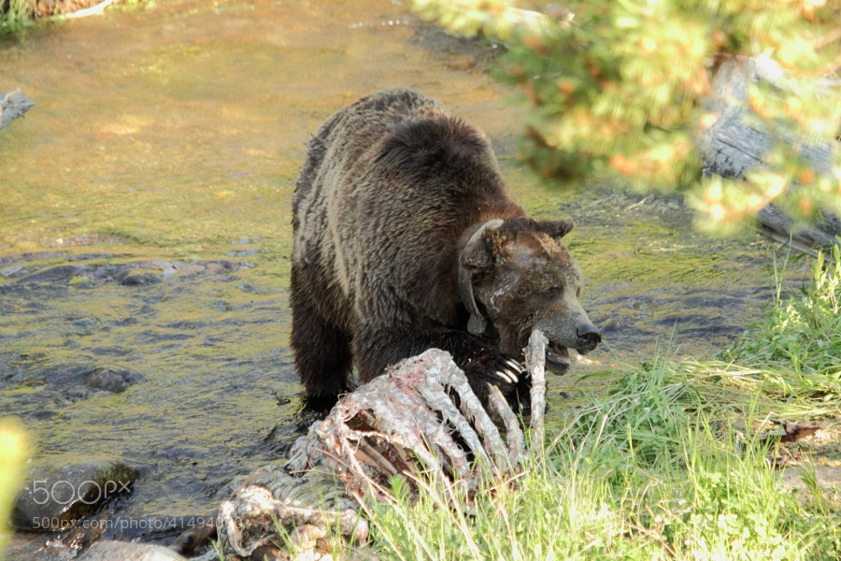
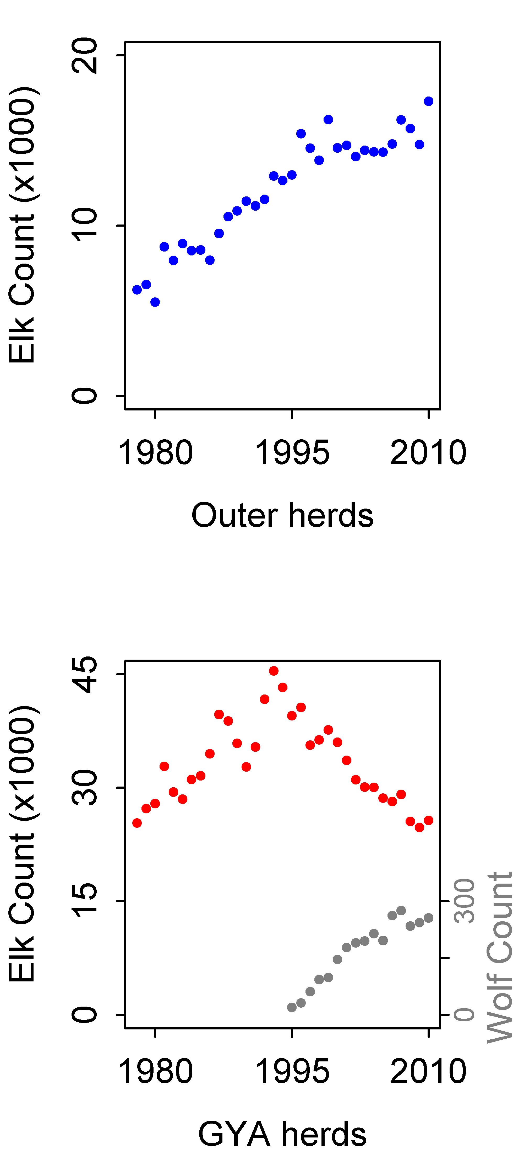
Elk carcasses and calves
7
8
M O N T A N A
2
1
5
12
3
4
11
I D A H O
6
W Y O M I N G
9
10
Outer elk herds
GYA elk herds

Slide 9
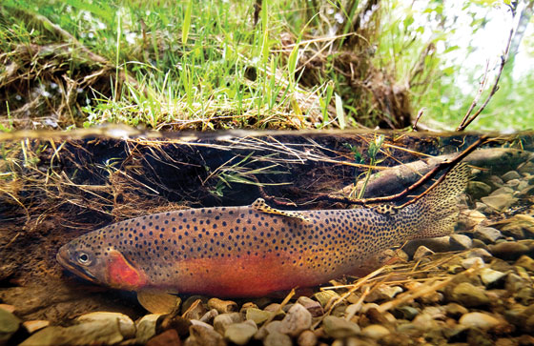
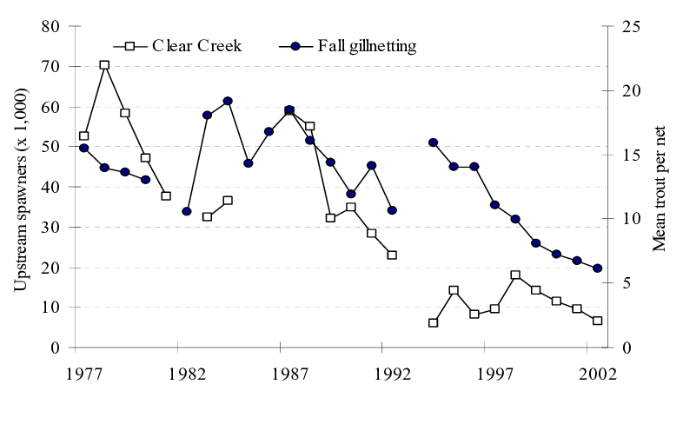
Cutthroat trout runs

Slide 10
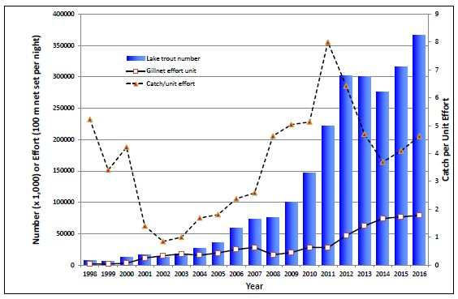

Slide 11
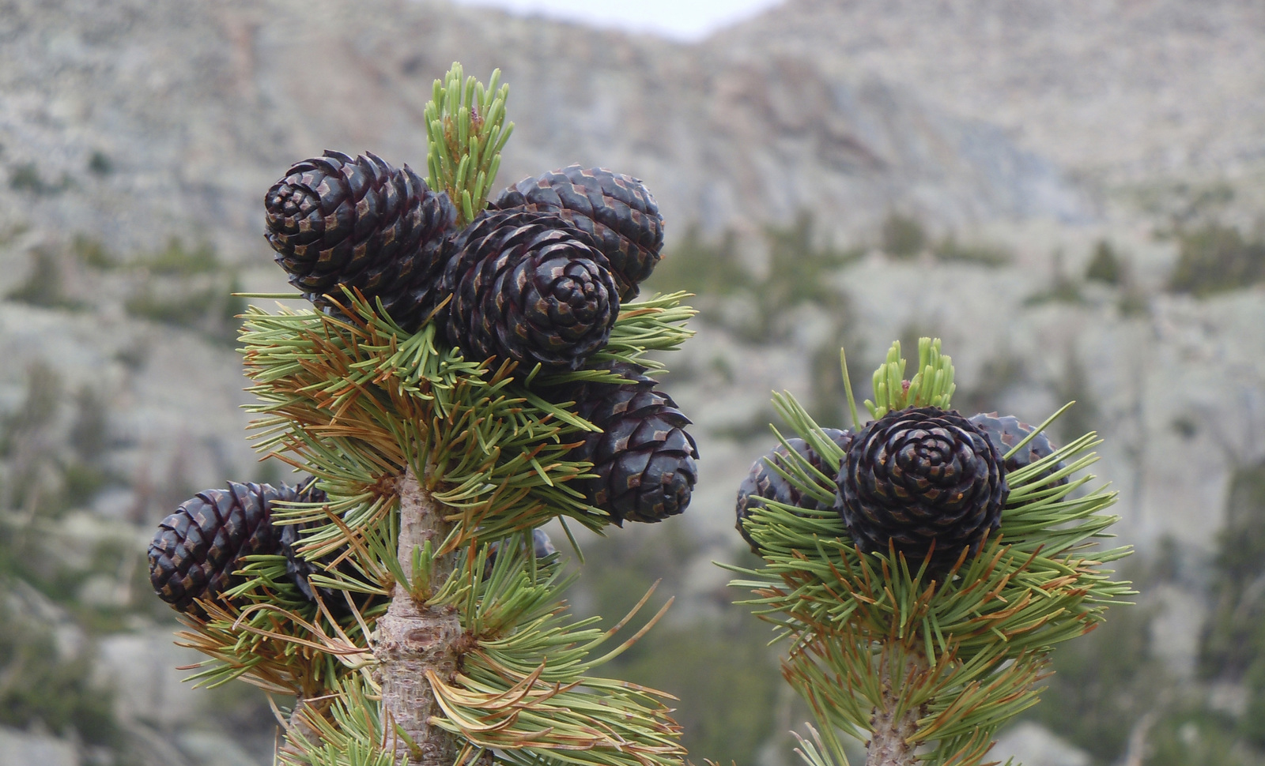
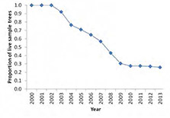
Whitebark pine cones

Slide 12
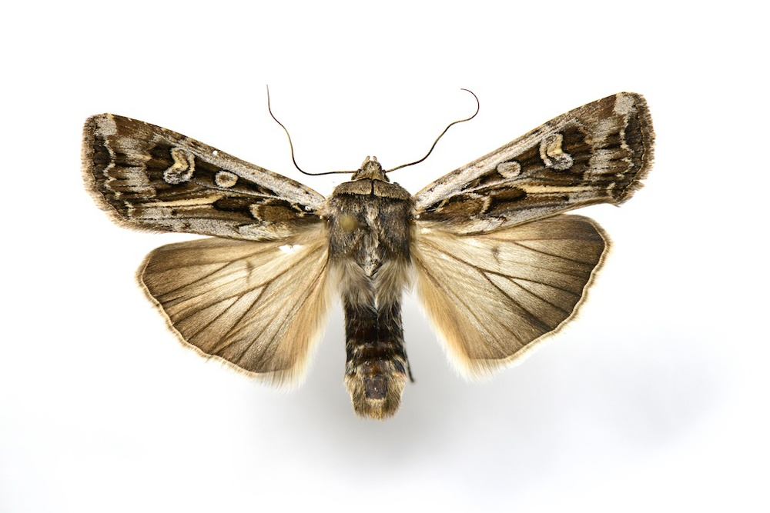
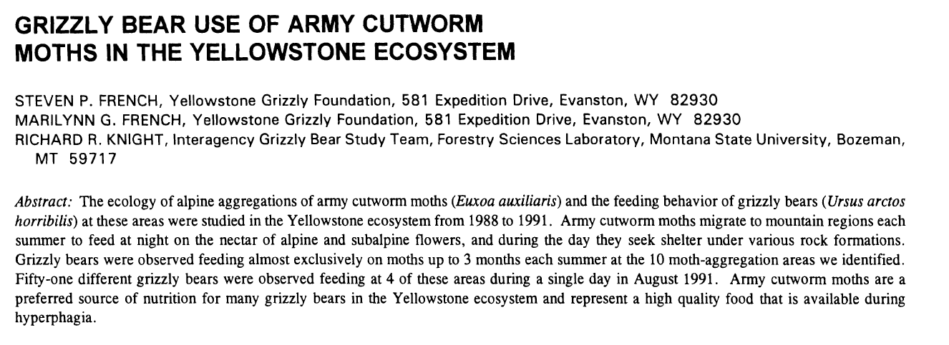

Slide 13
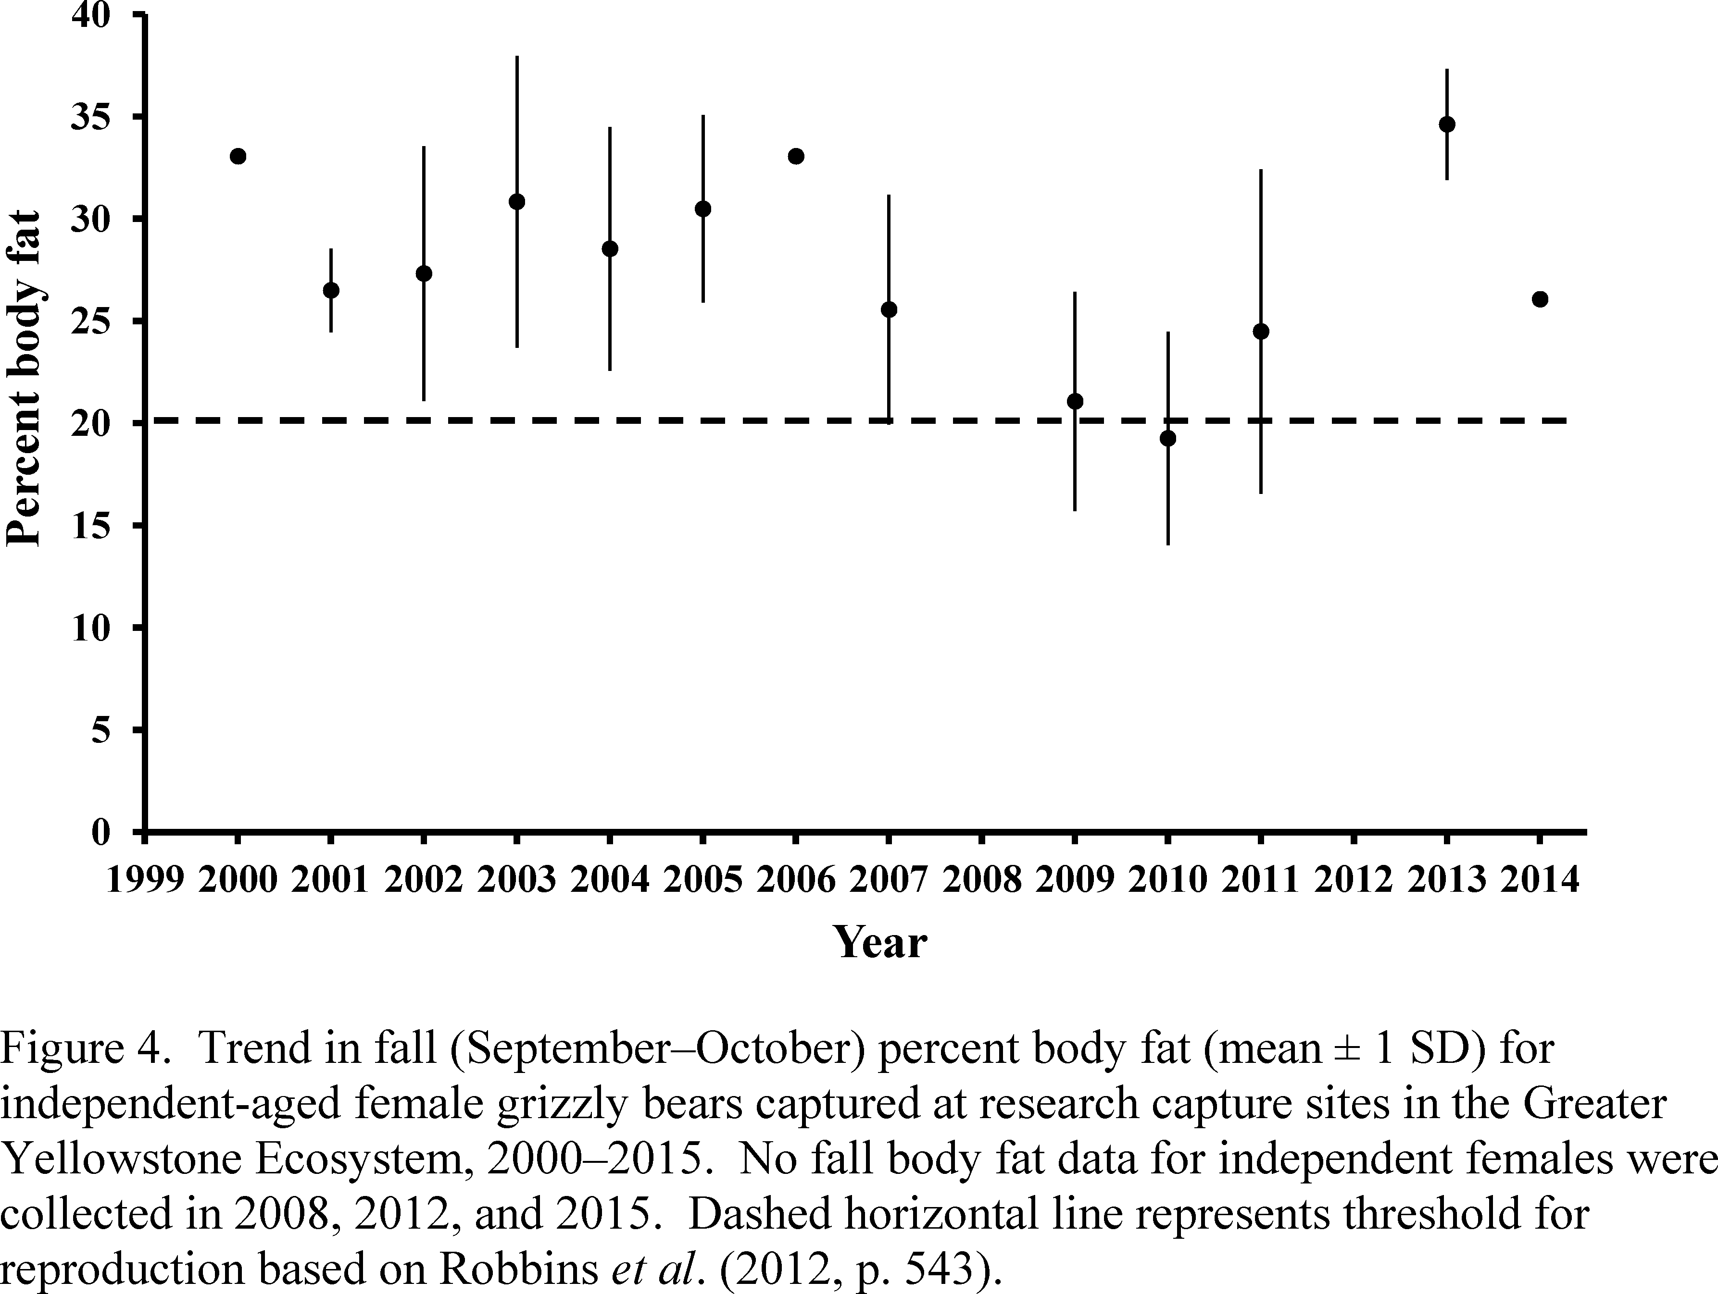

Slide 14
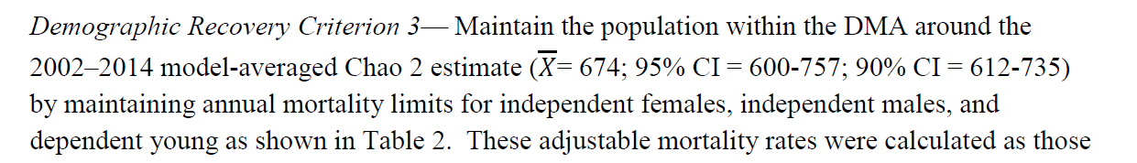
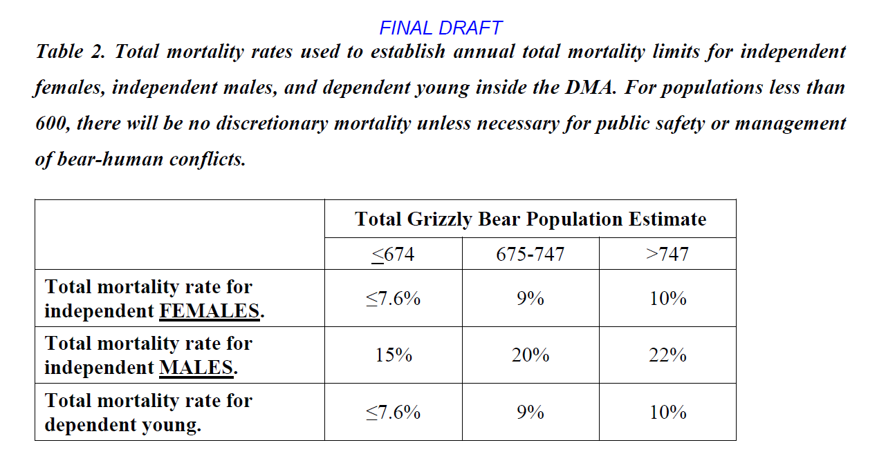
* DEMOGRAPHY - MORTALITY RATES

Slide 15
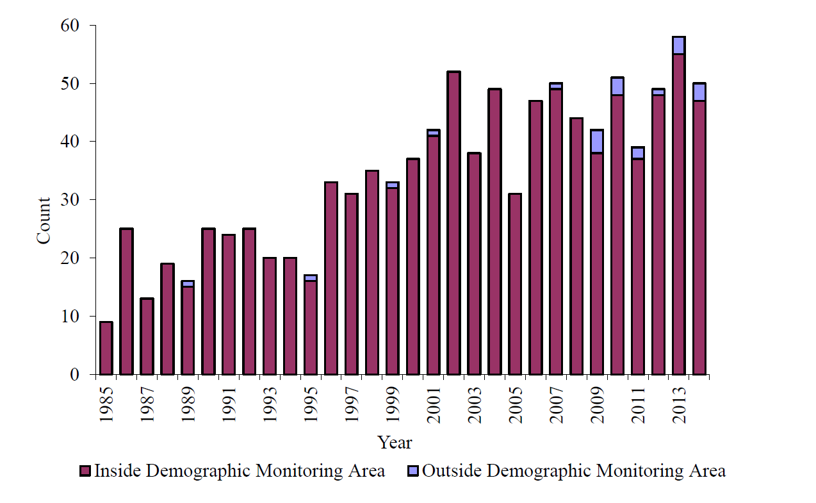
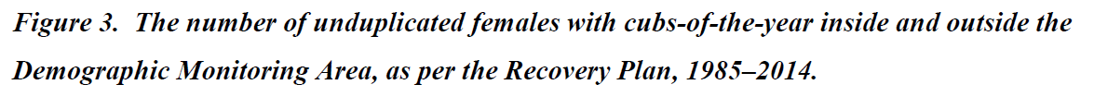

Slide 18
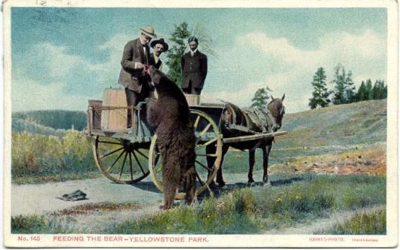
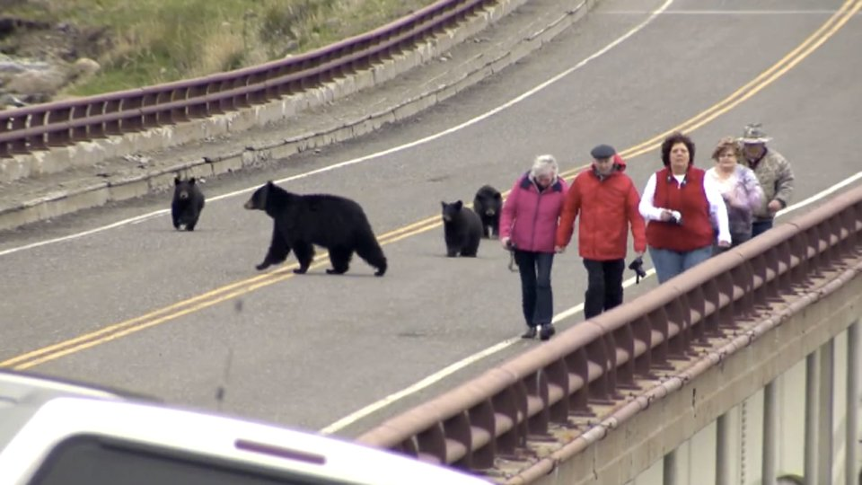

Slide 19
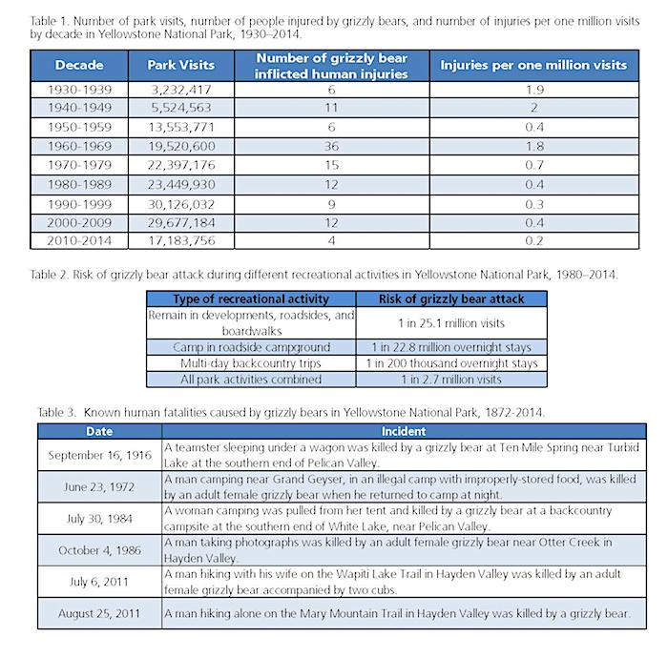

Slide 20
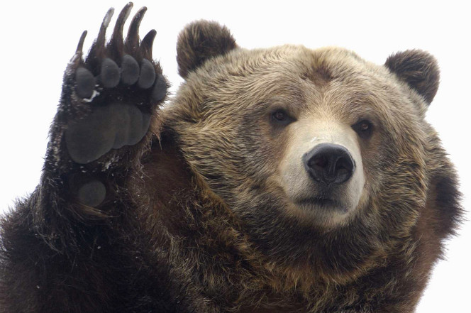

Slide 21
“Boyce et al. (2001) reviewed the existing published PVAs for GYE grizzly bears and updated these previous analyses using data collected since the original analyses were completed. They also conducted new PVAs using two software packages that had not been available to previous investigators. They found that the GYE grizzly bear population had a 1 percent chance of going extinct within the next 100 years and a 4 percent chance of going extinct in the next 500 years.”
“The authors cautioned that their analyses were not entirely sufficient because they were not able to consider possible changes in habitat and how these may affect population vital rates.”

Slide 22
