Slide 1
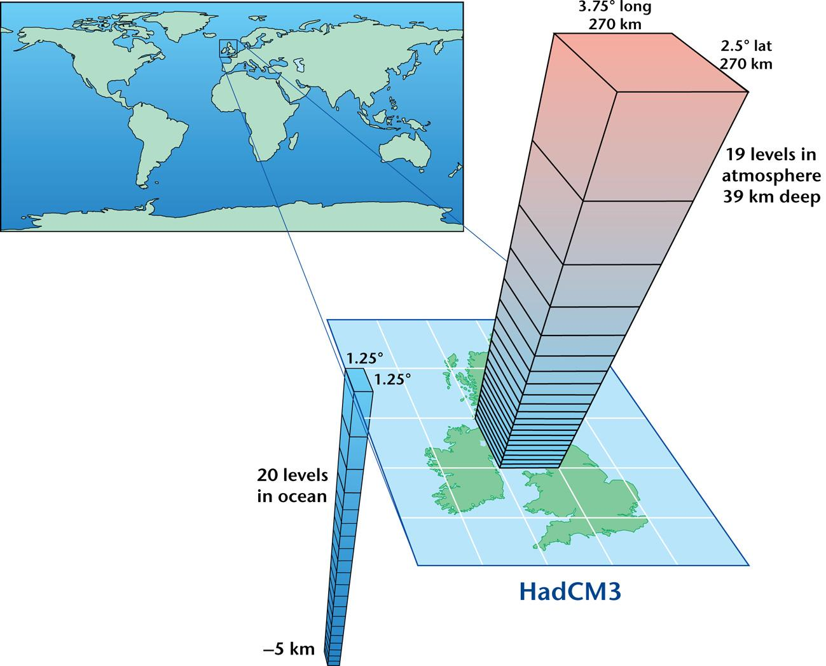
= 133,152 cells

Slide 2
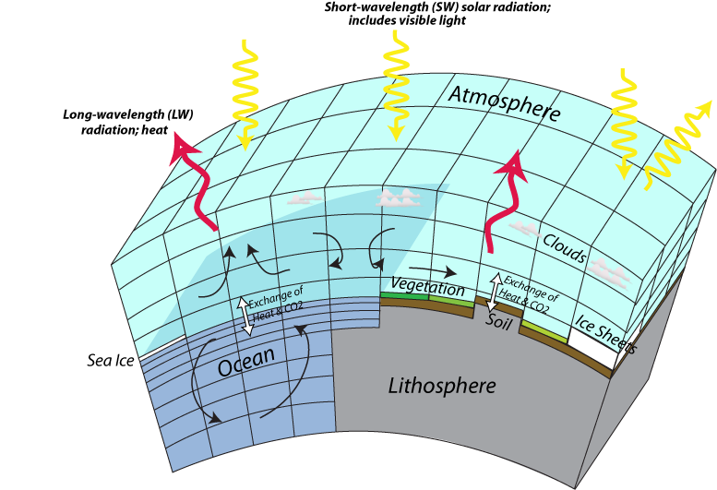

Slide 3
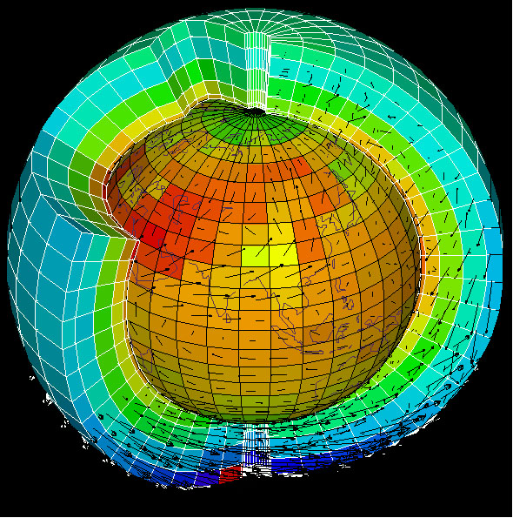
Also see animation for projections of GCM through time

Slide 4
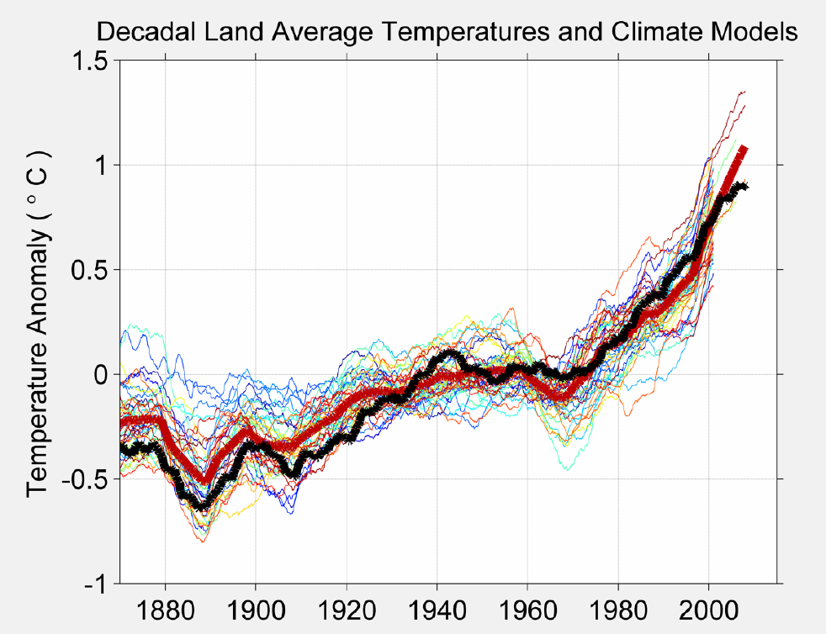

Slide 5
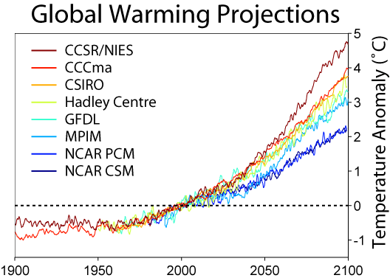

Slide 6
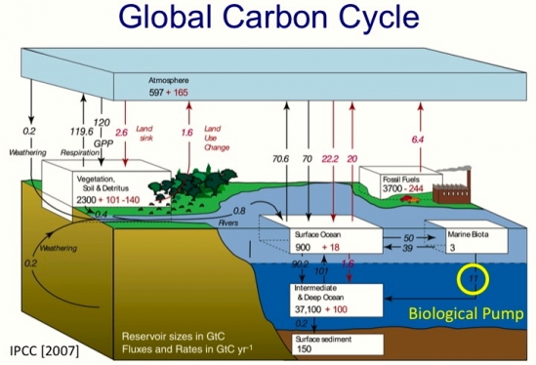

Slide 7


Slide 8
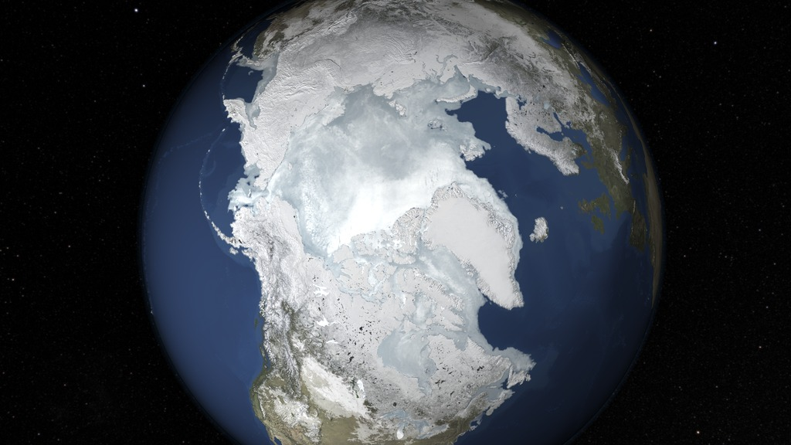

Slide 9
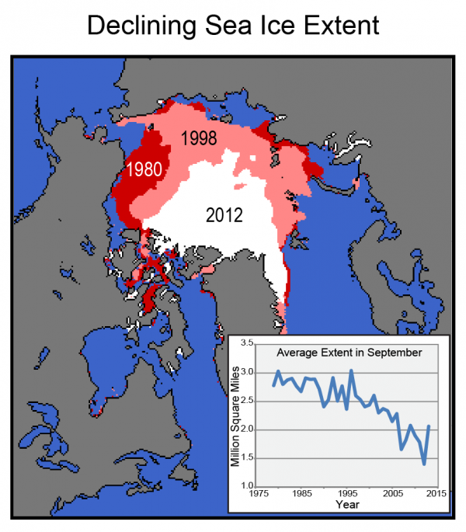

Effect on Albedo
↓ 13.3% per decade (NASA 2017)

Slide 11
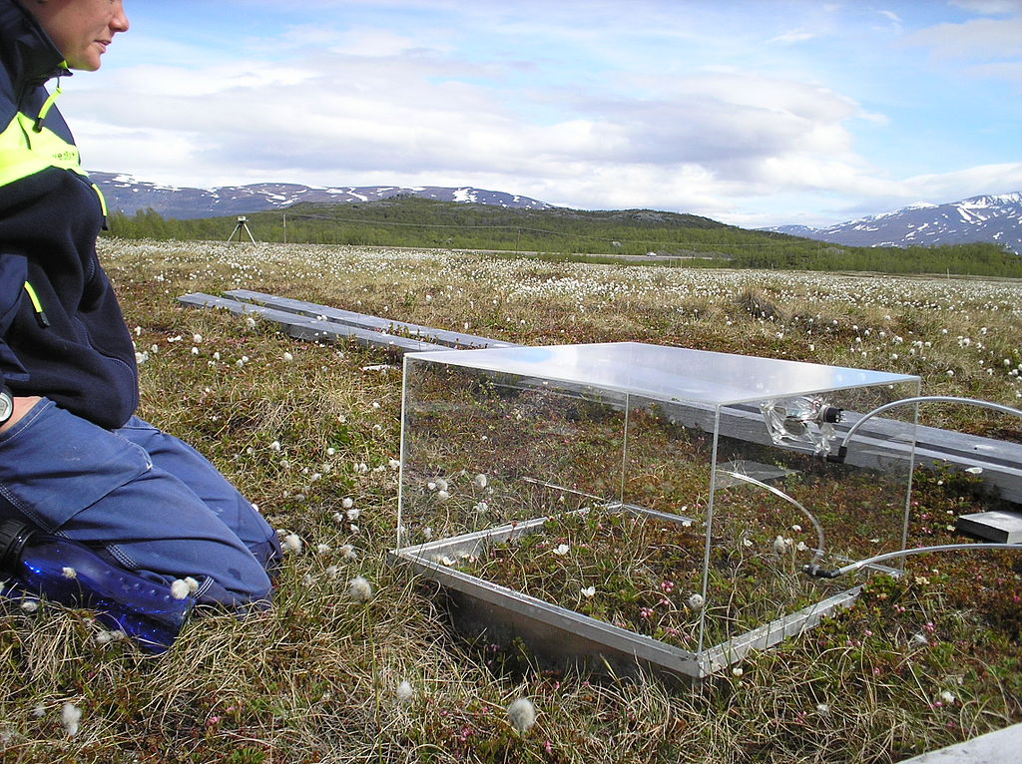

Slide 12
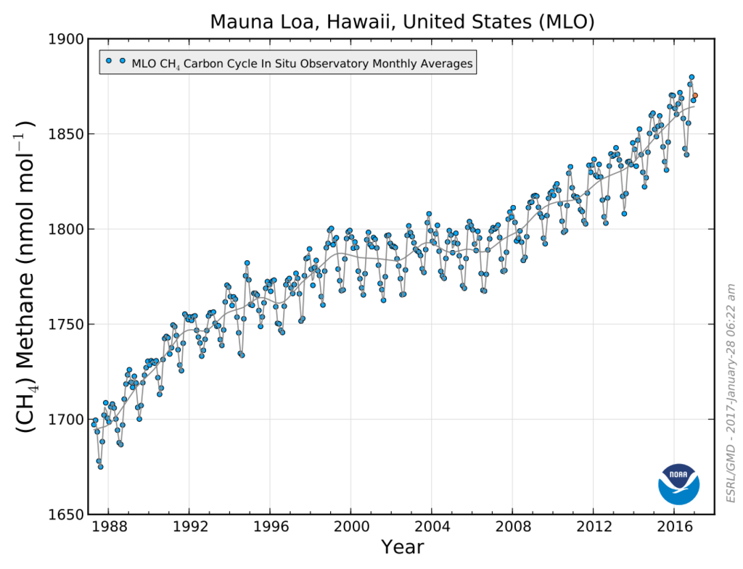

Slide 13
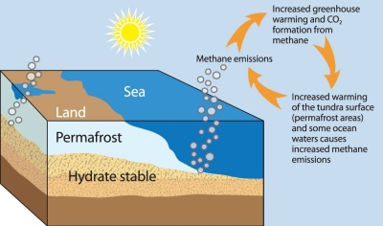

Slide 14
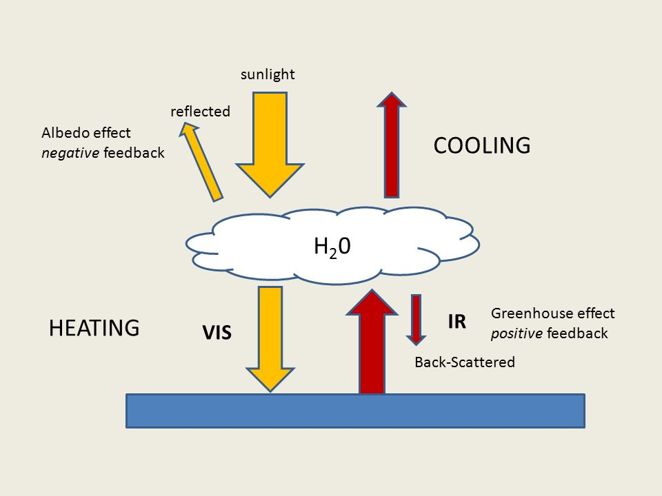

Slide 15
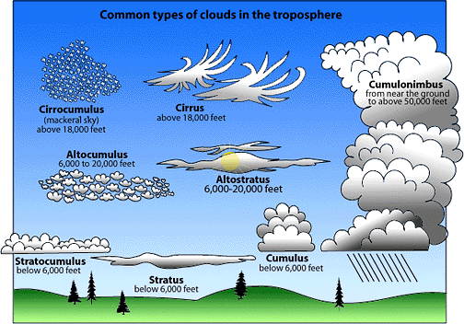
High Clouds
-let UV and visible in
-backscatter IR
-warming
Low Clouds
-reflect incoming
UV and visible
-cooling

Slide 16
