Slide 1
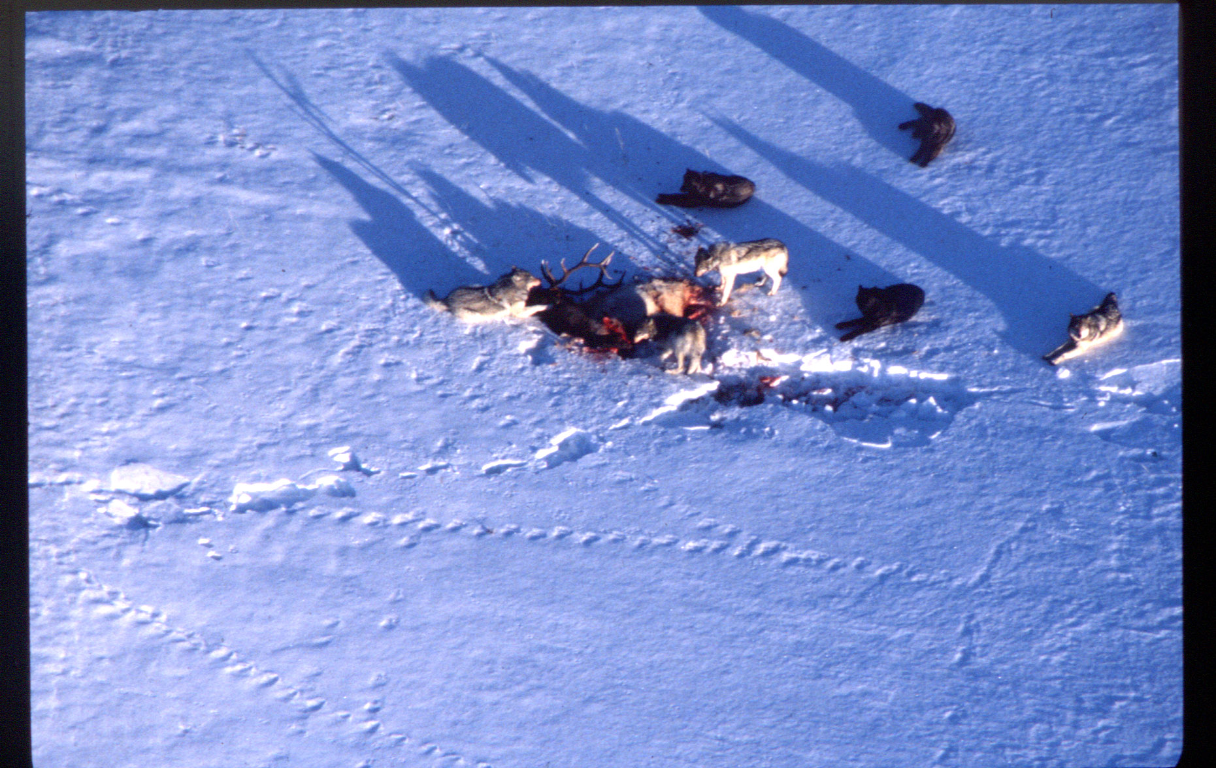
Dan Stahler photo

Slide 2
USFWS 2013

Slide 3
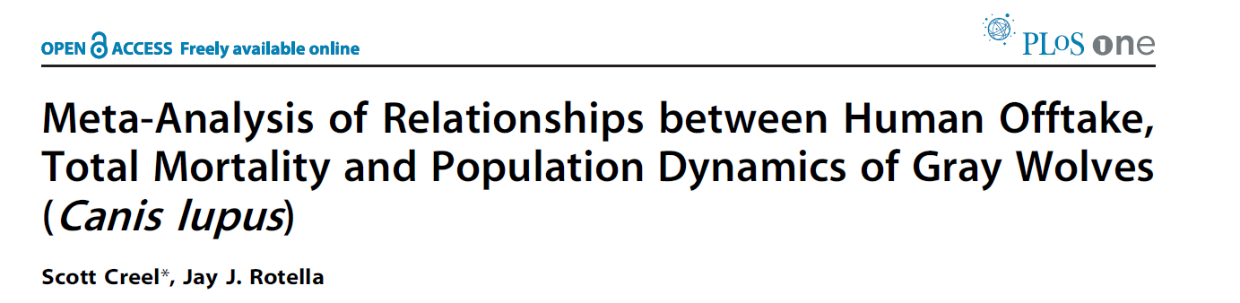
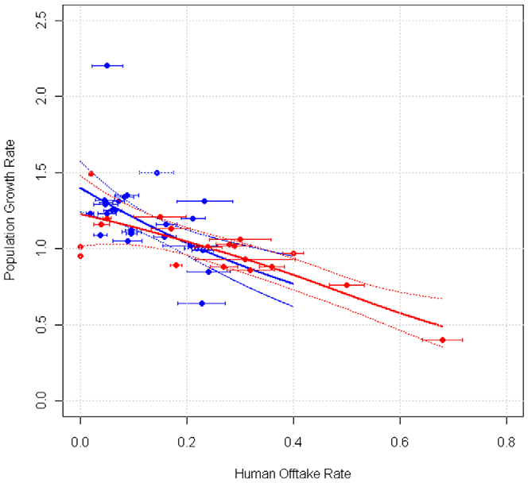

Slide 4
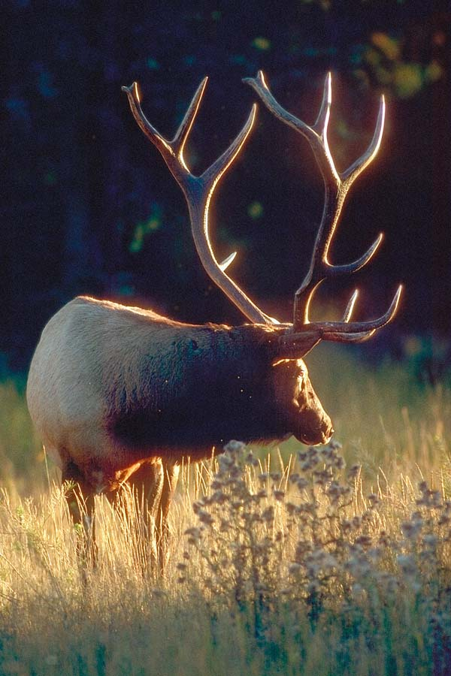
EIA Predator-prey models

Slide 5
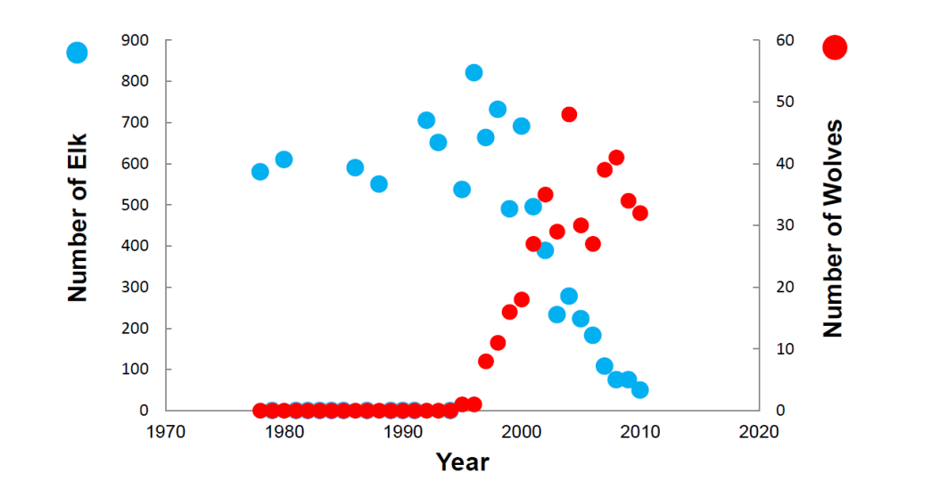
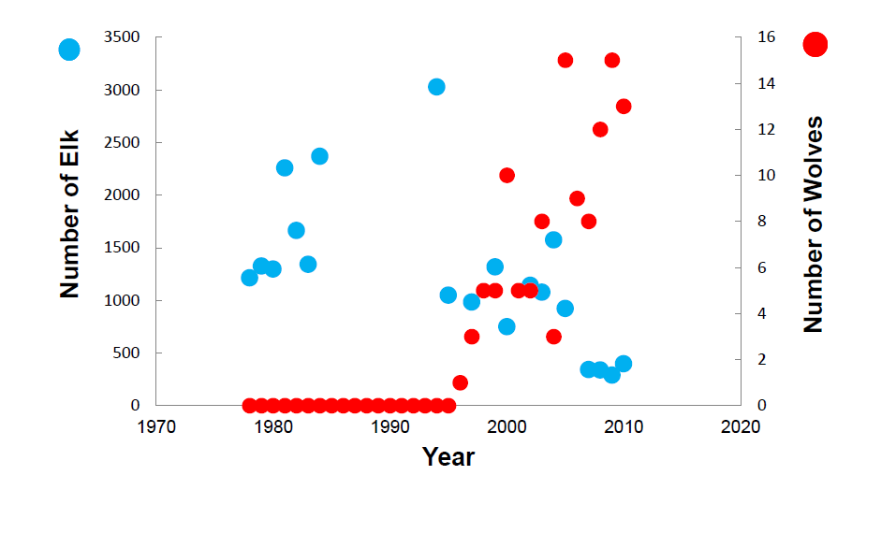
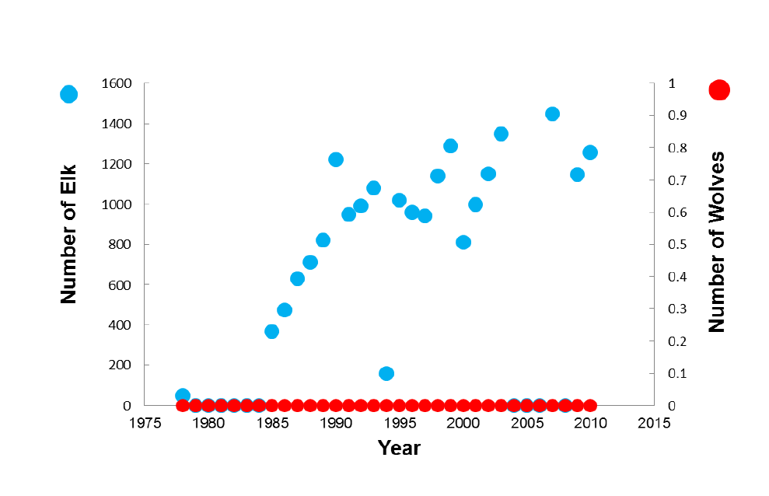
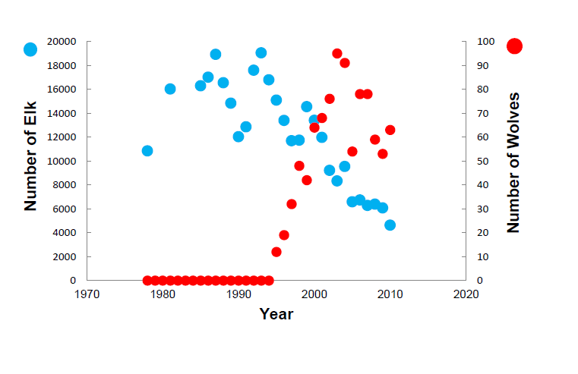
Central Yellowstone
Gallatin
Northern Range
Tobacco Root

Slide 6
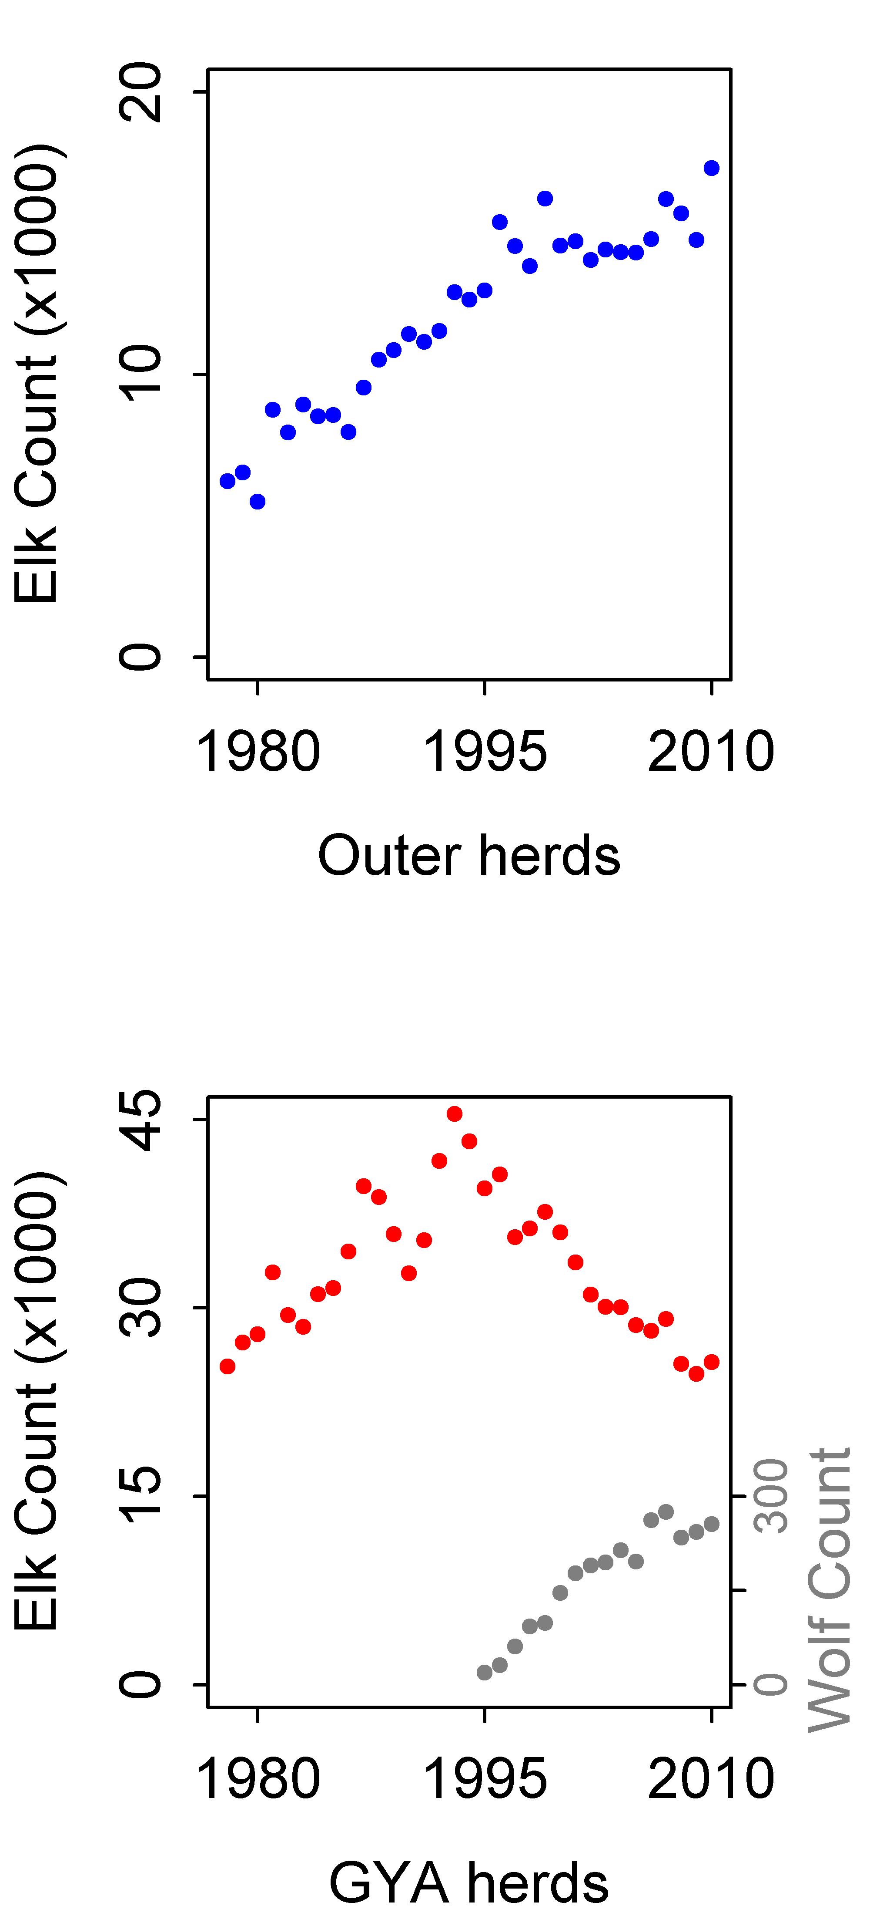
7
8
M O N T A N A
2
1
5
12
3
4
11
I D A H O
6
W Y O M I N G
9
10
Outer elk herds
GYA elk herds
12 herd units where elk were annually counted and classified in midwinter (calves/100 cows) by agencies and/or published studies from 1978 to 2010.
6 herds recolonized by wolves (with pre-post data), 6 herds continuously uncolonized by resident packs as of 2010

Slide 7
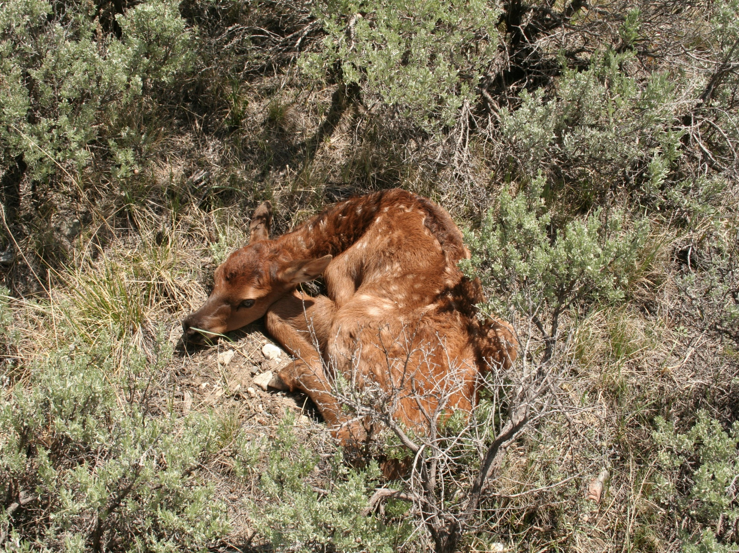

Slide 8
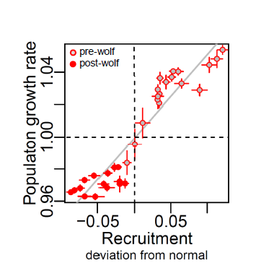
Calf recruitment is widely-recognized as a strong driver of dynamics in elk (and other ungulates)

Slide 9
Calves per 100 cows
GYA Herds
Outer Herds

Slide 10
GYE Elk Calf Recruitment
… and recent changes in recruitment
Elk Density
Winter Severity
Growing Season Rainfall
Human Harvest
Predation
Risk
Wolves
Offtake
Bears

Slide 11
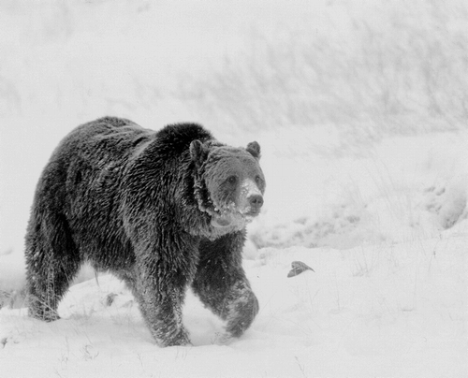
Do changes in GRIZZLY BEAR NUMBERS explain observed changes in calf recruitment?
Schwartz et al. 2006, Wildlife Monographs 161: 1-68

Slide 12
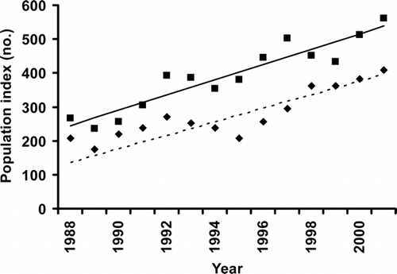
Changes in Grizzly Bear Numbers
Adjusted Estimate
Count
Schwartz et al. 2006, Wildlife Monographs 161: 1-68

Slide 13
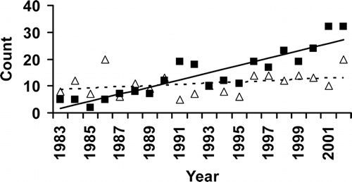
Changes in Grizzly Bear Numbers
Outside YNP
Within YNP
“Figure 5. Counts of unique female grizzly bears with cubs-of-year from 1983 to 2002 inside Yellowstone National Park (YNP) (open triangles) and outside YNP (solid squares). The slope of the fitted line inside YNP (dashed line) was not different from zero, whereas the slope for counts outside YNP (solid line) was significantly different from zero (P ≤ 0.001). “
Schwartz et al. 2006, Wildlife Monographs 161: 1-68

Slide 14
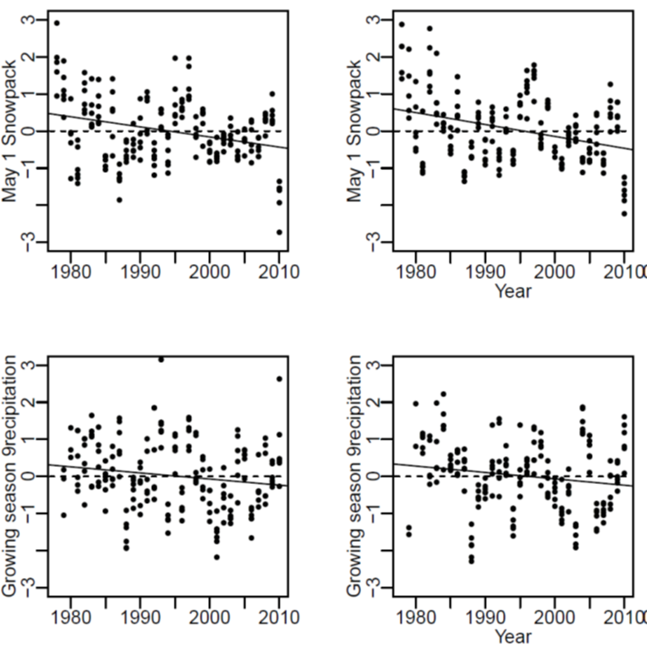
Can changes in CLIMATE explain the observed differences in calf recruitment?
UNCOLONIZED HERDS WOLF COLONIZED HERDS
WINTER SNOW ACCUMULATION
GROWING SEASON
PRECIPITATION
Christianson & Creel 2014 PLoS One 9(7): e102330

Slide 15
Can HARVEST patterns explain the observed differences in calf recruitment?
Uncolonized Herds
Wolf-colonized Herds

Slide 16
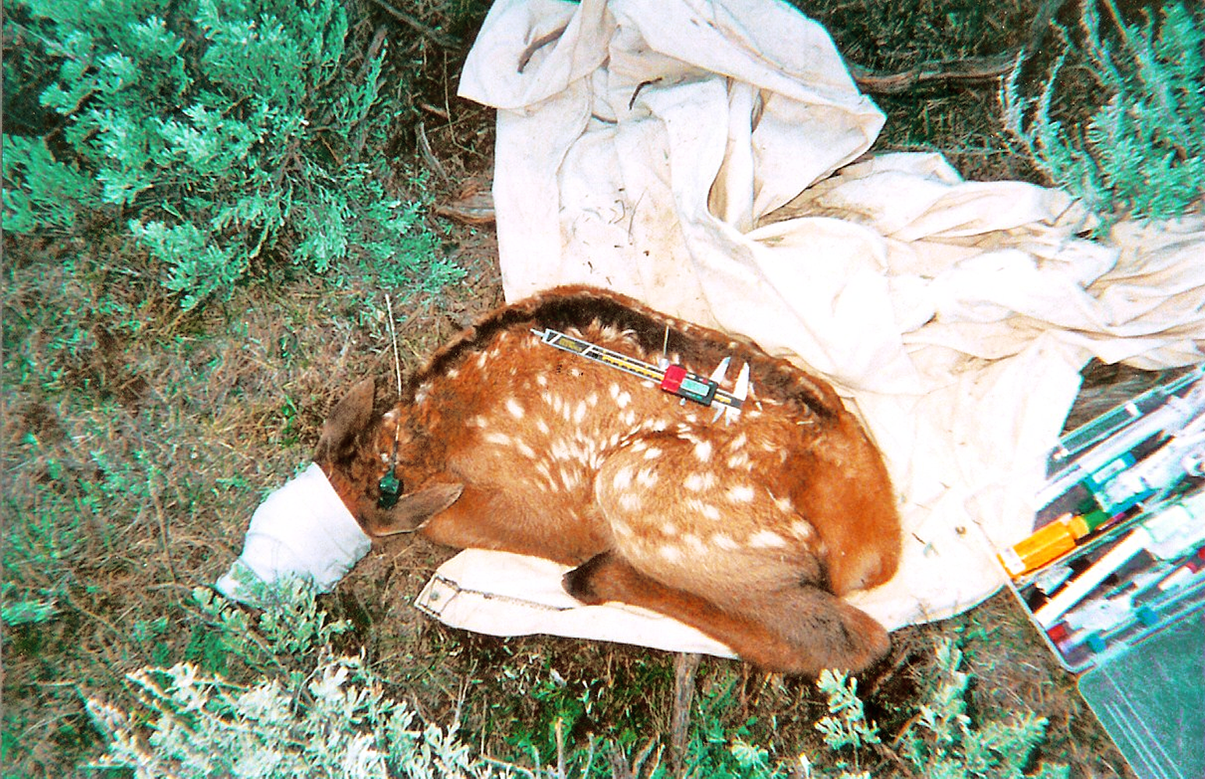
Griffin et al. (2011) review of 1,999 radio-collared calves in 12 populations found that “wolf predation was low and most likely a compensatory source of mortality”.
Creel & Christianson 2008 Trends in Ecology & Evolution 23: 194-201

Slide 17
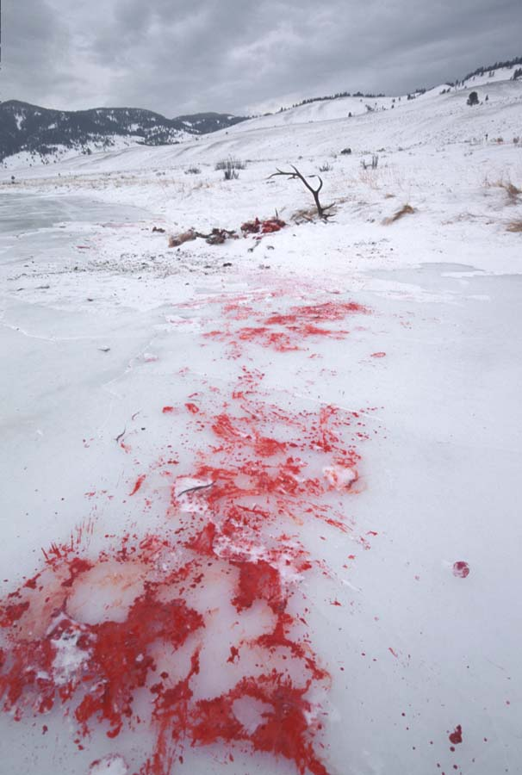
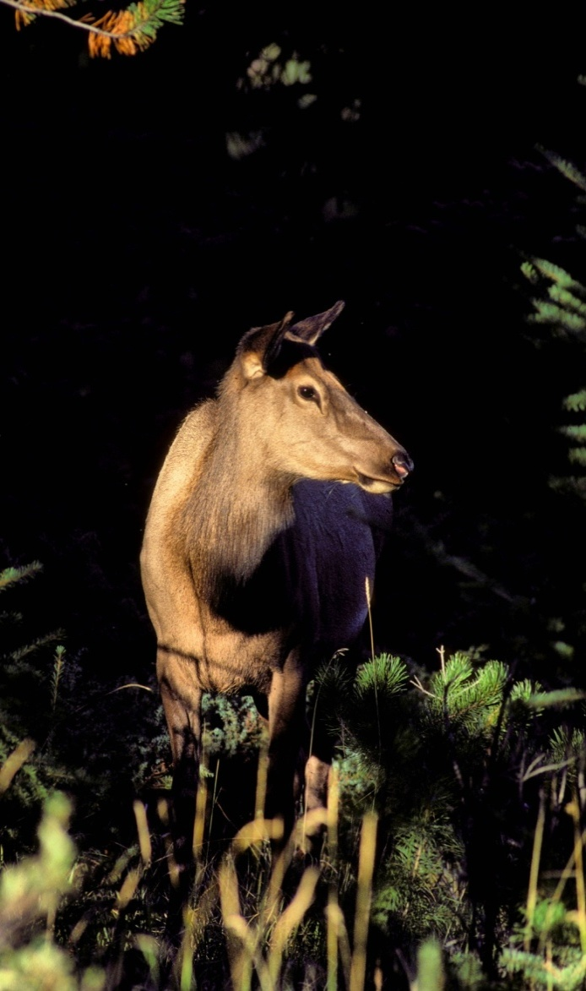
What are the relative magnitudes of direct and risk effects?

Slide 18
Christianson & Creel 2008 Behav Ecol 19: 1258 – 1266
Christianson & Creel 2010 Ecology 91:1184-1191

Slide 19
Fecal progesterone decreases with increasing predation risk…
1495 fecal samples
Samples at 2 week intervals
after 15 March
Symbol types denote annual
population means
Tests controlled for herd composition
High Risk
Low Risk

Slide 20
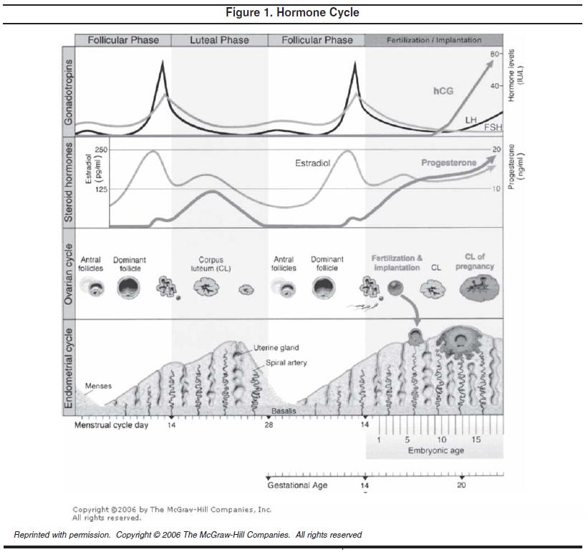

Slide 21
… and progesterone concentration predicts calf recruitment.
Calves/100 Cows
In following season

Slide 22
7
8
M O N T A N A
2
1
3
5
12
4
11
I D A H O
6
W Y O M I N G
9
10
Outer elk herds
GYA elk herds
Additive direct mortality is too small to yield this pattern. For 2,746 radio-collared elk in 45 populations, Brodie et al. (2013) found that “wolves and all carnivore species combined had additive effects on elk mortality, but only reduced survival by <2%”.
Widespread reductions in pregnancy rate have been >10X larger than observed effects on mortality, spatiotemporally aligned with wolf recolonization and changes in elk dynamics.
Other plausible limiting factors have not shown the spatiotemporal patterns of change that would produce these changes in elk dynamics.

