Slide 1
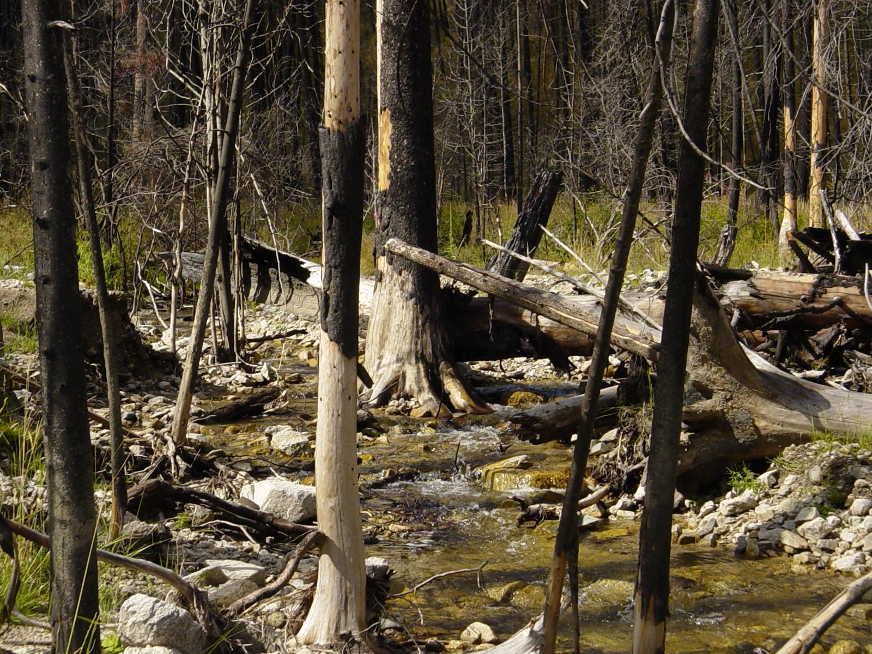


Effects of Wildfire On
Aquatic Ecosystems
Notes:
‹#›

Slide 2
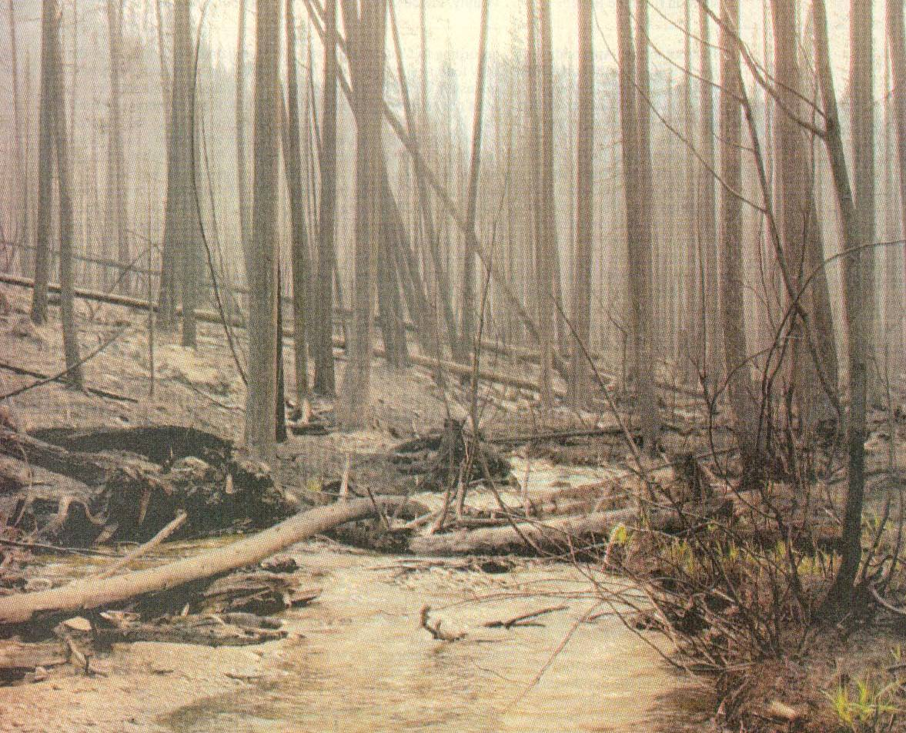
Would You Fish a
Burned Stream?
Tom Bauer / Missoulian
Notes:
‹#›
When the smoke cleared, portions of 91 fish-bearing streams were burned with varying severity of disturbance. 248 km of stream channel experienced moderate- to high- severity fire disturbance, fish kills were observed in four streams, and widespread fish population declines were documented.

Slide 3
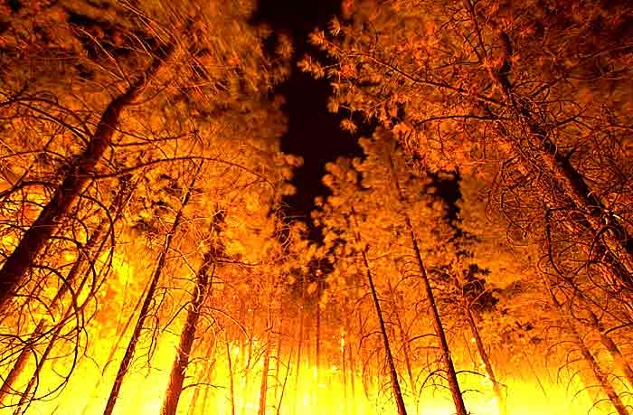
Direct Effects or First Order Effects (Depend on Fire Intensity and duration):
Physical
Dead Trees
Baked Soil
Stream Heating (lethal levels to fish?)
Chemical toxicity to water from smoke or ash (ammonium & phosphorus)
Notes:
‹#›

Slide 4
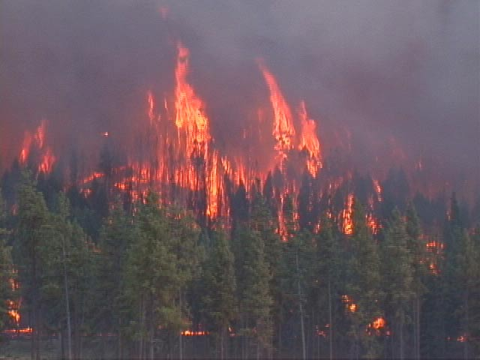
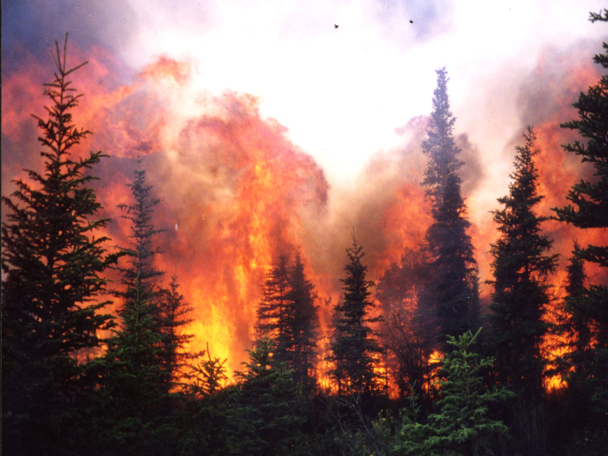
Direct Effects Second Order Effects (Depend on Fire Intensity and Duration):
Biological
Dead Trees
Fish Kills and mortality of other aquatic organisms
Combustion of Organic Matter and Organisms in Soil
Notes:
‹#›
The influence of wildfire on native fish populations is of increasing concern.
Nationwide over 49 million hectares of forest historically rated at low- to moderate wildfire risk are now classified as high risk. There are multiple interacting causes for this shift in fire regime (see bullets).
Thus, drought conditions in concert with substantial increases in ground fuel accumulation and live fuel ladders have left forested landscapes in some vegetation types prone to large, high intensity, stand replacing fires.

Slide 5
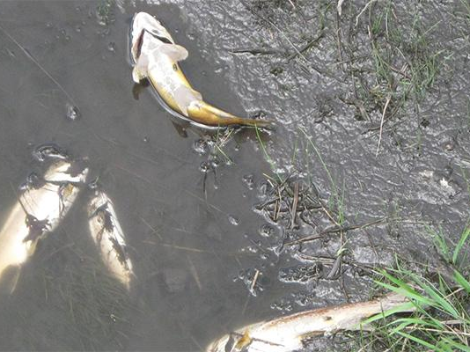
Ash-killed brown trout. Rio San Antonio, NM www.nature.org

Slide 6
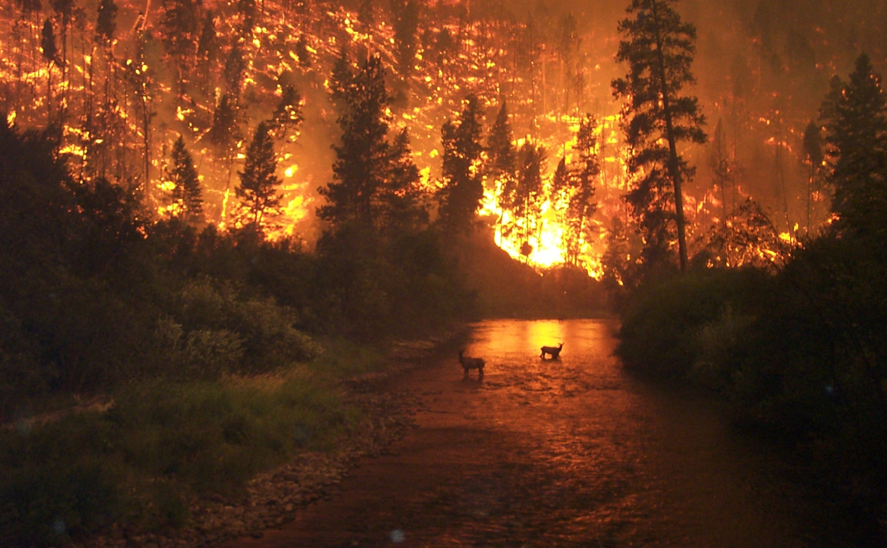
JOHN McCOLGAN/U.S. Forest Service
Notes:
‹#›
One such “catastrophic” wildfire event occurred in the Bitterroot River Basin during the summer of 2000 when drought conditions and numerous lightning strikes sparked widespread wildfire in the Bitterroot National Forest. This famous photo was taken near Sula, MT as flames converged on the East Fork of the Bitterroot River.

Slide 7
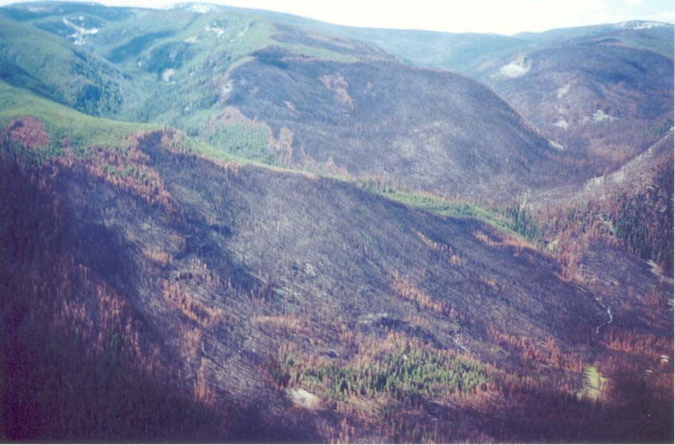
Indirect Effects
Depend Largely on Burn Severity, Area Burned, Terrain Slope, and Precipitation
Notes:
‹#›
In total 1,477 square kilometers burned equal to 22% of all BNF land. The largest fire in the basin in 2000 was the Valley Complex fire which burned 1182 square km and was actually the largest. These fires equated to the largest fire event in the basin’s recorded history.

Slide 8
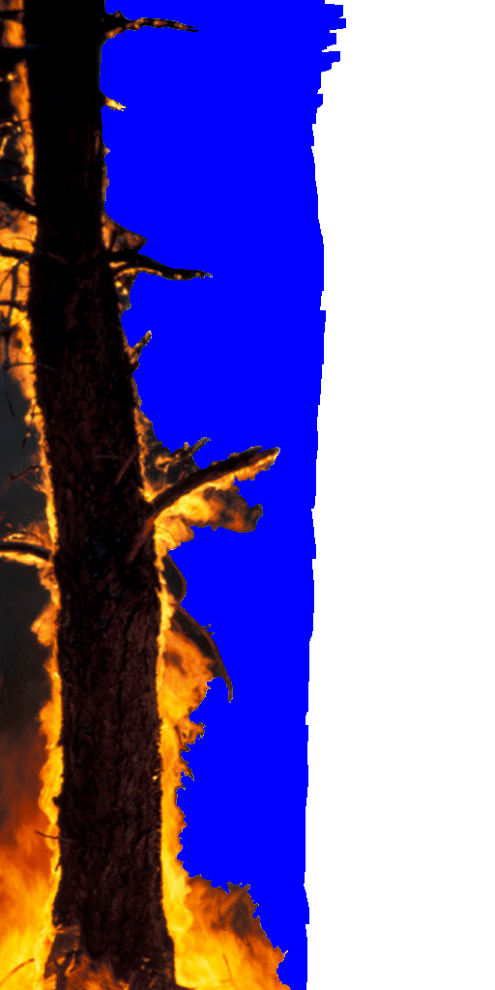
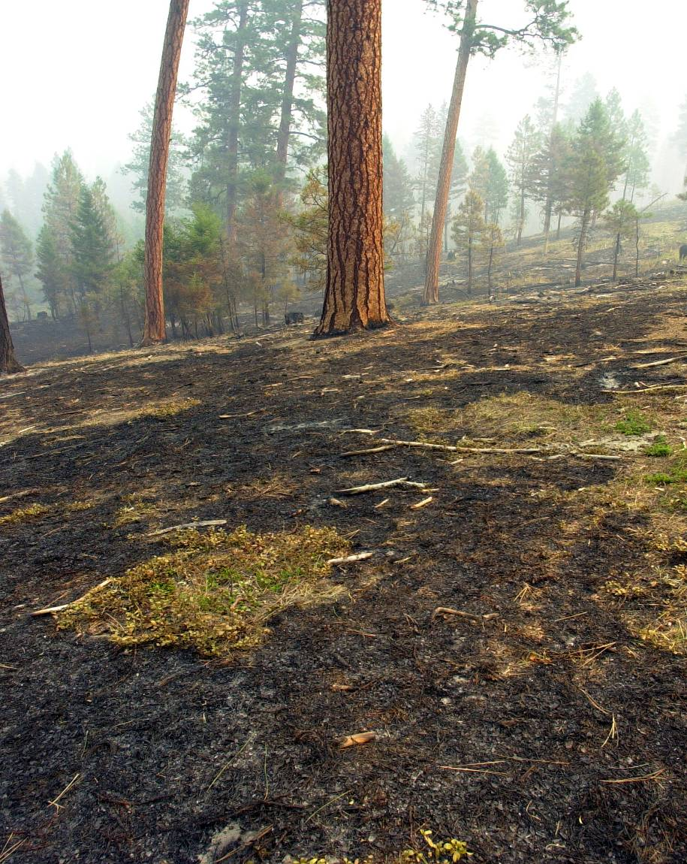
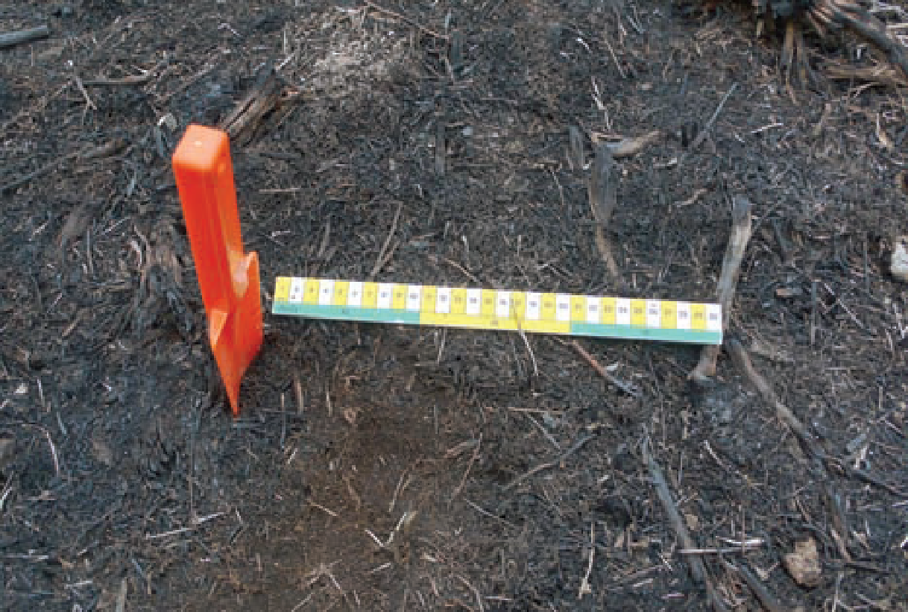
Low Burn Severity
Less than 50% consumption of litter, some char, needles and leaves mostly intact.
Notes:
‹#›
3 low severity reaches were classified as having mostly-intact live canopy and riparian vegetation, with a only a few scorched individual trees…

Slide 9
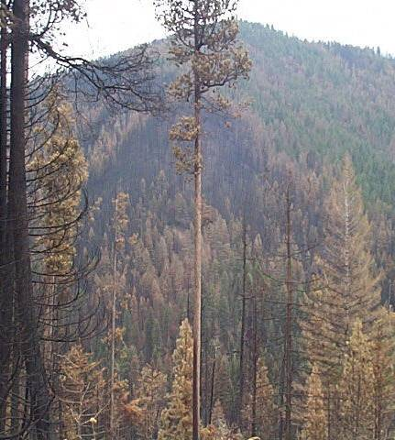
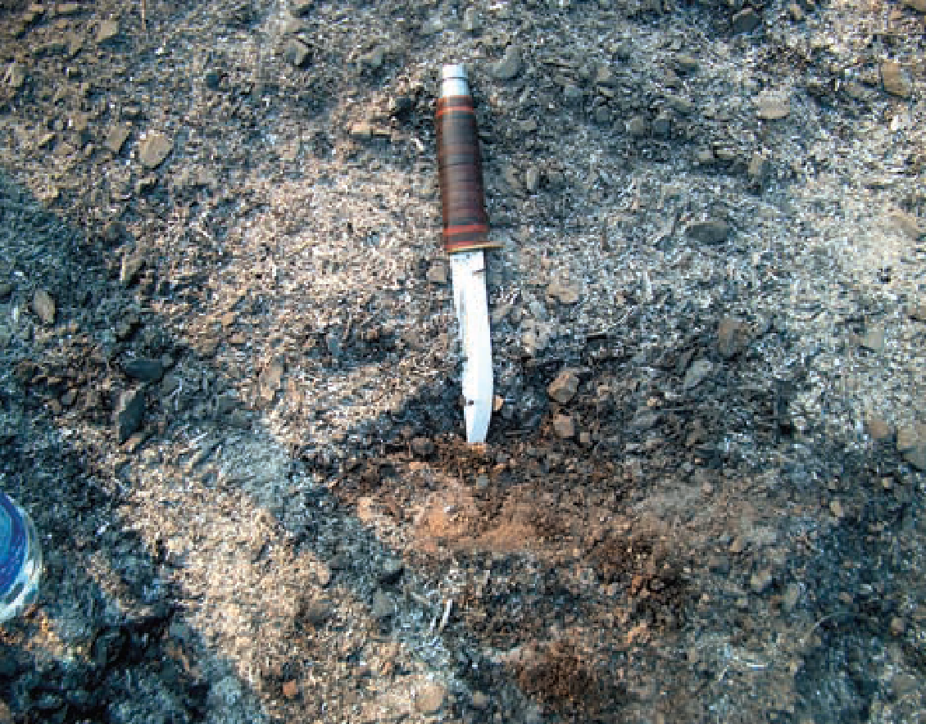
Moderate Burn Severity
Up to 80% consumption of soil litter
and duff. Recognizable leaves and needles remain to be cast on the ground.
Notes:
‹#›
Five moderate severity reaches classified by at least 20% conifers with scorched but not consumed needles and mostly intact riparian vegetation. Due to the similarity in burn effects and small sample size, low and moderate severity streams were grouped together into a low-moderate severity treatment for statistical analyses.

Slide 10
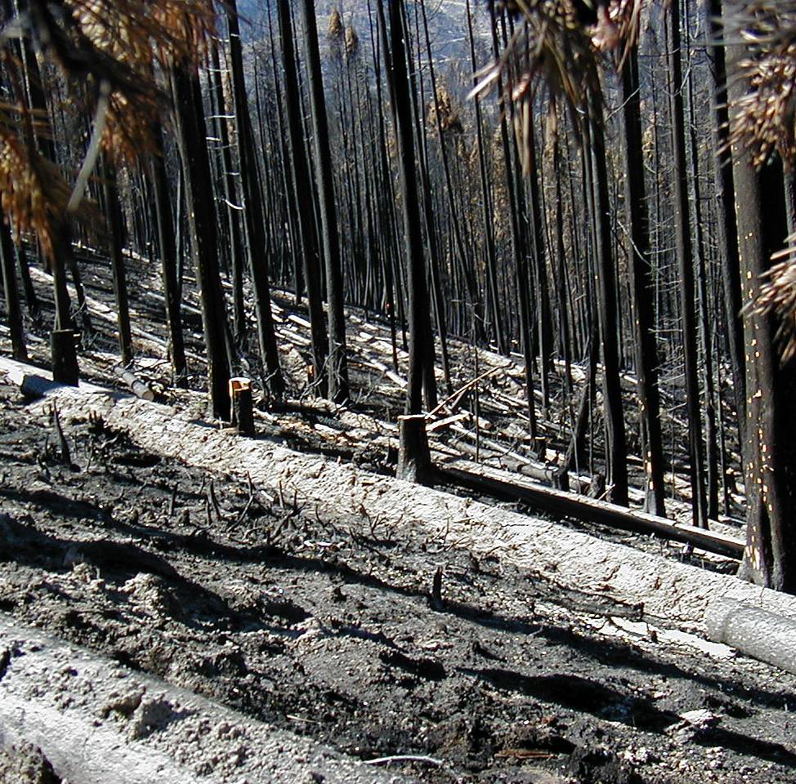
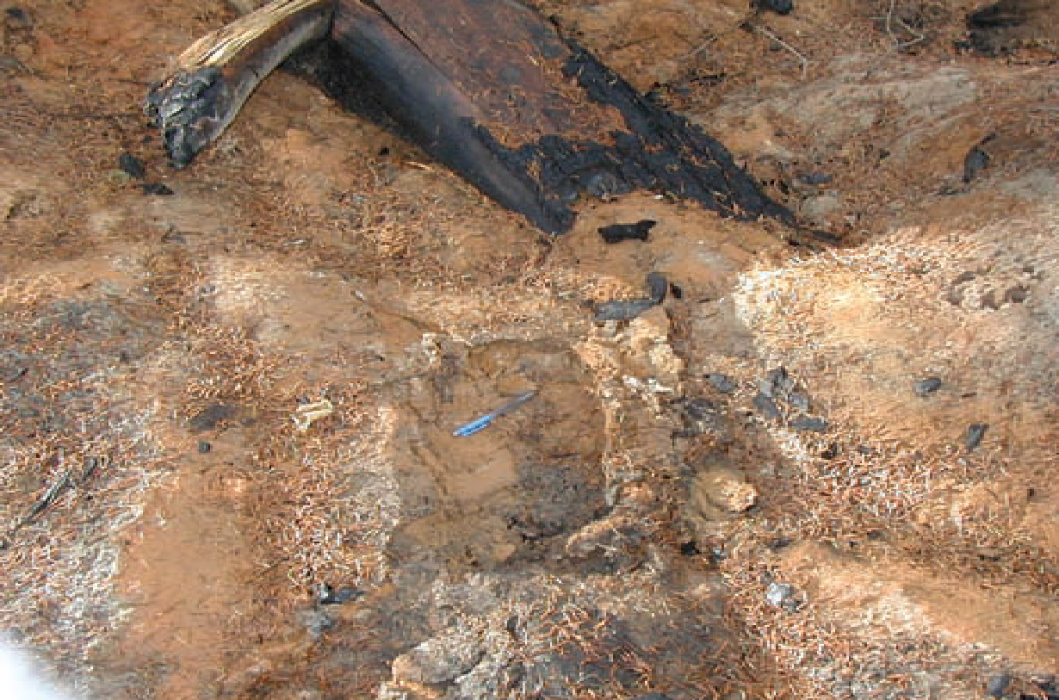
High Burn Severity
Little to no ground cover
(less than 20%). All or most litter and duff has been
consumed, only ash or bare soil (ash
blown away) remain. Little to no
potential for leaf- or needle-cast.
Notes:
‹#›
5 reaches with conifer canopies and riparian vegetation mostly consumed were classified as high severity…

Slide 11
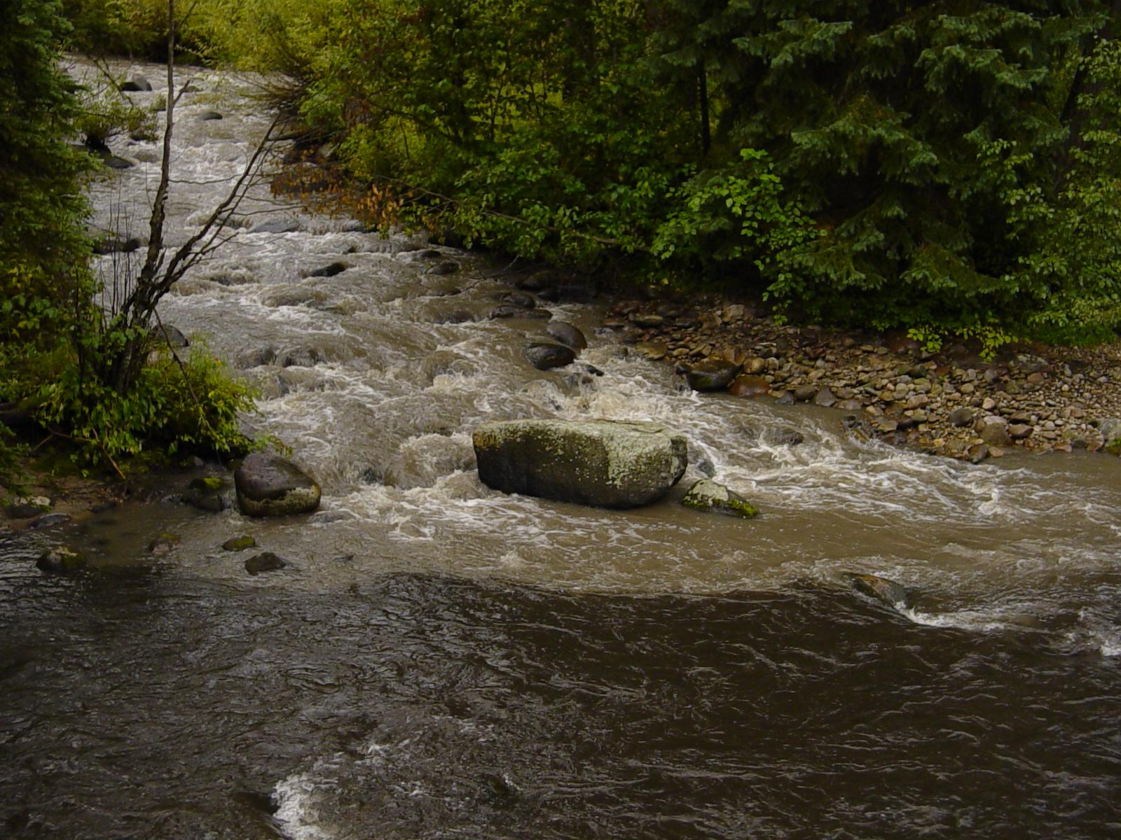
Indirect Effects (Short-Term)
Decreased water infiltration (hydrophobic soils), increased surface runoff, increased erosion, increased peak flows
Increased Sediment Delivery
Decreased Survival of Fish Eggs and Fry and Macroinvertebrate Abundance and Diversity
Notes:
‹#›
The effects of high severity wildfire are similar to those that have been shown to favor invasion of nonnative fish.
First, high intensity wildfire can decrease water infiltration over hydrophobic soils, increasing surface runoff, increasing erosion, increasing peak flows and ultimately increasing sediment delivery to stream channels.

Slide 12
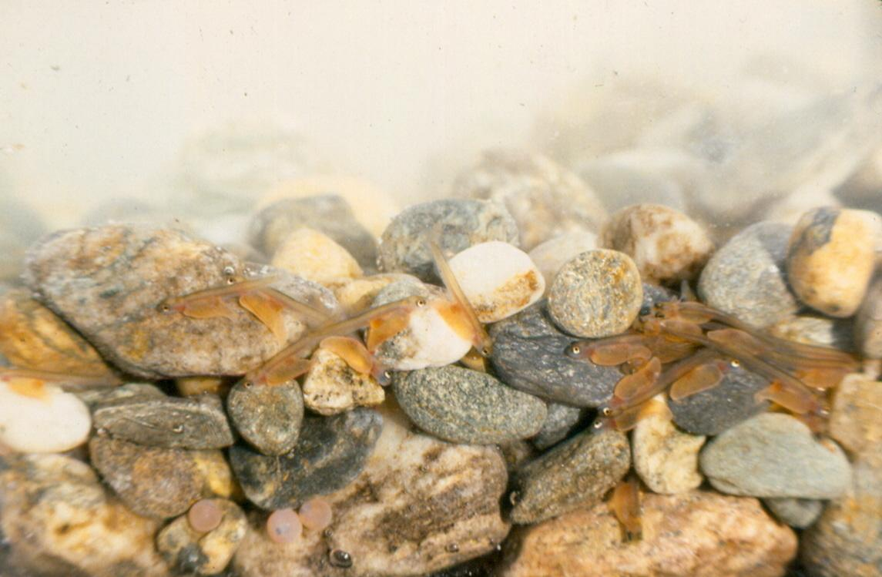
Salmon larvae

Slide 13
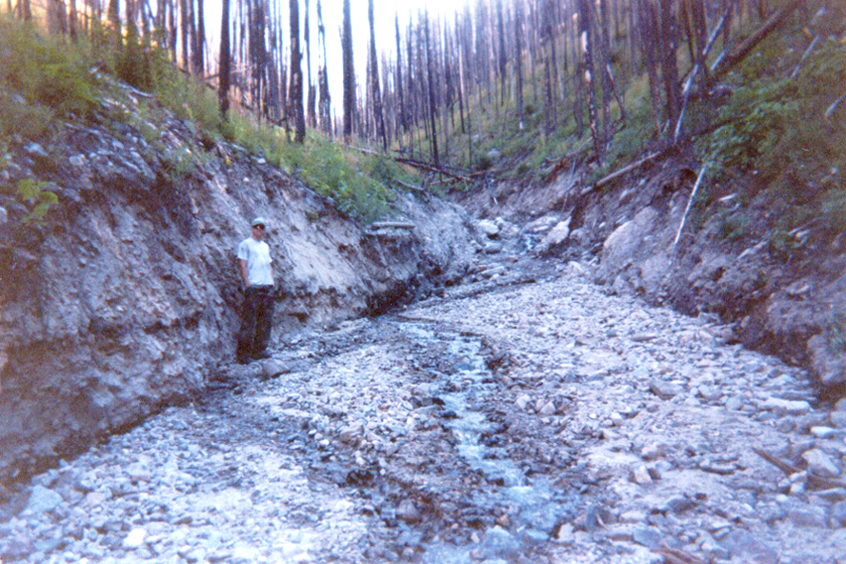
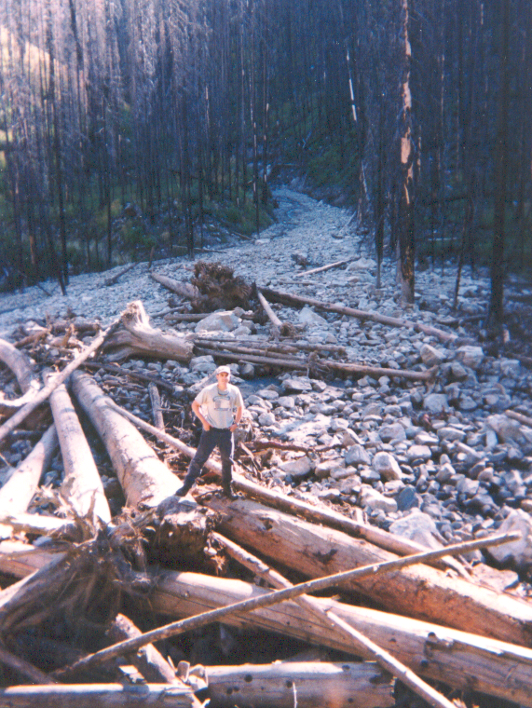
Debris Flows
(Either Surface Erosion or Infiltration)
Notes:
‹#›
In mid July 2001, severe thunderstorms over high-severity burned areas triggered debris flows that caused excessive sedimentation, channel instability, and fish kills in five drainages. These photos show the large Sleeping Child Slide that dams up Sleeping Child Cr.

Slide 14
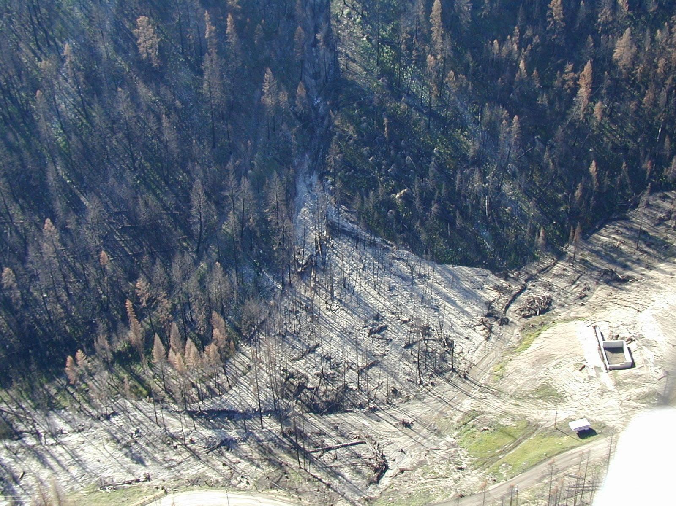
Laird Creek Debris Flow
Bitterroot River Drainage 2001
Laird Creek
Home Being Rebuilt

Slide 15
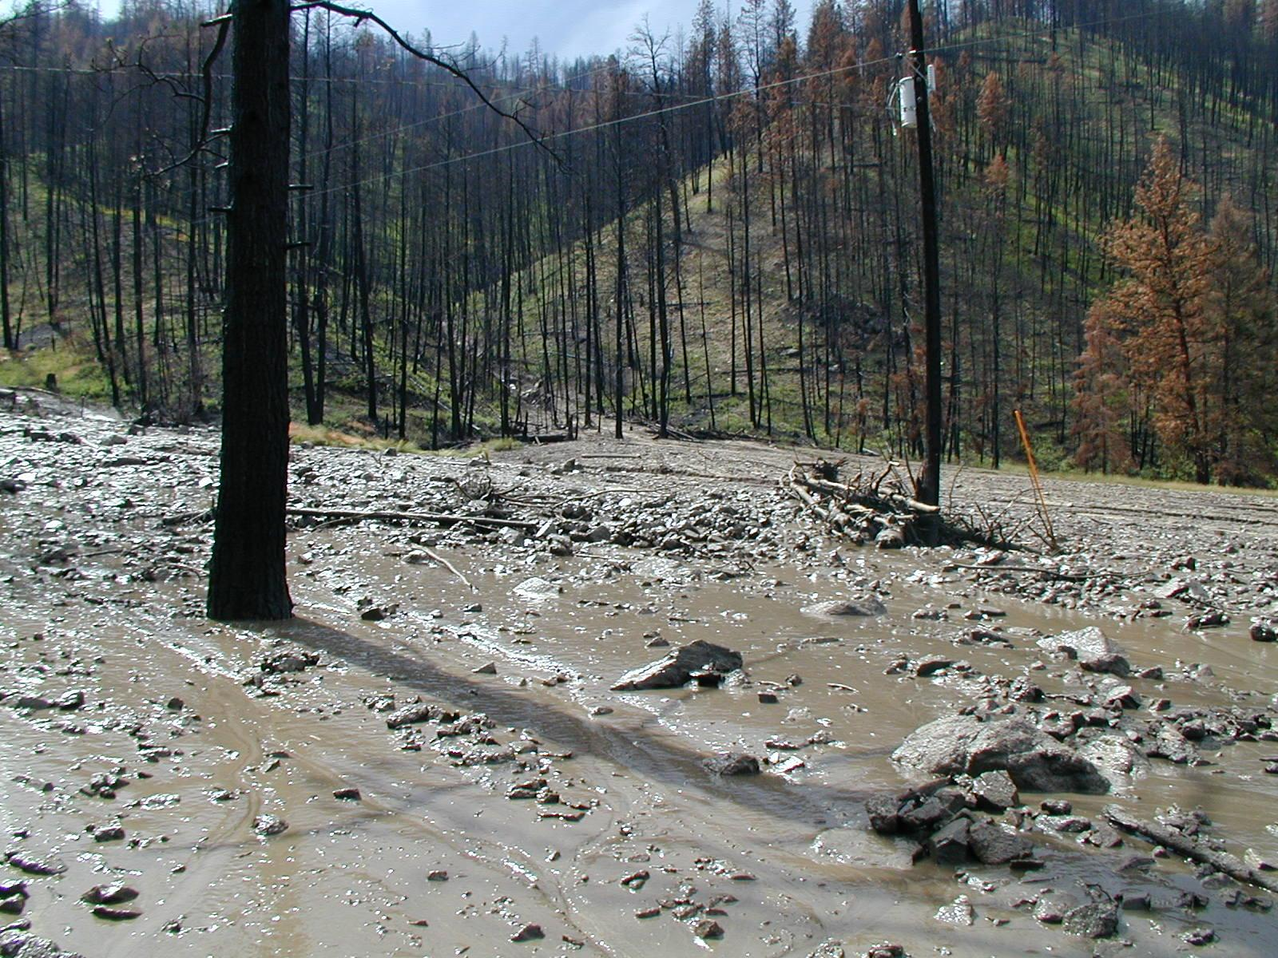

Slide 16
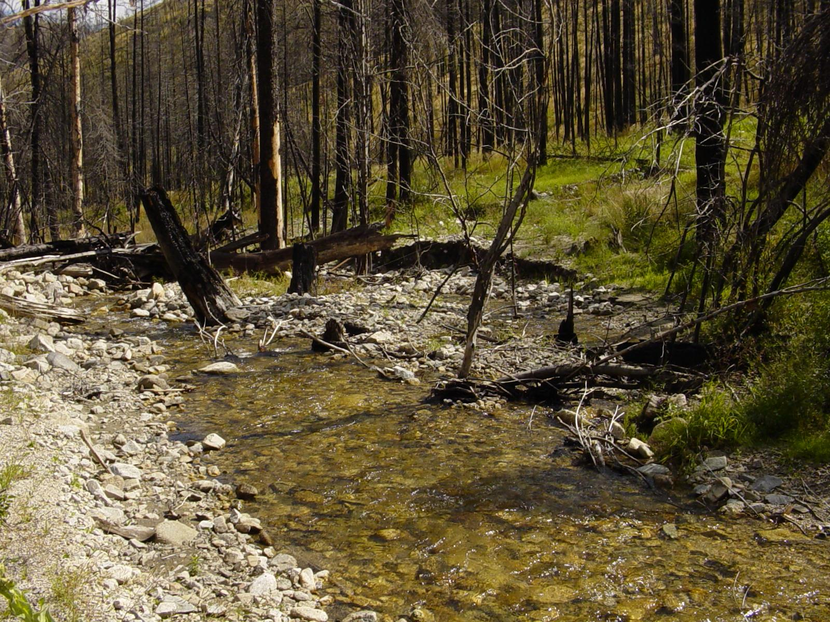
Reduced Survival & Abundance of Fish or Fish Kills
Mobilization of LWD, Channel Scouring, Sediment Deposition
Reduced Number and Size of Pools
Reduced Habitat Complexity
Notes:
‹#›
In addition, wildfire related debris flows can mobilize LWD, scour channels to bedrock, and fill channels with sediment, effectively reducing the number and size of pools. The decrease in LWD abundance and pool frequency ultimately leads to decreased habitat complexity.

Slide 17
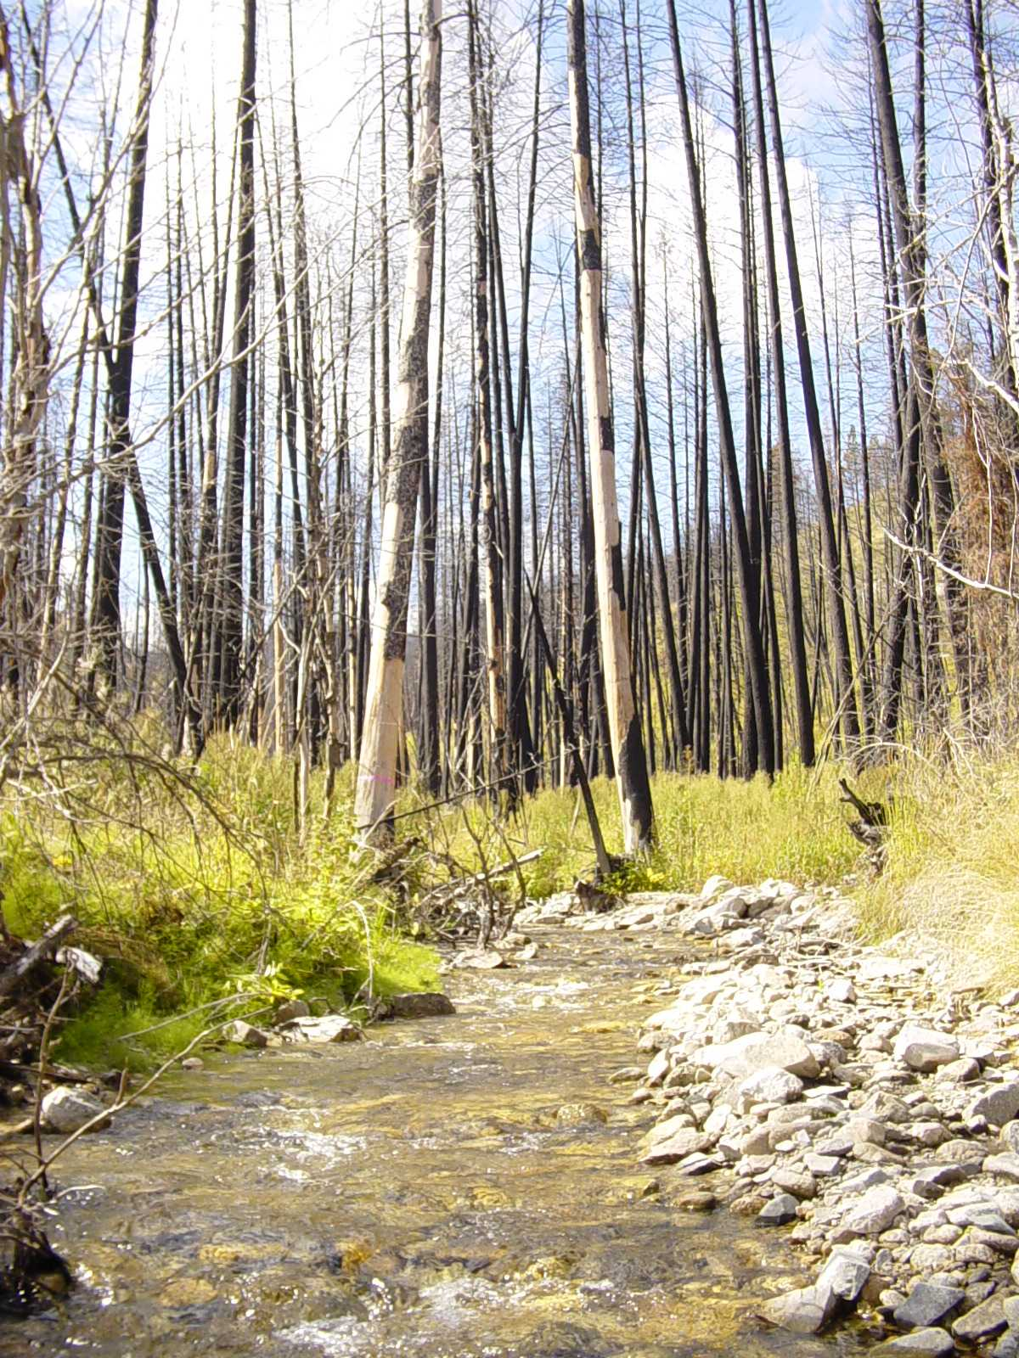
Stream Temperature Rise
Combustion of Canopy and Riparian Vegetation
Reduced Stream Shading
Increased Stream Temperature
Notes:
‹#›
Finally, combustion of Forest Canopy Cover and Riparian vegetation from high intensity fire reduces stream shading and can lead to elevated stream temperature.

Slide 18
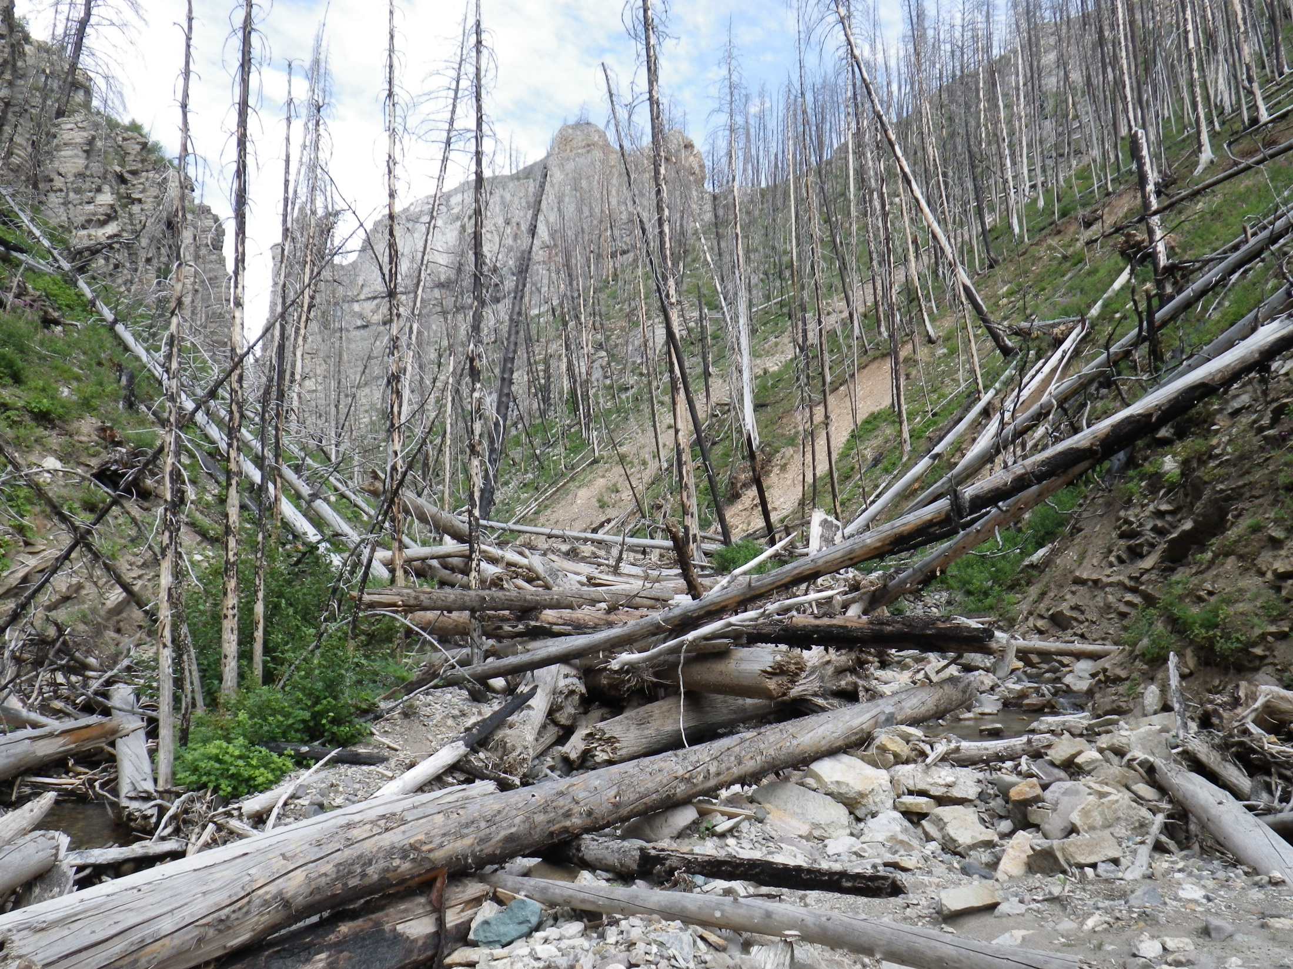
Looks Pretty Bad Right?

Slide 19
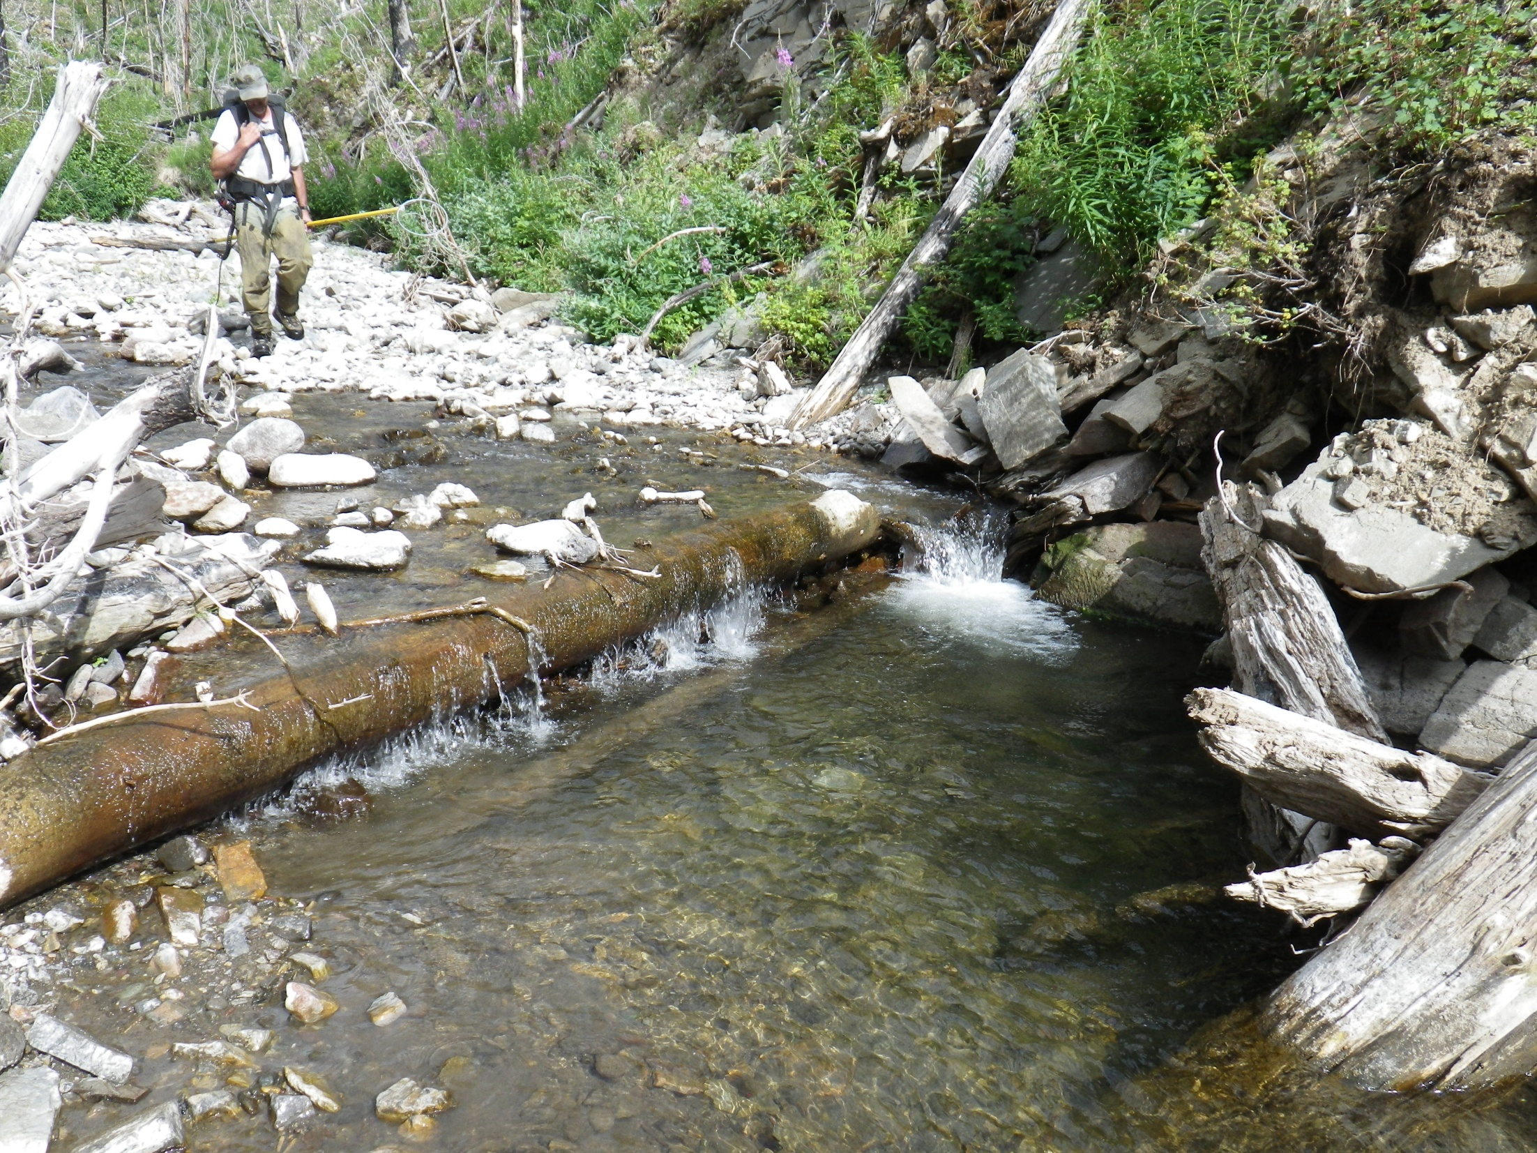
Wrong!

Slide 20

Wildfires & Debris Flows Reset Aquatic Ecosystems & Deliver Building Blocks of Healthy Complex Habitat

Slide 21
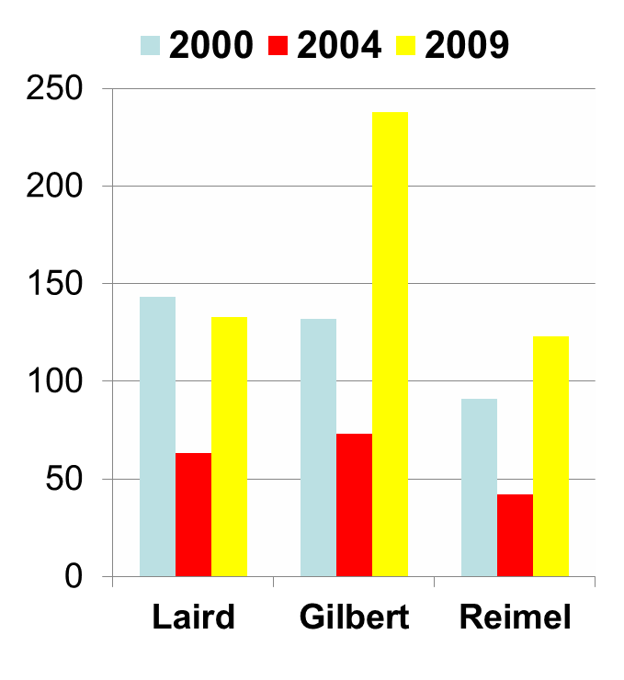
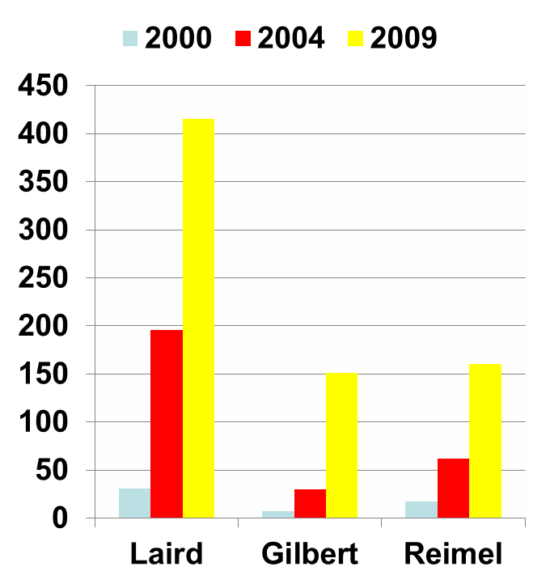
Bitterroot Stream Habitat Change
Pools Per Mile
Large Wood Per Mile

Slide 22
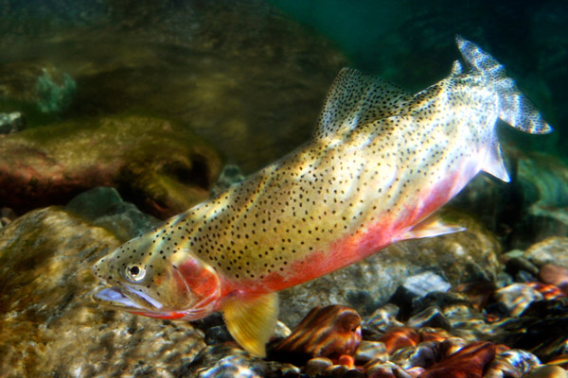
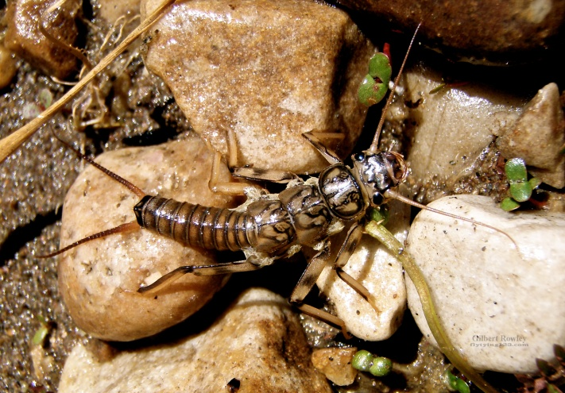
Long-Term Effects
Productivity From Increased Stream Temps
Large Woody Debris
Spawning Gravel
Clean Cobble
Habitat complexity

Slide 23
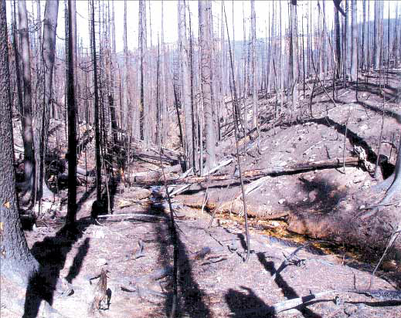
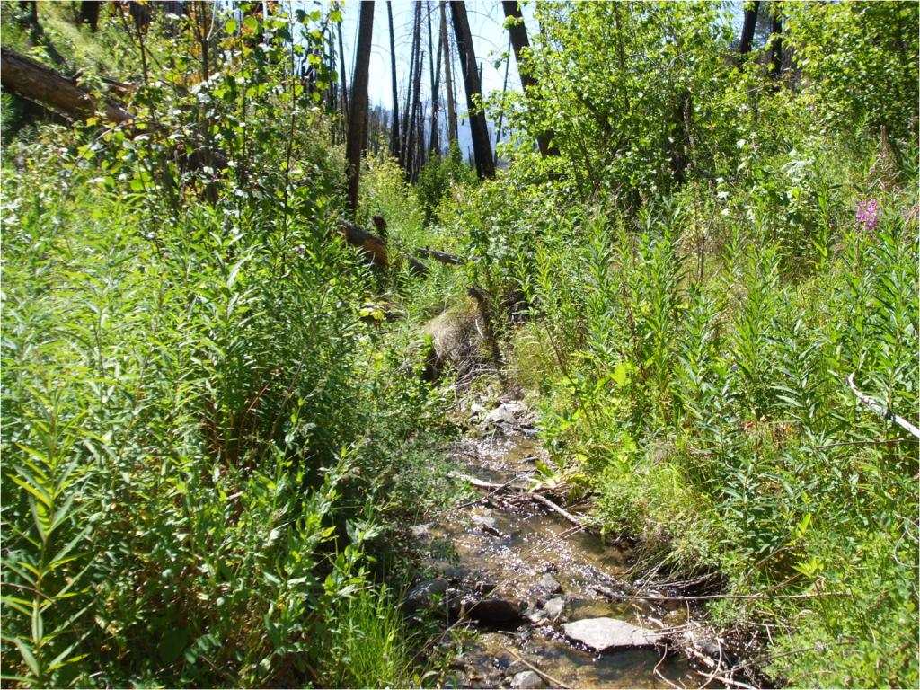
Vegetative Recovery
Bitterroot NF 2000
Bitterroot NF 2010

Slide 24
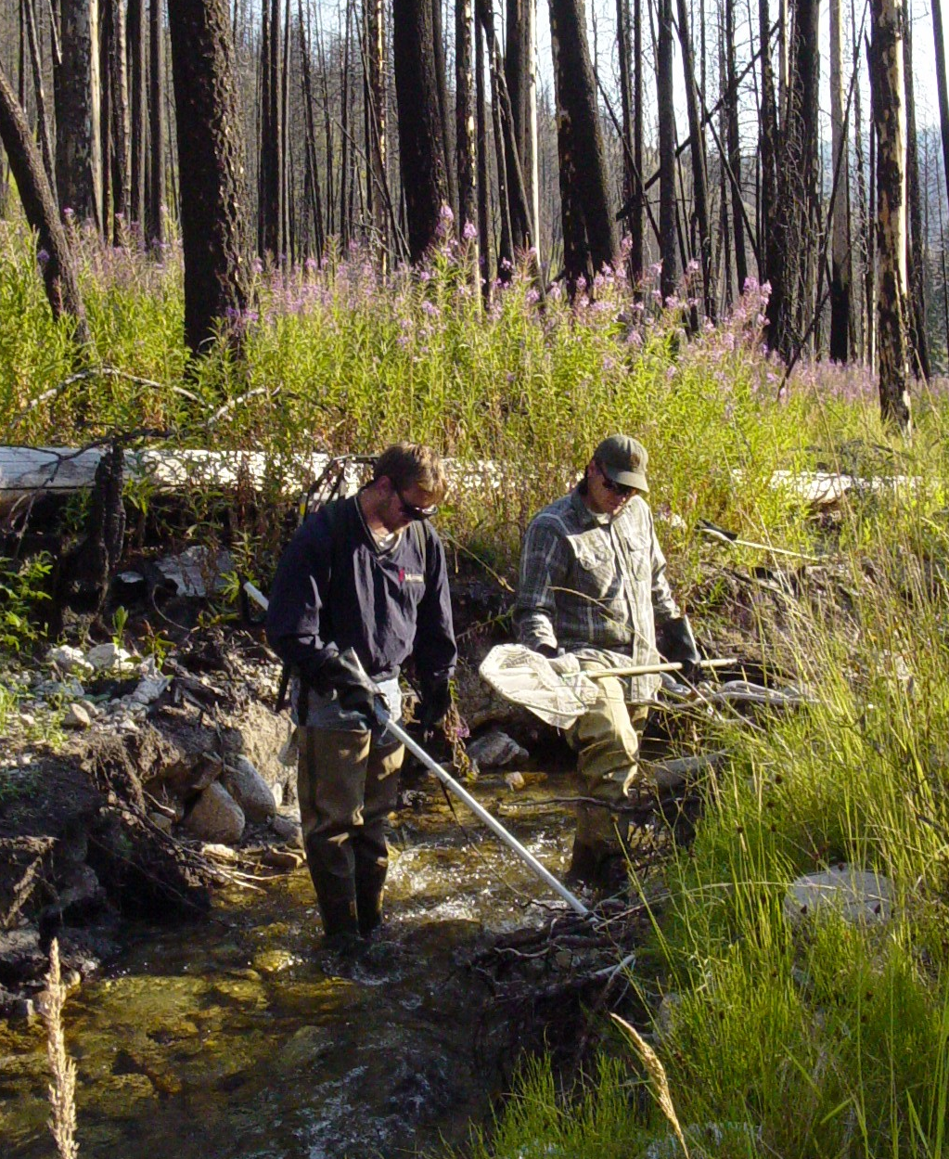
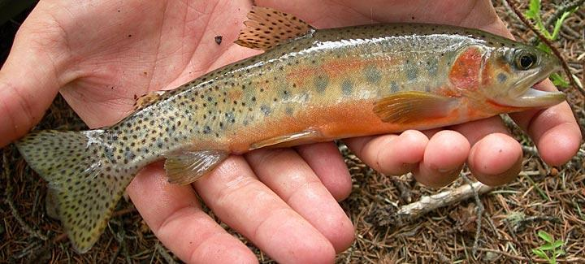
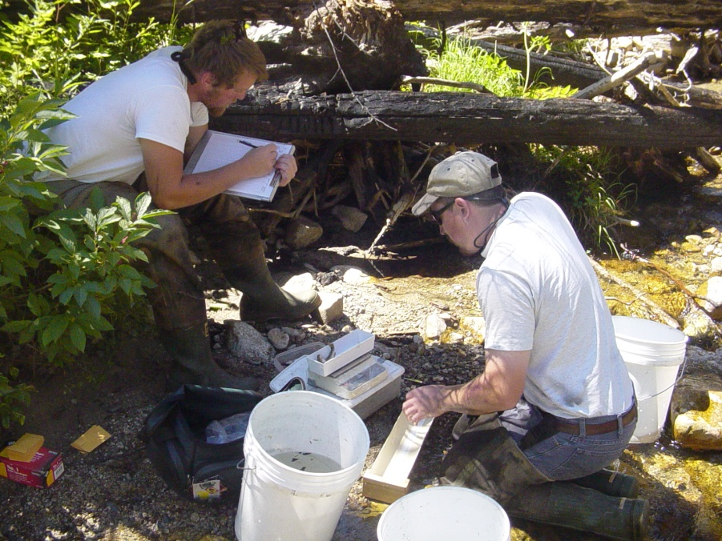
Fish Population Recovery

Slide 25
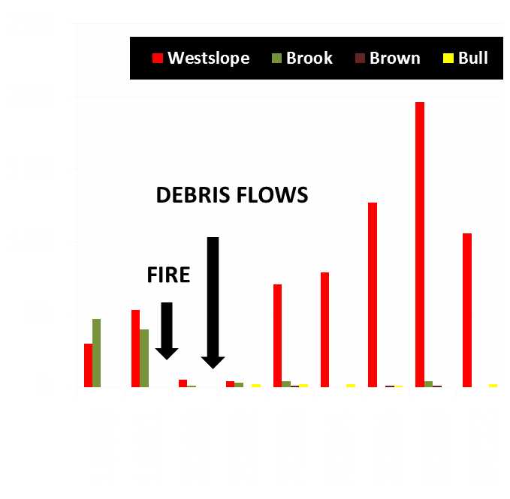
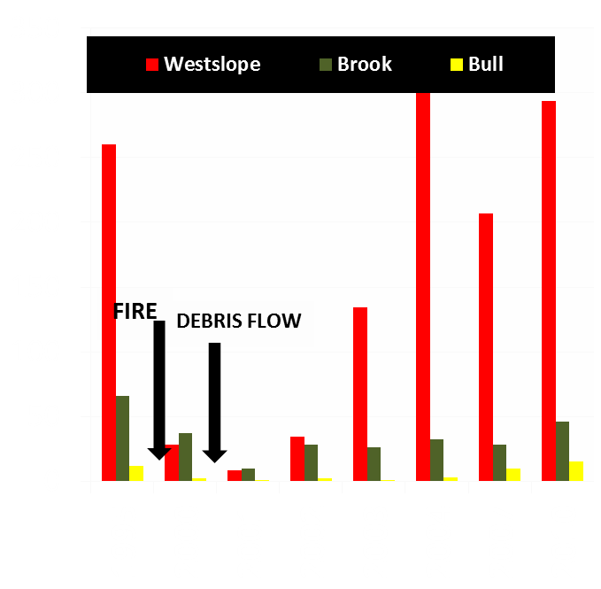
Laird and Chicken Creeks (Bitterroot NF)
# fish > 3 inches per 700 feet
# fish > 3 inches per 1000 feet

Slide 26
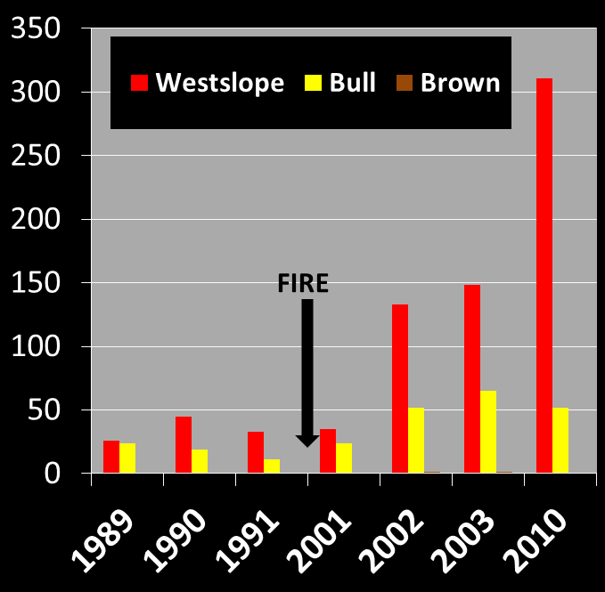
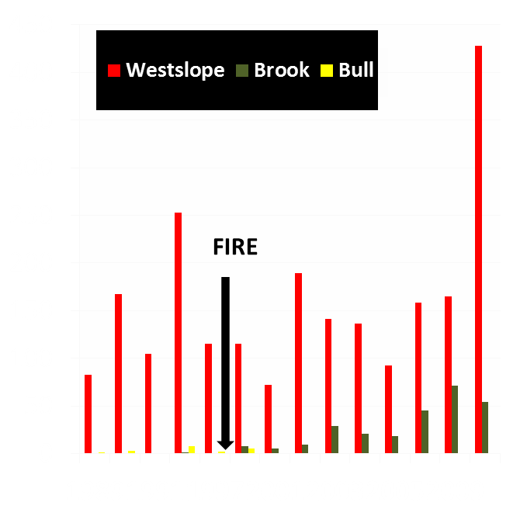
Meadow and Rye Creeks (Bitterroot NF)
B3 channel, 18’bkf, connected
B5 channel, 15’ bkf, connected

Slide 27
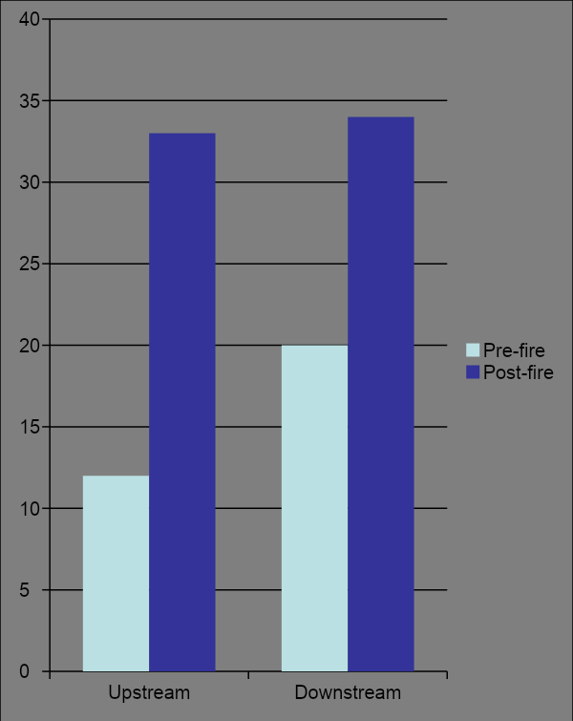
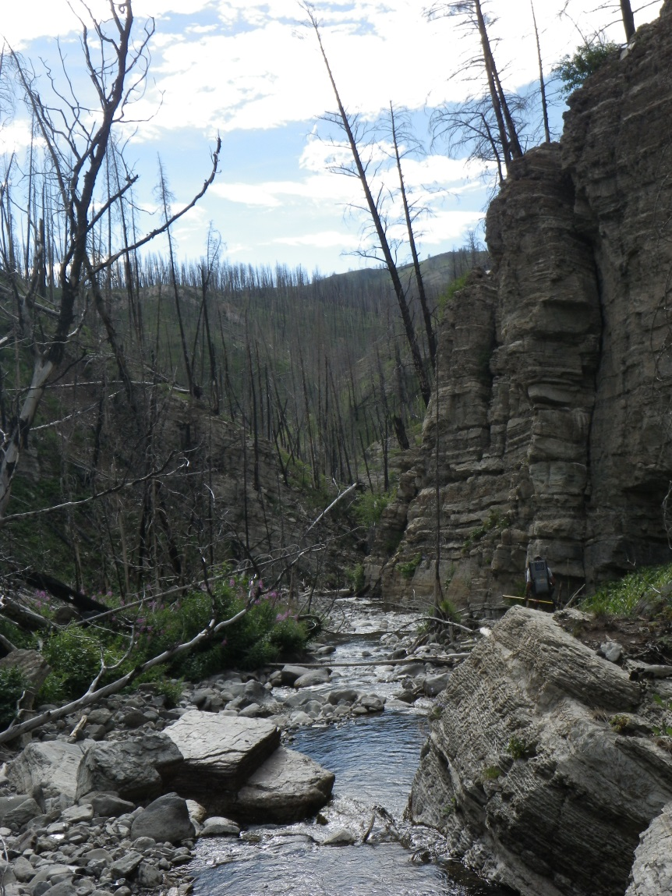
Anderson Creek Yellowstone Cutthroat Trout Monitoring
175% Increase
70% Increase
Notes:
There was a substantial increase in Yellowstone cutthroat abundance from 2003 (pre-fire) to 2012 (post-fire) in both Anderson Creek monitoring reaches. The estimated number of fish/100 m in the downstream reach increased from 20 to 34 (70 %) and the estimated number of fish/100 in the upstream reach increased from 12 to 33 (175 %) (Table 1).
‹#›

Slide 28
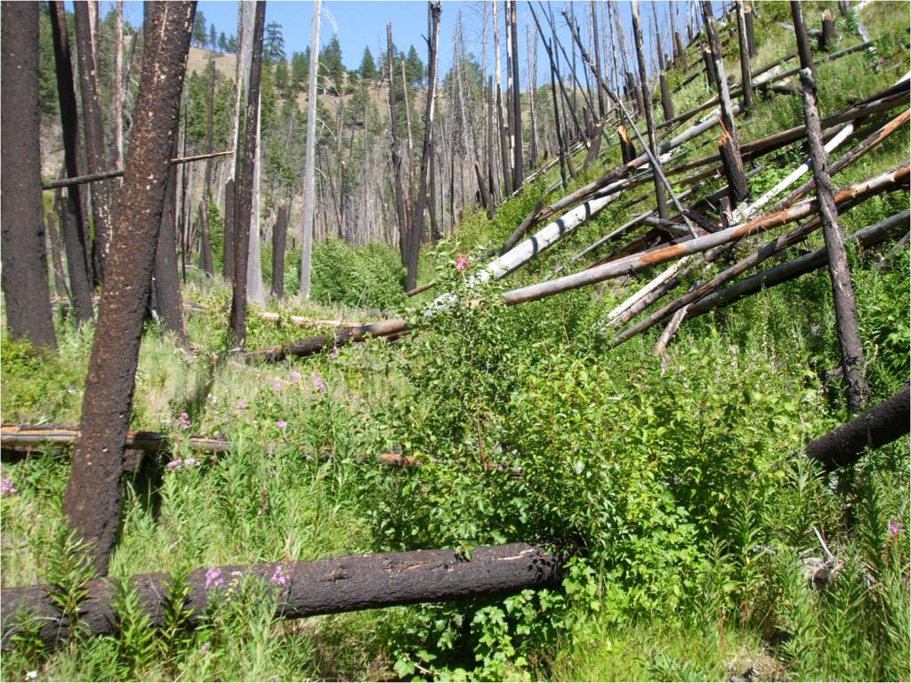
Is recovery of vegetation, fish habitat, and populations always fast?
It depends on:
Soil burn severity
Post-fire stream channel stability
The extent of fish population declines
Connectivity to source fish populations
Refugia
Medicine Tree Creek Bitterroot NF

Slide 29
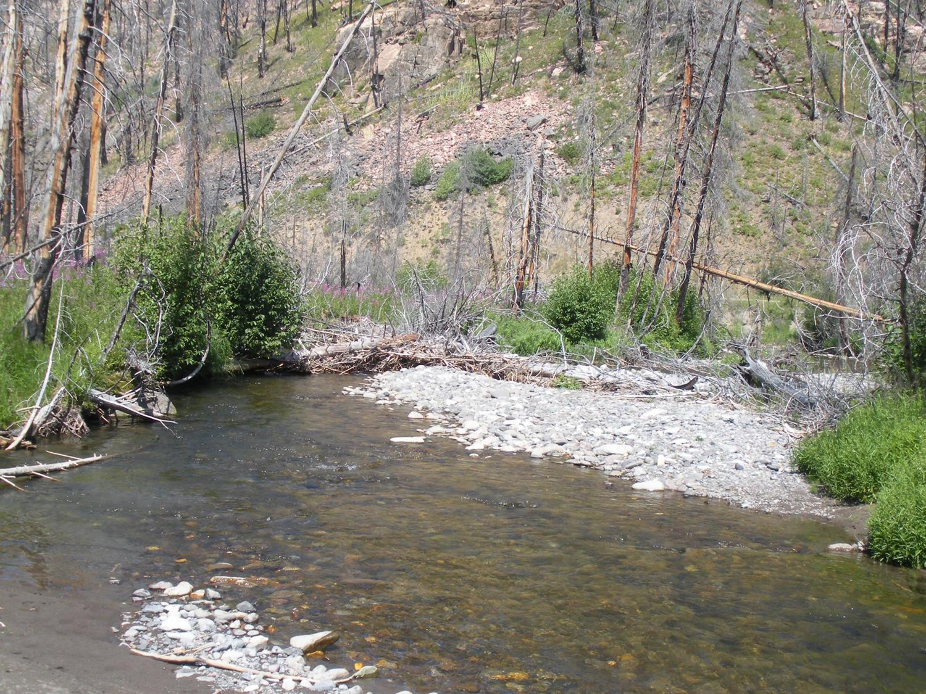
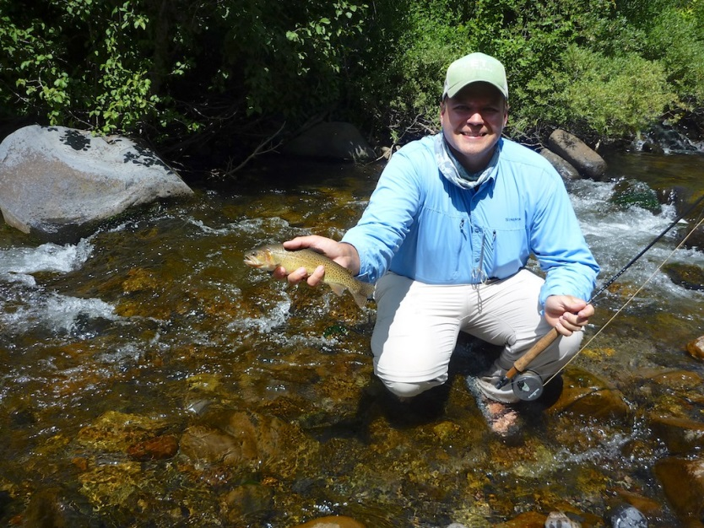
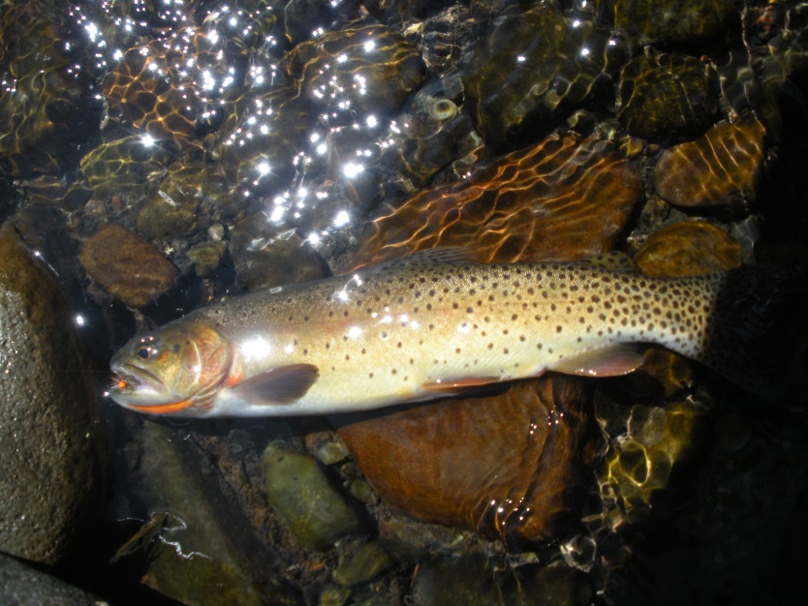
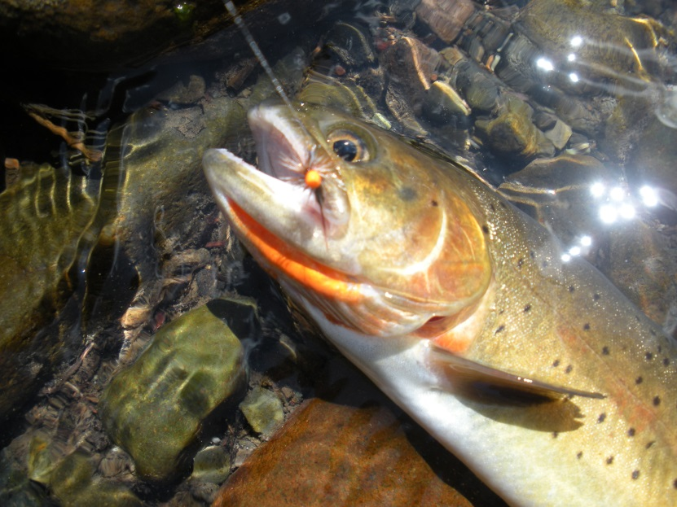
Now Would You
Fish a Burned Stream?

Slide 30
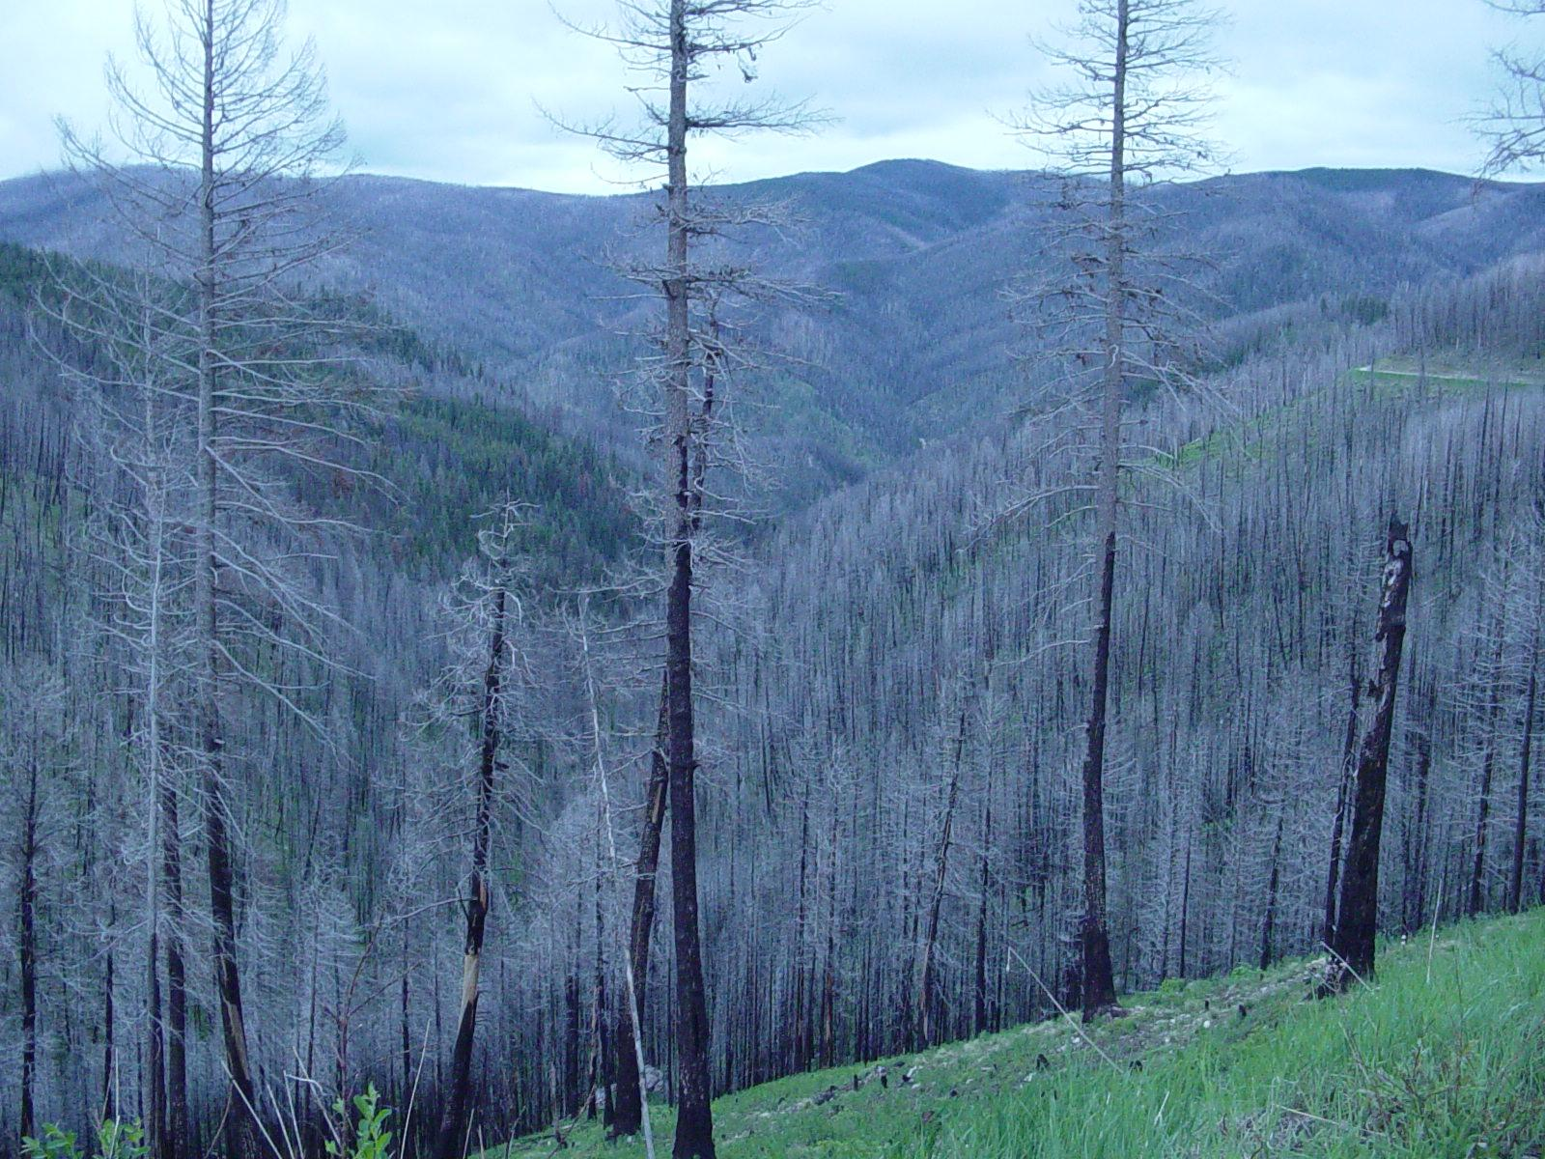
Acknowledgements
Chris Clancy - Montana FWP Hamilton
Mike Jakober - Bitterroot National Forest
Mike Young - Rocky Mountain Research Station
Tom McMahon - Montana State University
Scott Opitz- Montana FWP Livingston
Notes:
‹#›

