Slide 1
Grant-funded projects
NSF EPSCoR: CREWS – Consortium for Research on Environmental Water Systems
Upper Clark Fork (hard rock mining), Powder River Basin (energy extraction - fracking), Judith River Basin (agricultural runoff)
MSU, UM, MTech, SKC, LBHC

Slide 2
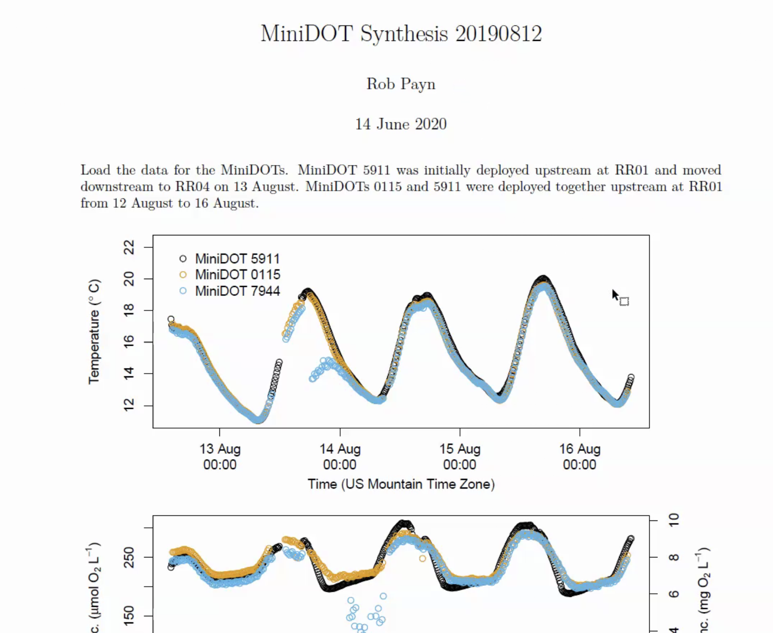
MiniDOT Synthesis 20190812, by Rob Payn
June 14, 2020

Slide 3
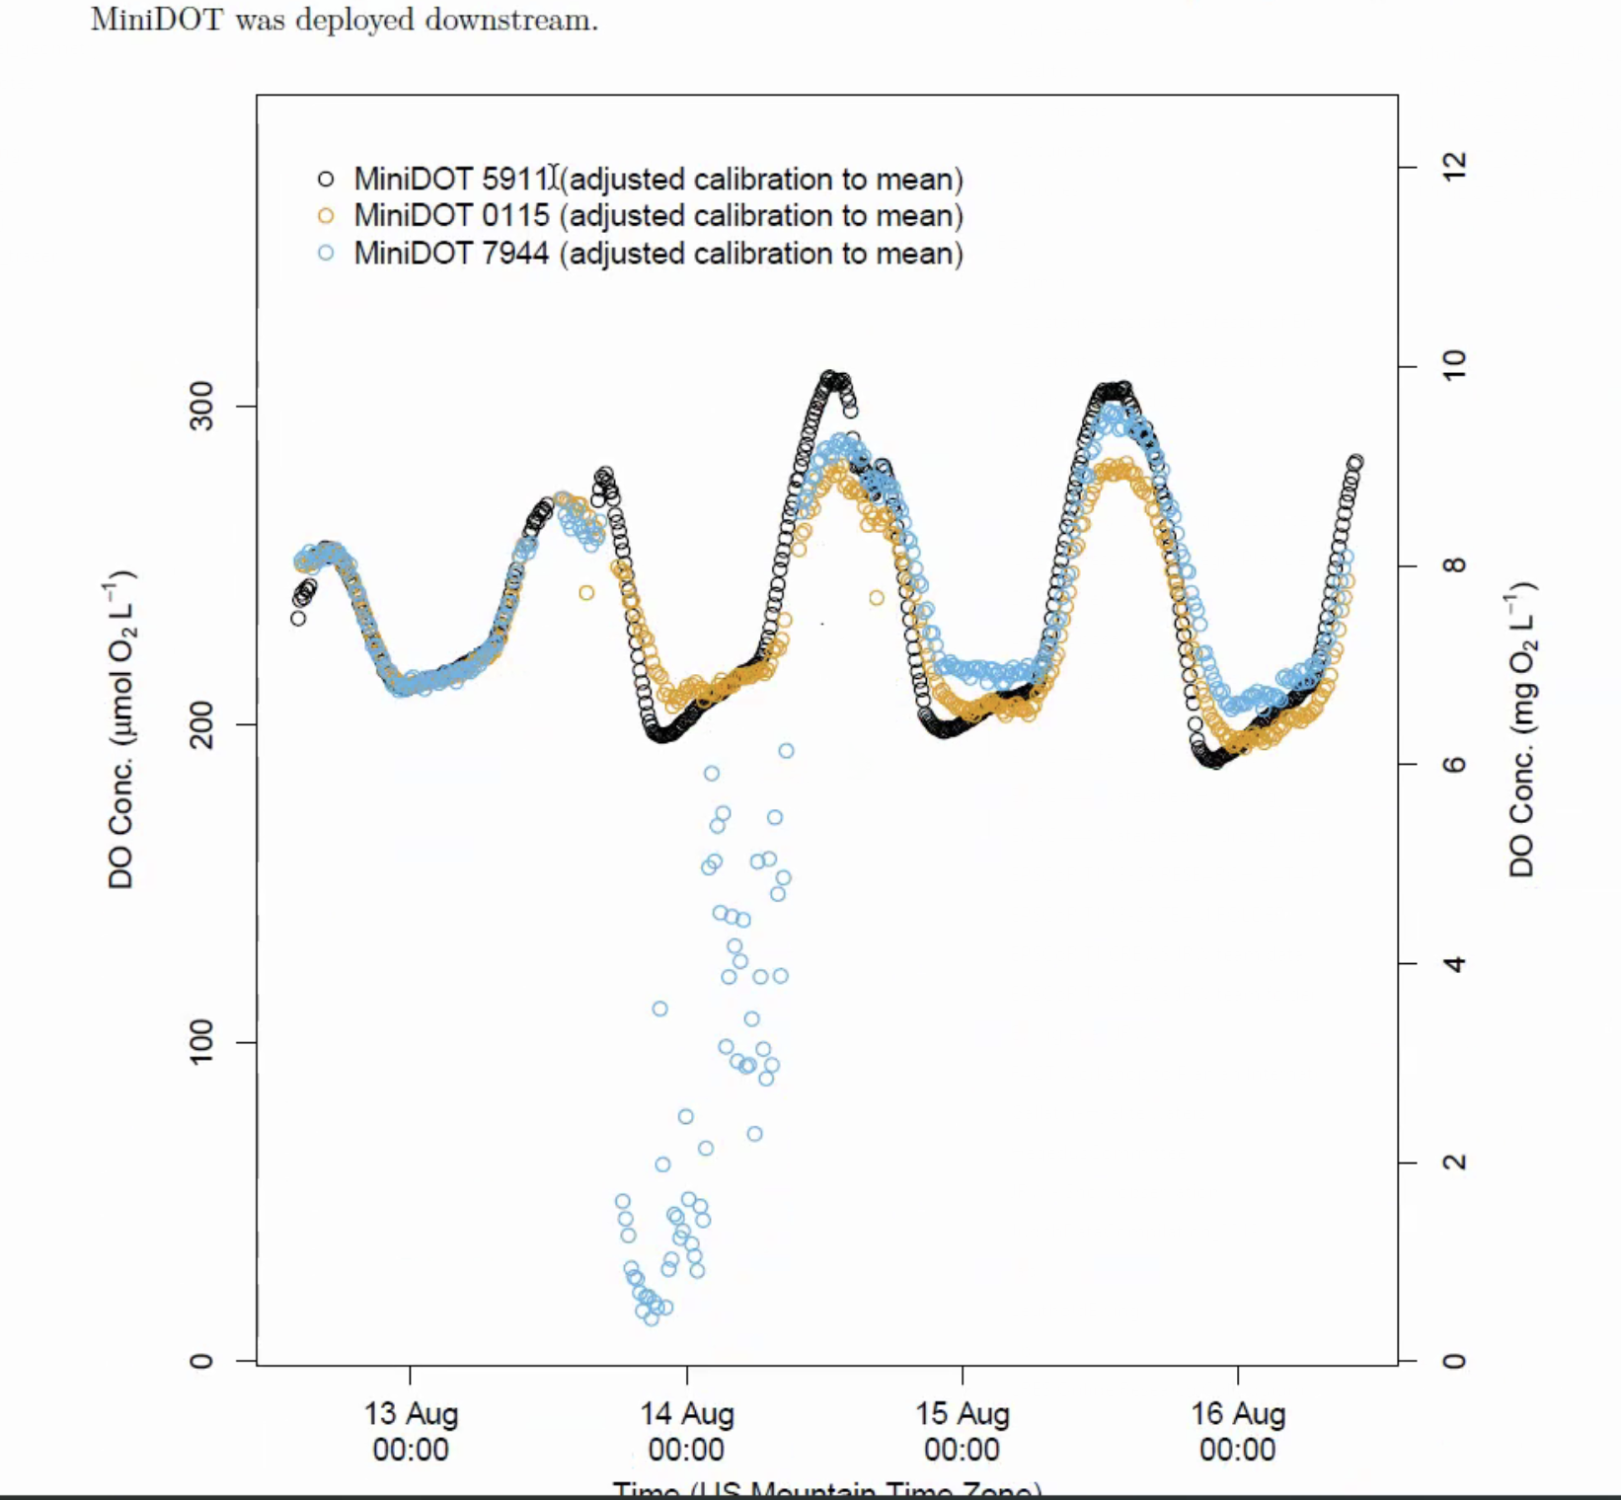
MiniDOT was deployed downstream

Slide 4
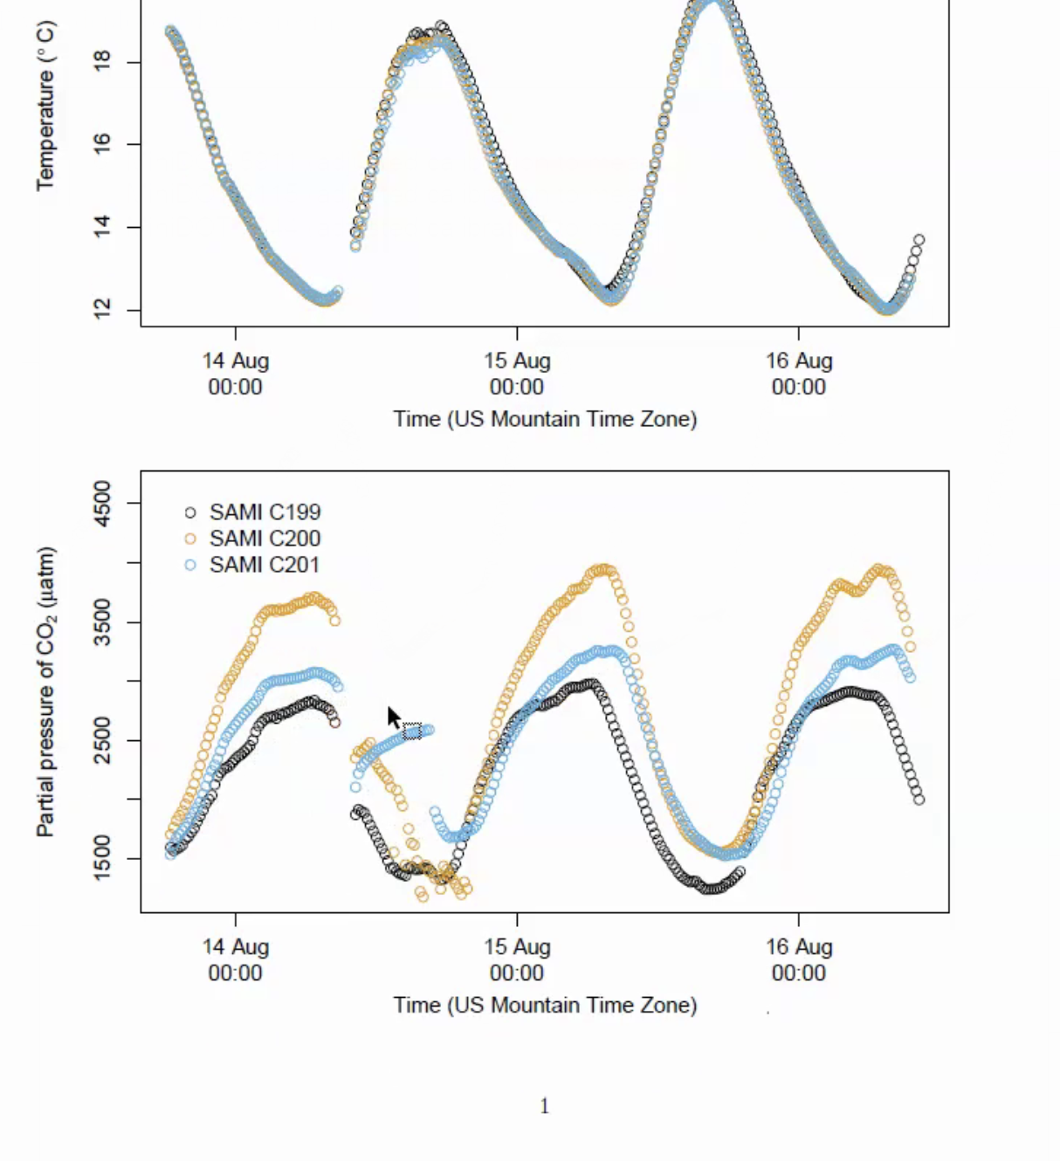
MiniDOT was deployed downstream (continued)

Slide 5
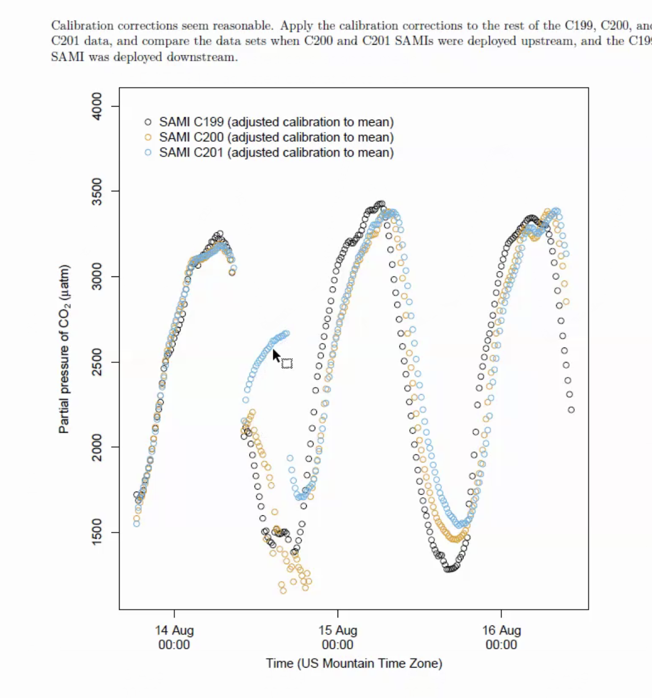
Calibration corrections

Slide 6
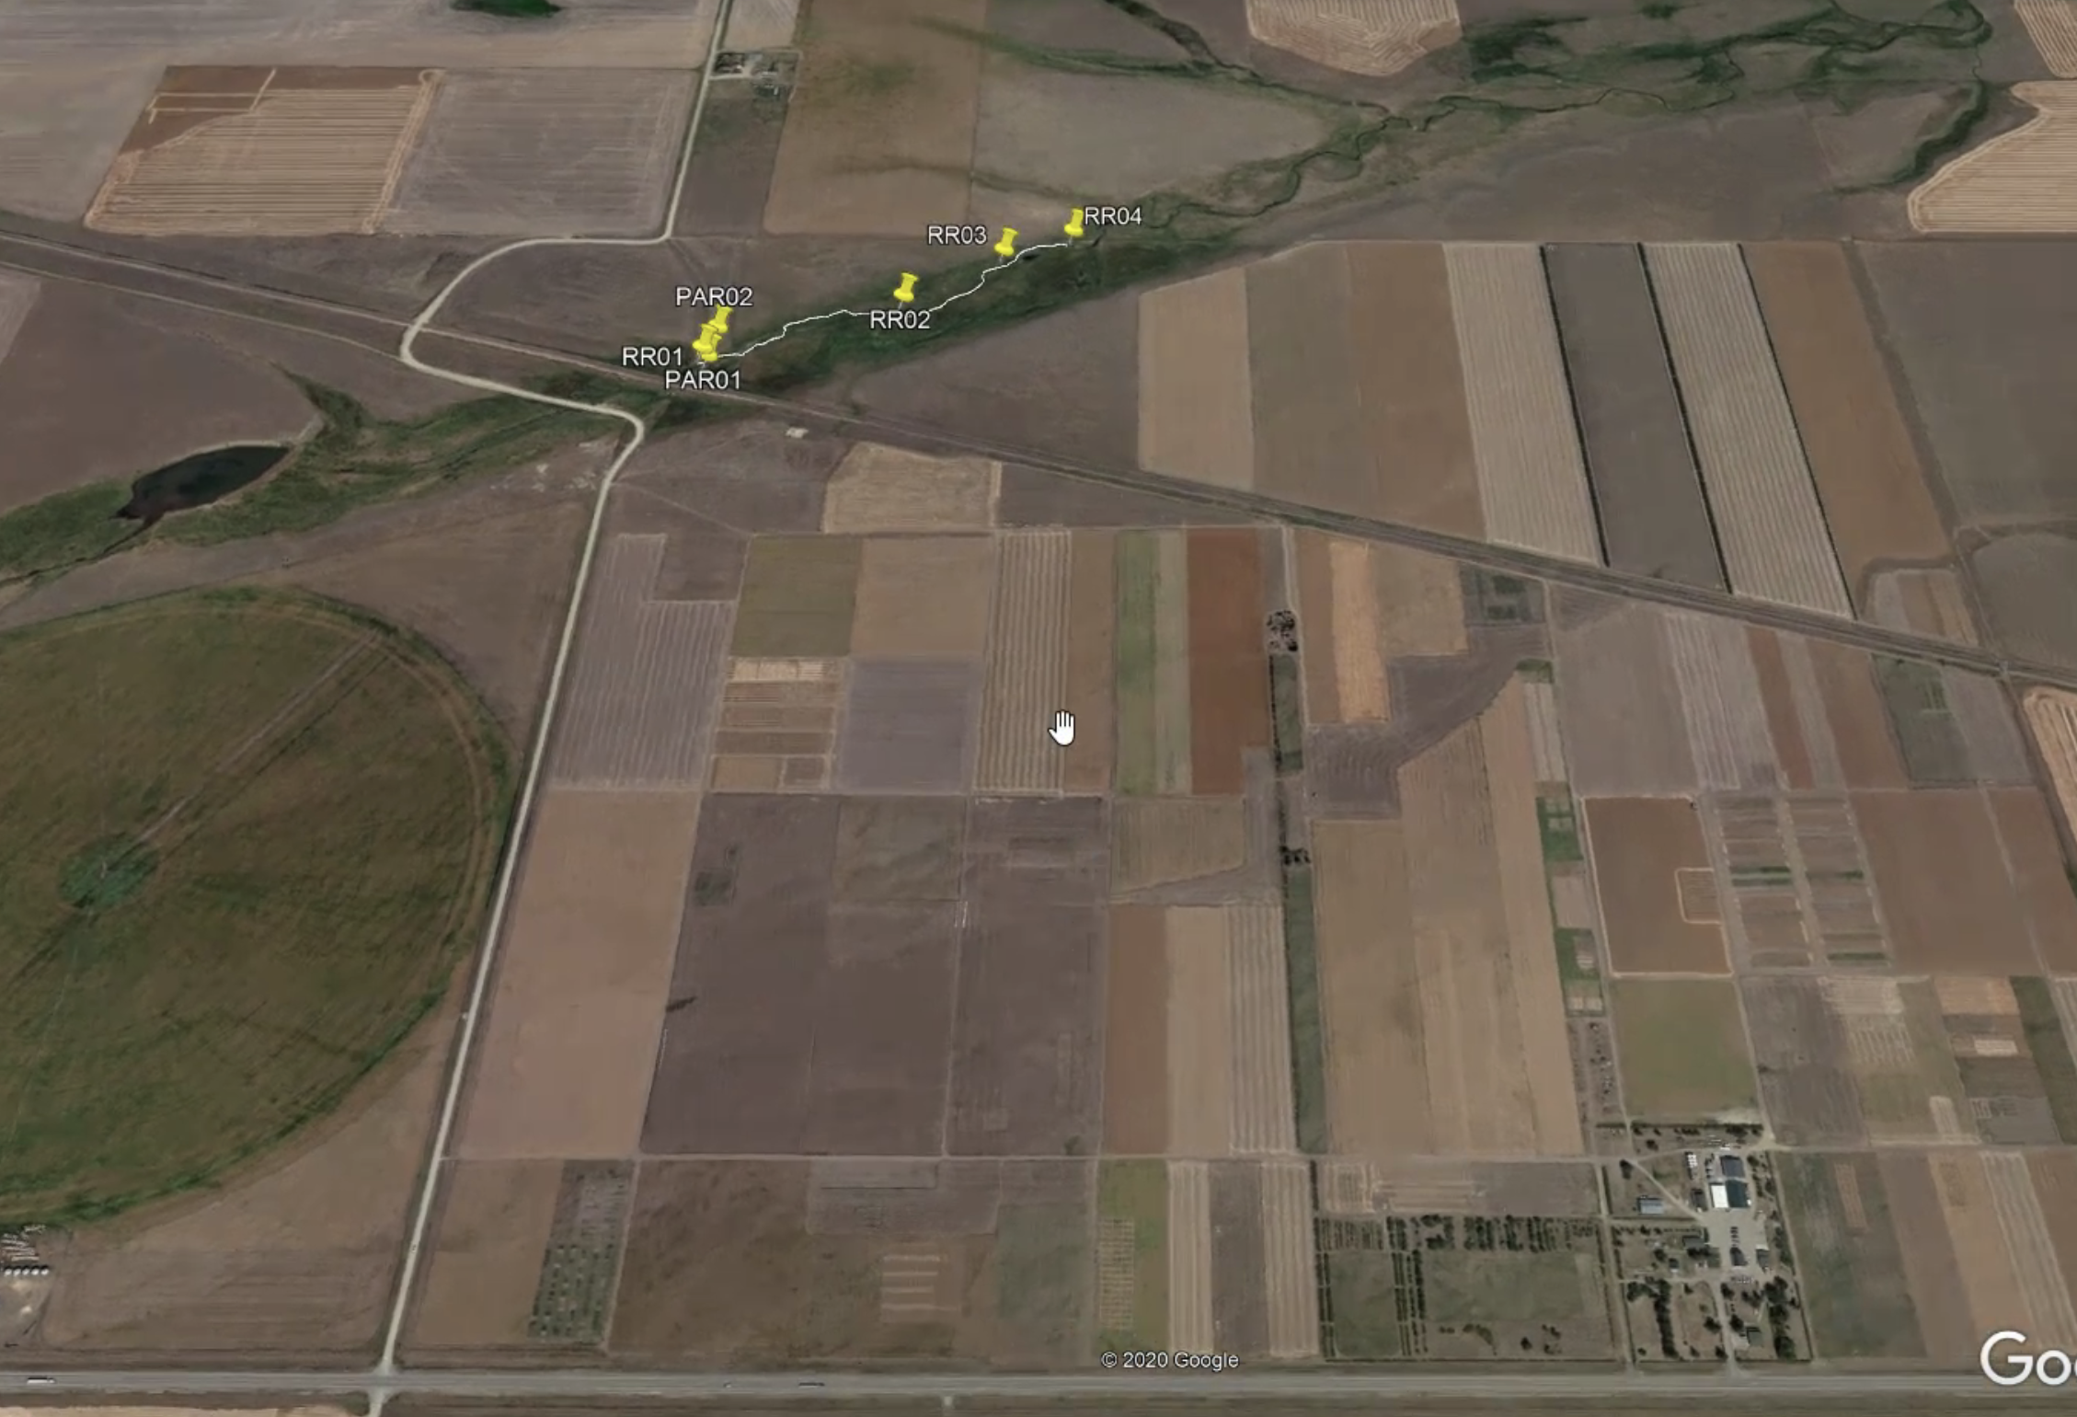
Airial map of stream spots measured:

Slide 7
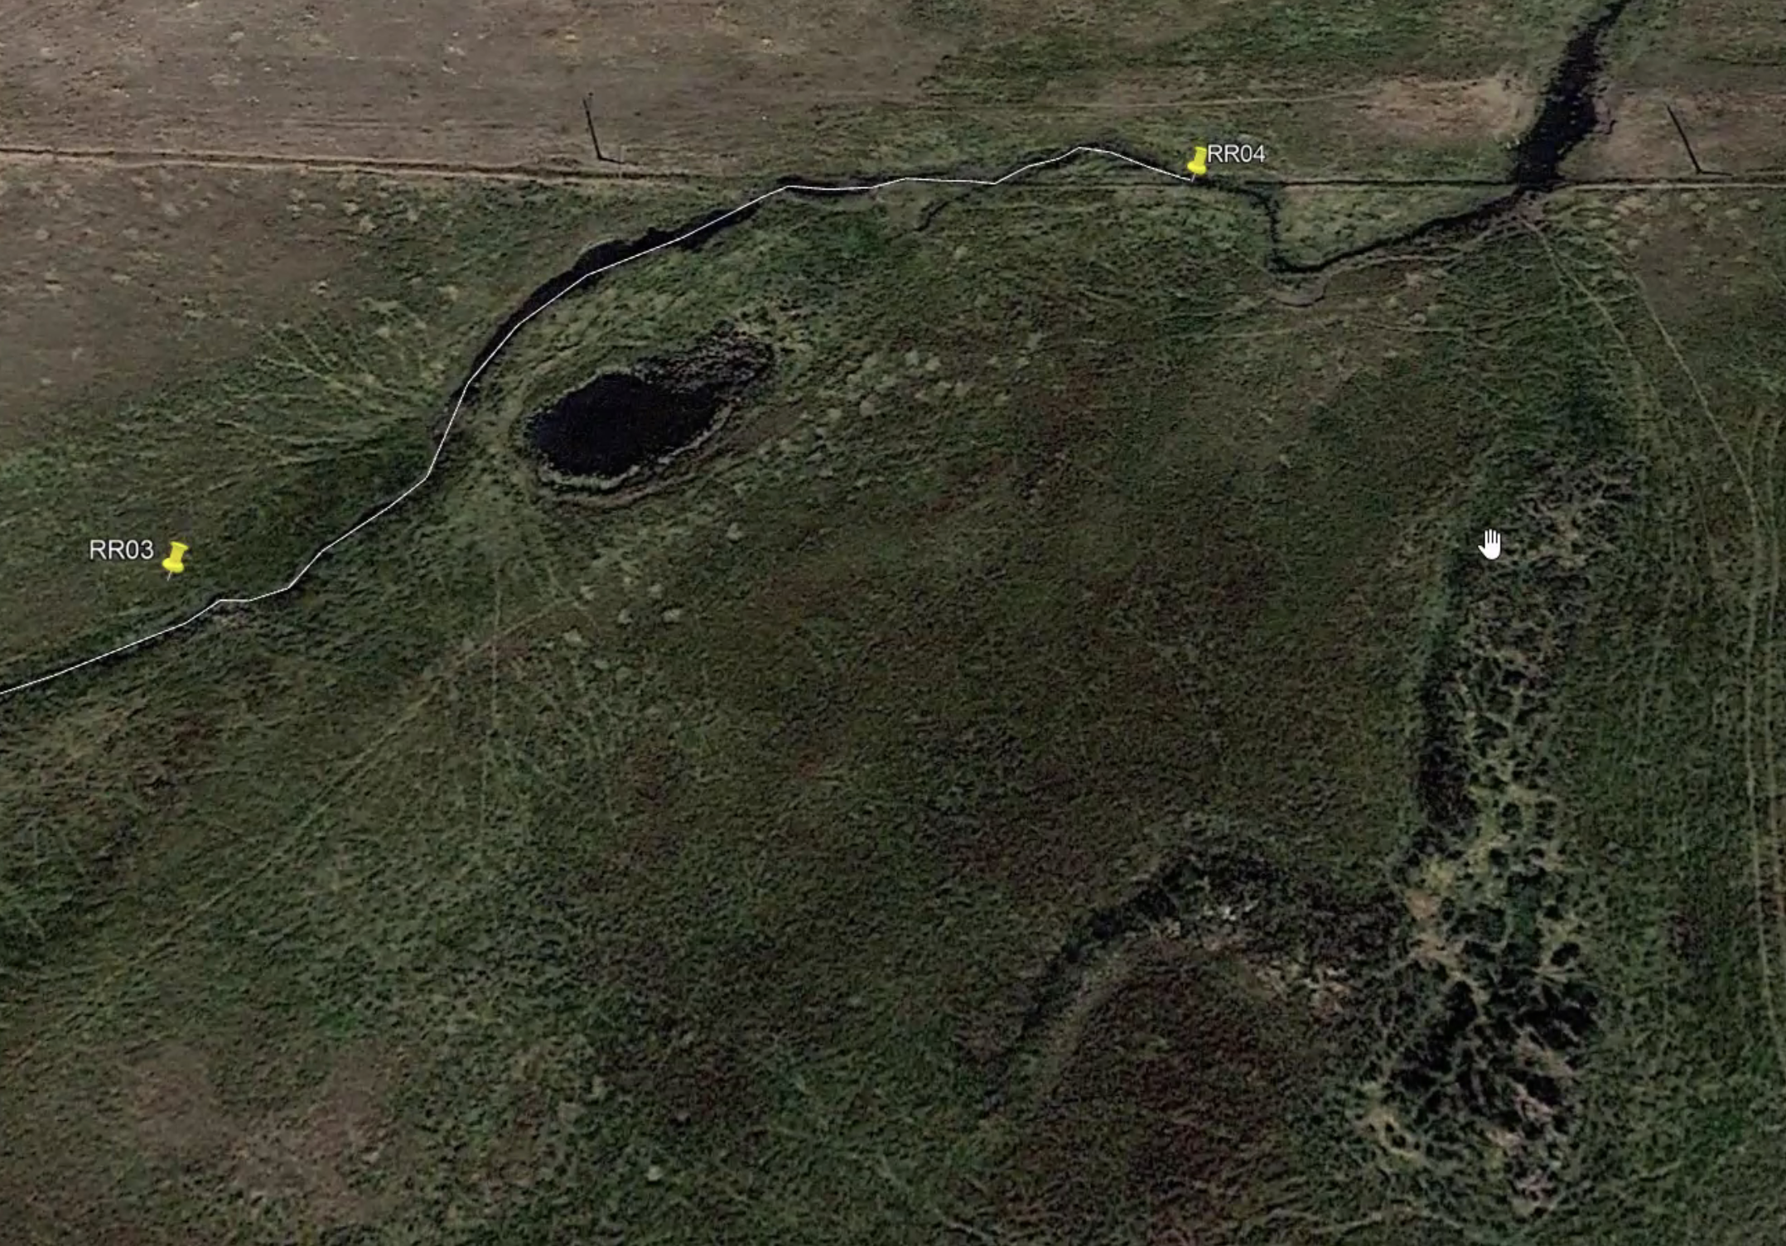
Satelite image of stream including areas RR03 and RR04

Slide 8
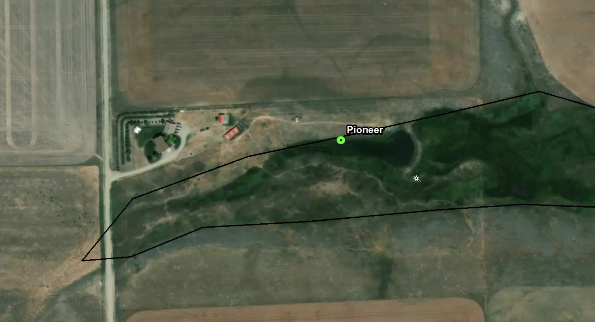
“Detrification engine”

Slide 9
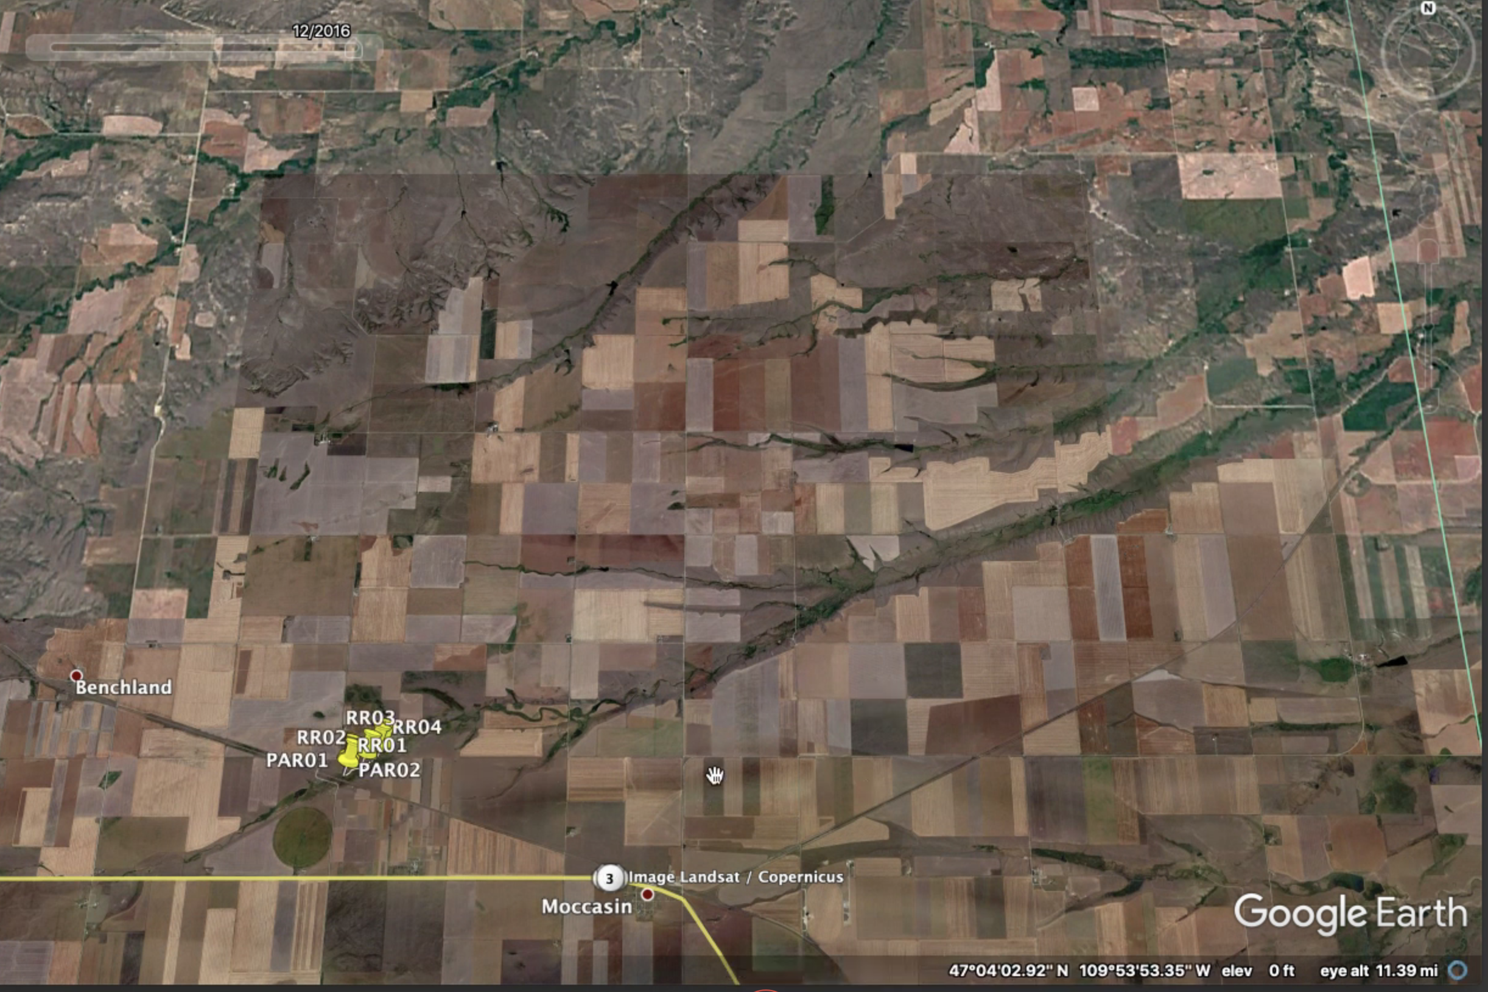
Satelite image farther out showing nearest towns

Slide 10
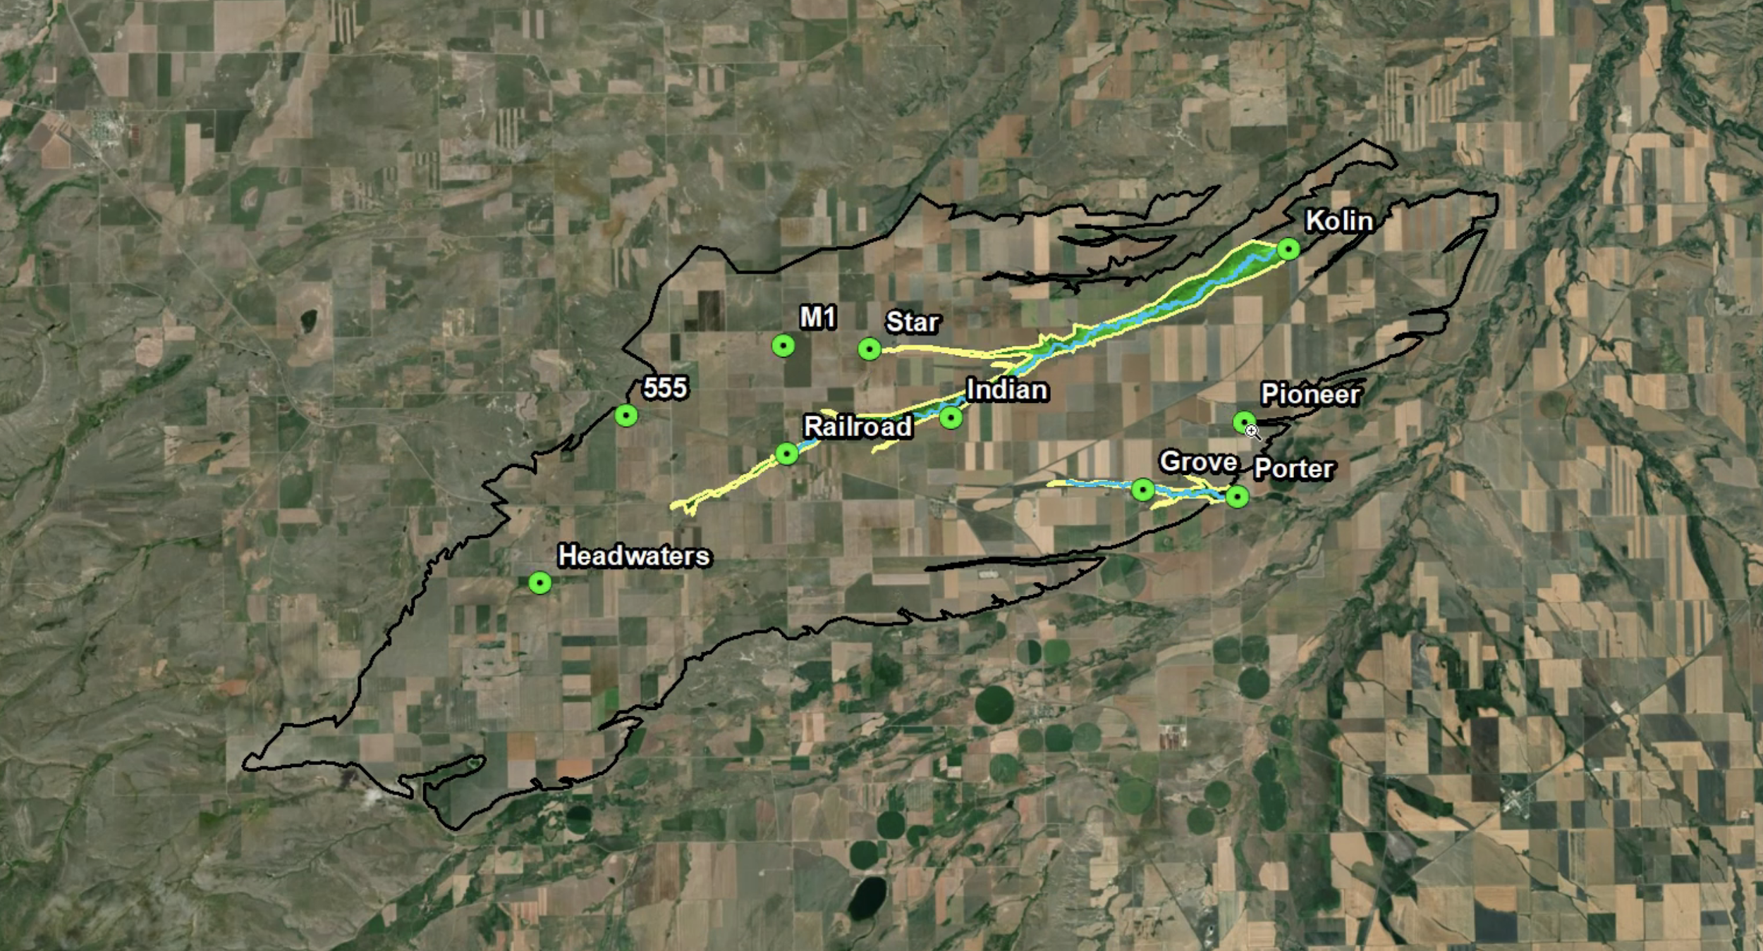
Satelite View farther still showing headwaters and towns

Slide 11
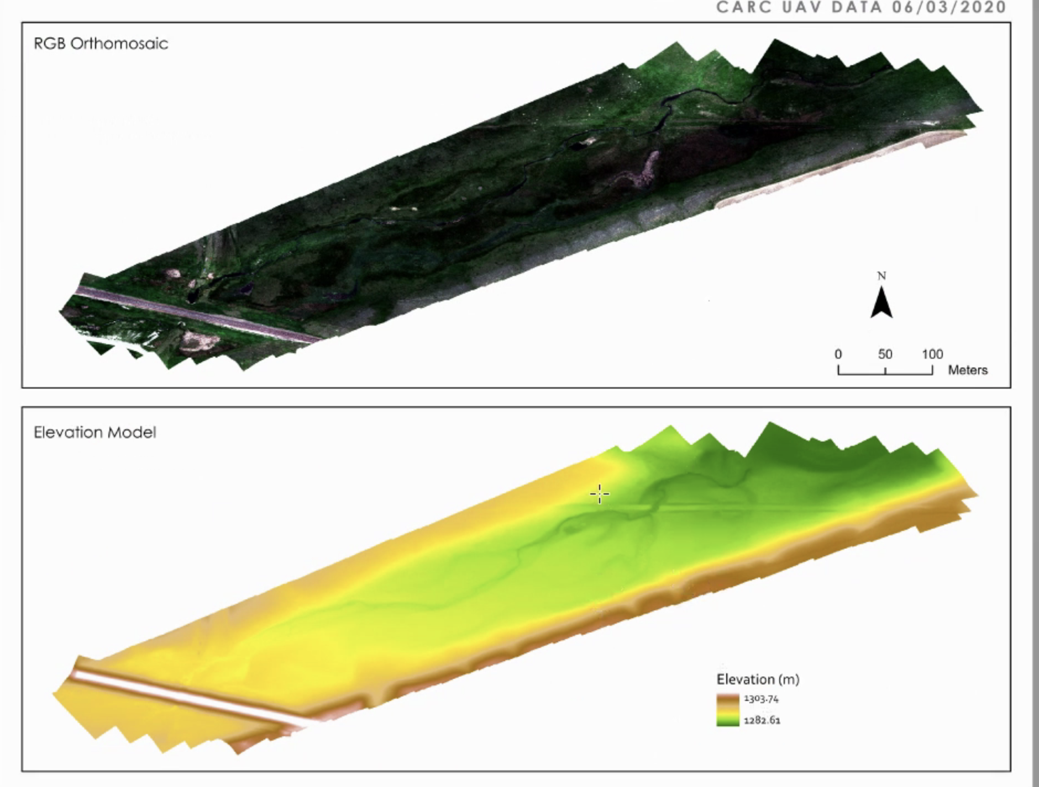
3D topographic models 1) RGB Orthomosaid, 2) Elevation Model

Slide 12
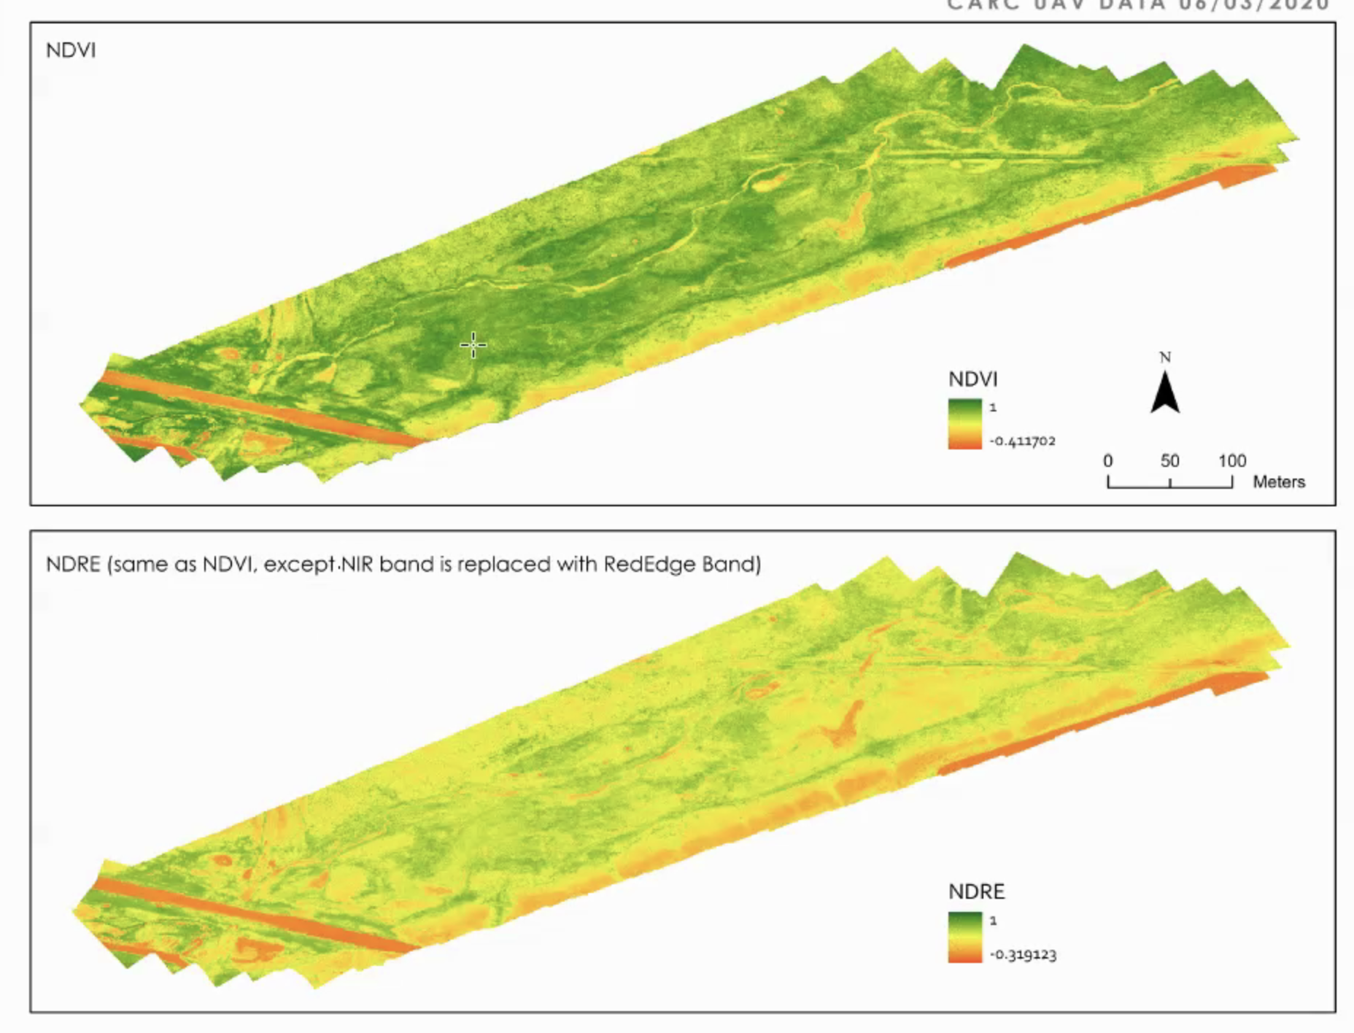
3D model NDVI and NDRE

