Slide 1
Buoyancy
Dr. Joel Cahoon
Civil Engineering
Summer 2009

Slide 2

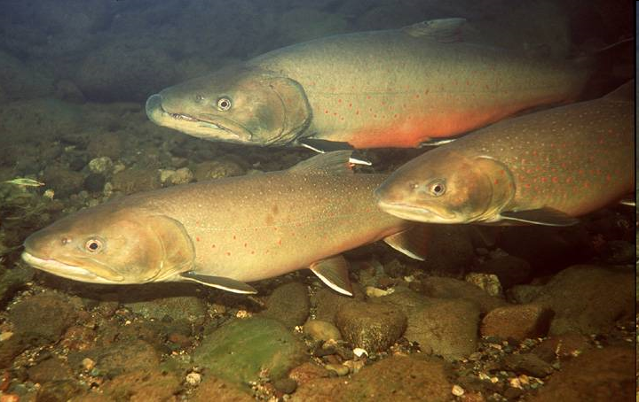
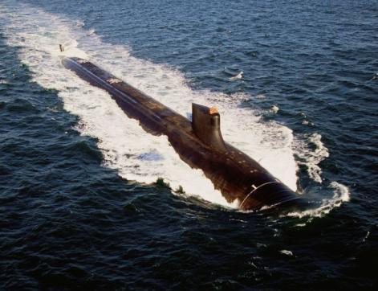
Buoyancy – Does an object float or sink?
Write on a piece of paper a list of things that might determine whether an object floats or sinks.

Slide 3

Buoyancy
Does an object float or does it sink?
Civil engineering students have a contest to design and race a canoe made from concrete!
Montana State University
American Society of Civil Engineers

Slide 4

Some concrete canoes float better than others!
University of Kansas – Daily Kansan
Photo by Anna Faltermeier

Slide 5
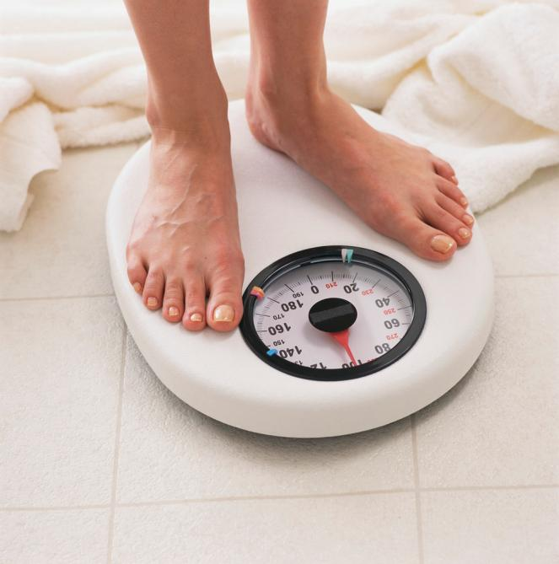
What is a Force?
The weight of an object is a force.
We will work with forces using the units of “pounds”.
Pounds is abbreviated “lb”.

Slide 6
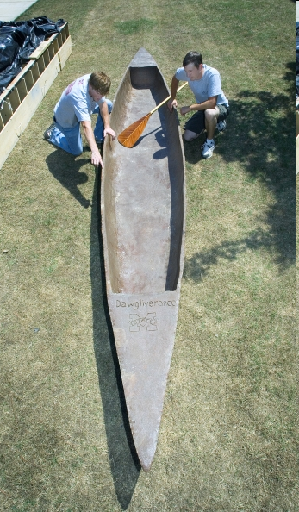
Force
This concrete canoe weighs 330 pounds.
Miss St University Relations News Bureau
(662) 325-3442
Contact: Robbie Ward
June 11, 2007

Slide 7
Forces
There are many ways to exert a force.
However, to determine buoyancy we only need to deal with the forces related to gravity.

Slide 8

Gravitational Forces
Weight of Object,
w = 195 pounds
195
pounds
=
w
The box doesn’t look like a canoe, but representing the canoe as a box simplifies our drawings.

Slide 9
What is a Force Balance?
w
Weight of Object,
w = 195 lb
F_{e}
+
=
195
lb
w
w
Supporting Force,
F_{e} = 195 lb
Note:
Up is (+)
The scale itself is providing the supporting force, and the supporting force is equal to the weight of the object.
Down is (-)

Slide 10

Other Supporting Forces?
The supporting force is from above. There is no supporting force from below.
Supporting Force,
F_{e} = 150 lb

Slide 11
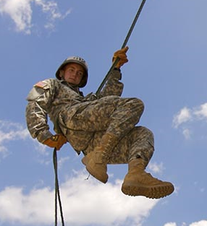
Other Supporting Forces?
F_{e}
Supporting Force,
F_{e} = 150 lb
w
Weight of Object,
w = 150 lb
+
=
w
0 lb
The supporting force is from above, and since it is equal to the weight of the object, the scale provides no support.

Slide 12
More Than 1 Supporting Force?
Crouch on a bathroom scale. Have two strong friends start to lift you by your elbows. Is there a point where half your weight is supported by your friends and half your weight is supported by the scale?
In the diagram, the block represents you.
F_{e} = 0.5 w
w
0.5 w

Slide 13
Why is there a Force Balance?
Newton’s 2nd Law:
Sum of All Forces Acting on a Body = Mass x Acceleration
If the body is not accelerating (it is either stationary or moving at a constant velocity) then Acceleration equals zero. So, a body at rest has:
Sum of All Forces Acting on a Body = 0
Don’t forget signs (+, - )!

Slide 14
Force Balance on a Submerged Object
Water Surface
Supporting Force, F_{e}
Weight of Object, w
Buoyant Force, F_{b}

Slide 15
Force Balance on a Submerged Object
The buoyant force, Fb, is determined by Archimedes’ Principle:
The buoyant force equals the weight of the water displaced by the object.
F_{b} = γ x V_{d}
γ = the unit weight of the water (lb/ft³)
V_{d} = the volume of water occupied by the submerged portion of the object (ft³).

Slide 16
What is the Unit Weight of Water?
A 1 foot cube of water weighs 62.4 lb. So, for water:
γ = 62.4 lb/1 cubic foot = 62.4 lb/ft³
Water
=
1 ft
62.4 lb
1 ft
1 ft

Slide 17
What is the volume displaced?
Depends on the shape. Here’s an example:
Water Surface
3 ft
Because this is a cube:
V_{d} = length x width x depth
V_{d} = 3 ft x 3 ft x 3 ft = 9 ft³
3 ft
3 ft

Slide 18
What is the volume displaced?
Depends on the shape. Here’s an example:
Water Surface
3 ft
6 ft
Because this is a cylinder:
V_{d} = π x (diameter/2)² x length
V_{d} = 3.1416 x (3 ft/2)² x 6 ft = 42.41 ft³

Slide 19
Now what, does it float or not?
Let’s say that an object is submerged in the water and then released. At the moment it is released, there is nothing holding it up from above and it is not resting on a solid object below. That’s the same as saying the supporting force, F_{e}, is zero.
F_{e} = 0
=
w
w
F_{b}
F_{b}

Slide 20
Now what, does it float or not?
At the moment of release there are only two forces left (w and F_{b}). With only two forces, there are only three possible cases:
w is greater than F_{b} (w > F_{b})
w is less than F_{b} (w < F_{b})
w is equal to F_{b} (w = F_{b})
w
F_{b}

Slide 21
Case 1
w is greater than F_{b} (w > F_{b})
If w is greater than F_{b}, then the sum of the forces is (w points downward, so w is negative):
sum of forces = (-w) + Fb
which will be a negative number!
w
Side Note:
Notice the length of the arrows.
F_{b}

Slide 22
Case 1
w is greater than F_{b} (w > F_{b})
If the sum of forces is non-zero, then the object is accelerating. Since the sum of forces is negative, the object is accelerating downward.
The object is sinking!
w
F_{b}

Slide 23
Case 2
2. w is less than F_{b} (w < F_{b})
Since the sum of forces is positive, the object is accelerating upward.
The object is floating!
w
F_{b}

Slide 24
Case 3
3. w equals F_{b} (w = F_{b})
Since the sum of forces is zero, the object is not moving at all (no acceleration).
The object is “neutrally buoyant”. It just stays in the place where it was released!
w
F_{b}

Slide 25

An example
A brick is 6 inches long, 3 inches wide and 3 inches tall. The brick was placed on a scale and weighed 4 lb. When submerged and then released, will the brick float?
6 in
3 in
3 in
The weight of the object, w, is 4 lb.
w = 4 lb
4 lb

Slide 26
An example
A brick is 6 inches long, 3 inches wide and 3 inches tall. The brick was placed on a scale and weighed 4 lb. When submerged and then released, will the brick float?
6 in
3 in
What is the volume displaced, V_{d}?
3 in
V_{d} = (6 in x 1 ft/12 in) x (3 in x 1 ft/12 in) x (3 in x 1 ft/12 in)
V_{d} = (0.5 ft) x (0.25 ft) x (0.25 ft)
V_{d} = 0.03125 ft³

Slide 27
An example
A brick is 6 inches long, 3 inches wide and 3 inches tall. The brick was placed on a scale and weighed 4 lb. When submerged and then released, will the brick float?
6 in
3 in
What is the buoyant force, F_{b}?
3 in
F_{b} = γ x V_{d}
F_{b} = 62.4 lb/ft³ x 0.03125 ft³ = 1.95 lb

Slide 28
An example
A brick is 6 inches long, 3 inches wide and 3 inches tall. The brick was placed on a scale and weighed 4 lb. When submerged and then released, will the brick float?
What is the sum of the forces?
Sum of forces = (-4 lb) + 1.95 = -2.05 lb
Sum of forces is negative, so the brick will accelerate downward. The brick will sink!
w = 4 lb
F_{b} = 1.95 lb

Slide 29
Another example
A block of wood is 6 inches long, 3 inches wide and 3 inches tall. The block was placed on a scale and weighed 1 lb. When submerged and then released, will the block float?
6 in
3 in
3 in
The weight of the object, w, is 1 lb.
w = 1 lb
1 lb

Slide 30
Another example
A block of wood is 6 inches long, 3 inches wide and 3 inches tall. The block was placed on a scale and weighed 1 lb. When submerged and then released, will the block float?
6 in
3 in
What is the volume displaced, V_{d}?
3 in
V_{d} = (6 in x 1 ft/12 in) x (3 in x 1 ft/12 in) x (3 in x 1 ft/12 in)
V_{d} = (0.5 ft) x (0.25 ft) x (0.25 ft)
V_{d} = 0.03125 ft³ Same as the brick!

Slide 31
Another example
A block of wood is 6 inches long, 3 inches wide and 3 inches tall. The block was placed on a scale and weighed 1 lb. When submerged and then released, will the block float?
6 in
3 in
What is the buoyant force, F_{b}?
3 in
F_{b} = γ x V_{d}
F_{b} = 62.4 lb/ft³ x 0.03125 ft³ = 1.95 lb Same as the brick!

Slide 32
Another example
A block of wood is 6 inches long, 3 inches wide and 3 inches tall. The block was placed on a scale and weighed 1 lb. When submerged and then released, will the block float?
What is the sum of the forces?
Sum of forces = (-1 lb) + 1.95 = 0.95 lb
Sum of forces is positive, so the brick will accelerate upward. The wood block will float!
w = 4 lb
F_{b} = 1.95 lb

Slide 33
A third example
A block of wood is 6 inches long, 3 inches wide and 3 inches tall. The block was placed on a scale and weighed 1 lb. When submerged and then released, we have shown the block will float. Now, how much of the block will be above water?
Or like this?
Water Surface
Like this?

Slide 34
A third example
From the second example:
V_{d} = 0.03125 ft³
But this was based on the whole block being under water. Now it is only partially submerged. The submerged volume is still (length x width x depth), but now the depth is only the portion under water:
depth

Slide 35
A third example
Once the block of wood floats to the top and comes to rest, it is no longer accelerating. If it is not accelerating, then the sum of forces equals zero. So we can solve Newton’s 2nd law for the unknown submerged depth.
Sum of forces = (-w) + F_{b} = 0
0 = (-w) + F_{b}
0 = (-w) + γ x V_{d}
0 = (-w) + γ x (6 in x 1 ft/12 in) x (3 in x 1 ft/12 in) x (depth)
w = 1 lb
F_{b} = 1 lb

Slide 36
A third example
Substitute values for w and γ, rearrange the equation and solving for the depth:
w = γ x (6 in x 1 ft/12 in) x (3 in x 1 ft/12 in) x (depth)
1 lb = (62.4 lb/ft³) x (6 in x 1 ft/12 in) x (3 in x 1 ft/12 in) x (depth)
1 lb
depth =
= 0.128 ft
(62.4 lb/ft³) x (6 in x 1 ft/12 in) x (3 in x 1 ft/12 in)
depth = 0.128 ft x (12 in/1 ft) = 1.54 inches
w = 1 lb
F_{b} = 1 lb

Slide 37
A third example
So, 1.54 inches will be submerged, and the remaining 1.46 inches will be above the water.
1.46 in
Water Surface
w = 1 lb
1.54 in
F_{b} = 1 lb

