Slide 1
Energy Conservation
Energy Conversion-The Penny Battery
Stephen W. Sofie
^{TEAMS}
Department of Mechanical & Industrial Engineering

Slide 2
The Conservation of Energy Law
→ energy cannot be created or destroyed
(it can only change forms so that energy in = energy out)
Ok seems simple enough - energy doesn’t come out of thin air or just disappear but
what is energy

Slide 3



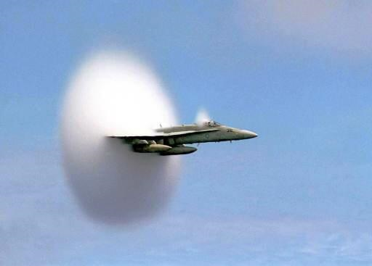
Scientists define energy as the ability to do work
Energy is found in different forms: such as light, heat, sound and motion

Slide 4
Kinetic Energy: Energy of Motion
KE = ½ mv²
^{m is mass}
^{v is velocity (speed)}

Slide 5
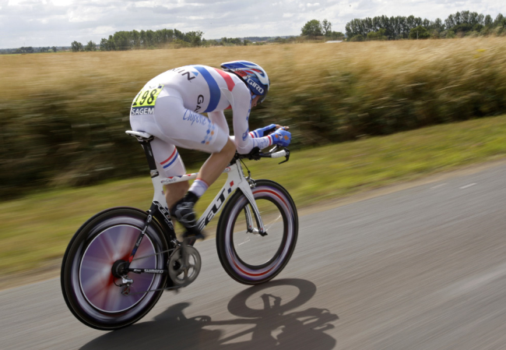

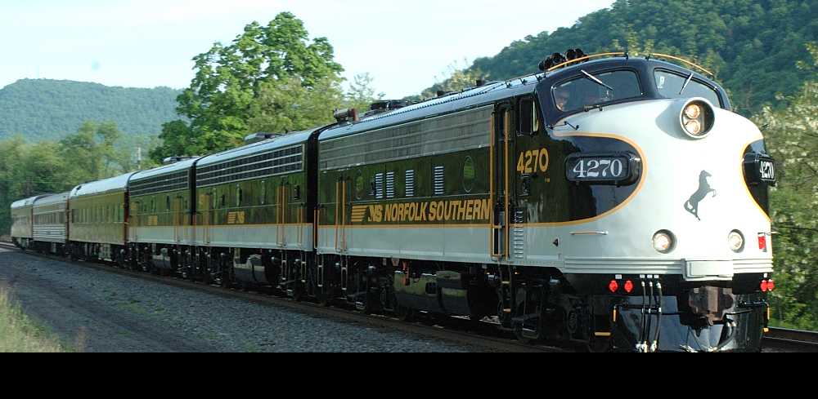
Which object has the most KE ?
Notes:
Calculations could be performed to show the dependence of KE on mass and velocity. Calcuate a series of incremental increases in mass with constant velocity and then calculate a series of incremental increases in velocity with constant mass. Graphing this data would indicate the stronger dependence on velocity given the squared term and non-linear growth.

Slide 6
Potential Energy: Stored Energy
PE = mgh
m is mass
g is gravity (acceleration)
h is height above the earths surface
Notes:
To show that the units are equivalent:
PE = mgh = kg⋅m/s²⋅m = kg⋅m²/s²
KE = ½ mv² = kg⋅(m/s)² = kg⋅m²/s²

Slide 7
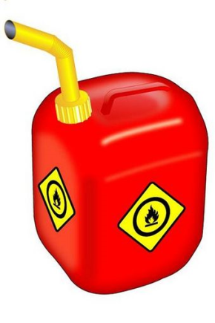

but…………….
Kinetic energy also includes electricity & heat
Potential energy includes chemical sources (fuel & food)
Notes:
Electricity is the flow of electrons from regions of negative charge to regions of positive charge. Hence we have the motion of electrons and is defined as kinetic energy.

Slide 8
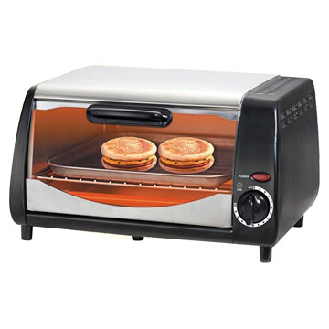

To use energy we change energy from one form to the next…….
This allows us to do stuff!
How does your toaster oven heat up?
Work
Electricity (KE)
Heat (KE)

Slide 9

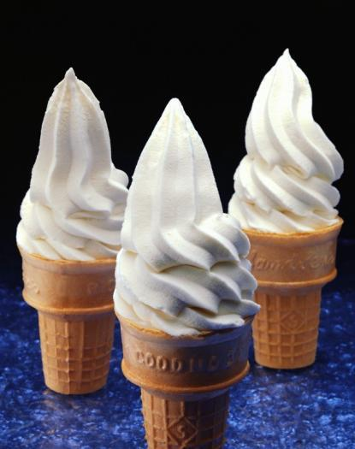
Work
Chemical Energy (PE)
Motion (KE)

Slide 10
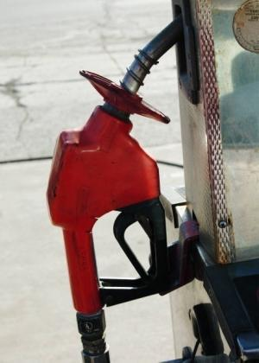

Work
Chemical Energy (PE)
Motion (KE)

Slide 11
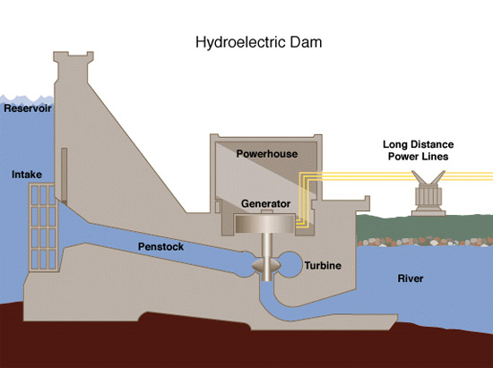
KE
Electricity (KE)
Notes:
The energy of motion in the water is converted into electricity. This is the same principle behind a wind turbine in which the motion of flowing air (instead of water) is converted into electricity.

Slide 12
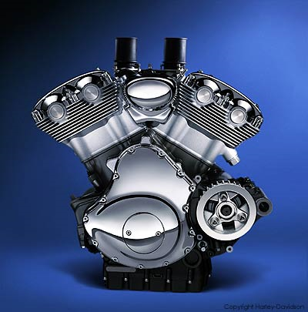
What about efficiency, doesn’t energy in = energy out
Yes, but…………
Heat (KE)
Chemical Energy (PE)
Heat (KE)
Motion (KE)
Notes:
Only 10-15% of the chemical energy of automotive fuel is converted into the motion, the rest is dissipated as heat through the radiator.
Efficiency is defined as the ratio of power input divided by the power output in terms of energy. This is never 100%, always less, hence the output is never equal to the input. No conversion process is perfect, albeit there are quantum mechanics processes at the atomic level that are indeed examples of perfect energy transfer. (ie. a photon excites an electron into a higher energy level, the electron then drops back down to the lower energy lever and emits a photon of the exact energy that excited it)
http://en.wikipedia.org/wiki/Energy_conversion_efficiency
Additionally, the human body is only about 5% efficient at converting chemical energy into motion, much heat is dissipated, while some heat is used to keep our body warm.

Slide 13
Electricity
How much electricity does a light bulb use?
100 Watts
How much electricity does a microwave use?
1500 Watts
How about the world?
16,000,000,000,000 Watts
Engineers and Scientists are trying to find new materials/
designs to convert electrical energy more cleanly and efficiently.
Batteries are an important technology for energy conversion (electro-chemical)

Slide 14

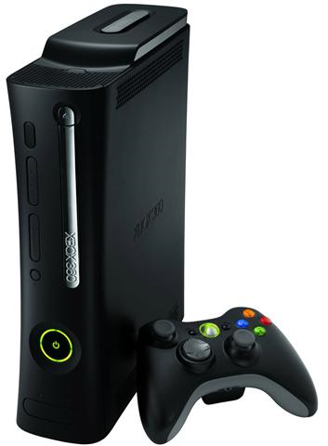
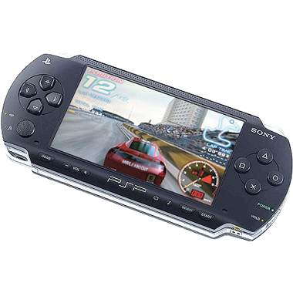
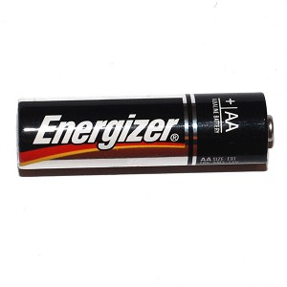


Chemical Energy (PE)
Heat (KE)
Electricity (KE)
Heat (KE)
Notes:
Batteries get warm because of internal resistance and hence some chemical energy is simply dissipated as heat. Lithium polymer, lithium ion, nickel metal hydride, and nickel cadmium batteries are superior to alkaline based batteries because of their low internal resistance, which allows them to supply more current and thus less heat loss under high drain applications.

Slide 15

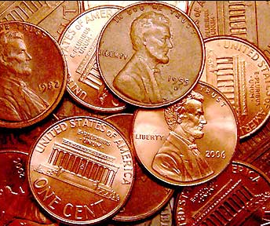
So what can we do with a penny to do work?

Slide 16
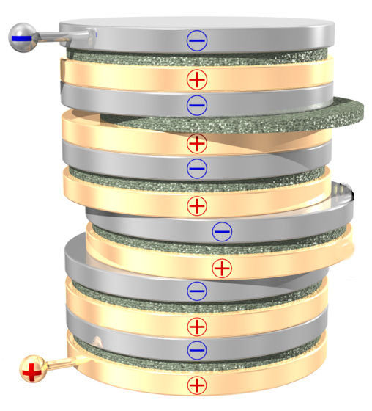
A penny has chemical energy (PE) that we can convert to electricity (KE)….
Al Foil
Electrolyte Sponge
Single Cell
Penny
Notes:
Note that the Al foil can be replaced with a rigid aluminum disc or even magnesium or zinc to achieve different voltages. Further you can also substitute the penny for copper sheet or flashing from the hardware store. The electrolyte sponge which was a paper towel should be wet, but not dripping to prevent shorting. The shape and overlap of the disks/electrolyte creating shorting problems generates excellent ideas and discussion related to concepts of engineering design. Focusing on a single chemistry and optimizing the way the battery is assembled is also a good exercise.
The acidity of the electrolyte promotes the dissolution of the electrode and hence the transfer of charge.
Lemon Juice – Citric Acid
Vinegar – Acetic Acid
Salt – Sodium Chloride
Ideally the electrolyte would be a solution that can hold many metal ions in solution, hence for a copper based battery like our penny battery, something like copper sulfate CuSO4 would present a much more effective electrolyte that can support charge transfer for much longer time. (our battery is capable of powering a light or small motor, but only for a short period of time).
Battery chemistry is not to complex for these systems, but since we are dealing with so many different electrolyte and potential anode materials, it could easily become far too confusing. If you would like some information on the chemistry of specific battery systems, I would be happy to provide additional information. This would lead well into the concept of why some batteries are rechargeable and others not – some materials simply cannot be feasibly be converted back into their metallic state after the electrochemical reaction has occurred.
Concepts of parrallel vs series circuits could also come into play, but I think this would serve better as either a pre or post activity.

Slide 17
Graphing the results is an excellent addition to this activity. Using the single cell voltage from the first stack, one can determine the voltage of the battery assuming each additional stack will be perfectly additive and thus linear. In reality the voltage of the battery will be less and can follow a potentially non-linear trend for which students can re-evaluate how the battery was constructed and engineer a solution to improve the battery voltage.

