Slide 1
Travel Training
November 2019 (updated)

Slide 2
Prior to Travel
A Travel Authorization/Advance Request should be completed PRIOR to travel if:
All or part of the trip will take place outside of Montana
The traveler is requesting an advance
      If lodging rates requested are above the standard rate of $96 (as of 10/1/19), or the GSA high cost city rate http://www.gsa.gov/portal/content/104877

Slide 3
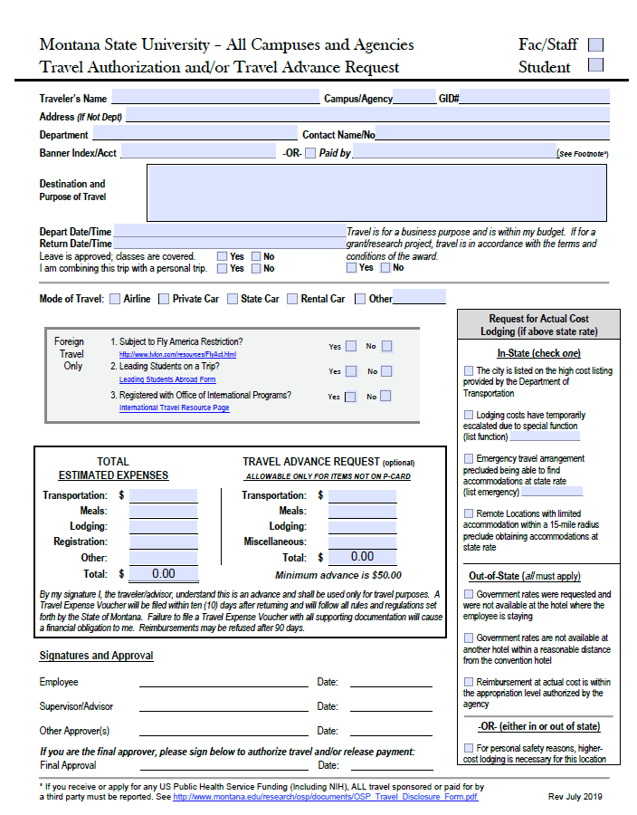

Slide 4
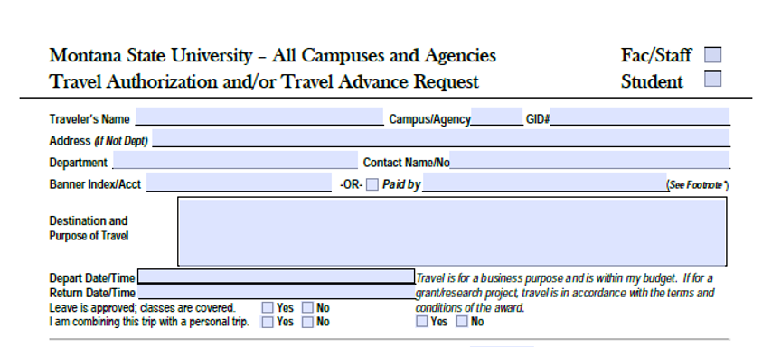

Slide 5
Travel Authorization form instructions
Check if Faculty/Staff or Student in the upper right-hand corner
Fill in Name, Campus, and Banner-Generated ID# (GID)
List your Address
• If a travel advance check is to be delivered to your department, you may leave the address information blank.
• If a check is not to be delivered to your department, list your home address here. This is also applicable if you have signed up for direct deposit for your travel reimbursements
4. List your department and a contact person knowledgeable about your trip, should there be questions about your travel.
5. Note the index/account to be charged for these expenses, or if paid by an external party, list that party
6. Describe Destination and Purpose of travel, and any other important details.
7. List Departure Date/Time, Return Date/Time
8. Check the following reminder boxes Yes or No:
• Leave is approved/Classes Covered
• Whether you are combining this trip with a personal trip. Note: extending the number of days you will be gone constitutes a “Yes” answer
• Affirm that this travel is for business and within your budget, and is appropriate for an award (if necessary)

Slide 6
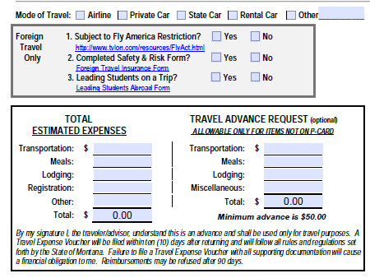

Slide 7
Travel Authorization form instructions (continued)
Check box for mode of transportation
For foreign travel, answer questions in shaded box. Complete additional forms as required. Attach email confirmation that trip is registered with OIP.
Fill in the Total Estimated Expenses
If requesting an advance, fill in the Travel Advance Request section
A few things to note:
UBS does not require a copy of the Travel Authorization form until AFTER travel is complete, UNLESS an advance is being requested.
However, if using grant funds, the Travel Authorization form must be sent to OSP prior to travel, even if an advance is not requested.

Slide 8
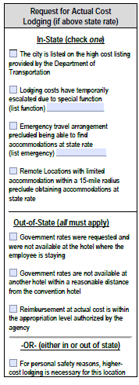
Lodging Above State Rates
      If requesting lodging above approved rates, read and check statements as appropriate. This portion must be completed if the lodging costs exceed the Government approved rates. Find them here: http://www.gsa.gov/portal/category/100120
In-State: Check the one explanation that applies.
Out-of-State: All must apply and be checked.
If none of the other reasons apply, but for safety reasons lodging with a government rate cannot be used, check the bottom-most box.

Slide 9
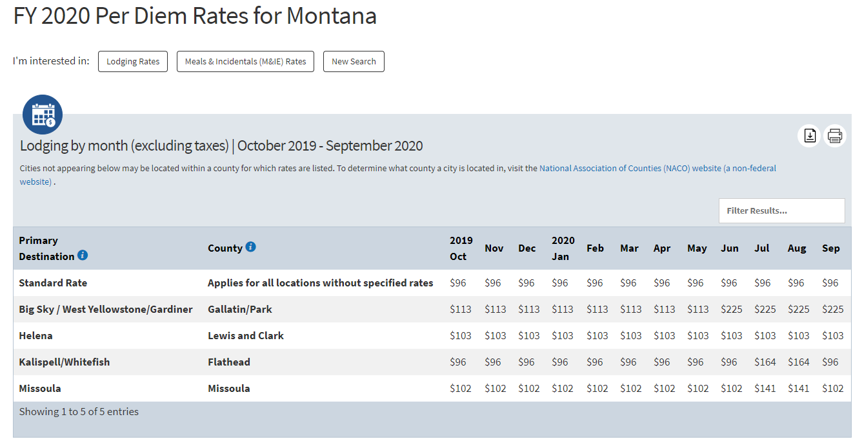

Slide 10
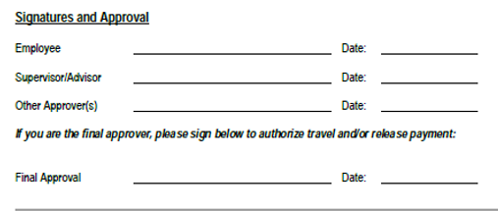
Approvals
Traveler must sign on ‘Employee’ line
Traveler’s supervisor, Student’s advisor or PI, must sign
Other approvers at the department’s discretion may sign (Dept. Head, Dean, Director, VP, OSP, MAES, ES…)
Final approval must be signed by appropriate designee to release payment and approve travel.

Slide 11
After Travel
A Travel Expense Voucher must be turned in after all travel when:
  Expenses are being claimed, including per diem
  A travel advance was given
A BPA must be submitted when the traveler is owed a reimbursement for expenses

Slide 12
Clearing Travel Advances
If a traveler received a travel advance and is owed for additional expenses:
  Submit a BPA and attach a copy of the Travel Authorization (TA), a Travel Expense Voucher (TEV), all receipts, and proof of travel if out of state
  Subtract the amount of advance from the total to be paid
If no additional expenses are owed to traveler:
  Submit a TEV with proof of travel, all receipts, and a copy of the TA
  If the traveler does not use the entire amount of the advance, deposit the remaining funds with the cashiers and attach a copy of the PROCESSED deposit slip with the TEV

Slide 13
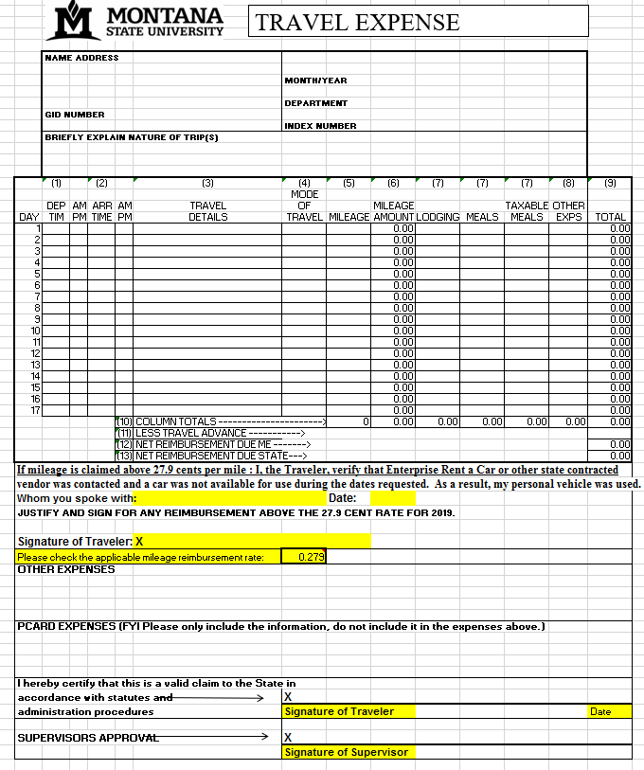

Slide 14
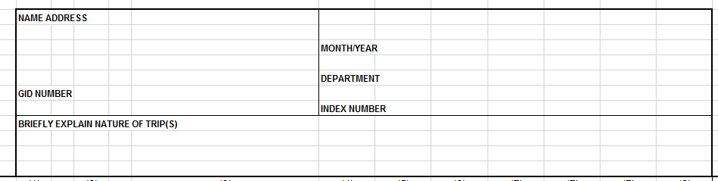
Travel Expense Voucher
Please complete all areas in the top of the TEV:
  Name and address
  Complete GID #
  Month and year of travel (not date of form completion)
  Department
  Index Number(s) to be charged for travel expenses
  Nature of trip: what, where (CABMA conference, Dallas, TX)

Slide 15
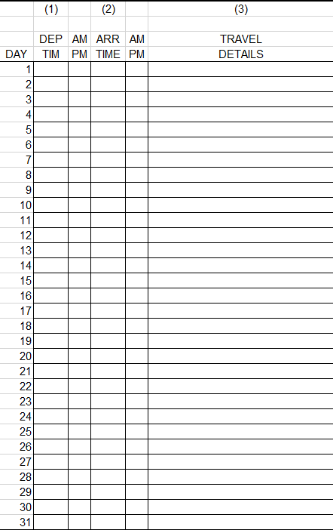
Bozeman-Billings
Billings – Miles City
Miles City - Bozeman

Slide 16
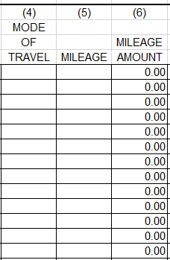
Mileage
Mode of Travel:
sc = state car
rc = rental car
pc = personal car
sa = state aircraft
ca = commercial air
pa = private aircraft
pt = passenger train
ot = other
Mileage = number of miles from point A to point B (only necessary if traveling by car)
Mileage amount = number of miles x appropriate mileage rate
2019 Mileage Rates:
High Rate $.585
High Rate (over 1,000 in a month) $.55
Low Rate $.279

Slide 17
Enterprise Rent-a-Car
Enterprise has replaced the MSU Bozeman Motor Pool
If a traveler is planning to request more than the low rate ($.279/mile) and is traveling more than 25 miles, they MUST contact Enterprise to check for availability. If an Enterprise car is available, and the traveler chooses not to take it, we cannot reimburse at the high rate
If a personal car is used and the high rate is requested, the traveler must document an appropriate reason why on the TEV.
Book online using MSU’s Enterprise Booking Tool at: https://legacy.enterprise.com/car_rental/deeplinkmap.do?bid=028&refId=GRP63MSU

Slide 18
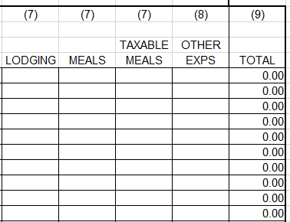
Lodging, Meals, Other
Lodging
  Unreceipted:
    Maximum reimbursement is $12
    All unreceipted lodging is taxable
  Actual cost of Lodging:
    Actual cost + Tax
      In-state = $96
      Federal = $96
    Or High cost city rate listed on GSA website: http://www.gsa.gov/portal/category/100120
    If rate is higher the Request for Actual Cost of Lodging section of TA form must be filled out for both in-state and out-of-state lodging

Slide 19
Lodging, Meals, Other
    Meal Per Diem
 | In-State | Out-of-State | Foreign
Breakfast | $7.50 | $13 | $7
Lunch | $8.50 | $14 | $11
Dinner | $14.50 | $23 | $18
Total Daily | $30.50 | $50 | $36
Other: Miscellaneous expenses should be put on the Pcard whenever possible
  Reimbursable with detailed receipt
  Without receipts reimbursable up to $24.99 (tolls, metered parking, etc)

Slide 20
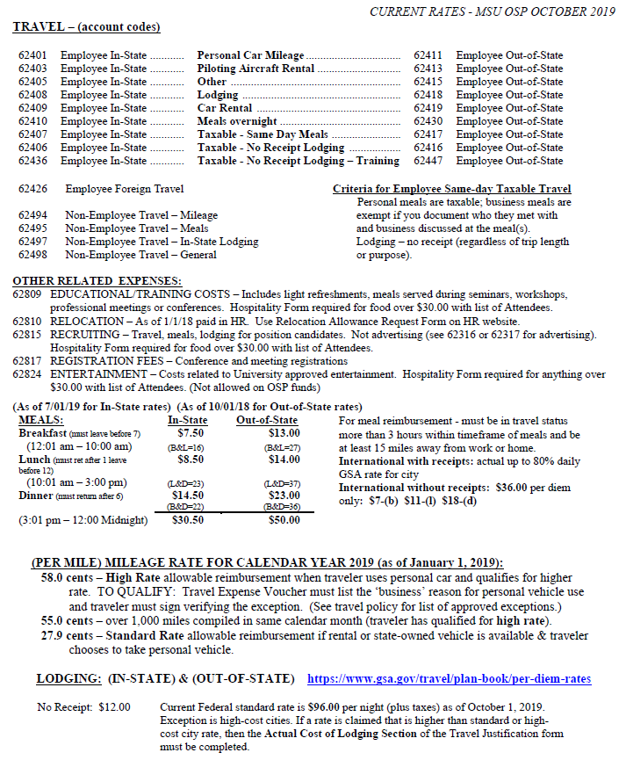
Travel Recap Sheet

Slide 21
Foreign Travel Tips
Actual cost of meals can be claimed only if original, detailed receipts are submitted
  Actual cost cannot exceed 80% of the M&IE column on the GSA foreign per diem table, found here: http://aoprals.state.gov/content.asp?content_id=184&menu_id=78
  80% is allocated as: 15% breakfast, 25% lunch, 40% dinner

Slide 22
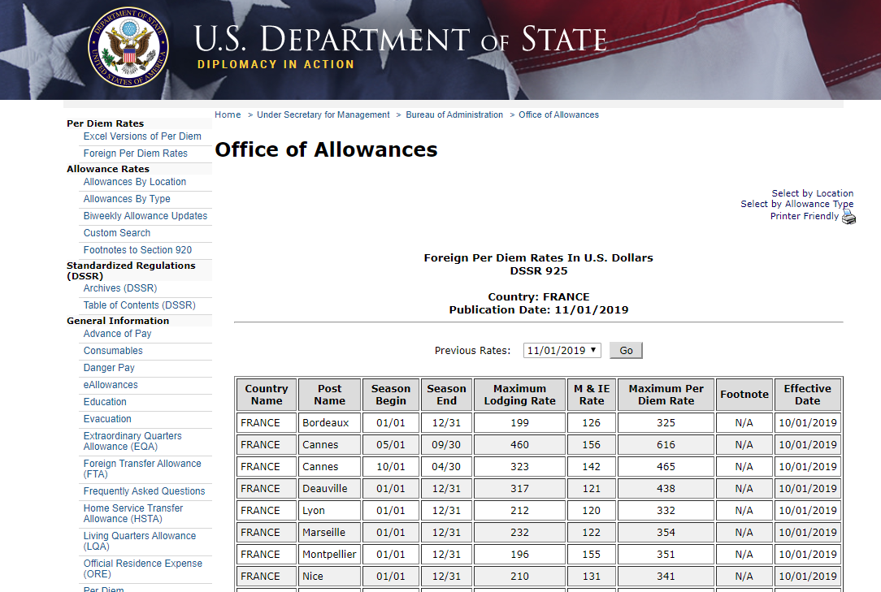

Slide 23
Currency Exchange – XE Website
When using the XE website for conversion
https://www.xe.com/travel-expenses-calculator/
please remember to set all foreign exchange fees to zero!
Travelers can submit for exchange fees separately

Slide 24
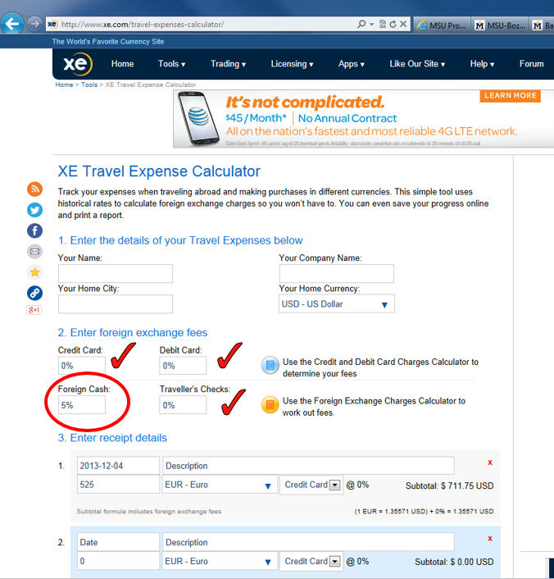

Slide 25
Notes for Travelers
If a new employee is going to be traveling, they should request a P-card
Meals do not go on a P-card when traveling
Meals provided by a conference cannot be claimed as per-diem. A copy of the registration receipt, showing meals provided by conference should be furnished to UBS
Hotel, airfare, registrations, shuttles should all be charged to P-card
Keep all original receipts that are going to be claimed
Keep boarding passes when applicable. Proof of travel is required

Slide 26
Personal/Business Travel
If an employee is combining a personal trip with a business trip, they MUST get an airline quote showing the difference in price
If traveling with family, only the business portion of the trip may be put on MSU pcard.
  If this is not practical, the traveler should pay with a personal card and be reimbursed for the business portion once travel is complete

Slide 27
Travel Over 1 Year
UBS should be notified if an employee is in, or will be in, travel status for more than one year
  Any reimbursements may be taxable

Slide 28
Accounts Payable Contacts
Lynne Hendrickson, x5739 Email: lhendrickson@montana.edu
BPA questions, special checks, cashed check verifications, foreign wire transfers, automatic deposits
Kathy Marker, x7922 Email: kathryn.marker@montana.edu
General accounts payable, travel questions
Ausra French, x5114 Email: ausra.french@montana.edu
General accounts payable, travel questions, travel advances
Jerry Mallack, x4382 Email: jerry.mallack@montana.edu
General accounts payable, travel questions
Polly Kogel, x5531 Email: polly.kogel@montana.edu
General accounts payable, travel questions
Darcy Tickner, x6411 Email: dtickner@montana.edu
Accounts Payable Financial Manager

Slide 29

Questions & Comments

