Slide 1
Procurement Services
Department Training

Slide 2
Contact Information (A.K.A. The most important slide)
Website: http://www.montana.edu/wwwbu/procurementservices/
Phone: 994-3211
Email: purchase@montana.edu
Notes:
Why most important: a lot of info today, exceptions, strange purchases, oddball things that don’t fit in the box.

Slide 3
Procurement Services Staff
Brian O’Connor
Director
boconnor@montana.edu
Alix Byrd Ramie Pederson
Procurement Officer Procurement Officer
alix.byrd@montana.edu ramie.pederson@montana.edu
406-994-3212 406-994-3213
Cheri Toeniskoetter
Procurement Associate
cheri.toeniskoetter@montana.edu
406-994-3211

Slide 4
How to Find Us
Location:
Montana Hall, Room 19 (basement)
Phone: 994-3211
Fax: 994-3000
Business Hours:
Monday – Friday 8:00 – 5:00 p.m.

Slide 5
Training Overview
Introductions
Delegated Authority
Total Contract Value
Purchases under $5,000
Purchases between $5,000 and $25,000
Purchases over $25,000
Independent Contractors
Information Technology Procurement
Sole Source and Brand Name Justifications
Term Contracts and Cooperatives
Notifications
Reducing Encumbrances with BPA
Exemptions
Controlled Items
Resources

Slide 6
Delegated Authority
Current Agreement at: http://www.montana.edu/wwwbu/procurementservices/Forms/2014%20Delegation%20Agreement.pdf
Title 18 Montana Code Annotated (MCA), Montana Procurement Act, Administrative Rules of Montana (ARM)
Montana State University granted Level Two delegation; authorized to purchase all non-controlled supplies or services up to $500,000.
Further Delegation to Campuses and Departments
All MSU Departments, Great Falls College-MSU, & MSU-Northern authorized to purchase all non-controlled supplies or services up to $25,000 – if trained!
Facilities Services, Auxiliary Services, ITC, & MSU-Billings authorized to purchase all non-controlled supplies or services up to $150,000 –additional training and informational requirements.
Notes:
At the discretion of the AGENCY Purchasing Director, such delegation may be revoked for failure to adhere to state purchasing regulations.

Slide 7
Total Contract Value
TCV* = Total Contract Value
The total contract value is the initial contract period, plus any options to renew, or the total potential purchase price of an item.
This includes shipping, handling, warranties, maintenance & support, convenience fees, reimbursable expenses, in short – ANY cost that the University will incur throughout the length of the contract
Total Contract Value is used to determine the proper procurement method.
*Handout: Frequently Used Acronyms
Notes:
Refer to attachment FUA
Example: $4,999/yr for a contract of 3 years makes the TCV $14,997

Slide 8
“Small” Purchases
$5,000 and under. Use the method that best meets your departments needs. Shop around!
Use your P-Card when possible.
Departmental Purchase Order or Contracted Service Agreement recommended when appropriate, but not required.
Notes:
At the discretion of the AGENCY Purchasing Director, such delegation may be revoked for failure to adhere to state purchasing regulations.

Slide 9
Limited Solicitations
Required for purchases $5,000.01 through $25,000.00
MUST be competitively bid.
Obtain quotes from three different vendors. Phone bids ok, but email/fax preferred. Record prices on PD-20* – use “as attached” as necessary. Compare “apples to apples” and must award to low cost. (contact PS for rationale other than low cost)
Must be multiple brands. If specific brand is needed complete PD-13 Brand Name Justification form.
If only one source available, complete PD-14 Sole Source Justification form.
Approved at the Department Level, requestor signs to indicate correct info and no conflict of interest.
*Handout: PD-20 Limited Solicitation Form
Notes:
At the discretion of the AGENCY Purchasing Director, such delegation may be revoked for failure to adhere to state purchasing regulations.

Slide 10
Limited Solicitations (continued)
Once lowest bidder is identified, issue Departmental Purchase Order (DPO, Form PD-12*) or use P-card if available.
For P-Card increase send email to purchase@montana.edu
If procuring services issue Contracted Services Agreement (CSA*, Form PD-49)
Stick to Boilerplate! Collect proof of workers compensation and insurance if applicable.
If paying an individual, determine Independent Contractor status (contact UBS for help)
Procurement documentation must be submitted with BPA or P-Card report.
*Handouts: PD-12 Departmental Purchase Order, PD-49 Contracted Services Agreement

Slide 11
“Large” Purchases
Process required for purchases above $25,000
Complete Purchase Requisition (Form PD-1*)
Submit Purchase Requisition to Procurement Services:
Drop off, mail, fax or scan/email are all acceptable. Currently working on online submittal.
Procurement Services will work with department to issue:
Invitation for Bid (IFB): Vendor must meet all requirements and be lowest cost (takes about 2- 3 weeks so plan accordingly.)
Request For Proposals (RFP): Vendor must be highest scoring offeror, combination of scored responses to requirements, offeror qualifications and cost (takes 6-8 weeks).
PO or Contract as necessary
*Handout: PD-1 Purchase Requisition
Notes:
At the discretion of the AGENCY Purchasing Director, such delegation may be revoked for failure to adhere to state purchasing regulations.

Slide 12
Independent Contractors vs. Employees
Degree of control exercised by MSU over the details of the work
Opportunity of the worker for profit or loss
Whether MSU can discharge to individual
Whether the work is an integral part of MSU’s regular business
Permanency of the relationship
Provision of employee benefits
For more information call UBS 994-5727 or go to: http://www.montana.edu/wwwbu/Forms/UBS%20TRAINING/Businessprocedurestrainingdocuments.html

Slide 13
IT Procurement
Contact pmo@montana.edu before you buy!
IT purchases require specialized knowledge. . . And often have an impact on other systems
Security considerations
Legal considerations
Leverage cost savings, operational efficiency
Pre-existing license agreements
IT is required by policy to shut down any system that has an adverse impact.

Slide 14
Sole Source and Brand Specific Justifications
Use PD-13 Brand Specific Justification, PD-14 Sole Source Justification*
If exempt from competitive procurement identify exemption.
Describe clearly what you need to purchase including any special functionality, measurable size or performance ranges, etc. List all required (not just desired) features.
Indicate if specifically identified in a grant, attach grant documentation.
Describe how you found this vendor or brand. List all other suppliers and detail what requirements they do not meet. Under $25,000 – approved at department level. Over $25,000 – approved at Procurement Services
*Handouts: PD-13 Brand Name Justification, PD-14 Sole Source Justification
Notes:
Good example of SSJ – table format.

Slide 15
SSJ and Brand Justifications (continued)
Sound rationale for a sole source purchase
Compatibility with existing equipment or space restrictions
Consistency of research
Unique functionality that is required
Poor rationale for a sole source purchase
“Industry Standard”
“Quality Provider”
History
Cost
Local
Notes:
At the discretion of the AGENCY Purchasing Director, such delegation may be revoked for failure to adhere to state purchasing regulations.

Slide 16
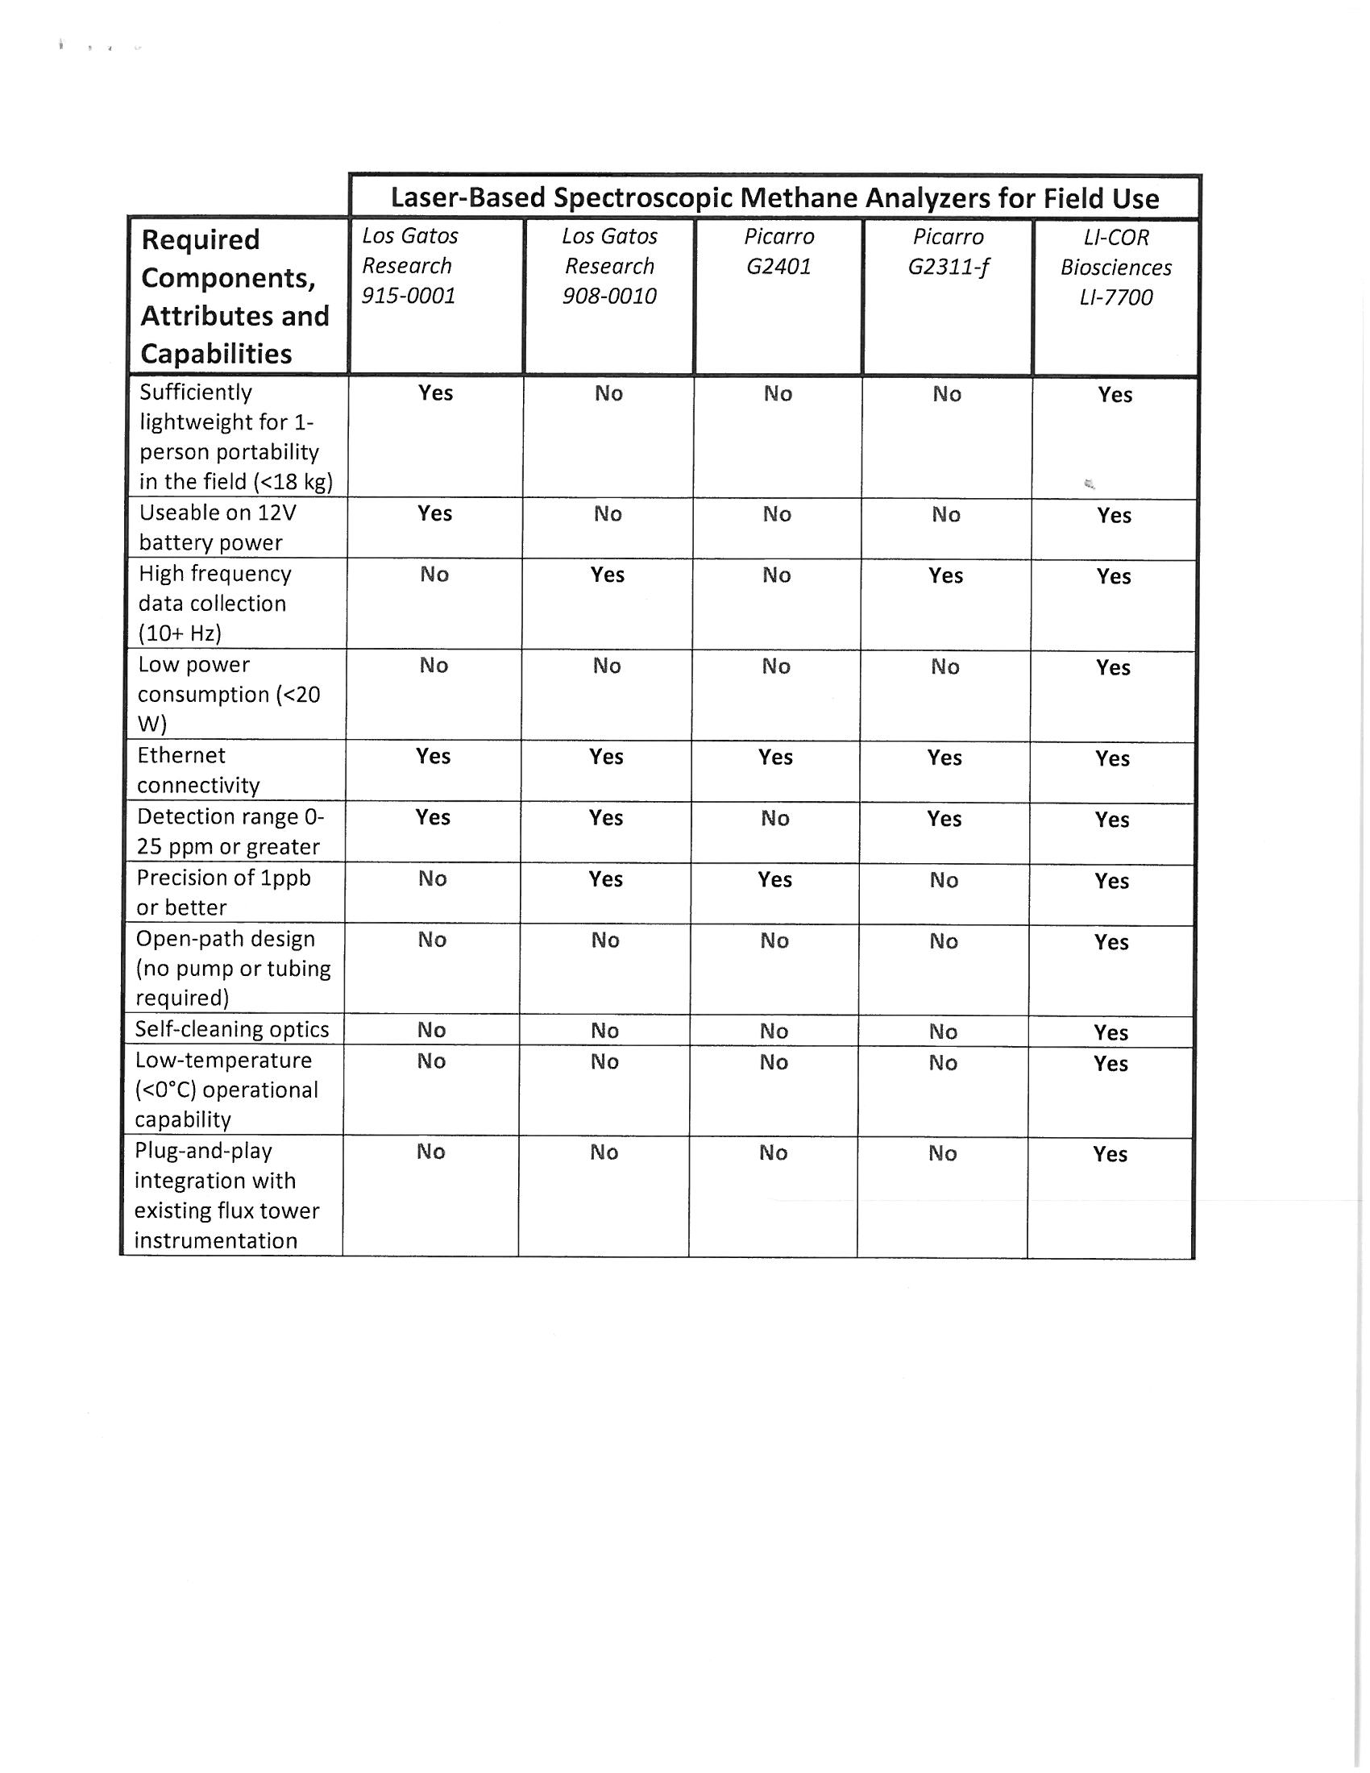
Good Justification Example

Slide 17
Direct Buy Opportunities: Term Contracts and Purchasing Cooperatives
List of all term contracts available for agency use: http://svc.mt.gov/gsd/apps/TermContractDefault.aspx
Do not require re-bidding.
Do not require DPO issuance or purchase requisition submittal.
Please order directly with vendor and indicate term contract number on BPA or P-Card report
List of purchasing cooperatives not yet on State Website, contact Procurement Services to discuss options.
Notes:
Who utilizes term contracts?

Slide 18
Notifications
Must indicate on BPA or P-Card report how something was procured.
PO or contract issued and funds encumbered by Procurement Services, use PO/ENC box and P/F.
All other situations, indicate one of the following in ref/addtl information box of BPA:
Procurement Documentation attached (Limited Solicitation/DPO/Sole Source/Brand Name Justification)
Term/Cooperative Contract #_______________ (indicate number)
Procurement Exempt _______________ (state reason)
This helps us both ensure compliance and speed processing.
Notes:
Who utilizes term contracts?

Slide 19
Reducing Encumbrance with BPA
Include your name,
phone number, and email address
Indicate Procurement Services PO or Contract number only
Make sure account code used for payment corresponds with account codes authorized for encumbrance on submitted PD-1
Indicate P for Partial payment or F for Final payment.
Only use F for final payments on encumbrances that will NOT be renewed. “F” completely closes out the encumbrance.

Slide 20
Procurement Exemptions
Competition not required for the following purchases:
Training
Travel
Books and periodicals
Employment of a registered professional engineer, surveyor, real estate appraiser, registered architect, physician, dentist, pharmacist or health care provider.
Commission of art for a museum or public display
Food produced in Montana
Professional Licenses
Renewal of software license agreements
Purchase or renewal of maintenance agreements for software or hardware
Advertising Placement (but not creation)
Interagency agreements

Slide 21
Controlled Items
Neither Departments nor Procurement Services are authorized to purchase:
New Vehicles*
Purchasing and Fueling Card programs
Bulk Fuel
Motor Oil & Grease
Bulk Propane
*vehicles purchased on requisition time schedule, statewide bid put out in spring and fall. All others must be purchased off of exclusive agreements in place.

Slide 22
Resources
Procurement Policy and Procedures: http://www.montana.edu/policy/purchasing/
Forms http://www.montana.edu/policy/purchasing/purch1800.html#1800
Purchasing Manual , Delegation Agreement Summary, FAQ’s, Training, Quick Reference Guide
General Services Division – State Procurement Bureau website http://www.gsd.mt.gov/default.mcpx
Purchasing ListServ (signup request to purchase@montana.edu)
Purchasing Staff
Other MSU Colleagues

Slide 23
Your turn!
What questions do you have?
What works? What doesn’t?
How can we better serve you?
Notes:
Who utilizes term contracts?

Slide 24
Thanks for attending! MSU Procurement Services 994-3211 purchase@montana.edu
Notes:
Who utilizes term contracts?

