Slide 1
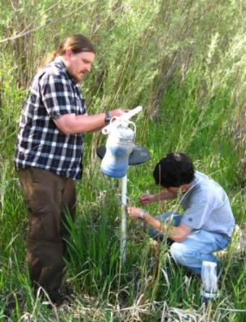
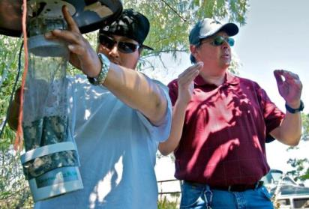
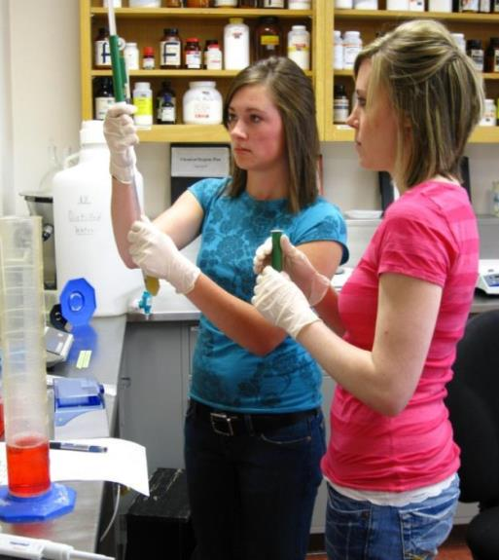
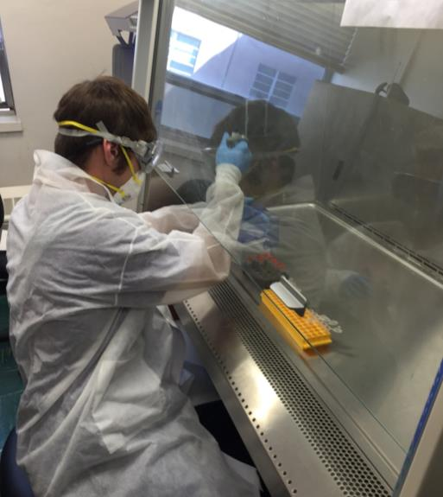
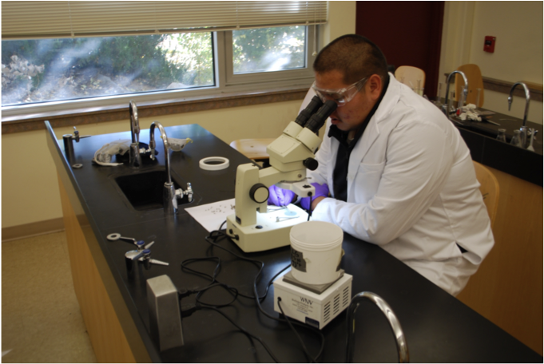
Apprenticeship Learning

Slide 2
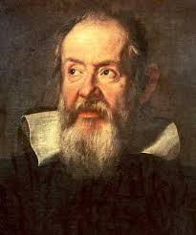
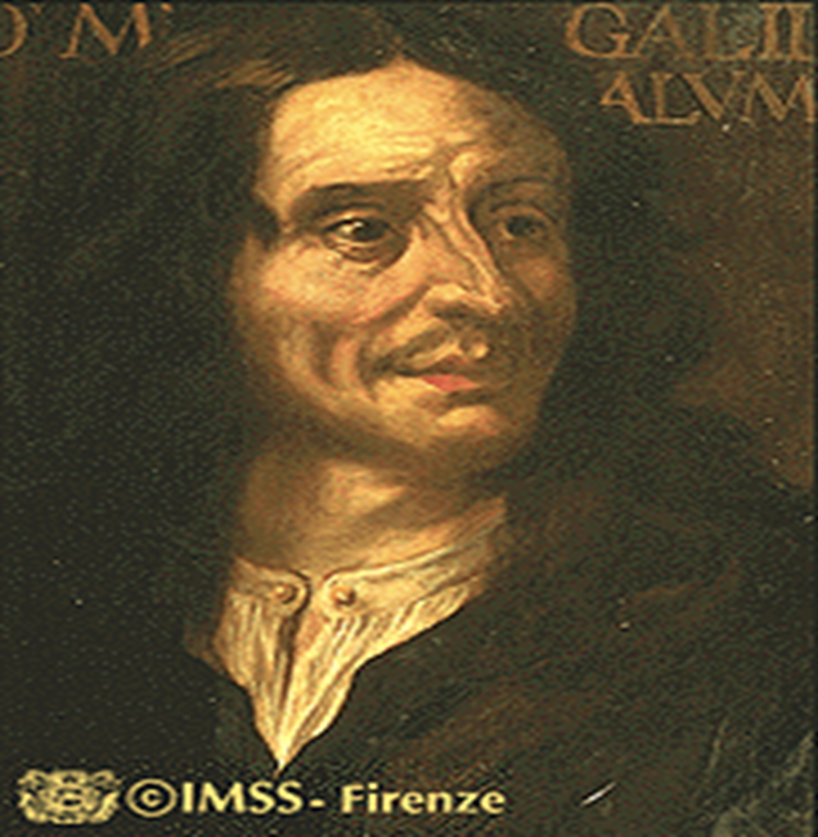
Science Education in the 17th Century
Highly effective but not very efficient
Mentor
Apprentice
Galileo: “Father” of Modern Science
Viviani: Galileo’s Apprentice

Slide 3
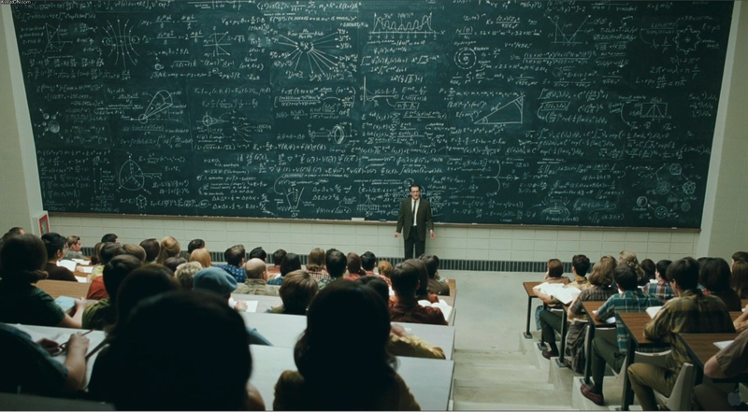
Science Education in the 20th Century
Highly efficient but not as effective

Slide 4
Science Education in the 21st Century
Critical Thinking
Collaboration
Competencies
Creativity
Synthesizing content across disciplines in the application of novel solutions to authentic problems
Scientists work in teams to solve complex problems
Emphasized over content
Creating new scientific products rather than “consuming” content information

Slide 5
How is Research Incorporated into Medical School Applications?
Experience/Activities Section of the AMCAS Application
  Up to 15 entries describing work or extracurricular activities (700 characters)
  Up to 3 entries highlighted as most meaningful (1375 more characters)

Slide 6
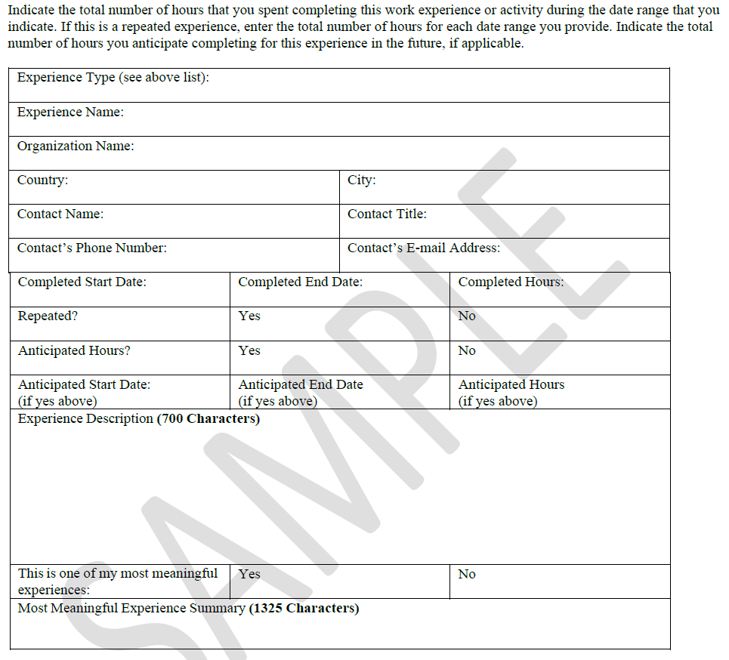

Slide 7
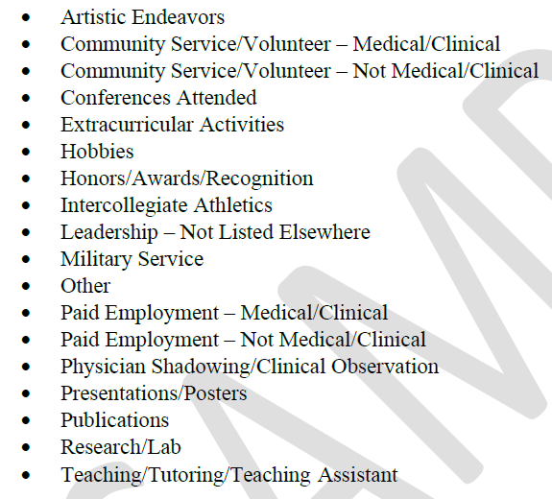
Experience Categories

Slide 8
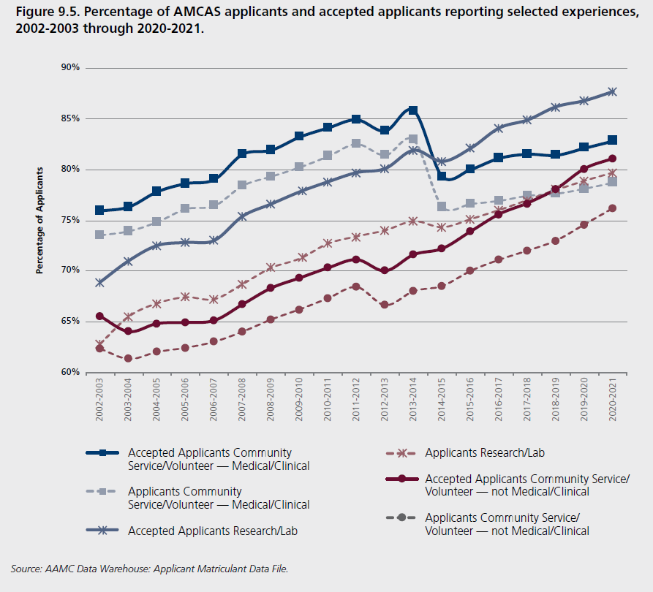
Trends in Experience

Slide 9
Key Points
Research experience in some form is important
Critical for some schools: e.g. UU and Stanford
Critical for MD/PhD programs
Types of experiences
  Course-based research: e.g. AREs
  Summer undergraduate research
  Products are important
    SURF presentations
    Conference presentations
    Peer-reviewed publications

Slide 10
Questions?

Slide 11
Pre-Med Research Experience
Mark Pershouse
Director of Pre-Medical Sciences
University of Montana

Slide 12
Reasons to do undergraduate research
Get a good(better) letter of evaluation
Get experience discerning anecdotal data from significant data, a valuable skill for any career
Many admissions officers are scientists as well
  Any connection during interviews is a good thing– common ground, conversation starters
The practice of medicine has elements of the scientific method embedded in it. (sGOT; liver ruleouts)
Undergraduate research may be a requirement for admission to medical school (competitive edge)

Slide 13
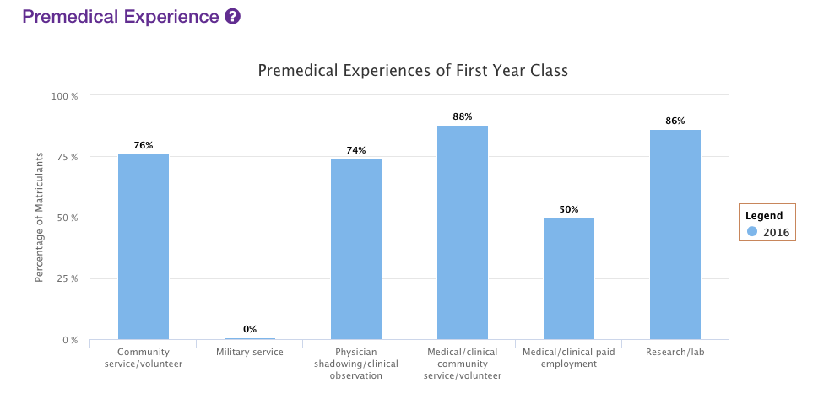
Albany
No recommendation or requirement

Slide 14
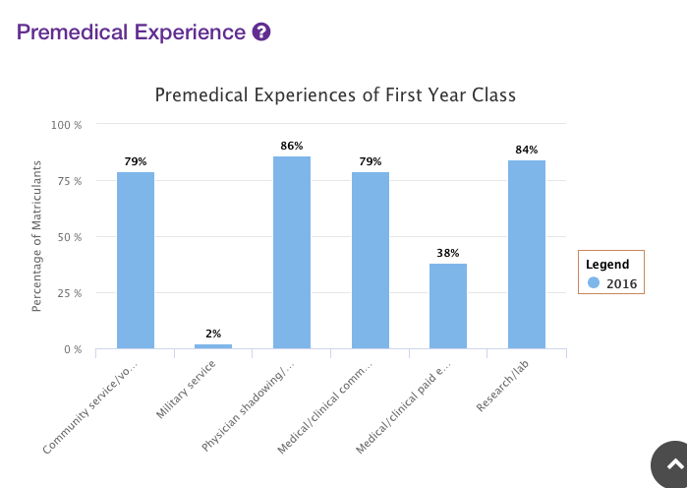
West Virginia
No requirement or recommendation

Slide 15
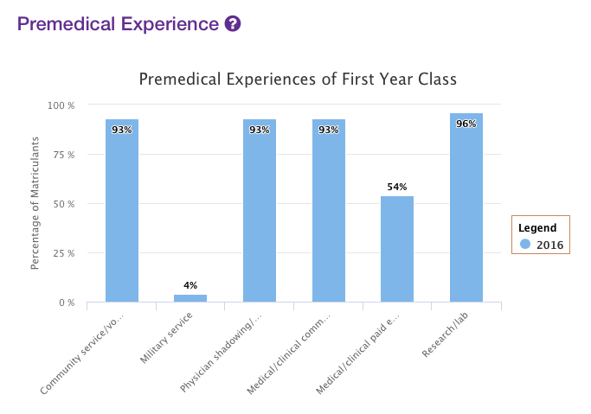
Utah
Research recommended

Slide 16
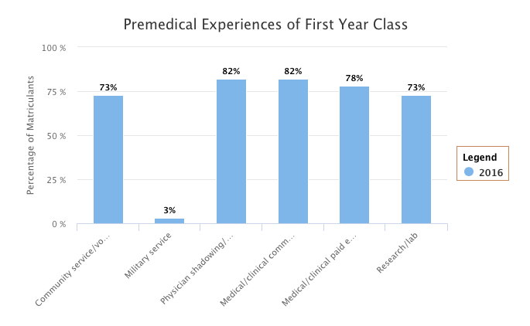
North Dakota
No recommendation or requirement for research

Slide 17
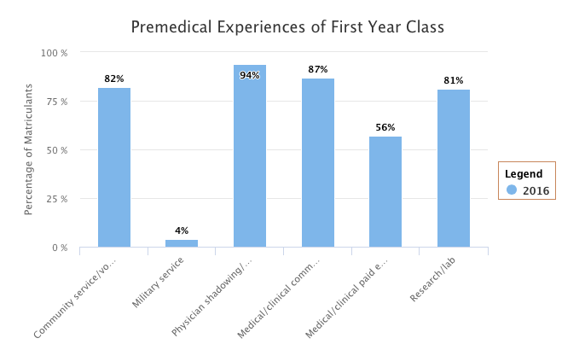
Univ. Washington
No recommendation or requirement

Slide 18
Reasons research may not be necessary
You know what is involved in a clinical trial
You understand discernment
You have had statistics
You understand the scientific method
You already have 6 great letters

Slide 19
Letter Example-Research Mentor
I have known Jethro since Spring of 2009. He approached me initially because of his interest in the work I am doing in partnership with physicians on the Ipso Facto Indian Reservation and he expressed an interest in joining my lab. He offered to volunteer several hours per week and that relationship has grown now to include his own independent project in my laboratory.
Jethro is a very pleasant, hard-working student with a very positive attitude. He is very persistent, methodical, and skilled at communication. His work on lab projects has been exemplary and has helped to advance the goals of the laboratory. This fall, he helped to reestablish order in our database and clinical sample storage systems. He performed well mastering several techniques new to him. These included isolation of genomic DNA from human blood samples, quantitation and aliquoting of DNA at various concentrations, PCR, allele specific restriction digests, capillary electrophoresis. When the instructions that I gave left room for some decision-making, he took the initiative and made good choices. It is very easy to develop trust in his abilities in a short time. His work has contributed to one presentation at a National meeting so far and his work will be submitted to a high impact journal as part of a large multi-institutional study of the pharmacogenetics of a tribal population.

Slide 20
Research Opportunities at UM (examples)
Dr. Nick Natale
Field of Study:anticancer drug discovery, anticonvulsant screening, diabetes
Email: nicholas.natale@umontana.edu
Phone Number: 243-4132
Office Location: Skaggs 477B
For more information please reference the website;
http://health.umt.edu/biomed/people/default.php?ID=1215
Dr. Mark Pershouse
Field of Study: genetics of cancer, cancer in medically-underserved populations
Email: mark.pershouse@mso.umt.edu
Phone Number: 243-4769
Office Location: Skaggs 282
For more information please reference the website;
http://health.umt.edu/biomed/people/faculty.php?ID=1347

Slide 21
Dr. Scott Wetzel
Field of Study: activation and subset differentiation of CD4⁺ T lymphocytes.
Email: scott.wetzel@umontana.edu
Phone Number: 243-2168
Office Location: Clapp Bldg. 216
For more information please reference the website;
http://hs.umt.edu/dbs/people/default.php?s=Wetzel
Dr. Steve Lodmell
Field of Study: viral RNA structure and function
Email: stephen.lodmell@umontana.edu
Phone Number: 243-4304
Office Location: CHCB (Clapp) 202
For more information please reference the website;
http://hs.umt.edu/dbs/people/default.php?s=Lodmell
Dr. Scott Samuels
Field of Study:
Email: samuels@mso.umt.edu
Phone Number: 243-6145
Office Location: CHCB (Clapp) 207
For more information please reference the website;
http://hs.umt.edu/dbs/people/default.php?s=Samuels

Slide 22
Dr. Orion Berryman
Field of Study: Organic chemistry and molecular recognition
Email: orion.berryman@umontana.edu
Phone Number: 243-6805
Office Location: Chemistry 009
For more information please reference his website;
http://www.cas.umt.edu/casweb/faculty/FacultyDetails.cfm?id=2056
Dr. Klara Briknarova
Field of Study: Structural biology, biomolecular nuclear magnetic resonance (NMR)
spectroscopy, protein structure, function, and dynamics.
Email: klara.briknarova@umontana.edu
Phone Number: 243-4408
Office Location: Chemistry 111
For more information please reference her website;
http://www.cas.umt.edu/chemistry/facultyDetails.cfm?id=926
Dr. Sarah Certel
Field of Study: Behavioral neurobiology, developmental genetics, cell biology
Email: sarah.certel@mso.umt.edu
Phone Number: 243-6425
Office Location: Skaggs Building 393
For more information please reference her website;
http://www.cas.umt.edu/casweb/faculty/FacultyDetails.cfm?id=1576

Slide 23
How to Join a Research Lab
Identify faculty with interests similar to yours
  This is contingent upon having UG research on your campus
  If you don’t look, into summer research opportunities
https://www.aamc.org/members/great/61052/great_summerlinks.html
http://www.pathwaystoscience.org/programs.aspx?descriptorhub=SummerResearch_Summer%20Research%20Opportunity
Stop by their lab/office to talk
Set up an appointment by email
Offer to volunteer for a defined period as a trial
Do well
  Be punctual
  Be professional
  Be imaginative
  Take some (measured) initiative
  Give them your best effort
  Have fun

Slide 24
What you should expect
Publications-in the best of cases
National Meeting presentations-certainly
Regional Meeting presentations-always
Course credit-if you need it
Senior Honor’s Thesis-Yes
A better understanding of research and the mindset of many admissions committee members

Slide 25
Take Home Message
Become a professional shopper for your patients
Get a better letter
Learn the Scientific Method
Find common ground with interviewers

Slide 26
REU and Others
https://www.nsf.gov/crssprgm/reu/
NSF funds a large number of research opportunities for undergraduate students through its REU Sites program. An REU Site consists of a group of ten or so undergraduates who work in the research programs of the host institution. Each student is associated with a specific research project, where he/she works closely with the faculty and other researchers. Students are granted stipends and, in many cases, assistance with housing and travel. Undergraduate students supported with NSF funds must be citizens or permanent residents of the United States or its possessions. An REU Site may be at either a US or foreign location.

Slide 27
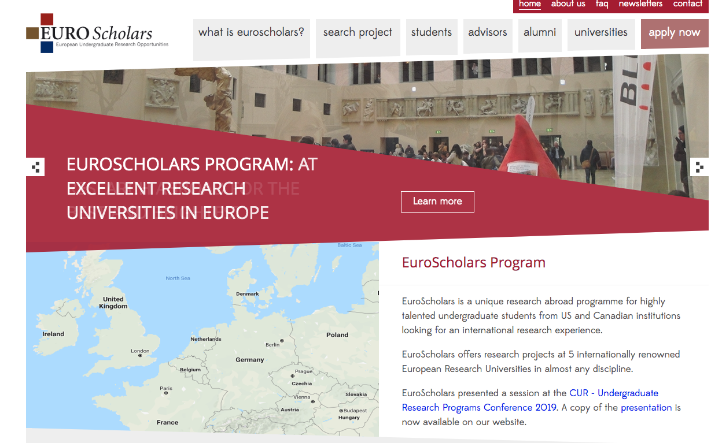
EuroScholars
https://euroscholars.eu/

Slide 28
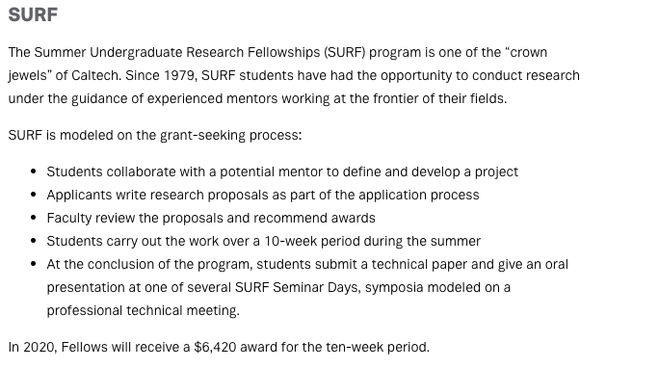
SURF/SURP

